Slide 1

Lecture 2
CSE0613101: Structured Programming Language

Slide 2
What is Computer?
Computer
Device capable of performing computations and making logical decisions
Computers process data under the control of sets of instructions called computer programs
Hardware
Various devices comprising a computer
Keyboard, screen, mouse, disks, memory, CD-ROM, and processing units
Software
Programs that run on a computer

Slide 3
Computer Organization
Logical units of computer
Input unit
“Receiving” section
Obtains information from input devices
Keyboard, mouse, microphone, scanner, networks, …
Output unit
Takes information processed by computer
Places information on output devices
Screen, printer, networks, …
Information used to control other devices

Slide 4
Computer Organization
Memory unit
Rapid access, relatively low capacity
Retains information from input unit
Immediately available for processing
Retains processed information
Until placed on output devices
Memory, primary memory

Slide 5
Computer Organization
Central processing unit (CPU)
Supervises and coordinates other sections of computer
Arithmetic and logic unit (ALU)
“Manufacturing” section
Performs arithmetic calculations and logic decisions
Secondary storage unit
Long-term, high-capacity
Storage
Inactive programs or data
Secondary storage devices
Disks
Longer to access than primary memory
Less expensive per unit than primary memory

Slide 6
The von Neumann architecture
CPU
Input Device
Output Device
ALU
CU
Main memory
(RAM)
Secondary
storage

Slide 7
How it works
How does a computer execute a program ?
(example programs: a computer game, a word processor, etc)
the instructions that comprise the program are copied from the permanent secondary memory into the main memory
After the instructions are loaded, the CPU starts executing the program.
For each instruction, the instruction is retrieved from memory, decoded to figure out what it represents, and the appropriate action carried out. (the fetch execute cycle)
Then the next instruction is fetched, decoded and executed.

Slide 8
Machine Languages, Assembly Languages, and High-level Languages
Three types of computer languages:
Machine language
Only language computer directly understands
“Natural language” of computer
Generally consist of strings of 0s and 1s
Instruct computers to perform elementary operations
One at a time
Cumbersome for humans

Slide 9
Machine Languages, Assembly Languages, and High-level Languages
Three types of computer languages
Assembly language
English-like abbreviations representing elementary computer operations
Clearer to humans
Incomprehensible to computers
Translator programs (assemblers)
Convert to machine language

Slide 10
Machine Languages, Assembly Languages, and High-level Languages
Three types of computer languages
High-level languages
Similar to everyday English, use common mathematical notations
Single statements accomplish substantial tasks
Assembly language requires many instructions to accomplish simple tasks
Translator programs (compilers)
Convert to machine language

Slide 11

C History
Developed between 1969 and 1973
Developed by: Dennis Ritchie
at Bell Labs
General purpose programming language.
Structured programming language

Slide 12
First C Program
/* My first simple C program */
#include <stdio.h>
void main ()
{
printf (“Welcome to C!\n”);
}
Comments
Header
All C programs have a main function;
they also start at main
Function to print to screen
Braces indicate start
and end of main
What to print
End of
statement
End of line

Slide 13
How to Run
Save a source code with extension “c”
(Ex: first.c)
Compile it and link it
Output: first.exe
Run the program.
Output of the program:
Welcome to C!

Slide 14
C Programming Environment
Preprocess/
Compile/
Link
Load/
Run
Edit
Editor
test.c
test.exe
CPU

Slide 15
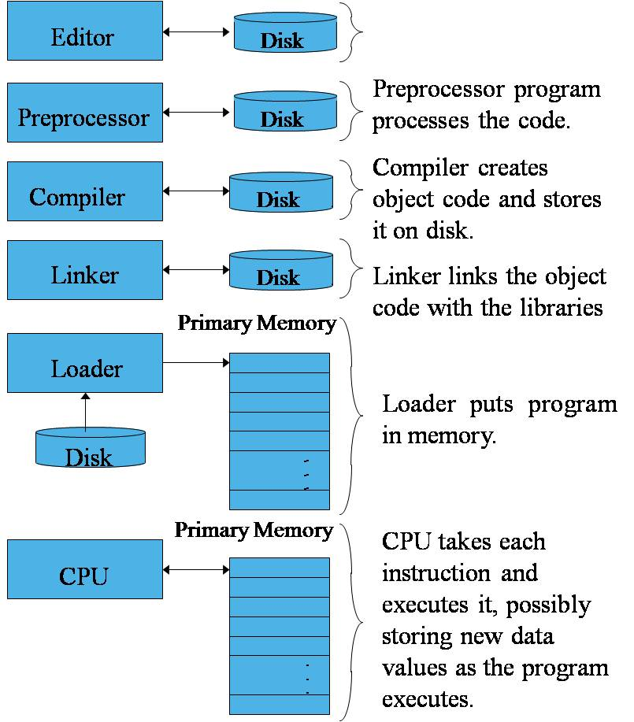
Basics of a Typical C Program Development Environment
Phases of C Programs:
Edit
Preprocess
Compile
Link
Load
Execute

Slide 16
Integrated Development Environments
An integrated development environment (IDE) is a software package that makes it possible to edit, compile, link, execute, and debug a program without leaving the environment.
Example: CodeBlocks, MS Visual Studio, Dev CPP

Slide 17
Typing Speed (Not related to this course but Important)
Important for every student in CSE
Try to type in grammatical way – Use 10 fingers to type
Use software to learn grammatical way of typing
Speed:
Should be at least 30 WPM (Words per minute)
Software
Ten Thumbs Typing Software
Or, any other Typing tutor software

Slide 18
Thank you

