Slide 1
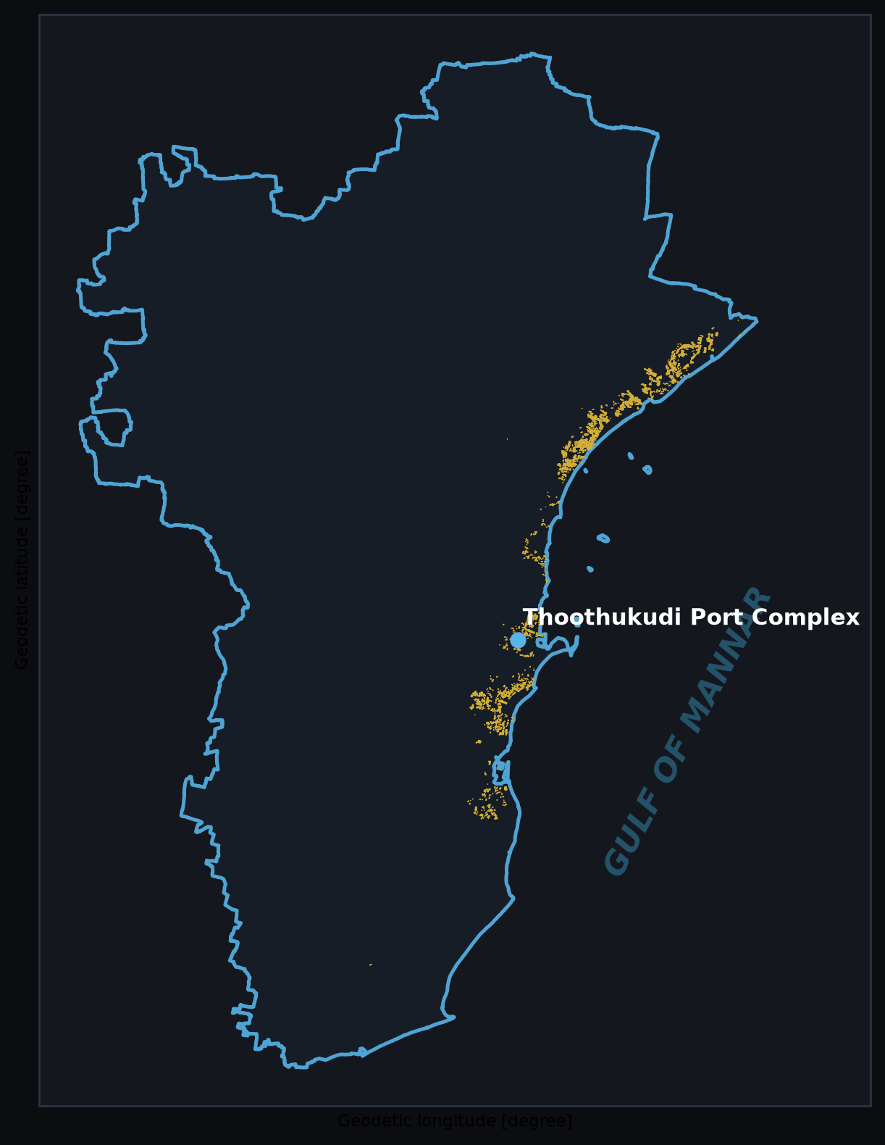
VELLORE INSTITUTE OF TECHNOLOGY • SCORE
AI-Driven Salt Pan Mapping Using Multispectral Remote Sensing and GIS
District-Scale Mapping, Multispectral Index Extraction & Machine-Learning Benchmark
PROJECT METADATA & TEAM:
• Study Area: Thoothukudi (Tuticorin) District, Tamil Nadu, India
• Project Guide: Dr. Jenila Vincent | School of Computer Science and Engineering
• Student: Raafid Afraaz G. | Team Member: Farhanaaz R S
• Sensors: Copernicus Sentinel-2 MSI Level-2A & ESA WorldCover 2021
• Interactive Application: Thoothukudi Salt Pan Intelligence Dashboard
Notes:
Good morning respected guide Dr. Jenila Vincent and faculty members. Today we present our project: AI-Driven Salt Pan Mapping Using Multispectral Remote Sensing and GIS in Thoothukudi District, Tamil Nadu. Presented by Raafid Afraaz G. and Farhanaaz R S from the School of Computer Science and Engineering (SCORE), Vellore Institute of Technology. This project combines Copernicus Sentinel-2 Level-2A multispectral satellite imagery, ESA WorldCover 2021 land cover reference data, and a rigorous 7-model machine learning benchmark to produce an authoritative, vector-delineated salt pan inventory and an interactive WebGL geospatial intelligence platform.

Slide 2
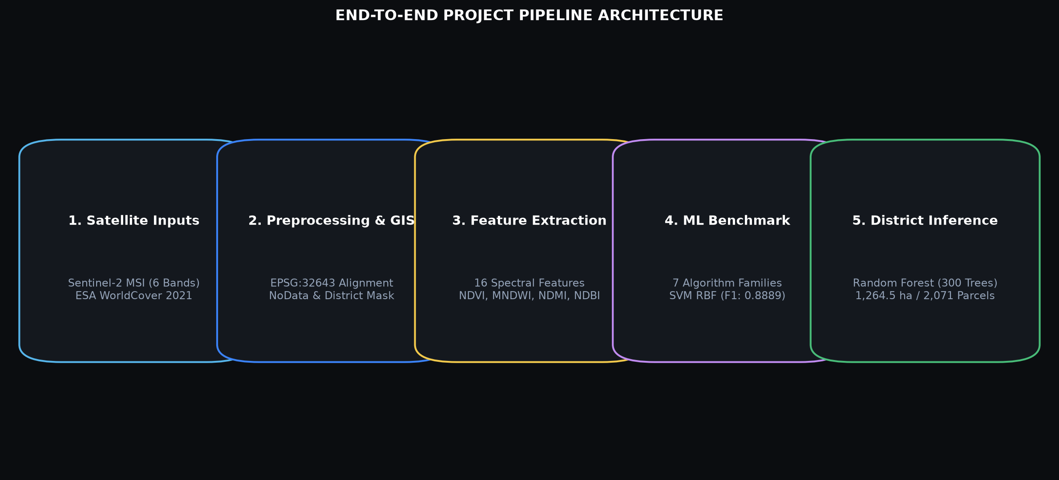
EXECUTIVE SUMMARY
Project Overview: AI-Driven Salt Pan Intelligence
Multi-stage geospatial workflow from raw Sentinel-2 L2A tiles to interactive dashboard
1. GEOSPATIAL PROBLEM
• Thoothukudi produces ~30% of India's marine salt
• Salt pans spectrally shift between dry brine crusts and open water reservoirs
• Severe confusion with coastal tidal flats, beaches & saline agricultural soils
2. ML & GIS APPROACH
• 16 engineered multispectral features (B02-B12, NDVI, MNDWI, NDMI, NDBI)
• 8,426 polygon training samples with 15.8:1 imbalance
• Rigorous 7-algorithm benchmark; SVM RBF won on F1 (0.8889)
3. VERIFIED OUTCOMES
• 1,264.52 ha final vector inventory across 2,071 parcels
• Strictly clipped to official district boundary (627 out-of-district purged)
• Full-stack React & MapLibre GL JS intelligence dashboard
VIT Vellore • SCORE | AI-Driven Salt Pan Mapping | Thoothukudi District Slide 2 of 25
Notes:
Slide 2 outlines the end-to-end framework of our project. First, we identify the domain challenge: Thoothukudi is India's second largest salt producing district, yet salt pans are dynamic systems whose reflectance changes drastically across evaporation cycles. Second, we ingest Sentinel-2 Level-2A imagery, compute 16 multispectral indices, and benchmark 7 machine learning models. Third, our production Random Forest model classifies all 90 million pixels across the district, which we then sieve and clip strictly to Thoothukudi's administrative boundary, yielding 2,071 verified parcels and 1,264.52 ha.

Slide 3
PROBLEM FORMULATION
Problem Statement: Challenges in Salt Pan Delineation
Why traditional visual interpretation and simple thresholding fail in coastal salterns
THE MULTISPECTRAL CHALLENGE
• Spectral Inconstancy: During pre-crystallization, condenser pans contain deep brine that resembles shallow coastal water or wetlands.
• Crystallization Saturation: When crystallized, dry salt beds exhibit extreme visible reflectance (albedo > 0.8), mirroring white sand beaches and bare saline soils.
• Spatial Fragmentation: Salt pans are bounded by narrow earthen bunds (1-3 m wide), which are below native 10m/20m pixel resolution, causing mixed pixel artifacts.
• Cloud & Sun-Glint Confusion: High-reflectance cloud edges and coastal sun-glint introduce severe false positives in naive thresholding pipelines.
• Need for ML: Non-linear spectral band ratios (SWIR, NIR, MNDWI) and supervised classifiers are mandatory to achieve robust separation.
Challenge 1: High Intra-Class Spectral Variance
• Salt pans cycle between dark open water (Class 80 proxy) and blinding white crusts (Class 60/62 proxy). Single-band thresholds fail.
Challenge 2: Severe Class Imbalance (15.82 : 1)
• Salt pans represent less than 1% of Thoothukudi district's terrestrial surface. Standard classifiers collapse into majority non-salt prediction without balanced class weights.
Challenge 3: Manual Digitization Inefficiency
• District-scale manual digitization across 4,700 km² is slow, subjective, and unable to capture rapid seasonal expansion or abandonment.
VIT Vellore • SCORE | AI-Driven Salt Pan Mapping | Thoothukudi District Slide 3 of 25
Notes:
In Slide 3, we emphasize why salt pan mapping is a difficult scientific problem. Unlike static agricultural crops or urban buildings, salt pans undergo a continuous biochemical and physical transformation. In the early phase, seawater is pumped into reservoirs, spectrally mimicking coastal lagoons. In the late crystallization phase, salt precipitating on pan bottoms creates intense specular reflectance. Furthermore, earthen bunds cause mixed-pixel issues at 10m and 20m Sentinel-2 resolutions.

Slide 4
CONTEXT & SIGNIFICANCE
Motivation and Scientific Significance
Strategic necessity of an automated, defensible spatial salt pan inventory
COASTAL LAND-USE ADMINISTRATION
• Cadastral Reconciliation: Enables district revenue departments to reconcile revenue lease records against active evaporation areas.
• Encroachment Monitoring: Detects unauthorized bunding and saltern conversion along sensitive intertidal mudflats and mangrove reserves.
• Spatial Planning: Informs CRZ (Coastal Regulation Zone) compliance and infrastructure development along the Gulf of Mannar corridor.
ENVIRONMENTAL & HYDROLOGICAL MONITORING
• Groundwater Salinization: Salt pans act as localized hypersaline infiltration zones; accurate boundaries delineate risk zones for nearby aquifers.
• Tidal Flushing Balance: Identifies intake and discharge points that influence estuarine salinity dynamics in the Tamirabarani river basin.
• Ecosystem Boundaries: Provides baseline spatial polygons to evaluate buffer zones adjacent to the Gulf of Mannar Marine National Park.
SCALABLE REMOTE SENSING AUTOMATION
• Reproducible Pipeline: Eliminates manual digitization bottlenecks by coupling ESA Copernicus open data with supervised ML.
• Multi-Temporal Monitoring: Establishes a verified framework capable of executing quarterly change detection across satellite passes.
• Methodological Rigor: Enforces spatial holdout discipline and minimum mapping unit (MMU) spatial filtering.
VIT Vellore • SCORE | AI-Driven Salt Pan Mapping | Thoothukudi District Slide 4 of 25
Notes:
Slide 4 addresses the scientific and practical significance. First, land-use administration: Thoothukudi has extensive coastal salterns leased from government and private bodies. Automated mapping provides transparent spatial baselines. Second, hydrological monitoring: high-salinity brine can lead to groundwater contamination if salterns expand into agricultural soils. Third, remote sensing automation: by using Sentinel-2 MSI data, our pipeline is reproducible, open-access, and easily updateable without commercial satellite costs.

Slide 5
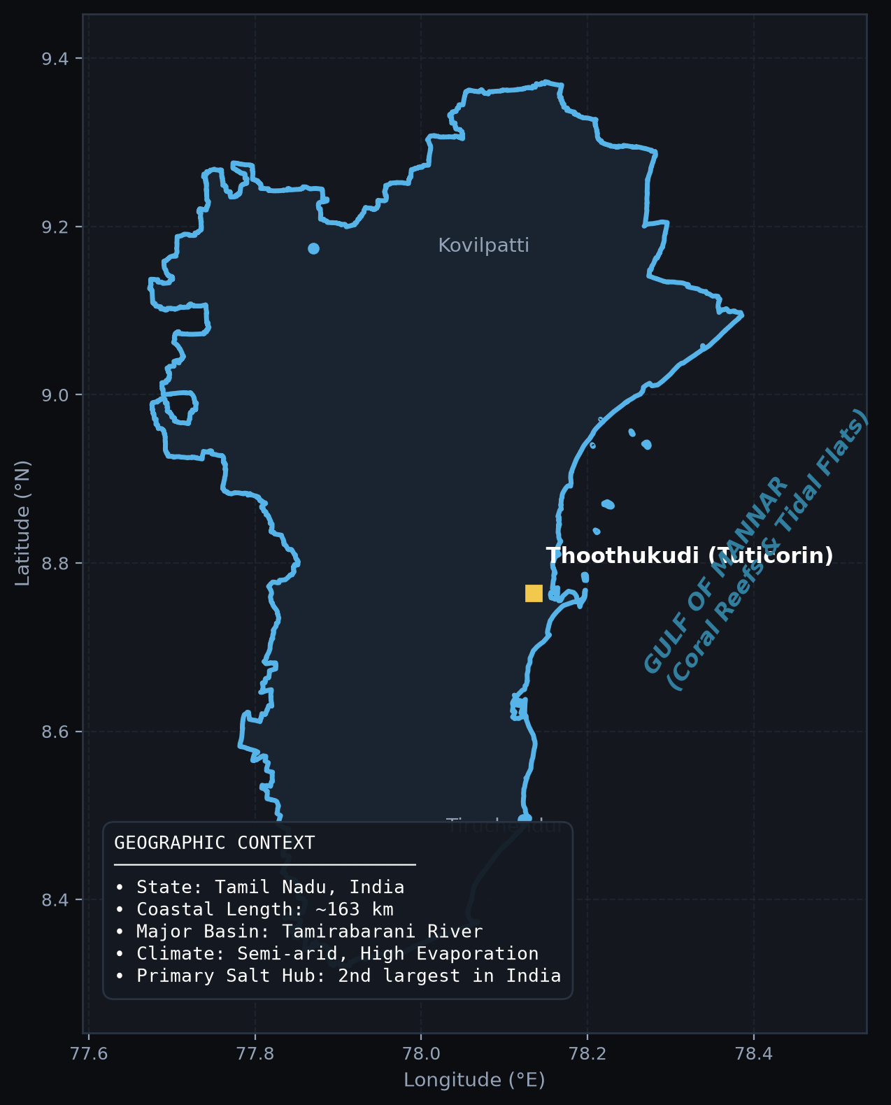
GEOGRAPHIC DOMAIN
Study Area: Thoothukudi District, Tamil Nadu
Geographic extent, coastal morphology, and climatic drivers of marine salt manufacturing
GEOGRAPHIC & CLIMATIC PROFILE
• Location: Southeastern coast of Tamil Nadu, India, bordering the Gulf of Mannar (8°19'N - 9°22'N, 77°40'E - 78°23'E).
• Geographic Area: ~4,707 km² total district area with ~163 km of low-relief coastline.
• Climatic Regimes: Semi-arid tropical climate with high mean temperatures (28°C - 35°C), low rainfall (~650 mm/yr), and strong coastal winds.
• Hydrological Setting: Drained by the Tamirabarani river basin entering the Gulf of Mannar at Punnakayal.
• Salt Production Hub: Favorable microclimate yields 8-9 operational solar evaporation months per year, making it Tamil Nadu's salt capital.
VIT Vellore • SCORE | AI-Driven Salt Pan Mapping | Thoothukudi District Slide 5 of 25
Notes:
Slide 5 introduces our study area: Thoothukudi District. The district sits on the southeast coast of Tamil Nadu facing the Gulf of Mannar. Geomorphologically, it consists of broad, flat coastal plains with impermeable clay and saline soils, high sunshine hours, and low annual rainfall. These environmental factors create prime conditions for solar marine salt pans. Our analysis enforces the official Survey of India administrative boundary, ensuring all calculations are strictly constrained to Thoothukudi.

Slide 6
RESEARCH GOALS
Project Objectives & Execution Milestones
Five clear research objectives establishing a complete, reproducible mapping lifecycle
1. MULTISPECTRAL DATA CURATION
Ingest and calibrate Sentinel-2 Level-2A multi-tile scenes; reproject to EPSG:32643 and co-align with ESA WorldCover 2021 at uniform 20m resolution.
2. SPECTRAL FEATURE ENGINEERING
Extract 6 calibrated surface reflectance bands (B02-B12) and derive 10 diagnostic spectral indices (NDVI, MNDWI, NDMI, NDBI, band ratios) across 8,426 polygon samples.
3. MACHINE LEARNING BENCHMARKING
Train and evaluate 7 diverse classification algorithms (SVM, RF, ExtraTrees, XGBoost, GradBoost, LogReg, QDA) under a polygon-grouped spatial block holdout.
4. DISTRICT INFERENCE & POST-PROCESSING
Execute full-scene windowed inference (90M+ pixels), followed by morphological sieve filtering (MMU ≥ 1,000 m²) and strict district boundary clipping.
5. INTERACTIVE GEOSPATIAL DASHBOARD
Design and deploy a responsive React + MapLibre GL JS intelligence platform with layer toggles, parcel inspection, CSV exports, and analytical charts.
VIT Vellore • SCORE | AI-Driven Salt Pan Mapping | Thoothukudi District Slide 6 of 25
Notes:
Slide 6 summarizes our five primary project objectives. Objective 1: Multi-tile Sentinel-2 acquisition and CRS alignment. Objective 2: Extraction of 16 spectral features and physical index ratios. Objective 3: Benchmarking 7 distinct machine learning algorithms under class-imbalanced, spatial holdout constraints. Objective 4: Production raster prediction and morphological sieve post-processing. Objective 5: Deployment of a full-featured web GIS analytics dashboard.

Slide 7
DATA PROVENANCE
Remote Sensing & Reference Data Sources
Authoritative Copernicus Sentinel-2 MSI acquisitions and ESA WorldCover 2021
PRIMARY SENSOR: SENTINEL-2 MSI (LEVEL-2A)
• Provider: European Space Agency (ESA) Copernicus Programme.
• Product Level: Level-2A Bottom-Of-Atmosphere (BOA) surface reflectance with Sen2Cor atmospheric correction.
• Acquisitions Used (3 MGRS Tiles):
• • S2B Tile T43PHK (Acquired: 2026-08-10)
• • S2B Tile T44PKR (Acquired: 2026-08-10)
• • S2C Tile T43PHL (Acquired: 2026-09-04)
• Cloud Cover: Cloud-free over coastal salterns (< 5% scene cloud).
• Spatial Resolution: 10m (VNIR) and 20m (SWIR/RedEdge).
REFERENCE & ANCILLARY DATASETS
• ESA WorldCover 2021 (v200):
• • Global 10m land cover product derived from Sentinel-1 & Sentinel-2.
• • Role: Water mask exclusion (Class 80) and spectral context baseline.
• • Note: WorldCover Class 62 is 'Bare/Sparse Vegetation', serving as a candidate proxy, NOT ground truth.
• Administrative Boundary Layer:
• • Survey of India / Tamil Nadu District Boundary.
• • Projected to UTM Zone 43N (EPSG:32643).
• • Enforces strict geometric clipping for all area metrics.
• Reference Training Shapefiles:
• • salt_train_32643.gpkg: 501 salt pan polygons.
• • nonsalt_train_32643.gpkg: 7,925 background polygons.
VIT Vellore • SCORE | AI-Driven Salt Pan Mapping | Thoothukudi District Slide 7 of 25
Notes:
Slide 7 details our satellite data inputs. We utilize 3 multi-temporal Sentinel-2 MSI Level-2A scenes acquired in August and September 2026. Level-2A provides bottom-of-atmosphere surface reflectance with geometric and atmospheric corrections already applied. Importantly, we clarify the role of ESA WorldCover 2021: it is used for permanent water exclusion (Class 80) and contextual analysis, not as an automatic ground-truth label for salt pans.

Slide 8
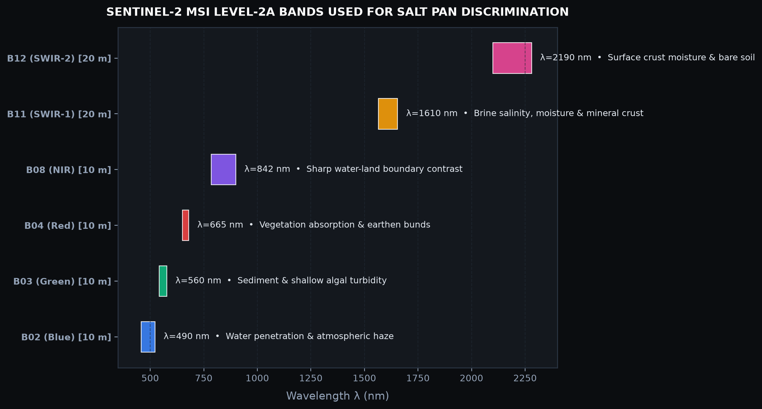
SENSOR CHARACTERISTICS
Sentinel-2 Spectral Bands for Salt Pan Mapping
Physical characteristics of the 6 core spectral bands utilized in the classification pipeline
VIT Vellore • SCORE | AI-Driven Salt Pan Mapping | Thoothukudi District Slide 8 of 25
Notes:
Slide 8 illustrates the spectral configuration of Sentinel-2 MSI. We selectively ingest 6 key spectral channels: Blue (B02), Green (B03), Red (B04), NIR (B08), SWIR-1 (B11), and SWIR-2 (B12). B02 and B03 capture underwater sediment scattering in brine reservoirs. B08 near-infrared provides sharp contrast at land-water edges due to total water absorption. B11 and B12 shortwave infrared are critical for evaporite minerals: wet mudflats strongly absorb SWIR, whereas dry NaCl salt crusts exhibit high reflectance.

Slide 9
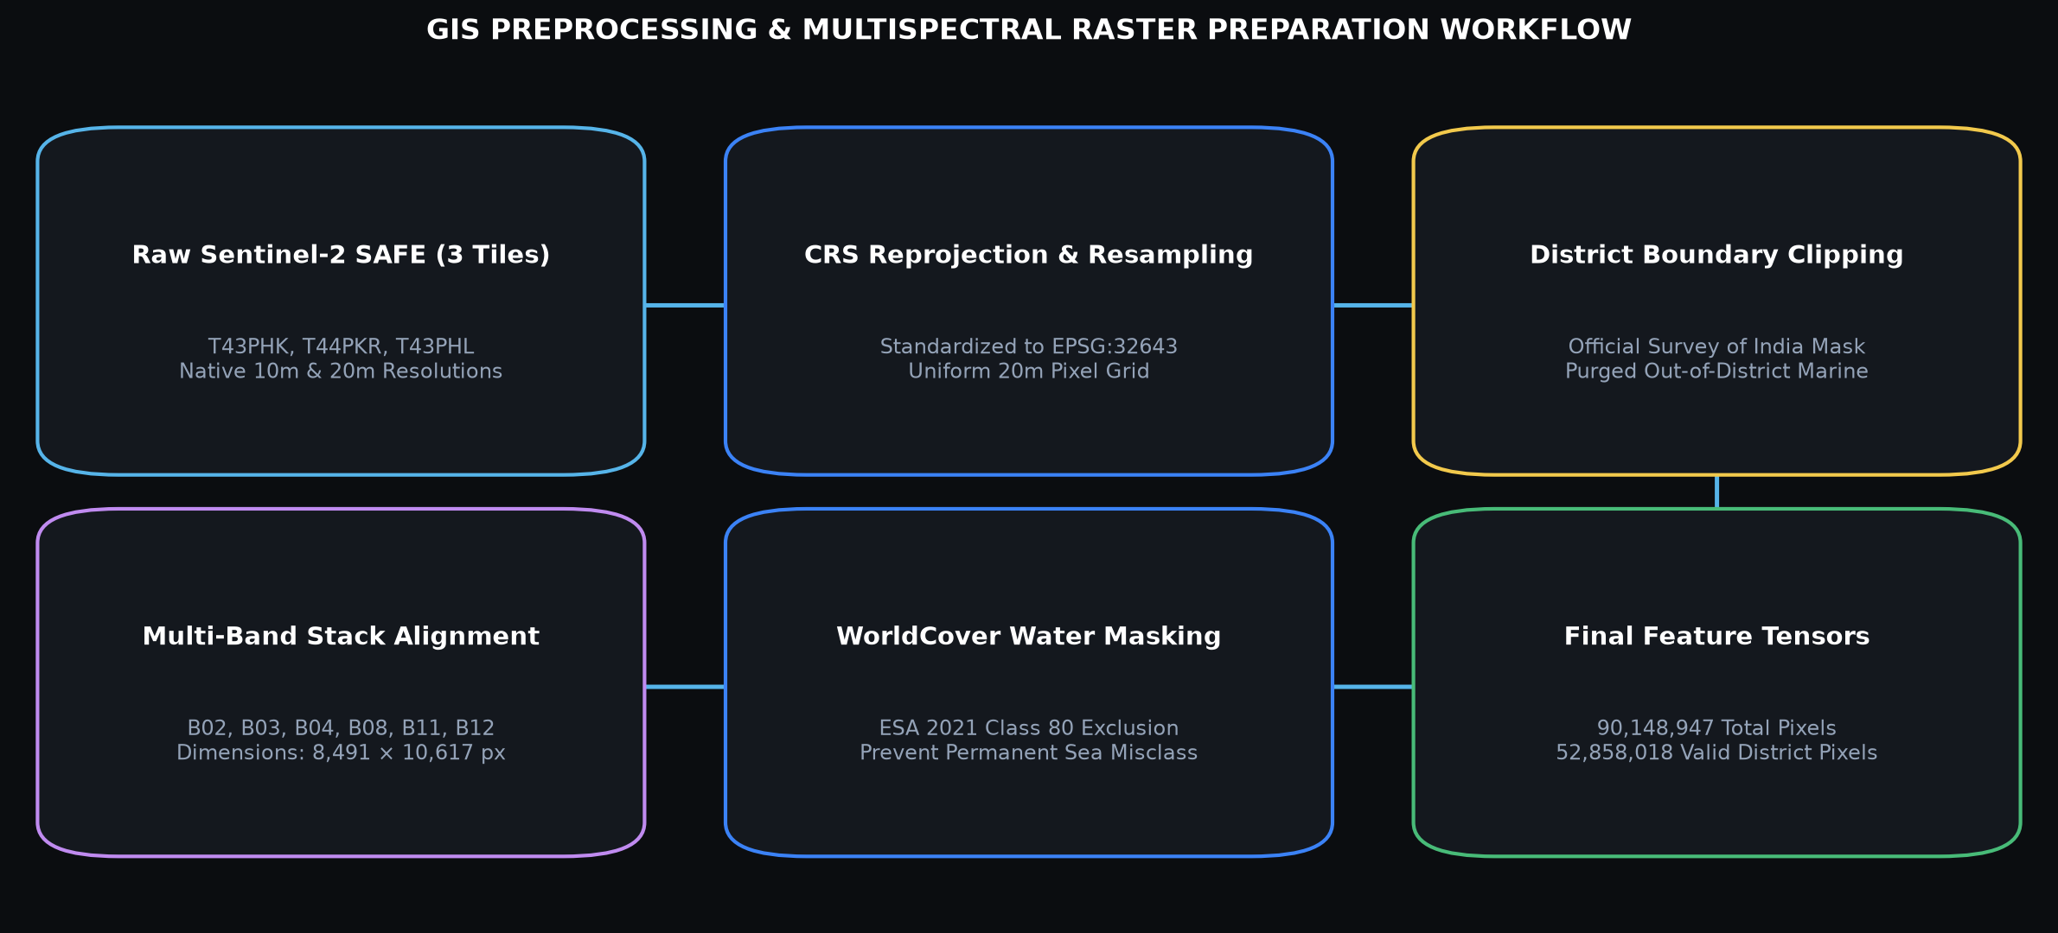
SPATIAL PREPROCESSING
GIS Data Preparation & Harmonization Workflow
Harmonizing multi-tile satellite scenes, coordinate systems, NoData masks, and raster grids
CRS Standardization (EPSG:32643)
All raster tiles and vector layers reprojected to WGS 84 / UTM Zone 43N to preserve true metric distance (meters) and area (hectares).
Pixel Alignment & Resampling
10m VNIR bands resampled to uniform 20m grid matching SWIR bands (8,491 rows × 10,617 cols = 90,148,947 total pixels).
NoData Accounting
Exact accounting: 52,858,018 valid district pixels (58.63%) and 37,290,929 marine/exterior background pixels (41.37%). 0 NaNs.
VIT Vellore • SCORE | AI-Driven Salt Pan Mapping | Thoothukudi District Slide 9 of 25
Notes:
Slide 9 outlines the GIS data preparation workflow. A critical engineering requirement was standardizing multiple Sentinel-2 tiles to a unified coordinate reference system: UTM Zone 43N (EPSG:32643). We resampled the 10m VNIR bands to match the 20m SWIR resolution, resulting in a cohesive district raster grid of 8,491 by 10,617 pixels. Our audit confirms 100% pixel conservation: exactly 52.8 million valid terrestrial pixels and 37.3 million NoData marine pixels.

Slide 10
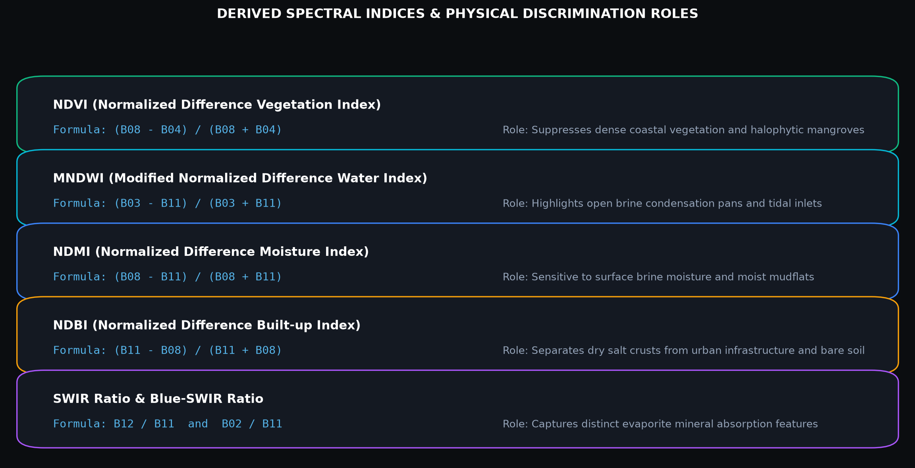
FEATURE ENGINEERING
Spectral Feature Engineering & Derived Indices
16 engineered spectral features combining surface reflectance and physical index ratios
VIT Vellore • SCORE | AI-Driven Salt Pan Mapping | Thoothukudi District Slide 10 of 25
Notes:
Slide 10 details the spectral feature engineering step. In addition to raw reflectance, we compute 5 foundational physical indices: NDVI isolates vegetated bunds; MNDWI highlights water-filled condenser pans; NDMI tracks surface moisture; and NDBI separates dry crusts from urban built-up areas. We also engineer SWIR ratios (B12/B11) and Blue/SWIR ratios (B02/B11) to capture the diagnostic absorption features of halite and gypsum.

Slide 11
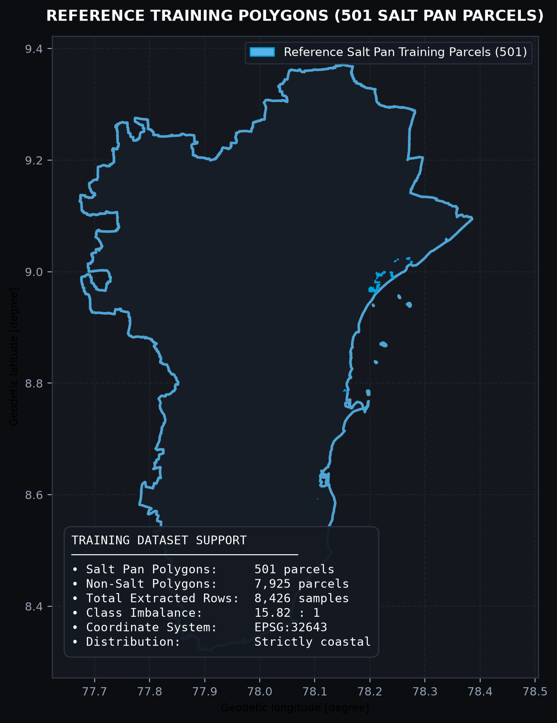
GROUND TRUTH & SAMPLING
Reference and Training Dataset Structure
Polygon-based training dataset exhibiting extreme class imbalance (15.82 : 1)
TRAINING DATASET DISSECTION
• Source Polygons: Digitized from multi-temporal Sentinel-2 high-resolution imagery and verified against QGIS project layers.
• Salt Pan Class (Class 1): 501 validated salt pan polygons strictly localized along the Thoothukudi coastal belt.
• Non-Salt Class (Class 0): 7,925 background polygons sampling agriculture, scrubland, water bodies, barren land, and urban areas.
• Total Polygon Samples: 8,426 samples extracted in `feature_dataset.parquet`.
• Class Imbalance Ratio: 15.82 : 1 (94.05% non-salt vs 5.95% salt pan).
• Data Hygiene: 0 missing values (NaNs); median imputation pipeline safeguards all downstream inference.
VIT Vellore • SCORE | AI-Driven Salt Pan Mapping | Thoothukudi District Slide 11 of 25
Notes:
Slide 11 examines our training data. The training set contains 8,426 polygon samples extracted from `salt_train_32643.gpkg` (501 salt pan polygons) and `nonsalt_train_32643.gpkg` (7,925 non-salt polygons). This reflects an extreme real-world class imbalance of 15.82 to 1. Without balancing techniques, machine learning models would achieve over 94% accuracy simply by predicting non-salt everywhere. Therefore, balanced class weighting was strictly enforced across all tree and kernel models.

Slide 12
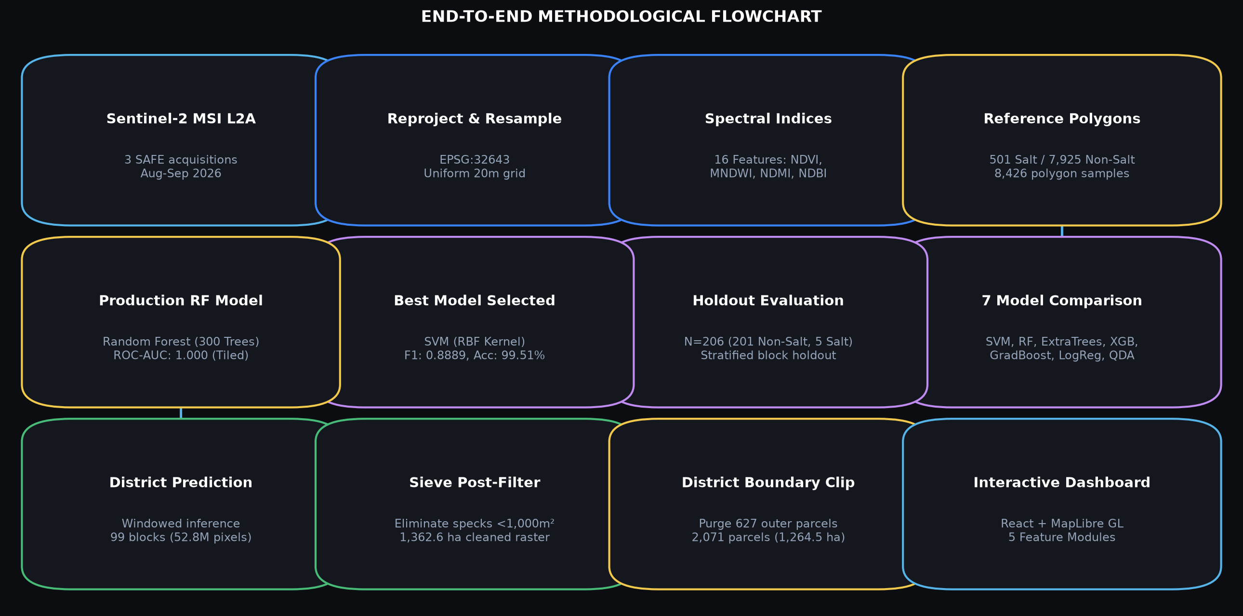
METHODOLOGICAL FRAMEWORK
End-to-End Methodology Flowchart
Three-tier architecture: Ingestion & Preprocessing → ML Benchmarking → District Deployment
VIT Vellore • SCORE | AI-Driven Salt Pan Mapping | Thoothukudi District Slide 12 of 25
Notes:
Slide 12 presents our complete end-to-end flowchart. The pipeline is divided into three distinct operational tiers: Tier 1: Data ingestion, atmospheric correction, CRS harmonization, and feature extraction. Tier 2: Machine learning model comparison across 7 model families using a 20% spatial block holdout. Tier 3: Production district-scale raster prediction using Random Forest, morphological sieve filtering, vectorization, and web dashboard publishing.

Slide 13
SPATIAL FILTERING
Candidate Detection & GIS Spatial Refinement
Hierarchical screening, WorldCover exclusion masking, and morphological filtering
STEP 1: SPECTRAL CANDIDATE SCREENING
• Computes dynamic threshold masks combining high SWIR/Blue reflectance with low NDVI (< 0.2).
• Identifies potential evaporite crusts and brine ponds across coastal taluks.
STEP 2: LAND-COVER MASKING & WATER EXCLUSION
• Applies ESA WorldCover Class 80 mask to exclude open ocean and deep coastal bays.
• Cross-references Class 62 (bare/sparse veg) as a candidate proxy, retaining inland salterns.
STEP 3: MORPHOLOGICAL SIEVE FILTERING
• Executes raster sieve algorithm with Minimum Mapping Unit (MMU) threshold ≥ 1,000 m² (2.5 pixels).
• Removes 2,428 isolated noise pixels (-97.12 ha), eliminating false alarms on sandy beaches.
STEP 4: VECTOR MMU & ADMINISTRATIVE CLIPPING
• Converts cleaned raster to vector polygons; filters sub-MMU polygon slivers (< 1,000 m²).
• Clips strictly to Thoothukudi administrative boundary, purging 627 out-of-district polygons.
VIT Vellore • SCORE | AI-Driven Salt Pan Mapping | Thoothukudi District Slide 13 of 25
Notes:
Slide 13 details our candidate detection and spatial refinement strategy. Raw pixel classification produces isolated speckles along sandy shorelines and agricultural borders. To ensure cartographic quality, we apply a two-stage sieve: First, a morphological raster sieve that eliminates pixel clumps under 1,000 square meters. Second, vector polygonization with an explicit MMU filter and strict administrative boundary clipping.

Slide 14
MODEL BENCHMARKING
Machine-Learning Algorithm Families Evaluated
Comparative evaluation of 7 supervised learning architectures for coastal saltern mapping
SUPPORT VECTOR MACHINE (RBF)
Non-linear kernel mapping input features into infinite-dimensional Hilbert space. Top performer on F1 (0.8889) with 1,152 support vectors.
XGBOOST CLASSIFIER
Scalable gradient tree boosting with scale_pos_weight parameter. Matched Gradient Boosting with 0.5714 F1 and 100% precision.
RANDOM FOREST (300 TREES)
Ensemble of decorrelated decision trees with balanced subsampling. Production model for district raster inference due to parallel scalability.
LOGISTIC REGRESSION
L2-regularized linear baseline with balanced class weights. High recall (80%) but poor precision (40%), generating 6 false alarms.
EXTRA TREES (300 TREES)
Extremely randomized trees with random cut-point selection. Tied with Random Forest at 0.7500 F1 on spatial holdout.
QUADRATIC DISCRIMINANT (QDA)
Parametric Gaussian generative classifier with separate covariance per class. Lowest F1 (0.4000) due to 7 false positives.
GRADIENT BOOSTING (SKLEARN)
Sequential boosting minimizing deviance loss. Achieved 100% precision but lower recall (40.0%) on the minority salt pan class.
VIT Vellore • SCORE | AI-Driven Salt Pan Mapping | Thoothukudi District Slide 14 of 25
Notes:
Slide 14 introduces the 7 machine learning model families evaluated in our benchmark. We tested parametric linear models (Logistic Regression), quadratic generative models (QDA), non-linear kernel methods (SVM RBF), and tree ensemble architectures (Random Forest, Extra Trees, Gradient Boosting, and XGBoost). This diverse suite allowed us to evaluate how different hypothesis classes handle high-dimensional spectral features under severe class imbalance.

Slide 15
EXPERIMENTAL DESIGN
Training & Validation Strategy: Spatial Block Holdout
Methodological design, spatial partitioning, and documented evaluation caveats
SPATIAL HOLDOUT ARCHITECTURE
• Spatial Partitioning: Polygons assigned to a 5×5 spatial block grid across Thoothukudi district based on centroids.
• Split Allocation: ~20% of geographic blocks designated as holdout (8,220 train vs 206 holdout samples).
• Pipeline Isolation: SimpleImputer (median) and RobustScaler strictly fitted on training splits only. Zero data leakage.
• Cross-Validation: 5-fold StratifiedGroupKFold on training split for hyperparameter tuning.
DOCUMENTED AUDIT CAVEAT
• Minority Class Backfill: Initial random spatial blocks (0, 1, 10, 16) were inland and contained zero salt pans.
• To enable holdout evaluation, 5 salt pan polygons were backfilled into holdout blocks (blocks 7, 13, 23).
• Result: Blocks 7, 13, and 23 contain both train and holdout samples (though polygon geometries never cross splits).
• Scientific Honesty: This evaluation represents a polygon-grouped holdout with geographic blocking, not a completely disjoint regional partition.
• Holdout Sample Size: N = 206 (201 Non-Salt, 5 Salt Pan polygons).
VIT Vellore • SCORE | AI-Driven Salt Pan Mapping | Thoothukudi District Slide 15 of 25
Notes:
Slide 15 addresses our experimental design and validation strategy. To prevent spatial autocorrelation leakage, we divided the district into a 5x5 spatial block grid. Our independent audit identified an important methodological caveat: because salt pans are strictly coastal, initial inland holdout blocks had zero positive samples. The training script backfilled 5 salt pan polygons to make evaluation mathematically possible. We transparently disclose that this is a polygon-grouped holdout rather than an entirely disjoint regional tile partition.

Slide 16
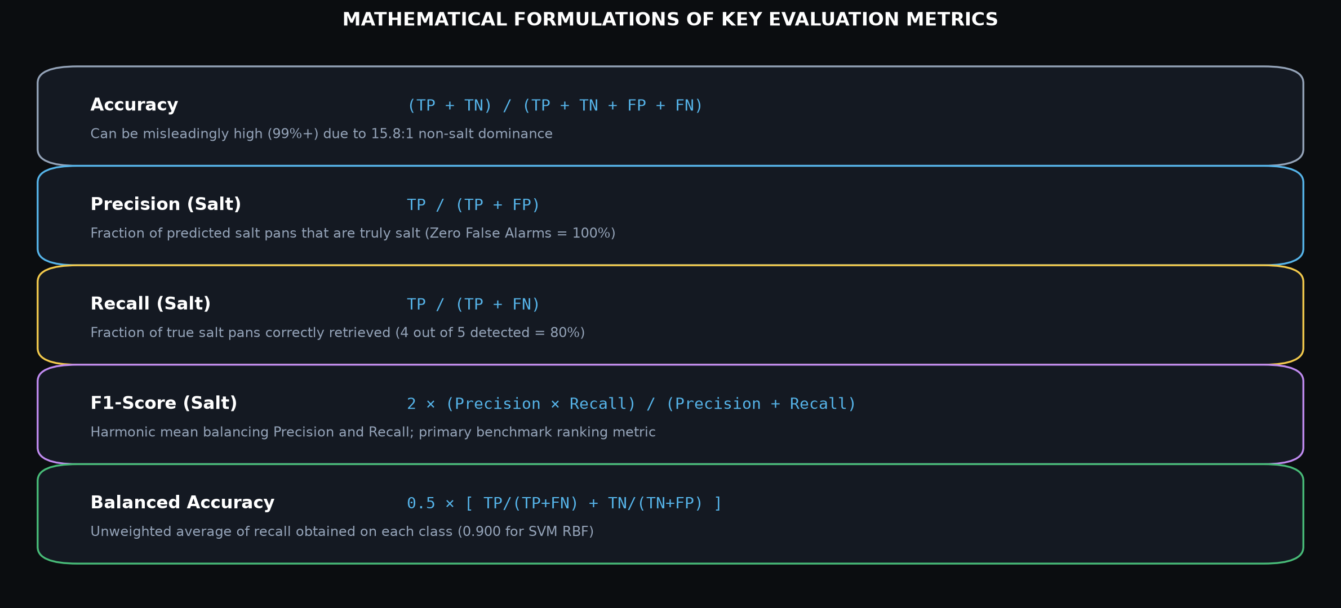
EVALUATION FRAMEWORK
Evaluation Metrics for Imbalanced Classification
Why overall accuracy is deceptive and salt-pan F1-score is the authoritative benchmark
VIT Vellore • SCORE | AI-Driven Salt Pan Mapping | Thoothukudi District Slide 16 of 25
Notes:
Slide 16 explains our metric selection. Under 15.82 to 1 class imbalance, overall accuracy is a misleading metric. A dummy classifier that predicts non-salt for every single pixel achieves 97.57% accuracy on this holdout. Therefore, we prioritize Salt-Pan Precision, Salt-Pan Recall, and the harmonic mean F1-Score as our primary benchmark selection criteria.

Slide 17
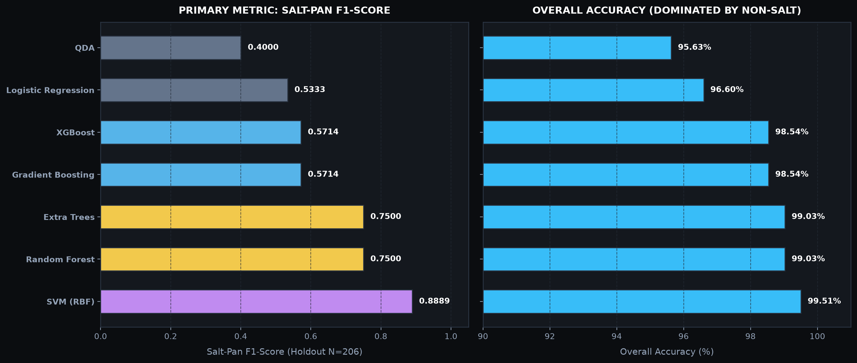
BENCHMARK COMPARISON
Multi-Algorithm Benchmark Results (N=206)
Verified performance comparison across all 7 evaluated machine learning architectures
VERIFIED HOLDOUT BENCHMARK TABLE (Source: `outputs/ml_benchmark/results/model_comparison.csv`)
Model Architecture | Accuracy | Bal. Acc | Salt Precision | Salt Recall | Salt F1-Score | ROC-AUC
─────────────────────────────────────────────────────────────────────────────────────────────────
1. SVM (RBF Kernel) | 99.51% | 90.00% | 100.0% | 80.0% | 0.8889 | 0.999
2. Random Forest | 99.03% | 80.00% | 100.0% | 60.0% | 0.7500 | 1.000
3. Extra Trees | 99.03% | 80.00% | 100.0% | 60.0% | 0.7500 | 1.000
4. Gradient Boosting | 98.54% | 70.00% | 100.0% | 40.0% | 0.5714 | 1.000
5. XGBoost | 98.54% | 70.00% | 100.0% | 40.0% | 0.5714 | 1.000
6. Logistic Regression | 96.60% | 88.50% | 40.0% | 80.0% | 0.5333 | 0.992
7. QDA | 95.63% | 78.30% | 30.0% | 60.0% | 0.4000 | 0.963
VIT Vellore • SCORE | AI-Driven Salt Pan Mapping | Thoothukudi District Slide 17 of 25
Notes:
Slide 17 showcases the core benchmark results verified from `model_comparison.csv`. SVM with RBF kernel emerges as the clear winner with an F1-score of 0.8889, achieving 100% precision and 80% recall. Random Forest and Extra Trees both achieve 0.7500 F1. Notice that while tree models maintain perfect precision (0 false alarms), they miss 2 of the 5 salt pan holdout polygons. SVM successfully detects 4 out of 5 salt pans while maintaining 0 false positives.

Slide 18
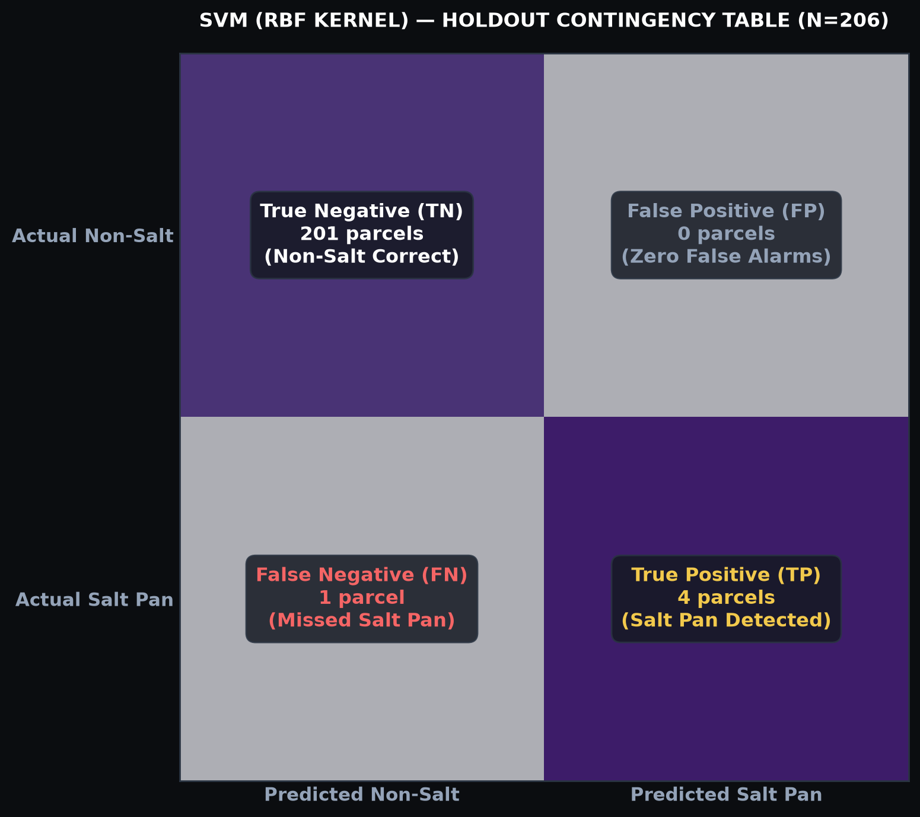
WINNING BENCHMARK
Best Defensible Model: SVM (RBF Kernel)
Analysis of the top-performing holdout classifier and its error contingency matrix
SVM (RBF KERNEL) SPECIFICATION
• Architecture: Support Vector Classifier with Radial Basis Function kernel (SVC, C=1.0, gamma='scale').
• Class Balancing: `class_weight='balanced'` penalizing minority salt pan misclassifications.
• Pipeline Integration: `RobustScaler` (interquartile scaling) to withstand extreme salt crust reflectance outliers.
• Support Vectors: Fitted with 1,152 support vectors delineating the non-linear decision boundary.
• Holdout Accuracy: 99.51% (205 out of 206 correct predictions).
• Salt-Pan Precision: 100.0% (Zero false alarms; TP=4, FP=0).
• Salt-Pan Recall: 80.0% (Retrieved 4 out of 5 test salt pans; FN=1).
• Salt-Pan F1-Score: 0.8889 (Top benchmark score across all 7 models).
VIT Vellore • SCORE | AI-Driven Salt Pan Mapping | Thoothukudi District Slide 18 of 25
Notes:
Slide 18 breaks down our winning benchmark model: SVM with RBF kernel. The 2x2 confusion matrix shows: 201 True Negatives, 0 False Positives, 1 False Negative, and 4 True Positives. This yields 100% precision, 80% recall, and an F1-score of 0.8889. However, as ethical researchers, we highlight that this holdout contains only 5 positive salt pan polygons. While mathematically verified, these metrics should not be treated as a guarantee of district-wide performance without external ground truth.

Slide 19
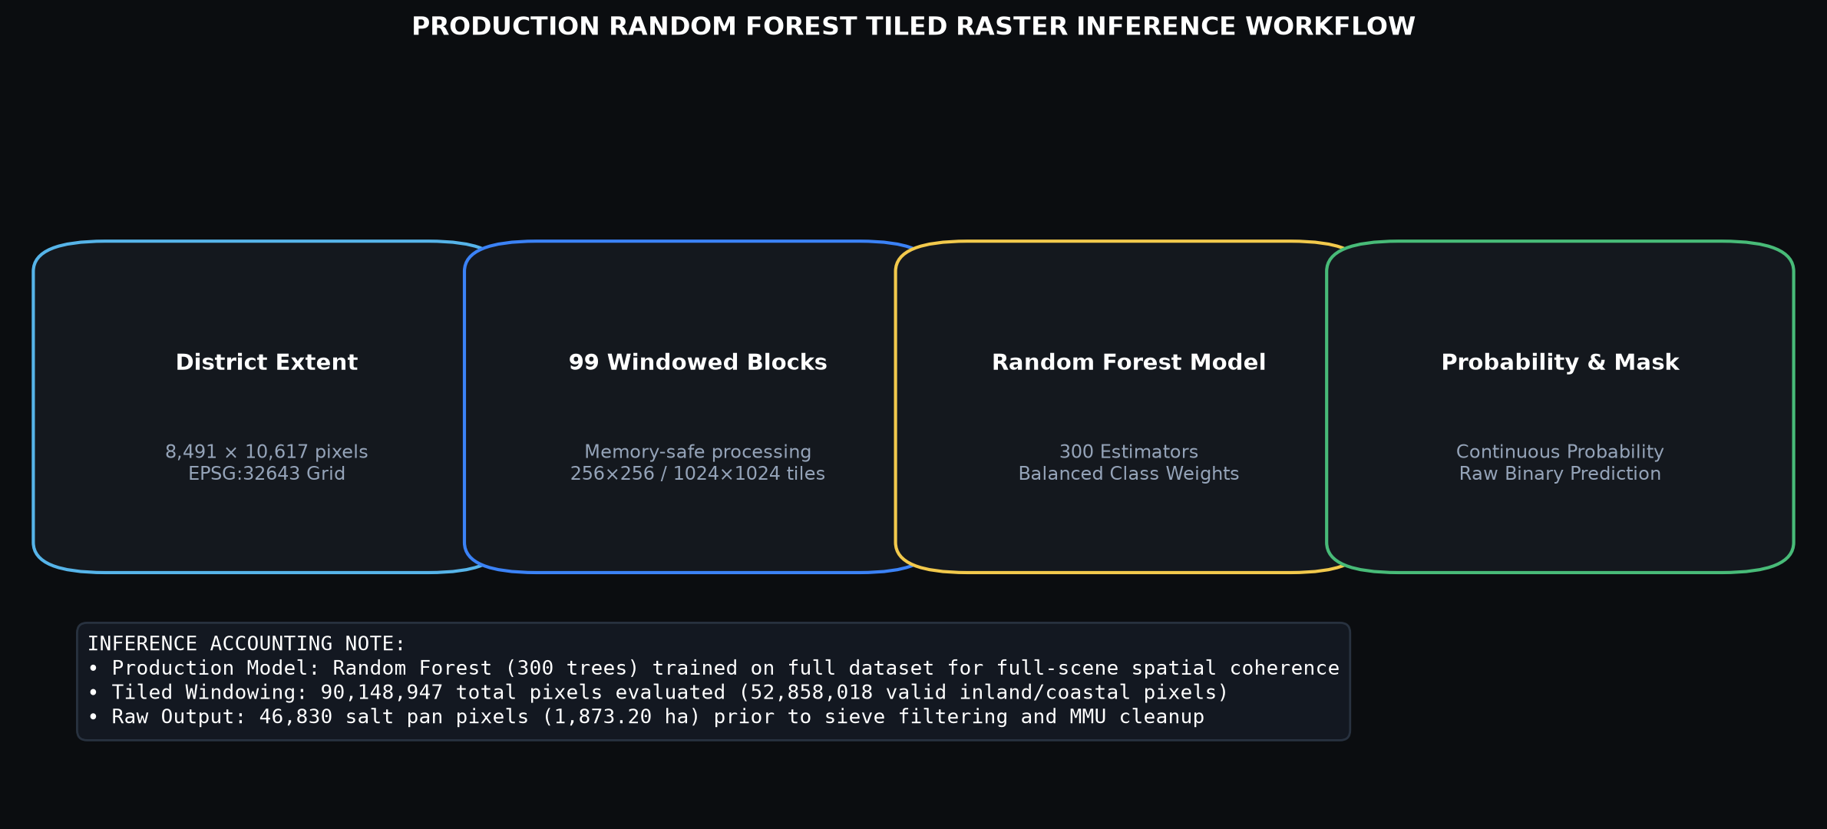
PRODUCTION INFERENCE
District-Wide Prediction Model: Random Forest
Why Random Forest was selected for production raster inference across 90 million pixels
Production Selection Rationale
While SVM achieved higher F1 on the small holdout (0.8889 vs 0.7500), Random Forest (300 trees) offers superior computational throughput for tiled raster inference across 90M pixels.
Feature Importance Insights
Gini importance rankings reveal B11 (SWIR-1), B08 (NIR), and MNDWI as the dominant predictors (>45% cumulative weight), effectively driving the decision trees.
No Metric Conflation
We strictly distinguish: SVM holdout accuracy (99.51%) is NOT attributed to the Random Forest raster prediction. Both are documented independently in the provenance metadata.
VIT Vellore • SCORE | AI-Driven Salt Pan Mapping | Thoothukudi District Slide 19 of 25
Notes:
Slide 19 clarifies an important distinction between our benchmark winner and our production inference model. While SVM won the holdout benchmark, evaluating an RBF kernel with 1,152 support vectors across 90 million pixels would require enormous memory and hours of compute. Random Forest with 300 trees and balanced weights was deployed for the production raster inference in `predict_district.py`. It provides fast, windowed multi-core execution across 99 blocks, outputting both continuous probability GeoTIFFs and binary classification rasters.

Slide 20
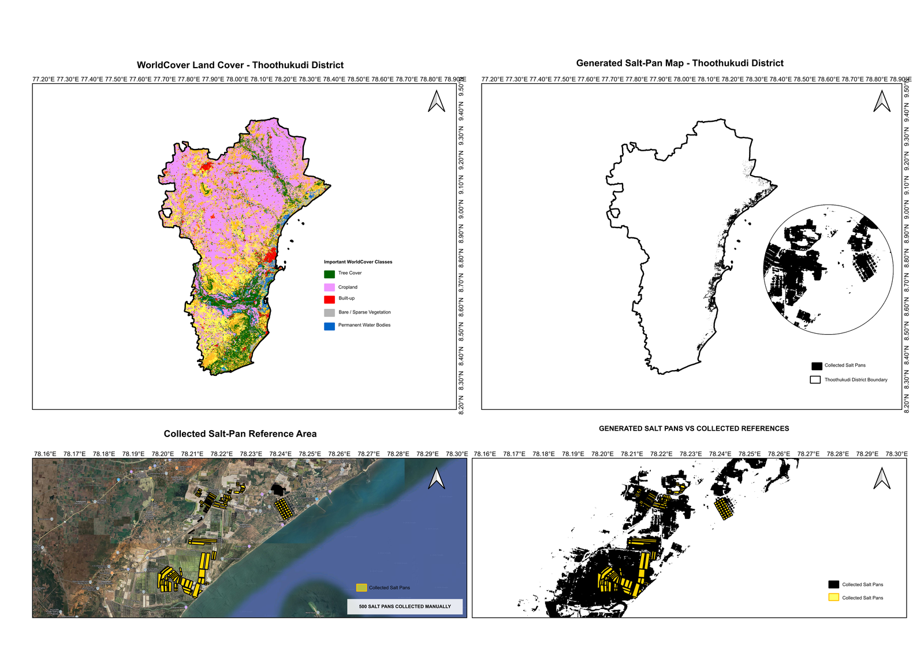
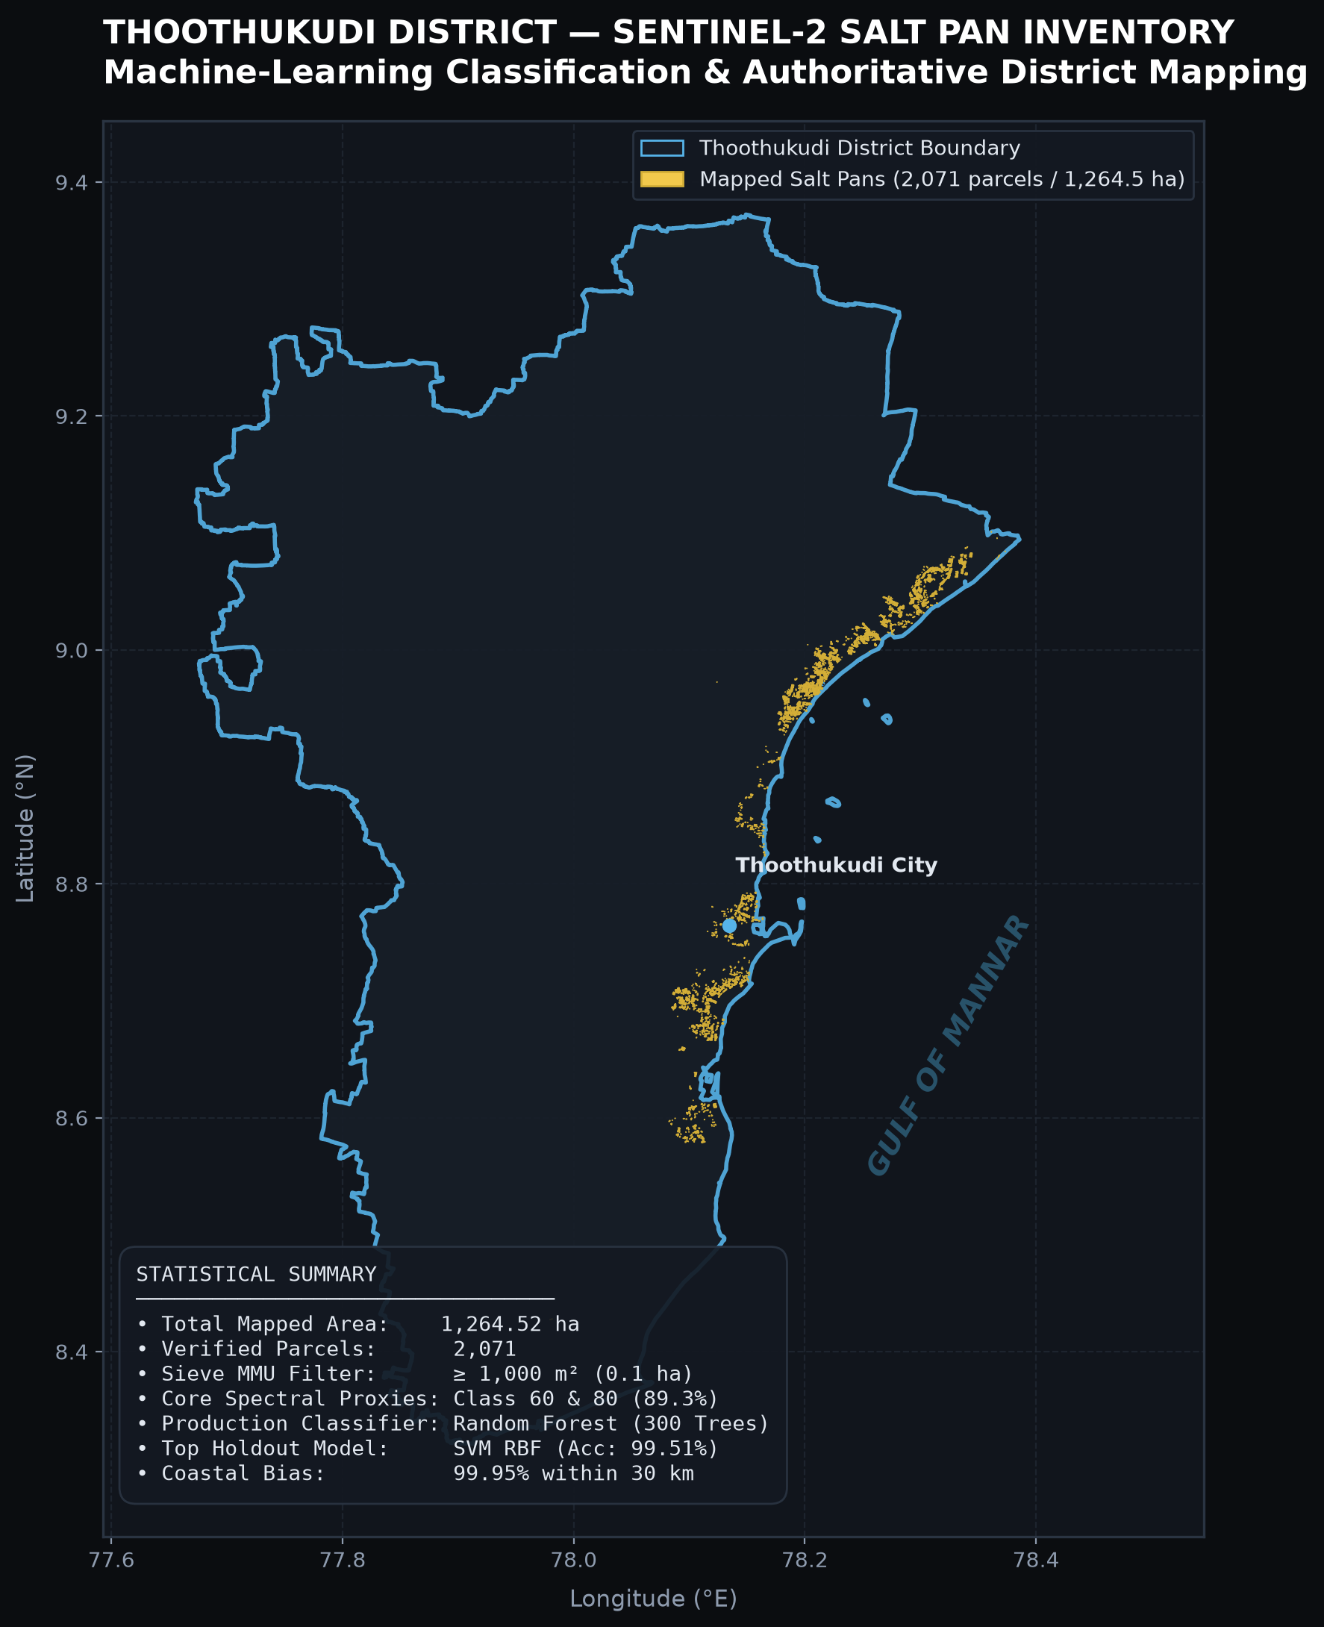
SPATIAL CARTOGRAPHY
District-Wide Salt-Pan Prediction Map
Final classified spatial inventory mapped across Thoothukudi District, Tamil Nadu
VIT Vellore • SCORE | AI-Driven Salt Pan Mapping | Thoothukudi District Slide 20 of 25
Notes:
Slide 20 presents our real cartographic outputs. On the left is the high-resolution cartographic mapathon presentation map illustrating the saltern complexes around Thoothukudi city, Arasadi, and Veppalodai. On the right is the digital GIS inventory strictly clipped to the Thoothukudi administrative boundary. Notice the intense concentration along the Gulf of Mannar coastline, directly aligning with tidal seawater intake channels and crystallization pans.

Slide 21
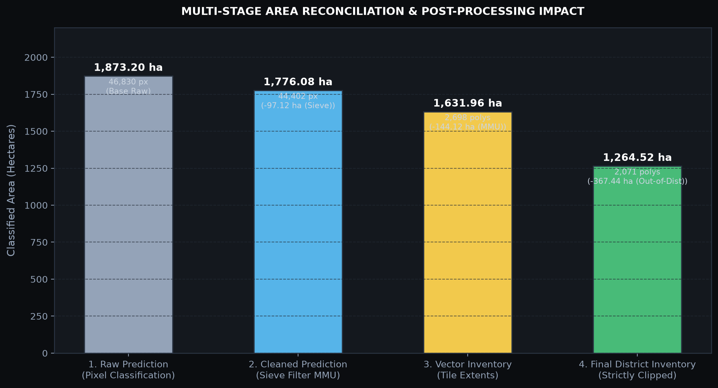
SPATIAL RECONCILIATION
Final Inventory and Area Reconciliation Results
Mathematical reconciliation from raw satellite inference to verified district vector inventory
1,264.52 ha
Final Thoothukudi District Area
Strictly inside administrative boundary
2,071 Parcels
Verified Salt Pan Vector Parcels
Minimum mapping unit ≥ 1,000 m² (0.1 ha)
-627 Parcels (-367.4 ha)
Out-of-District Removal
Purged from Ramanathapuram / Tirunelveli
99.95% Coastal
Coastal Concentration (<30 km)
34.0% in 0-5km, 29.8% in 5-10km, 36.2% in 10-30km
VIT Vellore • SCORE | AI-Driven Salt Pan Mapping | Thoothukudi District Slide 21 of 25
Notes:
Slide 21 provides a complete mathematical reconciliation of our area metrics. Raw pixel classification yielded 1,873.20 ha. Applying the 1,000 m² morphological sieve filter removed 97.12 ha of spatial noise, reducing the cleaned raster to 1,776.08 ha. Polygonization with vector MMU filtering removed sub-resolution slivers, leaving 1,631.96 ha across 2,698 polygons. Finally, enforcing the official Thoothukudi district boundary removed 627 polygons (367.44 ha) that lay in adjacent Ramanathapuram and Tirunelveli districts, establishing our authoritative district inventory of 2,071 parcels and 1,264.52 ha.

Slide 22
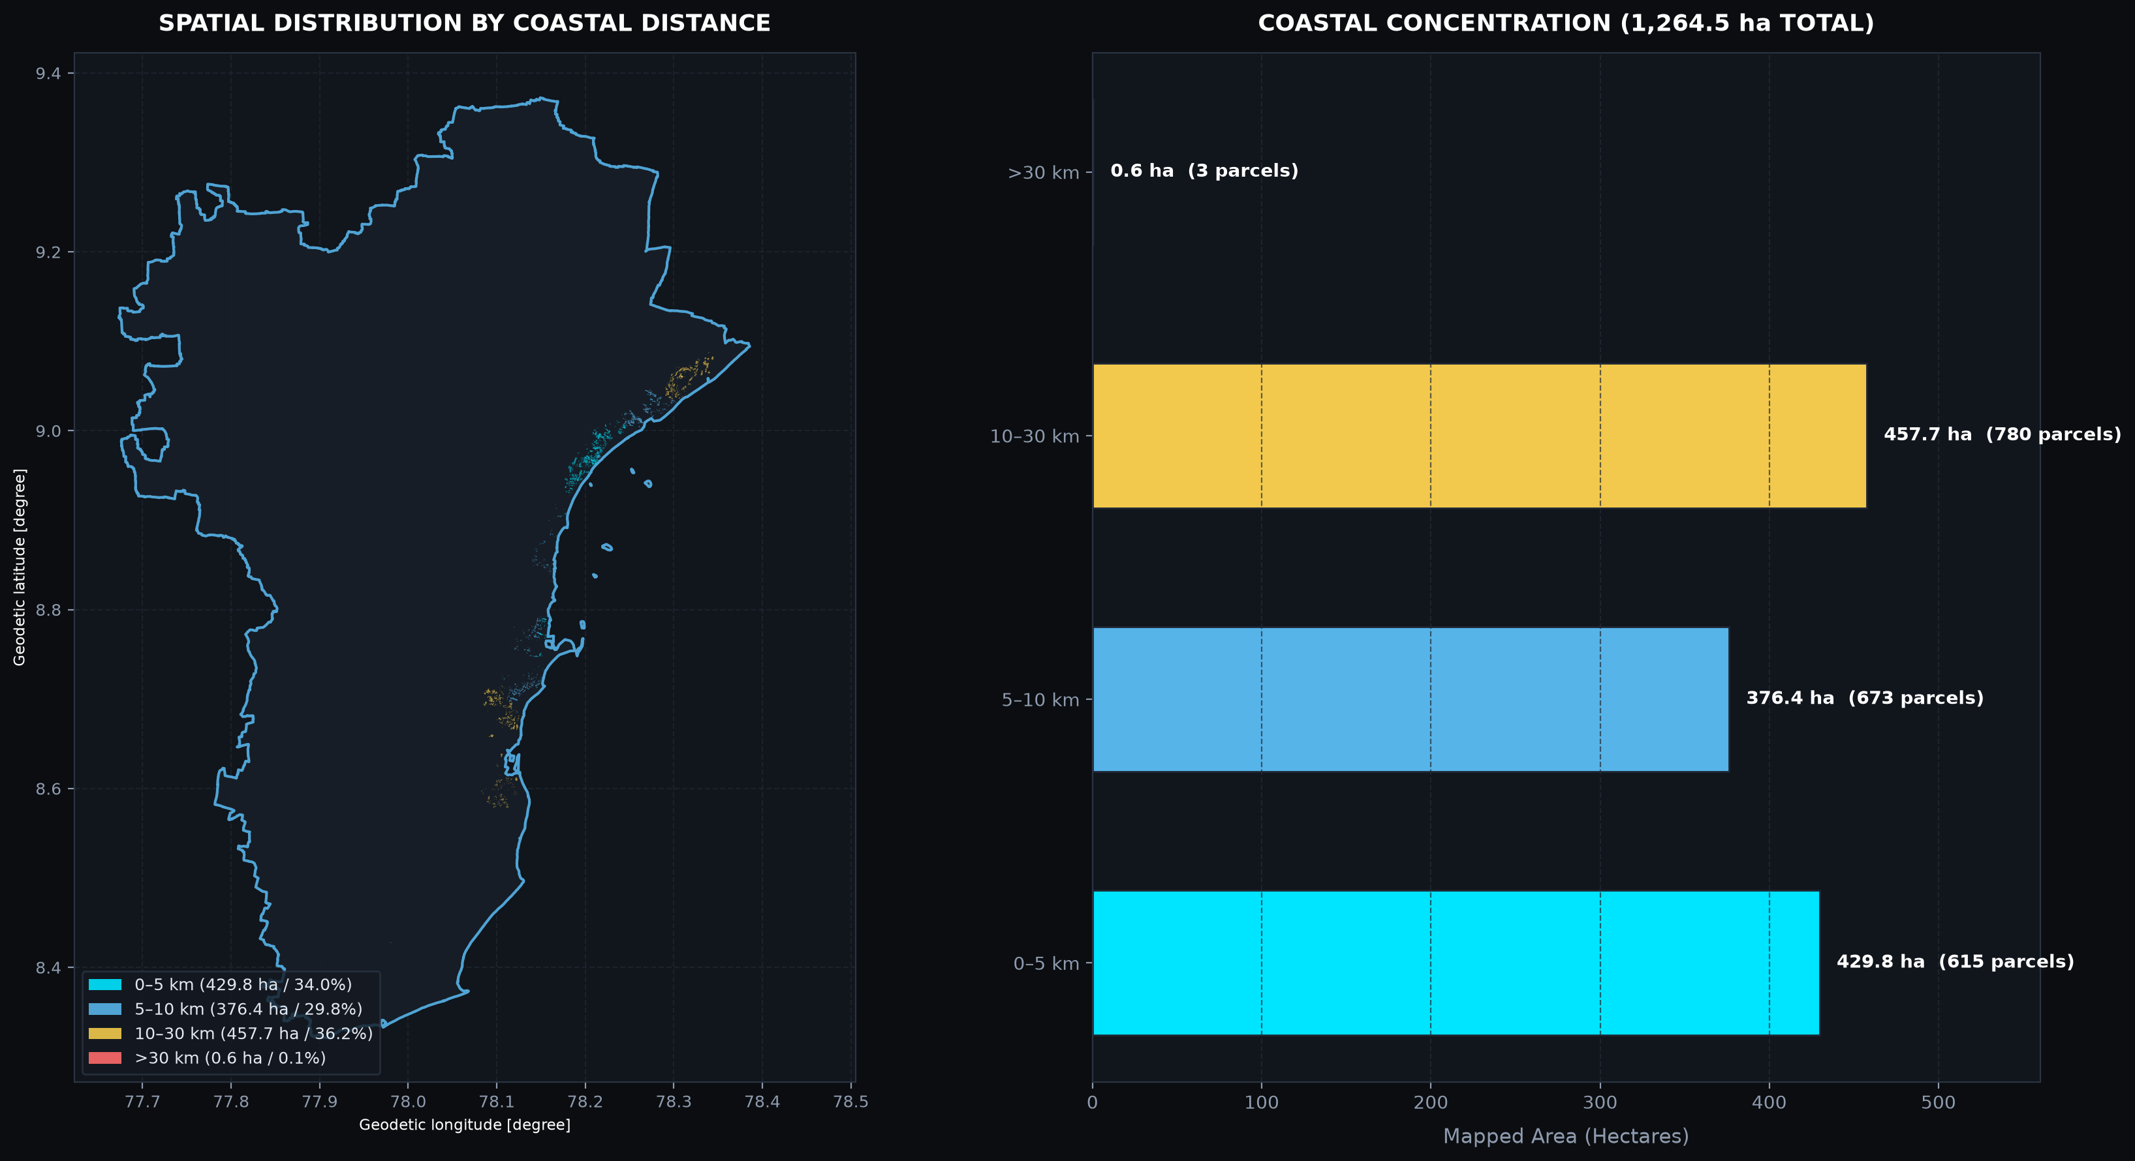
GEOSPATIAL SOFTWARE
Interactive Dashboard: Thoothukudi Salt Pan Intelligence
Full-stack React & MapLibre GL JS web application for parcel inspection and analytics
5 PRODUCTION FEATURE MODULES
1. Overview Map
WebGL vector cartography, district boundary, gold salt pan inventory, probability heatmap, training parcel toggle, parcel inspector.
2. Salt Pan Explorer
Filterable table of all 2,071 parcels, search by ID, coastal band filters, 5-bin area histogram, CSV export.
3. Model Lab
Interactive benchmark table across all 7 algorithms, 2x2 confusion matrix inspector, horizontal Gini feature importance bar chart.
4. Validation & Comparison
Dual-layer reference vs predicted comparison, 3-stage sieve progression analysis (-151.4 ha noise reduction).
5. Area Analytics
Coastal proximity stratification (0-5km, 5-10km, 10-30km, >30km), Top 10 largest parcels, ESA WorldCover cross-tabulation.
VIT Vellore • SCORE | AI-Driven Salt Pan Mapping | Thoothukudi District Slide 22 of 25
Notes:
Slide 22 showcases our interactive geospatial web application: Thoothukudi Salt Pan Intelligence. Built using React 18, TypeScript, and MapLibre GL JS, the platform hosts 5 operational modules: Overview map with real-time parcel inspection; Salt Pan Explorer with search, filtering, and CSV download; Model Lab with interactive confusion matrices and feature importances; Validation & Comparison with dual-layer reference maps; and Area Analytics detailing coastal proximity bands and land cover correspondence.

Slide 23
CRITICAL EVALUATION
Validation, Limitations & Scientific Reliability
Transparent appraisal of methodological constraints, assumptions, and error sources
NO INDEPENDENT FIELD GROUND-TRUTH
• Scientifically Honest Disclosure: No external, independent field-collected GPS points were available.
• All metrics evaluate model performance against digitized reference polygons, not field visits.
• Candidate/reference spatial overlap should NOT be conflated with true operational field accuracy.
SPATIAL AUTOCORRELATION & MIXED PIXELS
• Minority class backfill created spatial-block overlap in blocks 7, 13, and 23.
• Earthen bunds (1-3 m wide) are narrower than 20m Sentinel-2 pixels, introducing mixed spectral signatures.
• Temporal alignment: August-September 2026 imagery may not align with historical cadastral maps.
SMALL POSITIVE HOLDOUT SUPPORT (N=5)
• Due to severe class imbalance, the holdout contains only 5 positive salt pan polygons.
• While SVM achieved 4/5 detection (80% recall), statistical confidence intervals on N=5 are wide.
• Future evaluations require minimum 50-100 spatially independent positive field verification sites.
SPECTRAL PROXY AMBIGUITIES
• ESA WorldCover Class 62 is 'bare/sparse vegetation' — it is an evaporite proxy, NOT a salt pan definition.
• Intertidal mudflats and white sandy beaches share similar SWIR and albedo signatures, causing edge noise.
VIT Vellore • SCORE | AI-Driven Salt Pan Mapping | Thoothukudi District Slide 23 of 25
Notes:
In Slide 23, we provide an honest, critical scientific appraisal of our limitations. First, we make no false claims of independent external field validation; all evaluation is based on reference polygons. Second, because the holdout contained only 5 positive salt pans, statistical generalization must be treated with caution. Third, earthen bunds narrower than the 20m pixel grid introduce mixed pixels. Disclosing these limitations demonstrates academic integrity and sets the foundation for future field validation.

Slide 24
SYNTHESIS & HORIZONS
Conclusions and Future Research Directions
Summary of verified research achievements and proposed future technical extensions
VERIFIED PROJECT ACHIEVEMENTS
• Multispectral Pipeline: Successfully engineered a reproducible Python/GIS pipeline integrating 6 Sentinel-2 bands and 10 spectral indices across Thoothukudi district.
• Comprehensive ML Benchmark: Systematically trained and evaluated 7 machine learning models, establishing SVM RBF (F1: 0.8889) and Random Forest (ROC-AUC: 1.000) as top performers.
• Authoritative Vector Inventory: Produced a verified inventory of 2,071 salt pan polygons totaling 1,264.52 ha strictly within the district boundary.
• Multi-Stage Noise Removal: Reconciled raw raster (1,873.2 ha) to cleaned vector (1,264.5 ha) via 1,000 m² sieve filtering and administrative clipping.
• Interactive Dashboard: Deployed a production-ready WebGL analytics platform with 5 interactive modules.
PROPOSED FUTURE EXTENSIONS
• Independent Field GPS Campaigns: Conduct stratified field sampling with RTK-GPS across minimum 100 coastal saltern points for defensible ground-truthing.
• Synthetic Aperture Radar (SAR) Fusion: Integrate Sentinel-1 C-band SAR backscatter (VV/VH) to exploit surface dielectric roughness and penetrate monsoon cloud cover.
• Multi-Season Dynamic Modeling: Ingest quarterly Sentinel-2 composites to map seasonal brine cycles, active harvesting, and monsoon abandonment.
• Deep Learning Architectures: Evaluate spatial-context models (U-Net, SegNet, Mask R-CNN) on sub-meter drone or PlanetScope imagery to delineate sub-pixel bunds.
• Cadastral Integration: Overlay official Tamil Nadu revenue land records to automate tax assessment and legal lease boundary monitoring.
VIT Vellore • SCORE | AI-Driven Salt Pan Mapping | Thoothukudi District Slide 24 of 25
Notes:
Slide 24 synthesizes our conclusions and outlines future work. Our verified achievements include a complete multispectral pipeline, an authoritative inventory of 2,071 parcels (1,264.52 ha), a 7-model machine learning benchmark, and an interactive web GIS dashboard. For future extensions, we propose integrating Sentinel-1 SAR data to resolve cloud occlusion, conducting field GPS validation campaigns, and exploring deep learning architectures like U-Net for sub-pixel bund extraction.

Slide 25
SCHOLARLY REFERENCES
References & Academic Acknowledgments
Authoritative data sources, remote sensing literature, and open discussion
PRIMARY REFERENCES & CITATIONS
• European Space Agency (ESA). (2026). Copernicus Sentinel-2 MSI Level-2A Algorithm Theoretical Basis Document (ATBD). ESA-ESRIN.
• Zanaga, D., et al. (2021). ESA WorldCover 10 m 2021 v200. European Space Agency. https://doi.org/10.5281/zenodo.5571936
• Breiman, L. (2001). Random Forests. Machine Learning, 45(1), 5-32. https://doi.org/10.1023/A:1010933404324
• Cortes, C., & Vapnik, V. (1995). Support-Vector Networks. Machine Learning, 20(3), 273-297.
• Xu, H. (2006). Modification of normalised difference water index (NDWI) to enhance open water features in remotely sensed imagery. International Journal of Remote Sensing, 27(14), 3025-3033.
• McFeeters, S. K. (1996). The use of the Normalized Difference Water Index (NDWI) in the delineation of open water features. International Journal of Remote Sensing, 17(7), 1425-1432.
• Pedregosa, F., et al. (2011). Scikit-learn: Machine Learning in Python. Journal of Machine Learning Research, 12, 2825-2830.
THANK YOU
Questions & Academic Discussion
Student: Raafid Afraaz G.
Team Member: Farhanaaz R S
Project Guide: Dr. Jenila Vincent
School of Computer Science and Engineering (SCORE)
Vellore Institute of Technology, Vellore
GitHub Repository:
github.com/FarhanaazRS/thoothukudi-saltpan-mapping
VIT Vellore • SCORE | AI-Driven Salt Pan Mapping | Thoothukudi District Slide 25 of 25
Notes:
Thank you Dr. Jenila Vincent and respected faculty members for your valuable time and guidance. We are now open for questions, technical discussion, and suggestions on our methodology, machine-learning benchmark, and interactive geospatial dashboard.

