Slide 1
Event-Driven Smart Invoice & Billing Platform
Mini Project – Mid-Semester Evaluation Department of Computer Science Academic Year 2025–26
Prepared By Farhan Maniya (12302040701049) Eric Macwan (12302040701048) Lovedeep Singh Sandhu (12402040703012)
Guide Prof. Keyur Prajapati
Tech Stack:
Frontend • React
Backend • Node.js • Express.js
Database • MongoDB
Communication • Nodemailer (SMTP Email Integration)

Slide 2
User Request
Invoice Processing
Event Emission
Notification/Email Handler
Introduction
Project Overview
Web-based invoice and billing management platform
Designed using modular full-stack architecture
Supports customer, product, and invoice lifecycle management
Implements event-driven backend for decoupled communication
Provides automated in-app notifications and email alerts
Objective
To design a scalable billing system with clean separation of concerns
To demonstrate event-driven architecture in a real-world application

Slide 3
Literature Review
⚙️ Existing Systems
• Traditional billing software tightly couples invoice logic with communication mechanisms
• ERP modules provide billing features but are complex and heavy for small-scale use
• Limited modularity in academic-level billing implementations
• Difficult to extend with new notification channels
🔍 Identified Research Gap
• Lack of structured event-based communication models
• Limited focus on separation of concerns in billing systems
• Poor scalability in tightly integrated architectures
🚀 Proposed Approach
• Modular backend architecture
•Event-driven communication between services
• Decoupled notification and email handlers
• Improved maintainability and extensibility

Slide 4
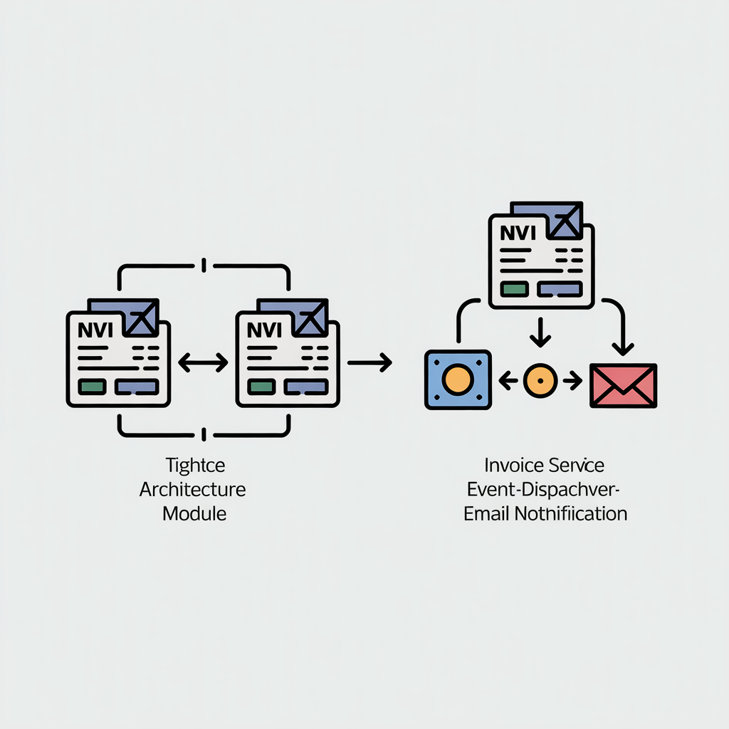
Problem Statement
• Modern billing systems often tightly integrate invoice processing with communication logic
• Direct email handling inside business modules reduces flexibility
• Lack of separation of concerns makes systems difficult to maintain
• Extending additional communication channels (SMS, Push, etc.) becomes complex
• Scalability issues arise in tightly coupled architectures

Slide 5


Hardware & Software Requirements
Hardware Requirements
• Processor: Intel i5 or equivalent • RAM: Minimum 8 GB • Storage: 256 GB SSD • Internet Connectivity
Software Requirements
• Node.js • Express.js • MongoDB • React • Nodemailer (SMTP Email Service) • Visual Studio Code

Slide 6
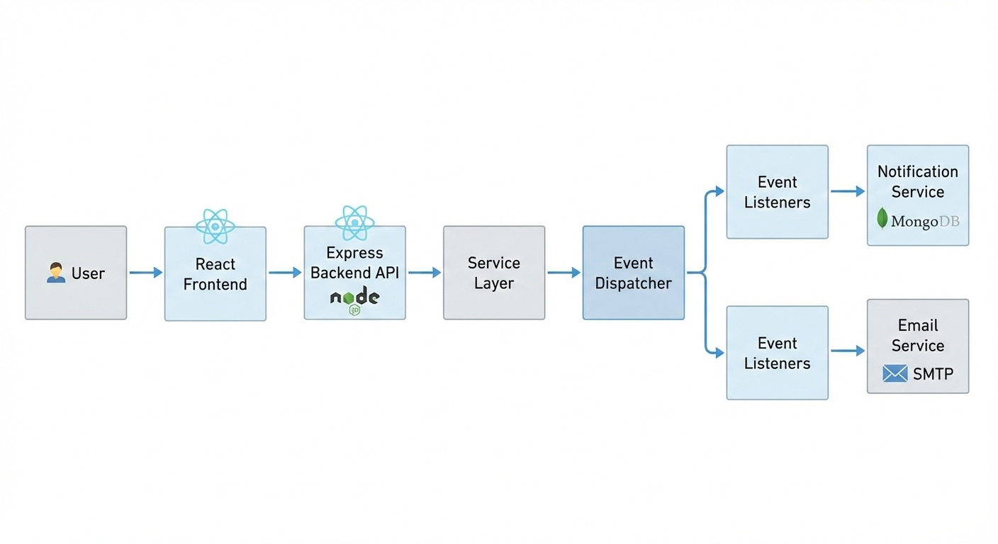
System Architecture
User
Application
Database

Slide 7
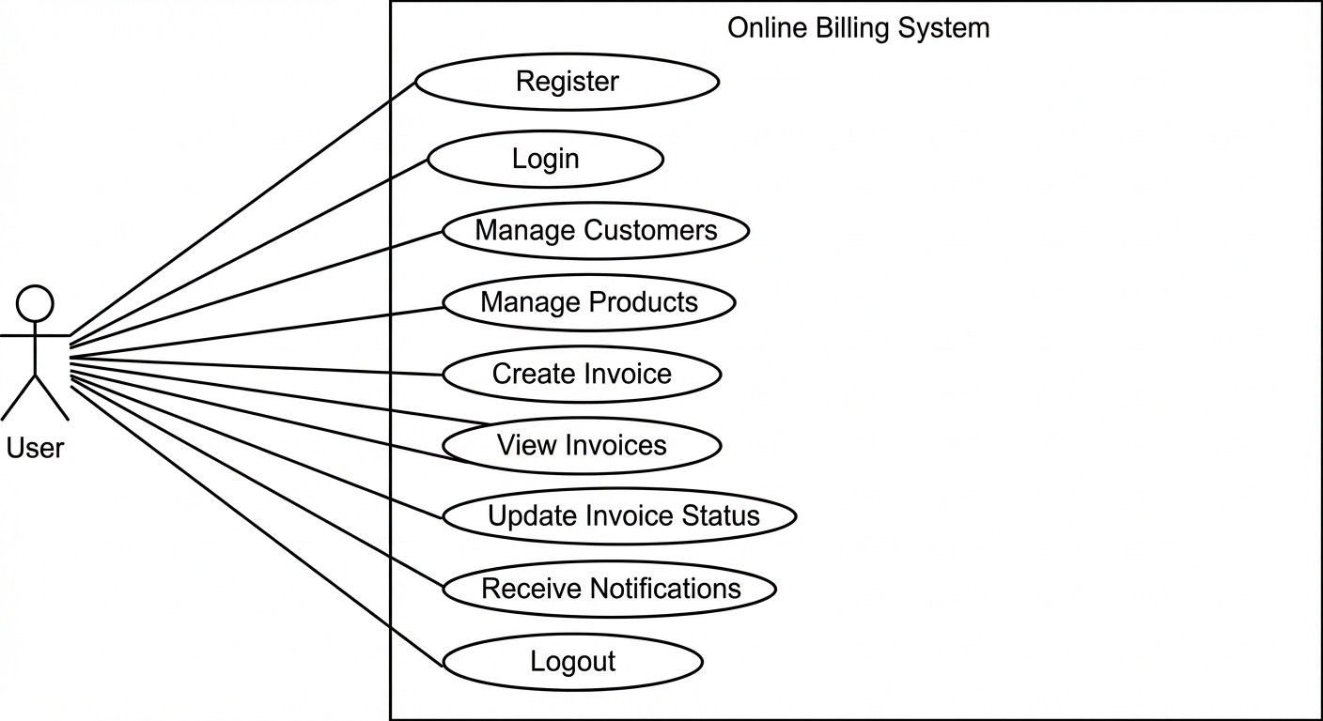
UML Use Case Diagram
Application
Database

Slide 8
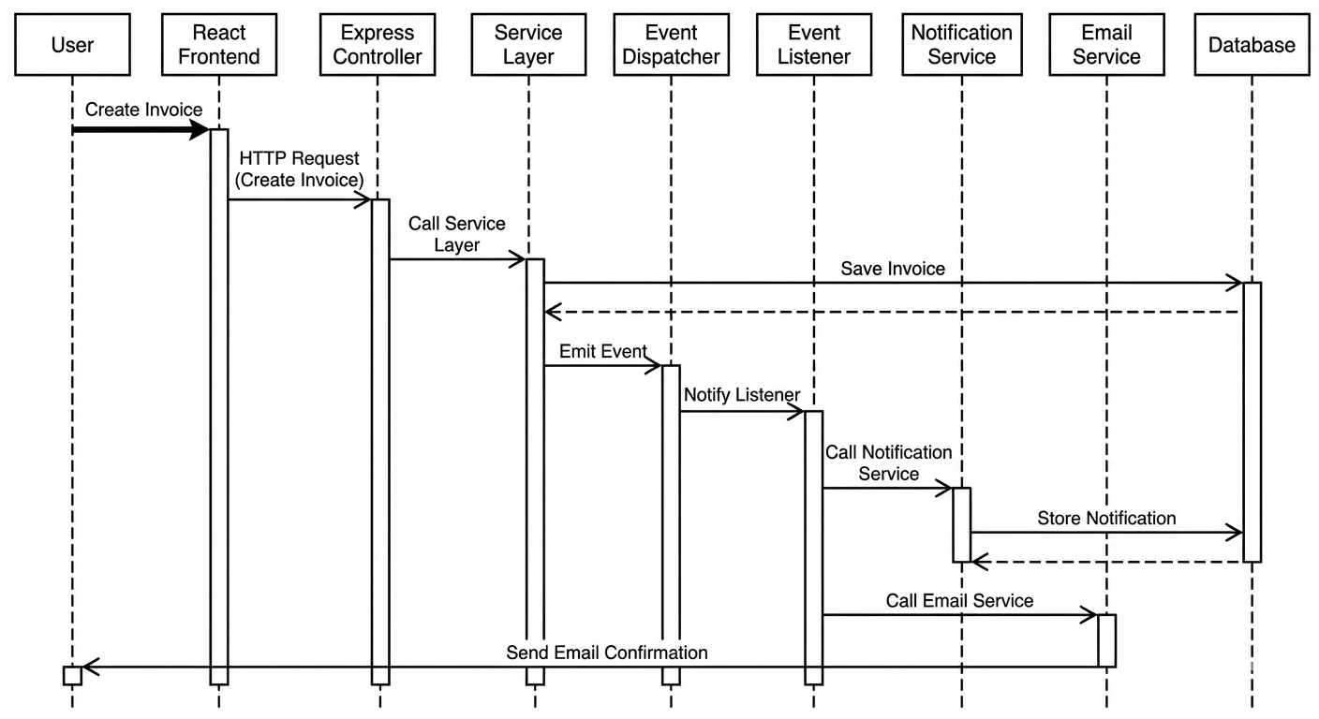
UML Sequence Diagram – Invoice Creation Flow
Application
Database

Slide 9
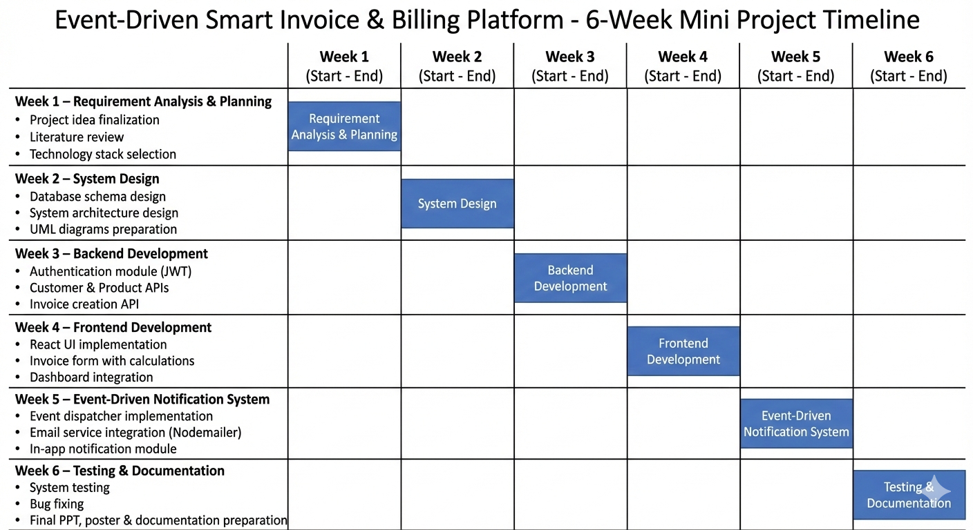
Project Timeline (6 Weeks Development Plan)
Application
Database

Slide 10
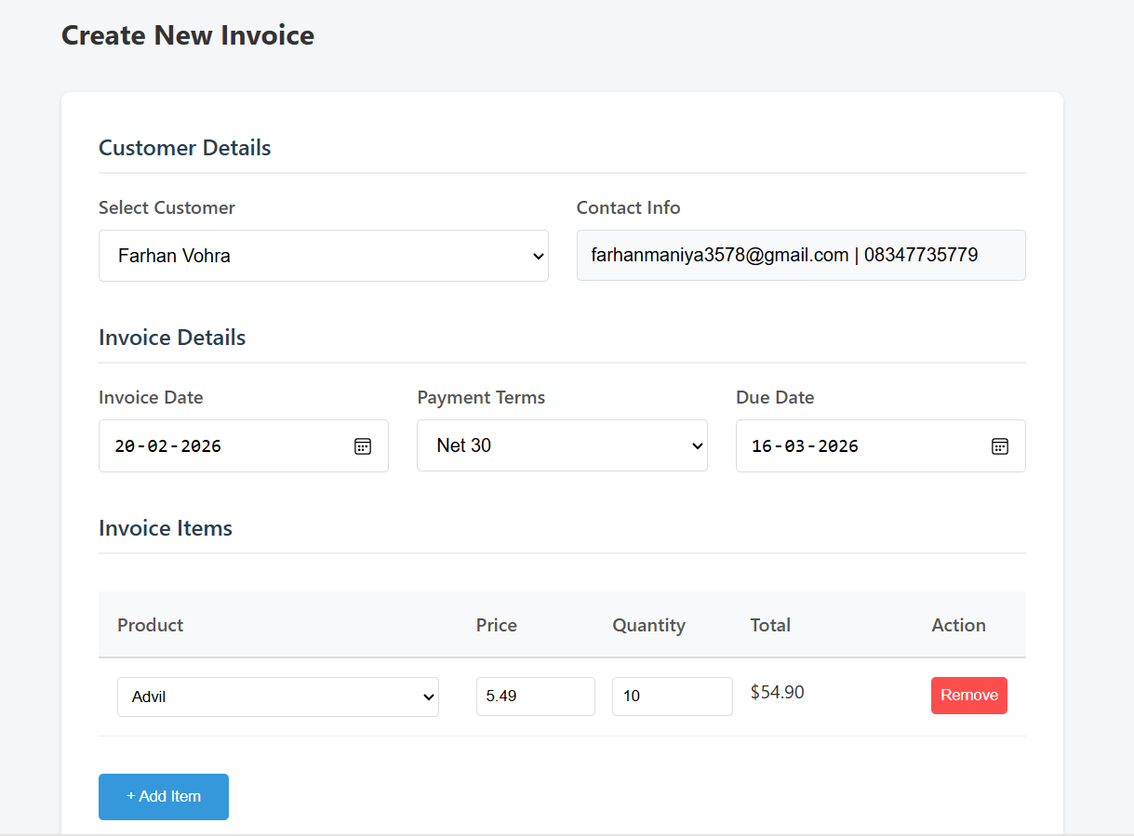
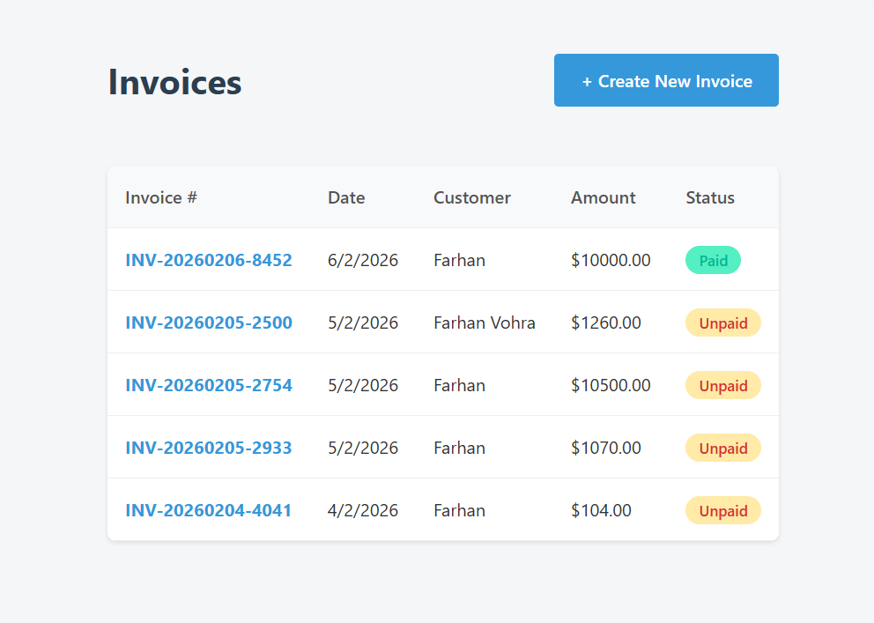
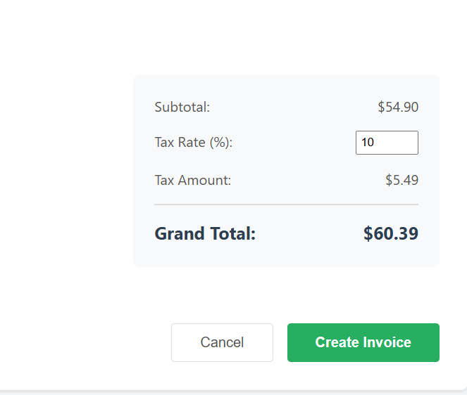
Implementation — Screenshots (placeholders)
Create Invoice Screen
Billing & Invoice Screen
Line items, tax/discount calculations, PDF export

Slide 11
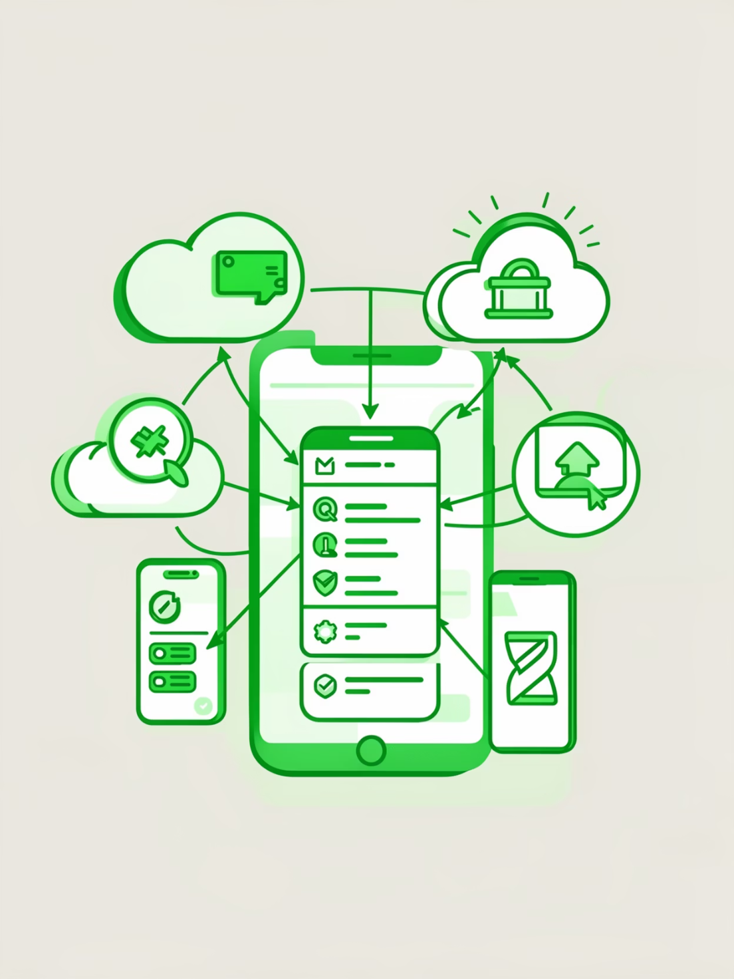
Future Work & Conclusion
Future Work
Integration with secure payment gateways (Stripe / Razorpay)
Role-Based Access Control (Admin, Accountant, Viewer)
Recurring invoices & automated billing scheduler
Migration to microservices architecture
Cloud deployment with CI/CD pipeline
Conclusion
Successfully implemented a modular full-stack billing platform
Demonstrated event-driven architecture in a real-world scenario
Achieved separation of concerns for scalability & maintainability
System reduces manual billing errors and improves traceability

Slide 12
References
React Documentation. (2024). React – A JavaScript library for building user interfaces. Retrieved from https://react.dev/
Node.js Documentation. (2024). Node.js Official Documentation. Retrieved from https://nodejs.org/
Express.js Documentation. (2024). Express – Fast, unopinionated, minimalist web framework for Node.js. Retrieved from https://expressjs.com/
Nodemailer Documentation. (2024). Nodemailer – Send emails from Node.js. Retrieved from https://nodemailer.com/
Gamma / Gemini AI Tools (2025). Used for UML diagram and architecture visualization assistance.

