Slide 1

Predicting Online Shopper Behavior with Machine Learning
A Comparative Analysis of Machine Learning Algorithms for E-commerce Behavior Prediction.
Presented By: Farhat Khalid (SP25-RCS-008)

Slide 2


Introduction: The Rise of E-commerce and Predictive Analytics
The rapid evolution of the internet and e-commerce has fundamentally reshaped consumer purchasing habits and business marketing strategies. As online shopping continues its accelerated growth, particularly influenced by global events, understanding and predicting consumer behavior has become paramount for businesses.
This research addresses the critical need for advanced predictive models to decipher complex online purchasing patterns, which can significantly enhance revenue generation and customer retention for e-commerce platforms.
Key Contributions:
Data Collection & Pre-processing: Assembled and refined a dataset of user session data.
Data Analysis: Derived insights from existing data to inform system development.
ML Algorithm Application: Implemented and evaluated various classification algorithms.
Model Design: Developed an improved framework based on the best-performing algorithm.

Slide 3

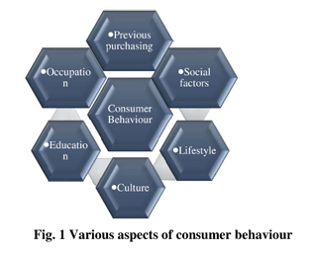
Understanding Consumer Behavior
Consumer behavior encompasses the entire purchasing journey, from initial product discovery to final acquisition. This complex process is influenced by a multitude of factors.
To gain a holistic view, combining operational data (O-data: finance, sales) with experience data (X-data: customer satisfaction, NPS) is essential. This integration provides a deeper understanding of growth drivers and future purchasing patterns.

Slide 4





Strategic Benefits of Predictive Analytics
Predicting consumer behavior allows businesses to implement proactive strategies, significantly impacting growth and profitability.
Decrease Consumer Churn
Identify potential churn risks and implement retention strategies, which is more cost-effective than acquiring new customers.
Improve Consumer Retention
Predict which customers are likely to stay or leave, enabling targeted actions to retain valuable clients.
Enhanced Customer Satisfaction
Understand demands and interests to create more tailored experiences, fostering loyalty and positive word-of-mouth.
Boost Customer Involvement
Leverage user experience data (surveys, social media) to identify motivations and map them to business outcomes like sales and NPS.

Slide 5


Methodology: Data-Driven Insights
Our proposed methodology systematically analyzes online shopper data to build robust predictive models.
Pre-processing
Exploratory Analysis
Algorithm Selection
Performance Eval
Dataset Overview:
Source: UCI Online Shoppers' Intention dataset.
Features: 18 attributes (categorical & numerical) from 12,330 user sessions over one year.
Skewed Data: Approximately 85% negative samples (no transaction) and 15% positive samples (transaction completed).

Slide 6
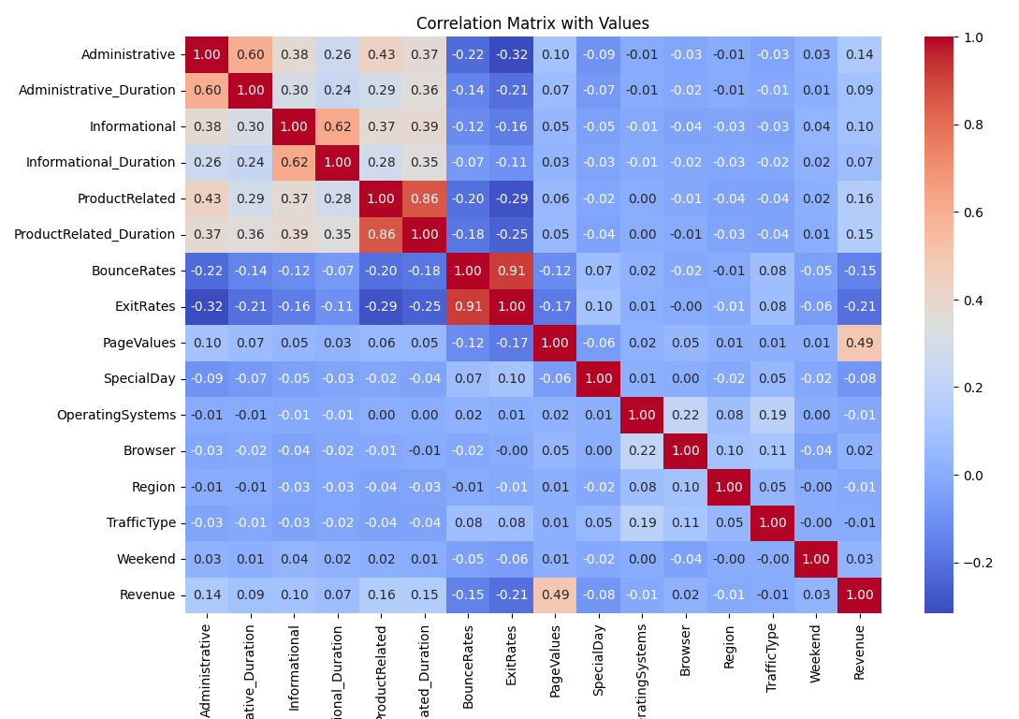
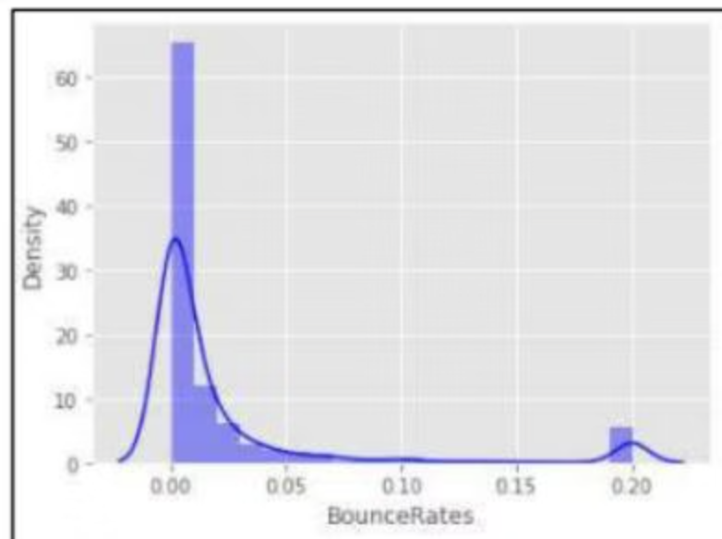

Exploratory Data Analysis: Key Findings
Initial analysis revealed several critical insights into user behavior and website engagement metrics.
Correlation Among Factors:
Page Metrics Distribution:
Bounce-rate and page-values exhibit highly skewed distributions, indicating most users have low bounce rates and page values, signifying engagement.
Visitors spend more time on product-related pages than administrative or informational ones, and purchase likelihood increases with time spent on product pages, as shown in Figures 4-9.
Bounce-rate and page-values exhibit highly skewed distributions, indicating most users have low bounce rates and page values, signifying engagement.
Visitors spend more time on product-related pages than administrative or informational ones, and purchase likelihood increases with time spent on product pages, as shown in Figures 4-9.

Slide 7
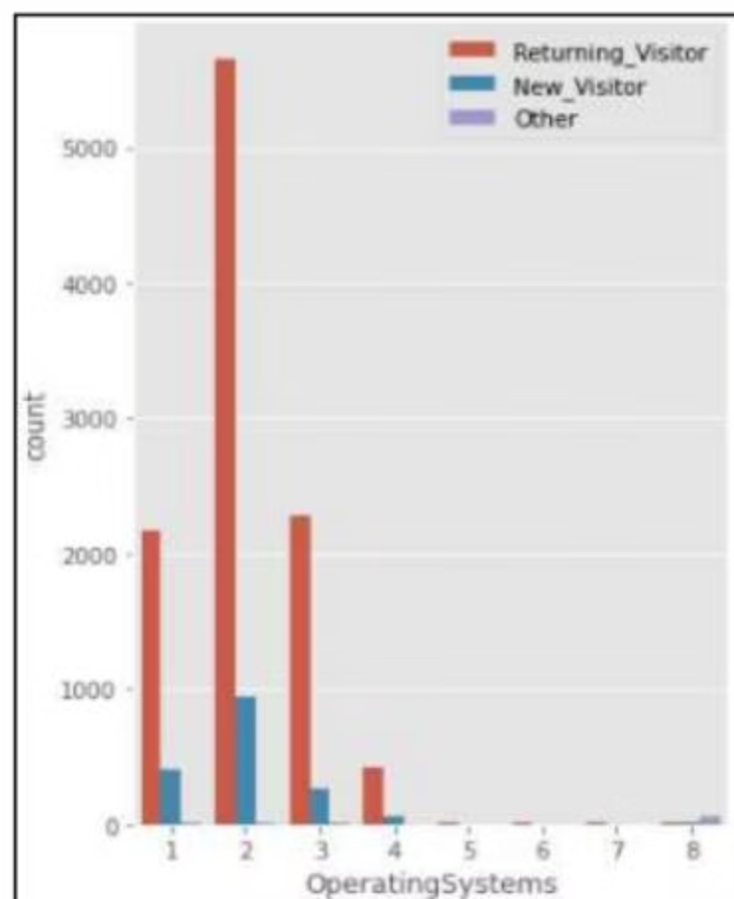
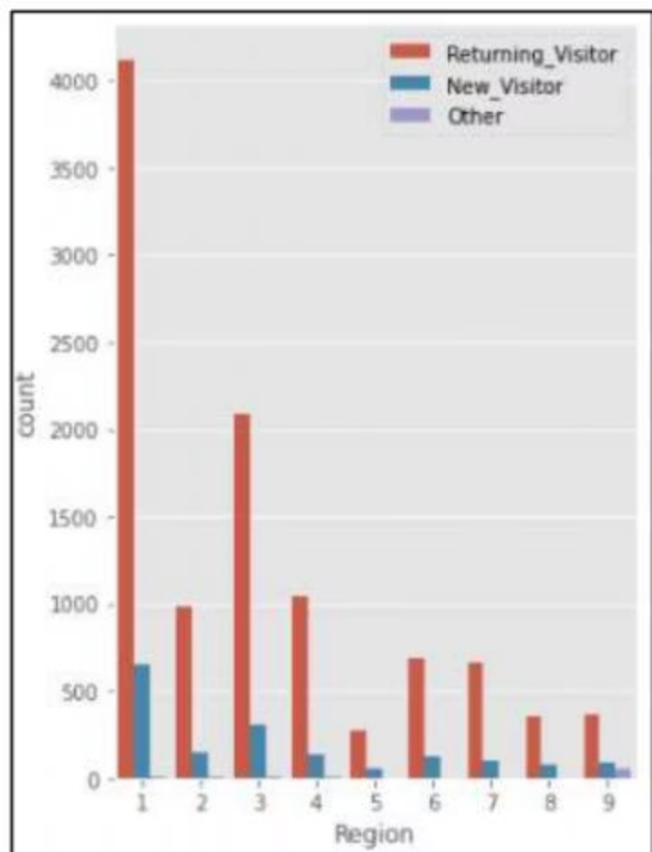
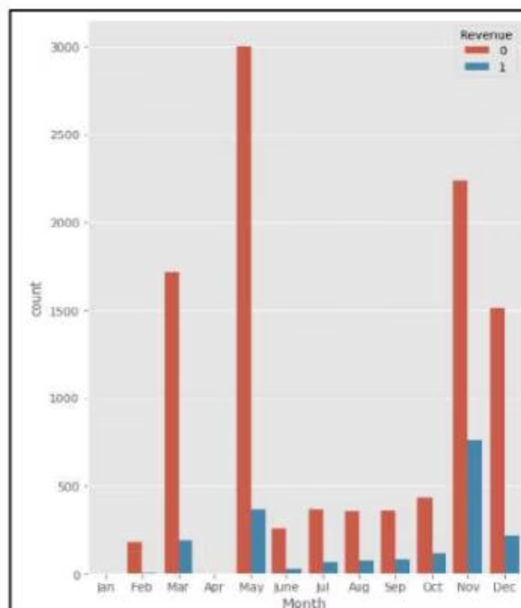
Visitor Segmentation and Temporal Patterns
Analyzing visitors by device, region, traffic source, and time provides actionable insights for targeted strategies.
Operating System Usage:
Regional & Traffic Analysis:
Revenue by Month & Special Days:
Operating System Category 2 is dominant, highlighting the need for UI compatibility across diverse platforms.
Significant transactions occur towards year-end (November, December), and near special days, emphasizing seasonal strategy importance.
Region Category 1 shows the highest customer involvement, suggesting targeted marketing efforts for other regions.

Slide 8
Comparative Analysis of Machine Learning Models
Seven distinct classification algorithms were evaluated to determine the most effective predictor of online shopper behavior.
Model
Accuracy
Precision
Recall
F1-Score
ROC-AUC
GradientBoosting
0.901
0.723
0.589
0.649
0.929
RandomForest
0.901
0.751
0.537
0.626
0.923
SVM
0.888
0.690
0.500
0.580
0.859
LogisticRegression
0.881
0.743
0.356
0.481
0.887
AdaBoost
0.880
0.604
0.647
0.625
0.898

Slide 9
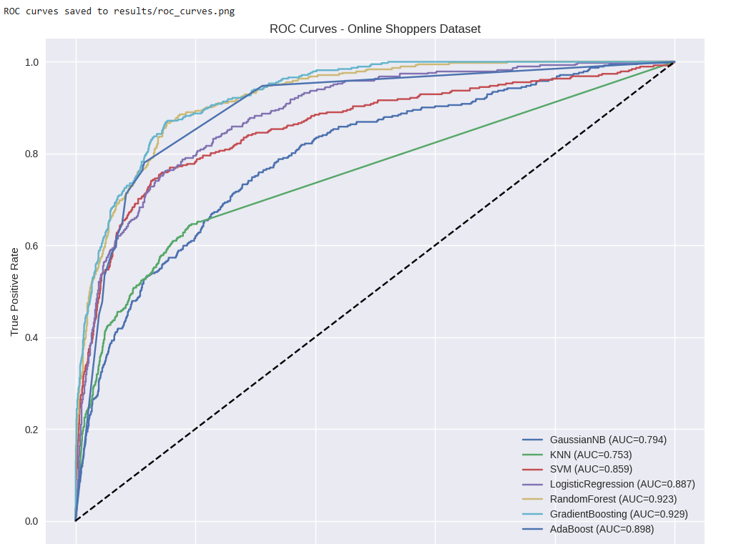
ROC-AUC
The ROC curve visually confirms Gradient Boosting's superior performance across key metrics among the initially compared algorithms, closely followed by Random Forest.

Slide 10
CatBoost Model: Optimized Performance and Key Drivers
To enhance predictive accuracy, the CatBoost algorithm was subjected to hyperparameter tuning, yielding optimal settings and revealing critical factors influencing online purchasing decisions.
Optimal Parameters
Model Depth
Best AUC (CV)
Learning Rate: 0.03
Depth: 6
0.928
L2 Leaf Reg: 9
Bagging Temp: 0.5
(Cross-Validation)
Model Performance Metrics
Top Feature Importances
Accuracy
0.863
Month
25.85%
Precision
0.536
Page Values
24.39%
Recall
0.832
Page Value Product
11.85%
F1-Score
0.652
Exit Rates
4.38%
ROC-AUC
0.931
Total Page Duration
3.63%
Product Pages Ratio
3.30%
The CatBoost classifier demonstrated strong predictive performance on the Online Shoppers Purchasing Intention dataset. Early stopping was triggered at 315 trees to prevent overfitting, indicating good generalization capability. The model achieved an accuracy of 86.25%, a recall of 83.25%, and an F1-score of 65.23%. Notably, the ROC–AUC score of 0.931 indicates excellent discrimination between purchasing and non-purchasing sessions, which is particularly important given the imbalanced nature of the dataset.
The final CatBoost model demonstrates strong predictive capabilities, with "Month," "Page Values," and "Page Value Product" identified as the most influential
factors in predicting online shopper intention.

Slide 11

Conclusion & Future Directions
Optimal Model for Prediction:
The Gradient Boosting Algorithm demonstrating an accuracy of around 91% and precision of 76% after tuning. CatBoost also showed promising results, particularly with a high ROC-AUC of 0.931.
Feature Importance (CatBoost):
1
Month
Highly influential (25.85%), indicating strong seasonal purchasing patterns.
2
PageValues
Significant impact (24.39%), reflecting the value generated
by user interactions on certain pages.
3
PageValueProduct
Crucial (11.85%), showing the direct contribution of product pages to revenue.
4
ExitRates
A notable factor (4.38%), indicating points where users leave the site.

