Slide 1



Sandip Foundation’s
SANDIP POLYTECHNIC, NASHIK
DEPARTMENT OF COMPUTER ENGINEERING
[A.Y. 2025-2026]
A PRESENTATION ON
“ OBE TRACKING SYSTEM ”
Presented By,
HANDE SALONI
SHAIKH FARHEEN
NIGAL KHUSHI
DEORE GAYATRI
Under the guidance of,
MR. Y. N. JADHAV

Slide 2


OBE TRACKING SYSTEM
Sandip Foundation’s, Sandip Polytechnic, Nashik
Track Outcomes With Ease
02

Slide 3

CONTENTS:
Sandip Foundation’s, Sandip Polytechnic, Nashik
Introduction
Existing System
Drawback of Existing System
Proposed System
Use case Diagram
System Architecture Diagram
Technology Stack
Data Flow Diagram Level-0
Data flow Diagram Level-1
Advantages
Applications
Future Scope
Conclusion
03

Slide 4
Sandip Foundation’s, Sandip Polytechnic, Nashik
INTRODUCTION TO OBE:
Outcome-Based Education (OBE) focuses on the knowledge and skills students achieve after completing a course.
NBA follows the OBE framework to ensure quality and continuous improvement in technical education.
Course Outcomes(COs):Statements describing what students should know or be able to do after completing a specific course.
Program Outcomes(POs):Broader competencies students should achieve upon completion of the program
Program Specific Outcomes(PSOs):Specialized skills related to a specific discipline.
Each of these outcomes must be clearly mapped and evaluated using structured assessments methods
04

Slide 5
Sandip Foundation’s, Sandip Polytechnic, Nashik
EXISTING SYSTEM:
OBE tracking and report generation is manual, relying on spreadsheets and paper records.
Faculty must calculate CO-PO attainment manually, which is time-consuming and error-prone.
Generating reports like CIS, Result of Evaluation requires significant effort and often leads to delays.
No role-based access control, so data security and confidentiality are not ensured.
Absence of centralized system.
05

Slide 6
Sandip Foundation’s, Sandip Polytechnic, Nashik
DRAWBACKS OF EXISTING SYSTEM:
Data Inconsistency: Different spreadsheet formats cause non-uniform attainment results.
Lack of Automation: Manual calculations increase errors and consume time.
Limited Audit Readiness: Report generation for accreditation requires extensive manual compilation.
Poor Data Security: Spreadsheet files can be modified without proper authorization.
Increased Faculty Workload: Repetitive documentation and calculations reduce productivity.
06

Slide 7
Sandip Foundation’s, Sandip Polytechnic, Nashik
PROPOSED SYSTEM:
Automates CO-PO-PSO attainment calculations using assessment data
Enables direct faculty entry of CIS and assessment marks
Maintains a centralized academic database for performance analysis
Indirect survey responses are directly stored and processed, eliminating manual score entry by faculty
Provides role-based access control
Automatically generates accreditation-ready reports
Supports bulk data upload, audit logs, and data security
07

Slide 8
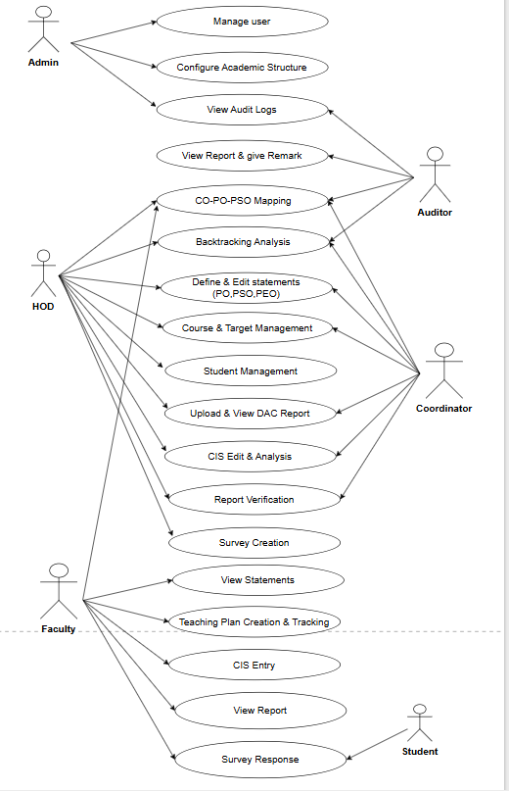
Sandip Foundation’s, Sandip Polytechnic, Nashik
USECASE DIAGRAM:
Actors in Use case
1. Admin
2. HOD
3. Coordinator
4. Faculty
5. Auditor
08

Slide 9
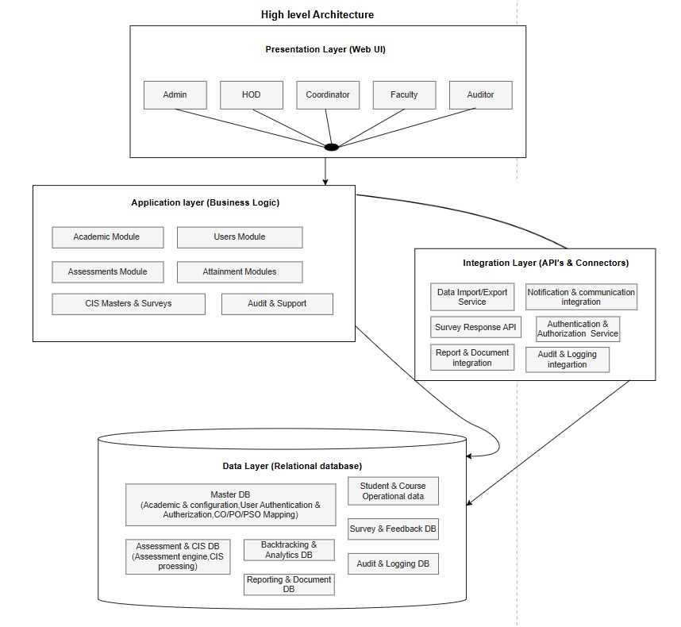
Sandip Foundation’s, Sandip Polytechnic, Nashik
SYSTEM ARCHITECTURE:
09

Slide 10
Sandip Foundation’s, Sandip Polytechnic, Nashik
TECHNOLOGY STACK
.
Frontend: React + Bootstrap
Backend: Django Rest Framework
Database:
1. Development: SQLite
2. Deployment: PostgreSQL
Authentication: JWT (JSON Web Token)
Other Integrations:
1. Google’s SMTP API for email notifications
2. Google Charts for dashboards
10

Slide 11
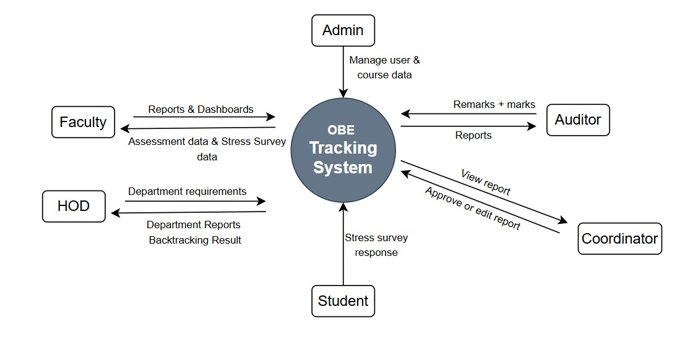
Sandip Foundation’s, Sandip Polytechnic, Nashik
DATA FLOW DIAGRAM:
DFD Level 0
11

Slide 12
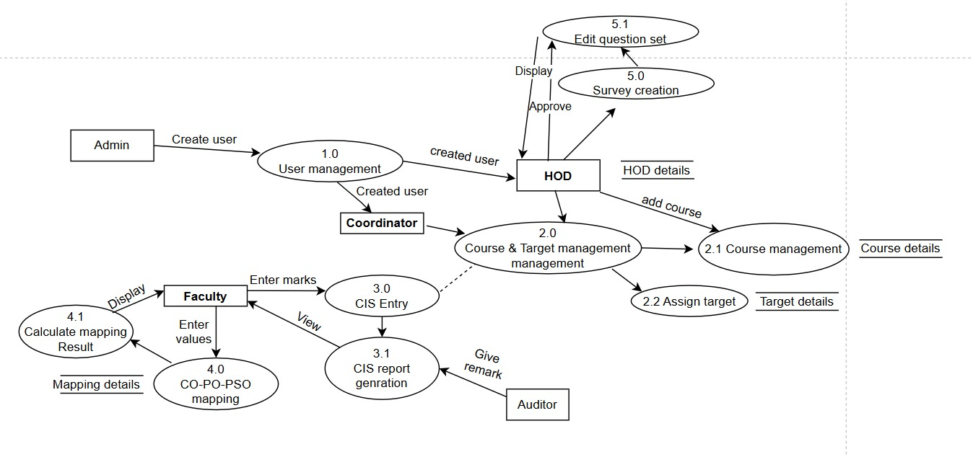
Sandip Foundation’s, Sandip Polytechnic, Nashik
DATA FLOW DIAGRAM:
DFD Level 1
12

Slide 13
Sandip Foundation’s, Sandip Polytechnic, Nashik
ADVANTAGES:
Reduces manual workload through automated CO, PO calculations.
Improves accuracy by minimizing human errors in attainment computation.
Centralized data management enables easy access and organized record keeping.
Role-based access control ensures data security and confidentiality.
Helps monitor student performance and identify students needing support.
Generates reports quickly, supporting audits and accreditation processes.
Flexible and scalable system suitable for future enhancements.
13

Slide 14
Sandip Foundation’s, Sandip Polytechnic, Nashik
APPLICATIONS :
Student Performance Monitoring : Tracks achievement of Course Outcomes (COs) and Program Outcomes (POs).
Accreditation Support: Facilitates NBA accreditation by providing structured, verifiable outcome-based data.
Centralized Academic Data Management: Stores marks, CO–PO mappings, and surveys in a single secure platform.
Student Well-Being Monitoring : Analyzes stress surveys to support counselling and enhance overall student welfare.
Informed Decision Making : Helps faculty and administration improve curriculum and teaching strategies.
14

Slide 15
Sandip Foundation’s, Sandip Polytechnic, Nashik
FUTURE SCOPE:
Integration AI-based analytics for enhanced CO–PO prediction
Implement real-time dashboards for students and faculty
Expand stress monitoring with personalized intervention strategies
Incorporate mobile application support for easy access
Utilize data to improve curriculum and support academic research
15

Slide 16
Sandip Foundation’s, Sandip Polytechnic, Nashik
CONCLUSION:
The Outcome Tracking System automates the Outcome Based Education process by simplifying CO–PO attainment calculation and CIS assessment management. It reduces manual effort, improves accuracy, and provides centralized academic data and automated reports. Overall, the system enables efficient and reliable outcome-based evaluation within educational institutions.

Slide 17
THANK YOU
Sandip Foundation’s, Sandip Polytechnic, Nashik

