Slide 1
Team Name: Android FLAShians
Team members:
1. 22BCE9119 - Pushadapu Lalitha Sahithi
2. 22BCE9732 - Gosula Sruthi
3. 22BCE9783 - Mohammad Farheen Naz
4. 22BCE9993 - Shaik Apsar Safiya

Slide 2
Problem Statement
In today’s fast-paced world, managing personal finances effectively has become increasingly challenging.
Most people rely on manual tracking methods like notes, spreadsheets, or memory, which are prone to errors, forgetfulness, and lack of real-time insights.
Without a streamlined and visual tool to monitor income, expenses, and savings, individuals often lose control over their financial habits and struggle to make informed spending decisions.

Slide 3
Solution: Xpensor
An easy-to-use Android app that helps users track daily expenses and incomes, view real-time balances, and manage their finances effortlessly through a clean, intuitive dashboard.
Features:
• Add transactions (expense/income) with optional description
• Update or delete any transaction
• Search transactions by name or description
• Sort transactions from newest to oldest and vice versa
• Real-time dashboard showing total balance, income, and expenses
• Floating Add Transaction button
• Toast messages for transaction actions
• Clean, user-friendly UI with splash screen and custom icon

Slide 4

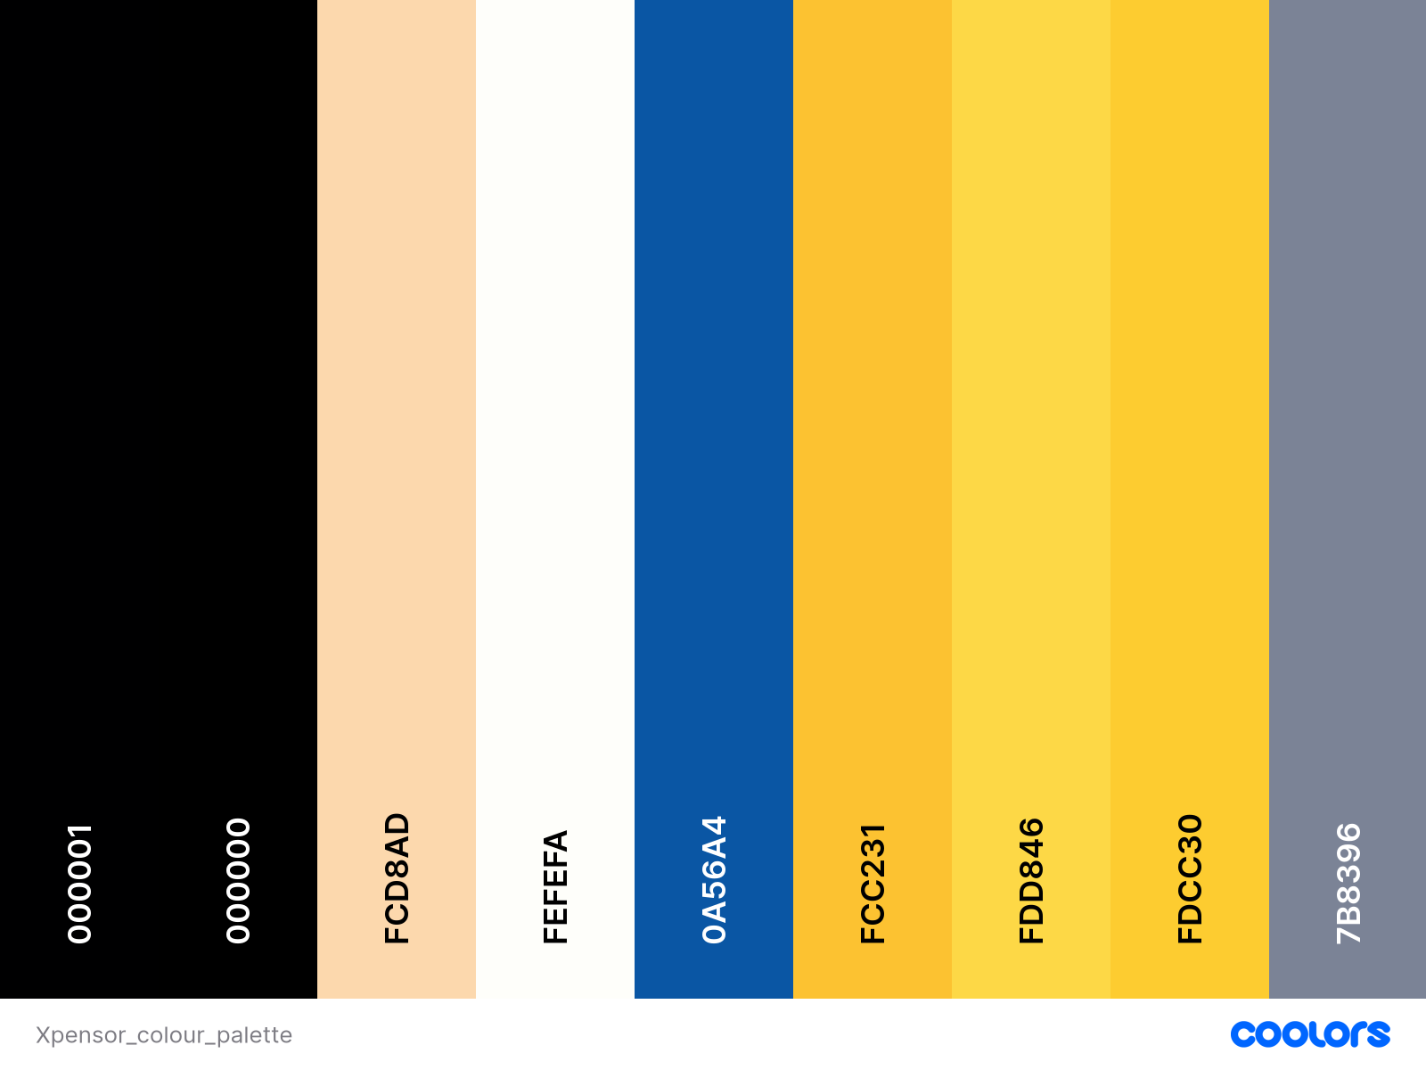
App Icon & Colour Palette
App Icon: Colour Palette:
Resource: Figma Resource: Coolors

Slide 5
Concepts Used
XML Layout Concepts:
• ConstraintLayout — Position elements flexibly using constraints
• LinearLayout — Vertical stacking for scrollable content
• ScrollView — Enables vertical scrolling for long forms
• CoordinatorLayout — For Material FAB & Snackbars
• Material Components
• MaterialCardView — Transaction & dashboard cards
• MaterialButton — Add, Update, Delete transaction buttons
• FloatingActionButton — Add new transaction
• TextInputLayout + TextInputEditText — Form fields with validation
• AutoCompleteTextView — Label dropdown
• RadioGroup & RadioButton — Expense/Income selection
• RecyclerView — Display transaction list
• Toolbar — Custom title bar
• ImageButton — Close and sort actions
• TextView — Labels, amounts, dates
• Drawable Icons — EditText icons
• app:cardCornerRadius, app:cardElevation — Card styling
• app:layout_constraintXXX — Constraints
• android:inputType — Keyboard types

Slide 6
Kotlin Code Concepts:
• View Binding — Access views easily
• Room Database — Entities, DAO, Database
• ViewModel + LiveData — Observe data changes
• ListAdapter + DiffUtil — RecyclerView updates
• RecyclerView Adapter — Custom adapter
• Intent Passing — Data between activities
• MaterialDatePicker — Date selection
• AutoCompleteTextView — Labels dropdown
• Snackbar — Quick messages
• Companion Objects — Constants
• SafeArgs / putExtra — Data passing
• String & Number Formatting — Currency format

Slide 7
Future Scope
• Add monthly and yearly expense reports with graphical charts.
• Integrate cloud sync using Firebase Firestore for multi-device access.
• Include voice-based transaction entry and real-time notification reminders.

Slide 8
Team Member Contributions
Pushadapu Lalitha Sahithi
Designed app screens using XML layouts
Implemented Room Database setup and entity classes
Created ViewModel and LiveData integration
Shaik Apsar Safiya
Developed Add Transaction and Update Transaction features
Handled form validations and MaterialDatePicker integration
Worked on dashboard balance calculations

Slide 9
Gosula Sruthi
Created RecyclerView and custom TransactionAdapter
Integrated ListAdapter with DiffUtil for efficient updates
Designed splash screen and custom app icon using Figma
Mohammad Farheen Naz
Implemented sorting of transactions by date (newest to oldest & vice versa)
Developed search functionality for transactions
Integrated Snackbar and Toast feedback messages
Prepared the presentation slides

