Slide 1


Analysis of COVID-19 Measures Effectiveness
Final Presentation
Visualizations, Leadership
Guided By: Prof. Sergey Rodin
Presenting By: Farhin Ashikali Saiyed(100845602)

Slide 2
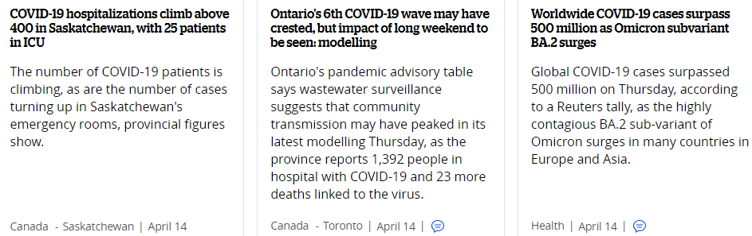
Introduction
Due to COVID-19 people lives and economy affected drastically in previous years. However, after vaccines and mandatory precautions comes in place to reduce COVID-19 effects, existing Measures are proven to be effective and should not be reduced due to the threat from emerging variants.
Source: CBCNEWS

Slide 3
Data Analysis approach
Analyse current situation in the major areas and on-going trend:
Total number of cases
Affected provinces of CANADA
Death rate
Daily Deaths
Vaccination ratio
New Variants Breakdown
Data source taken from Government of Canada COVID-19

Slide 4

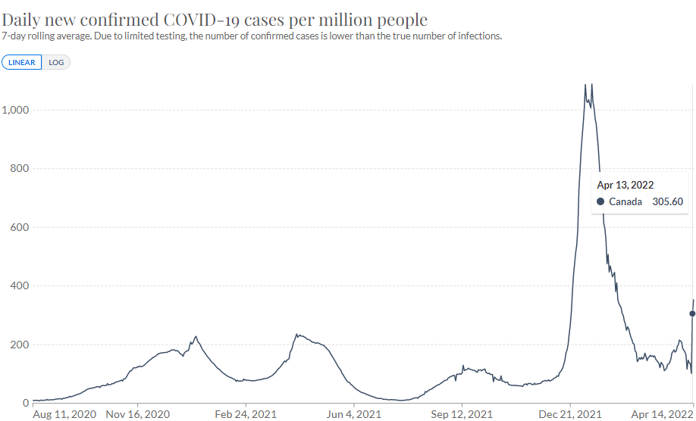
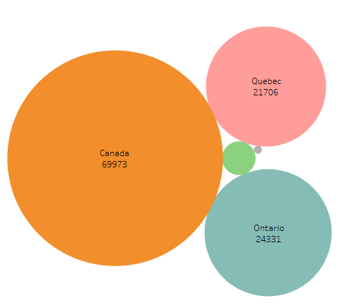


Current Situation

Slide 5
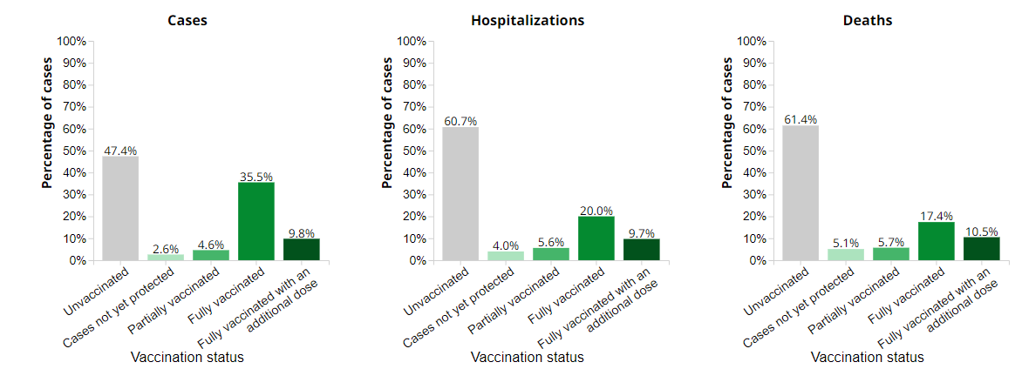
Vaccination status

Slide 6
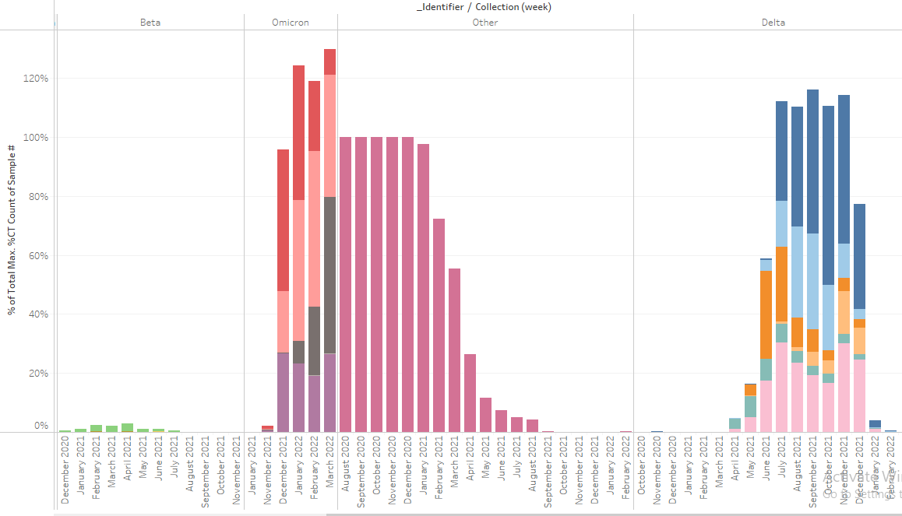
COVID-19 Variants of Concern

Slide 7
Recommendations
Advice to wear mask at public places.
Release restrictions to fully open public places will help to rebuild economy.
Booster doses should be in consideration to avoid death rates in upcoming variants of COVID-19.
Be prepared for upcoming subvariants and continue to take precautions.

Slide 8
Thank You
Public Health Agency of CANADA
Special Advisory Committee for COVID-19
OTTAWA, CANADA

