Slide 1

Influenza: Understanding the Seasonal Flu and Vaccine Trends
Influenza, commonly known as the flu, is a highly contagious respiratory illness caused by the influenza virus. It can lead to severe complications, hospitalizations, and even fatalities, especially among vulnerable populations like the elderly, young children, and those with underlying health conditions. To protect public health, annual seasonal flu vaccines are recommended by health authorities worldwide. However, understanding the complex factors that shape people's vaccination patterns is crucial for improving vaccination rates and saving lives.

Slide 2
The H1N1 Pandemic Outbreak
In 2009, the world faced a significant public health challenge with the emergence of the H1N1 influenza virus, also known as "swine flu." This strain of the influenza A virus sparked a global pandemic that spread rapidly across borders. The H1N1 pandemic highlighted the critical importance of preparedness, scientific research, and global coordination in addressing novel infectious disease threats. Understanding the impact of this pandemic event can provide valuable insights into how people's perceptions and behaviors towards vaccination may have been influenced.

Slide 3
Factors Influencing Seasonal Flu Vaccine Uptake
Education Level
Age and Employment
Concern and Knowledge about H1N1
Studies have shown that higher levels of education can positively correlate with the likelihood of receiving the seasonal flu vaccine. Individuals with advanced degrees or higher levels of formal education may have a greater understanding of the importance of vaccination and the risks associated with influenza.
Age and employment status can also play a significant role in seasonal flu vaccine uptake. Older adults, particularly those over 65 years of age, are at higher risk of severe influenza-related complications and are often prioritized for vaccination. Similarly, employed individuals may have easier access to workplace vaccination programs, which can increase their vaccination rates.
The level of concern and knowledge about the H1N1 influenza pandemic can also influence a person's willingness to receive the seasonal flu vaccine. Individuals who were more aware of the risks and impacts of the H1N1 outbreak may be more inclined to take preventive measures, such as getting the seasonal flu shot, to protect themselves and their communities.

Slide 4
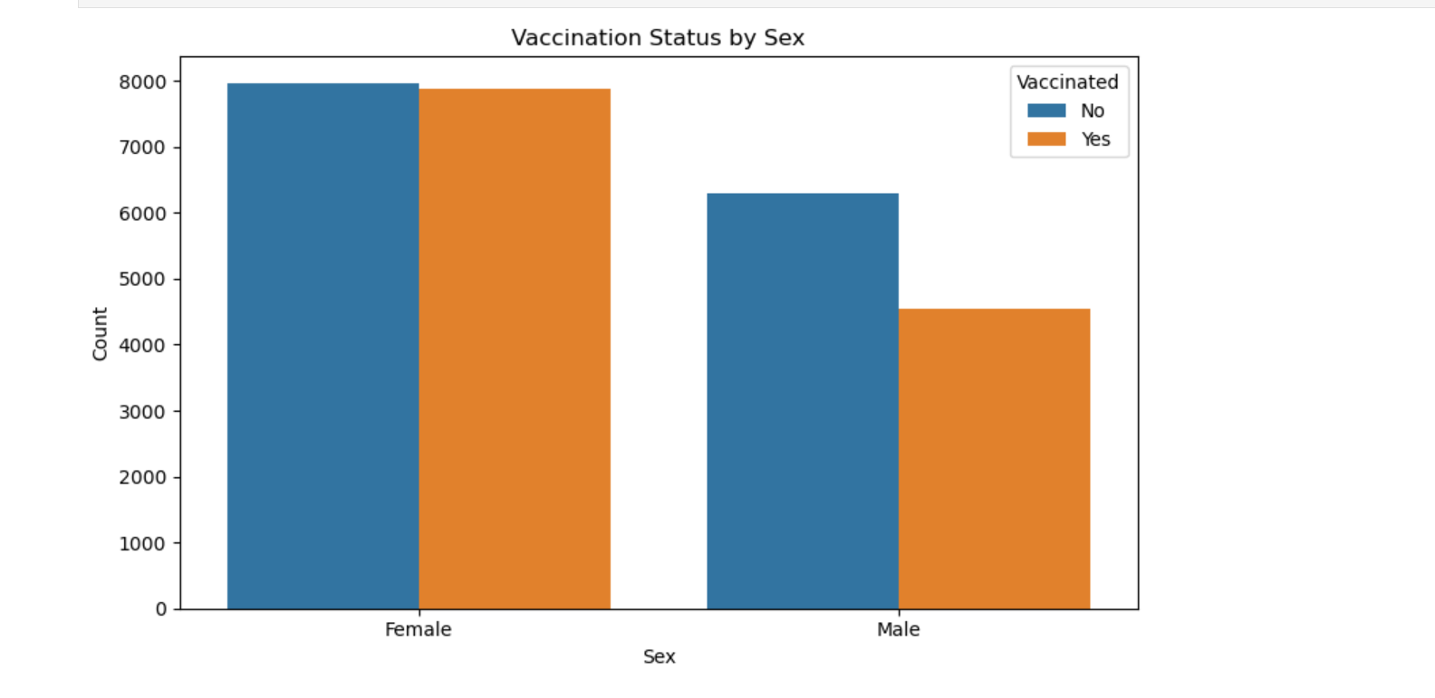
Among females, the difference between vaccinated and unvaccinated individuals is minimal. The proportion of vaccinated individuals is higher in females compared to males. Overall, the males show a lower overall vaccination rate compared to females.
The proportion of vaccinated individuals is higher in employed compared to unemployed

Slide 5
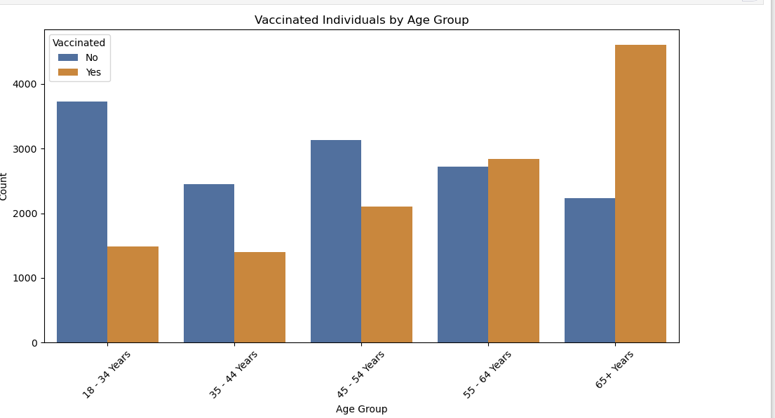
The 65+ age group has the highest proportion of vaccinated individuals, while the 18-34 age group has the highest proportion of unvaccinated individuals.

Slide 6
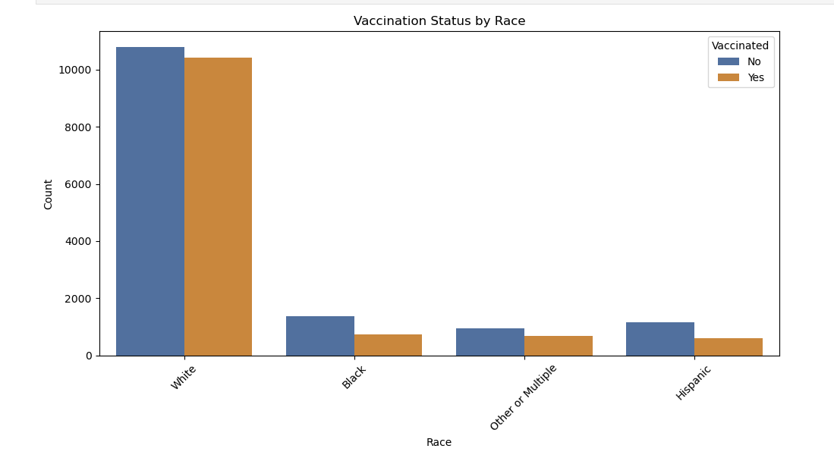
There are disparities in vaccination rates among different racial groups, with the White racial group having higher vaccination rates compared to other groups. The lower vaccination rates in the Black, Other or Multiple, and Hispanic groups indicate potential areas for targeted public health interventions to increase vaccination coverage.

Slide 7
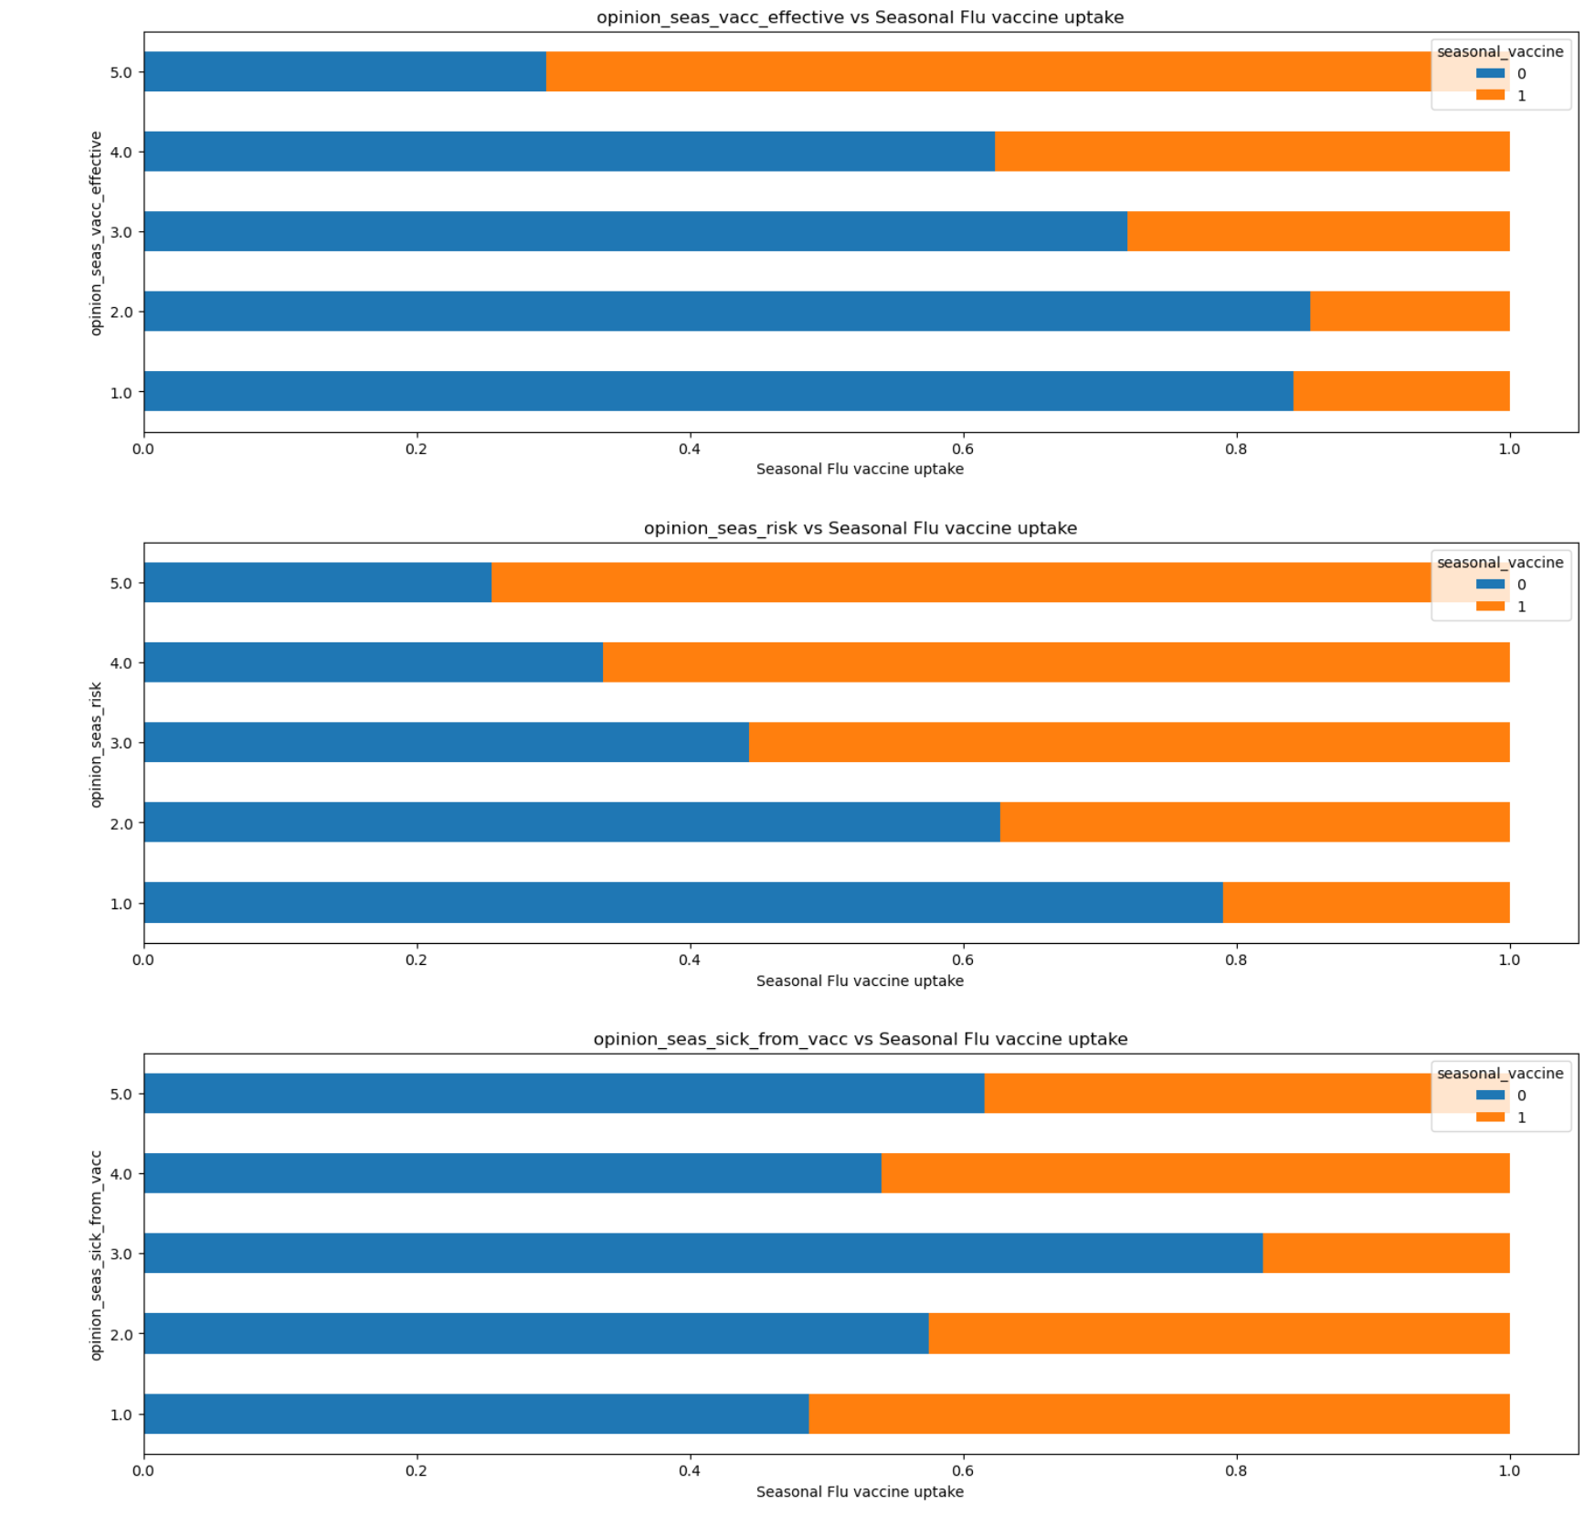
Does people’s opinion influence covid intake?

Slide 8
Addressing Disparities in Vaccination Rates
Educational Attainment
Income and Poverty
Racial Disparities
The data indicates significant differences in vaccination rates among racial groups. Developing culturally-relevant and linguistically-appropriate interventions, in collaboration with community leaders, is essential to address the specific concerns and barriers faced by underrepresented populations.
The data reveals that individuals with higher levels of education are more likely to receive both the H1N1 and seasonal flu vaccines. Targeted outreach and education efforts should be implemented to ensure that those with lower educational attainment have access to accurate information and resources about vaccination
The disparity in vaccination rates between individuals in higher and lower income brackets underscores the need for initiatives that address socioeconomic barriers to access. Providing free or subsidized vaccination programs in areas with higher poverty rates could help to mitigate this disparity

Slide 9

Vaccine Hesitancy: A Growing Concern
1
Mistrust in Vaccines
2
Influence of Personal and Social Factors
Vaccine hesitancy, the unwillingness or refusal to receive vaccines, is a complex and growing public health challenge. Some individuals may express concerns about the safety, efficacy, or side effects of vaccines, leading to hesitancy or resistance to vaccination.
People's views on vaccination can be shaped by a variety of personal and social factors, including their cultural beliefs, personal experiences, access to accurate information, and the influence of their social networks and communities.
3
Evolving Attitudes over Time
Attitudes towards vaccination can also change over time, as new information, public health events, and social trends impact people's perceptions and decision-making processes related to vaccine acceptance.

Slide 10

The Importance of Seasonal Flu Vaccination
Reduced Illness and Complications
Community Protection
Reduced Societal Burden
Getting the seasonal flu vaccine can significantly reduce the risk of contracting the flu and experiencing severe illness, hospitalization, or even death. Vaccination is particularly important for high-risk individuals, such as the elderly and those with underlying health conditions.
When a large proportion of the population is vaccinated, it can create a "herd immunity" effect, which helps protect even those who are unable to receive the vaccine, such as infants or immunocompromised individuals.
Widespread seasonal flu vaccination can alleviate the substantial social and economic burden associated with influenza outbreaks, including missed work, healthcare costs, and disruptions to daily life.

Slide 11



Overcoming Vaccination Barriers
Improve Health Literacy
Strengthen Community Engagement
Enhance Vaccine Accessibility
Provide accessible and accurate information about the importance of vaccination, addressing common misconceptions and vaccine safety concerns.
Collaborate with community leaders, trusted healthcare providers, and local organizations to build trust and encourage vaccination among diverse populations.
Ensure that seasonal flu vaccines are widely available and conveniently accessible, especially for vulnerable and underserved communities.

Slide 12




Conclusion: Towards a Healthier Future
Understand Vaccination Patterns
Develop a comprehensive understanding of the factors that influence seasonal flu vaccine uptake, using data-driven insights to guide public health strategies.
Address Vaccine Hesitancy
Implement multi-faceted approaches to address vaccine hesitancy, including improving health literacy, strengthening community engagement, and enhancing vaccine accessibility.
Improve Vaccination Rates
By addressing the barriers to vaccination and empowering individuals to make informed decisions, we can work towards increasing seasonal flu vaccine uptake and protecting public health.

