Slide 1

Unity Mobile Game
Advisor:
Pedro Fazenda
Students:
André Faria 47455
Sara Nobre 47504

Slide 2
Game overview
01
Gameplay
02
Table of contents
Development tools
03
Inspiration
04
Concept and target audience
Objectives and core gameplay
Tools and platforms used
What inspired us to create it
Project management
05
Gantt chart
2/8

Slide 3

Game overview
A strategy turn-based rogue-like mobile game where the player progresses through the world utilizing cards and receiving rewards.
Genres:
Action
Turn based
Card battle
Rouge-like deck builder
Fantasy
Target audience:
Age around 15-30 years old.
3/8

Slide 4
Objectives
Core gameplay
Progress through rooms and acquire upgrades
Use those upgrades to reach the final room and beat the stage
Proceed to the next stage and repeat…
Choose a path
Turn-based with a set energy limit
Use cards to attack and defeat enemies
Acquire upgrades that help in the next fights
4/8

Slide 5





Development tools
Unity
Aseprite
Firebase
Figma
Google play
Engine used to develop the game
Software used to draw all the art
Editor used to create diagrams
Service used to store the data
Platform used to release the game
5/8

Slide 6
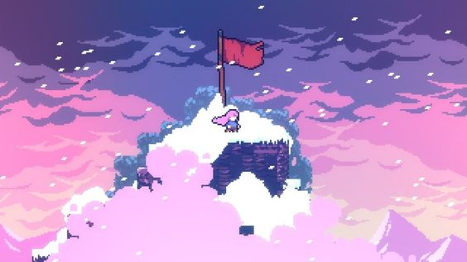
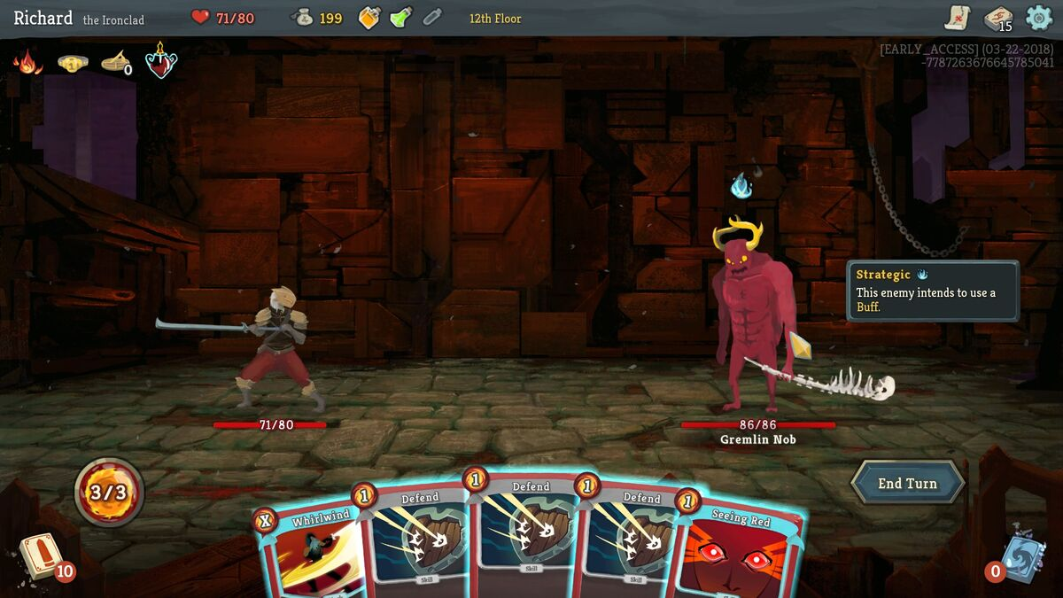
Inspiration
Celeste
Slay the Spire
Simple yet appealing pixel art
Turn-based deckbuilding gameplay
6/8

Slide 7
Gantt chart
7/8

Slide 8

Thanks
Do you have any questions?
André Faria A47455@alunos.isel.pt
Sara Nobre
A47504@alunos.isel.pt

