Slide 1

Simplifications of
Context-Free Grammars
Costas Buch - RPI

Slide 2
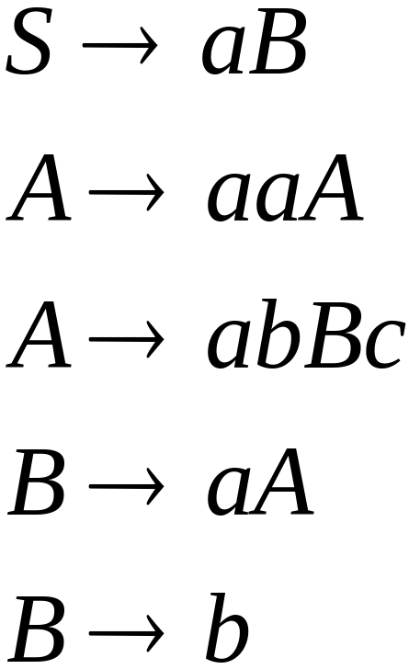
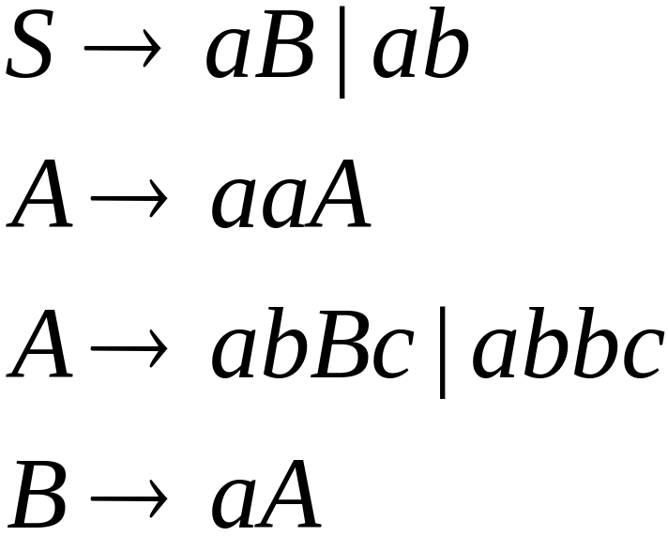

A Substitution Rule
Equivalent
grammar
Substitute
Costas Buch - RPI

Slide 3


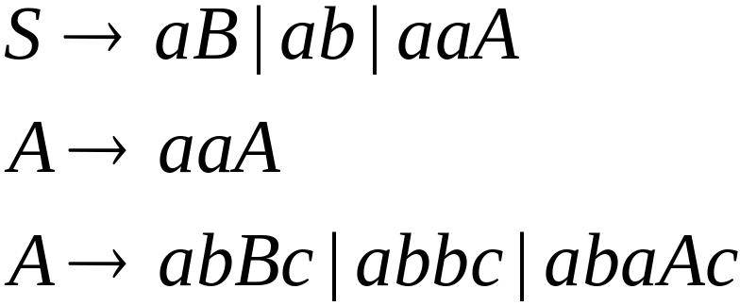
A Substitution Rule
Substitute
Equivalent
grammar
Costas Buch - RPI

Slide 4
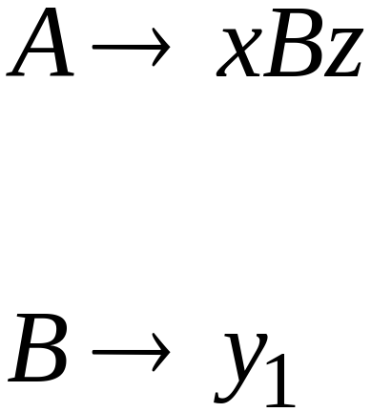
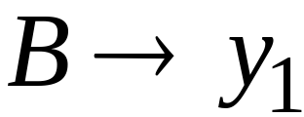
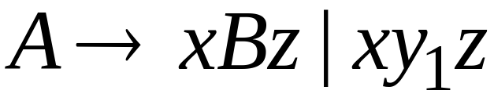
In general:
Substitute
equivalent
grammar
Costas Buch - RPI

Slide 5
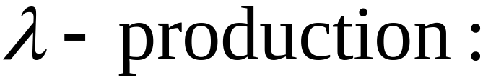


Nullable Variables
Nullable Variable:
Costas Buch - RPI

Slide 6
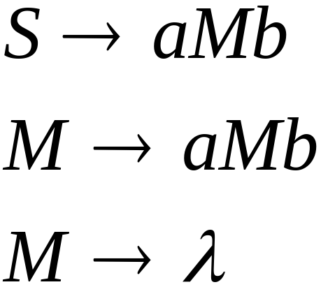
Removing Nullable Variables
Example Grammar:
Nullable variable
Costas Buch - RPI

Slide 7
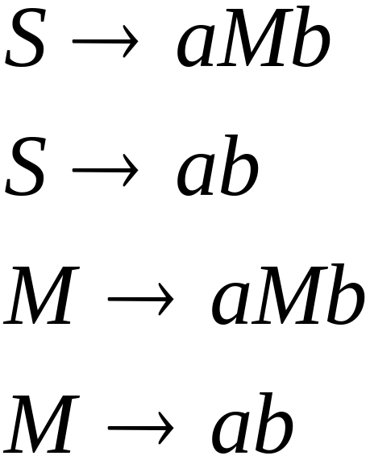

Final Grammar
Substitute
Costas Buch - RPI

Slide 8

Unit-Productions
Unit Production:
(a single variable in both sides)
Costas Buch - RPI

Slide 9

Removing Unit Productions
Observation:
Is removed immediately
Costas Buch - RPI

Slide 10
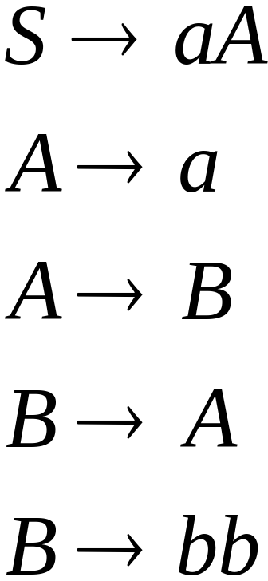
Example Grammar:
Costas Buch - RPI

Slide 11
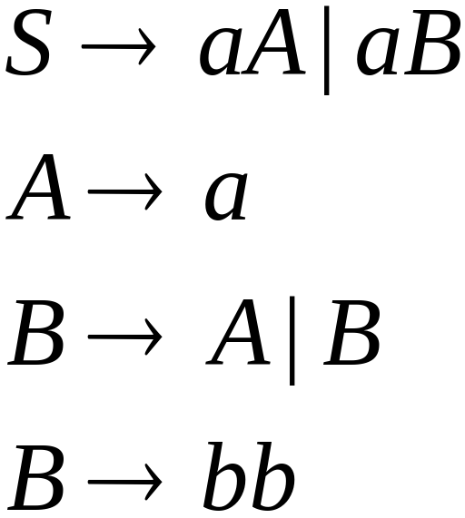

Substitute
Costas Buch - RPI

Slide 12
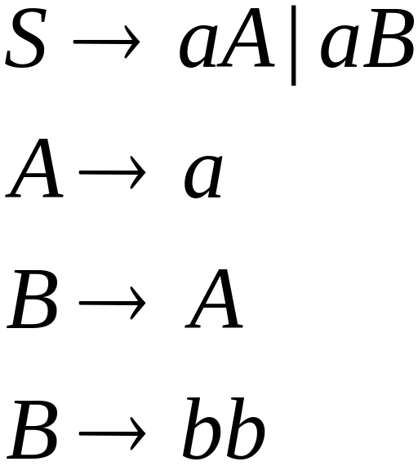

Remove
Costas Buch - RPI

Slide 13
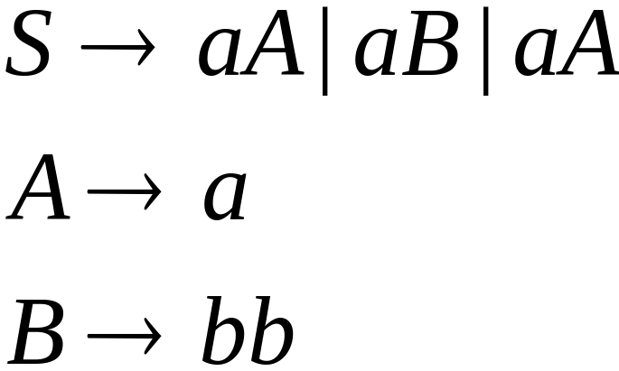

Substitute
Costas Buch - RPI

Slide 14
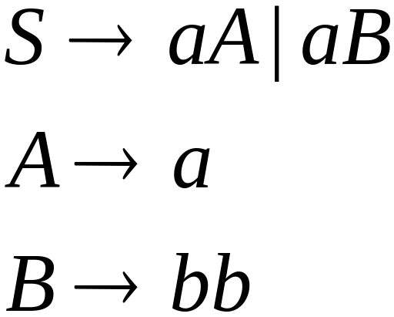
Remove repeated productions
Final grammar
Costas Buch - RPI

Slide 15
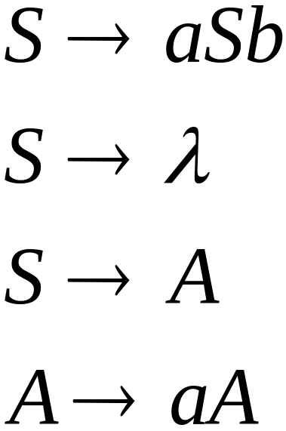
Useless Productions
Useless Production
Some derivations never terminate...
Costas Buch - RPI

Slide 16
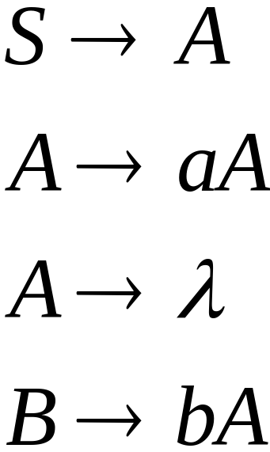
Another grammar:
Useless Production
Not reachable from S
Costas Buch - RPI

Slide 17



In general:
contains only
terminals
if
then variable is useful
otherwise, variable is useless
Costas Buch - RPI

Slide 18

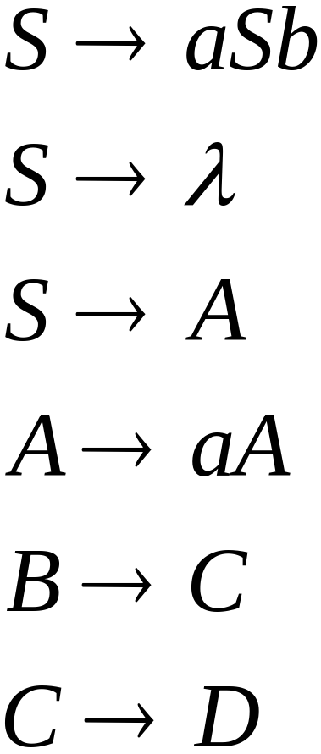
A production is useless
if any of its variables is useless
Productions
Variables
useless
useless
useless
useless
useless
useless
useless
Costas Buch - RPI

Slide 19
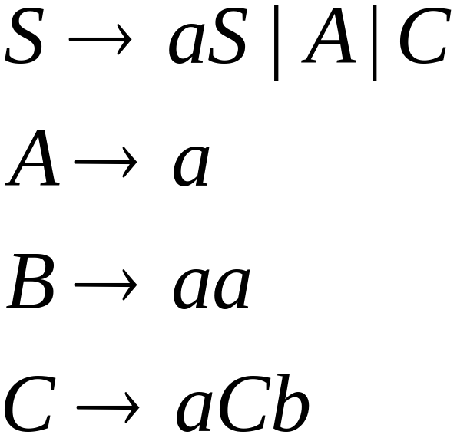
Removing Useless Productions
Example Grammar:
Costas Buch - RPI

Slide 20
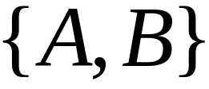

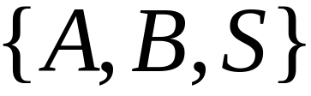
First:
find all variables that can produce
strings with only terminals
Round 1:
Round 2:
Costas Buch - RPI

Slide 21
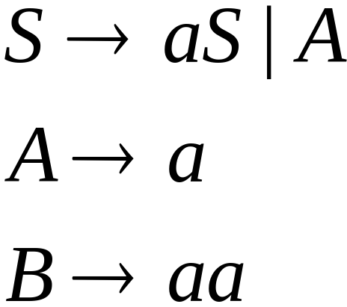
Keep only the variables
that produce terminal symbols:
(the rest variables are useless)
Remove useless productions
Costas Buch - RPI

Slide 22




Second:
Find all variables
reachable from
Use a Dependency Graph
not
reachable
Costas Buch - RPI

Slide 23
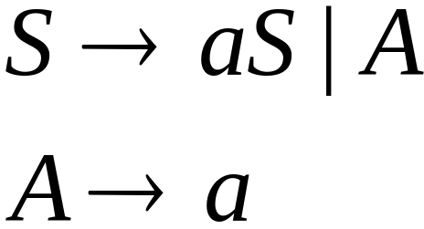
Keep only the variables
reachable from S
(the rest variables are useless)
Final Grammar
Remove useless productions
Costas Buch - RPI

Slide 24
Removing All
Step 1: Remove Nullable Variables
Step 2: Remove Unit-Productions
Step 3: Remove Useless Variables
Costas Buch - RPI

Slide 25
Normal Forms for
Context-free Grammars
Costas Buch - RPI

Slide 26


Chomsky Normal Form
Each productions has form:
or
variable
variable
terminal
Costas Buch - RPI

Slide 27
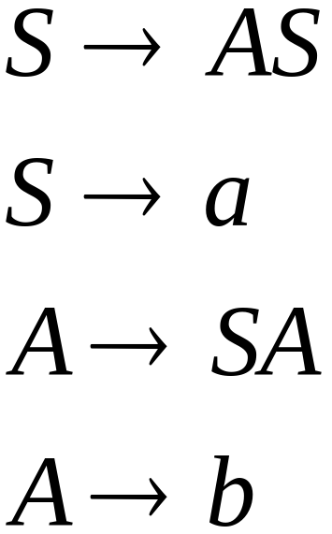
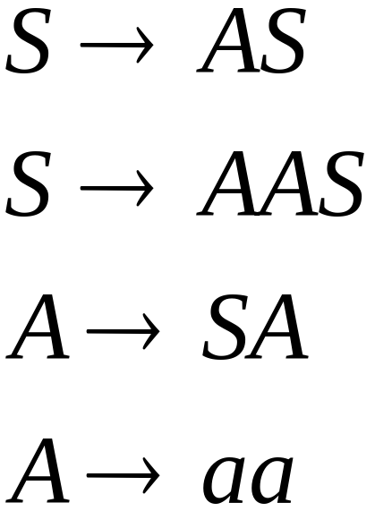
Examples:
Chomsky
Normal Form
Not Chomsky
Normal Form
Costas Buch - RPI

Slide 28
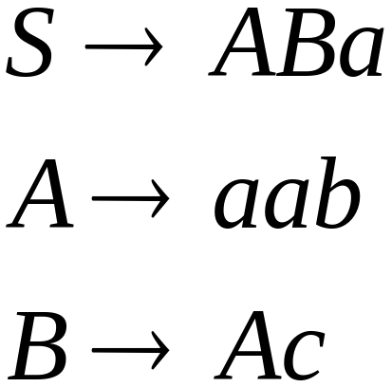
Convertion to Chomsky Normal Form
Example:
Not Chomsky
Normal Form
Costas Buch - RPI

Slide 29
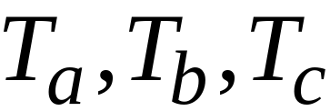
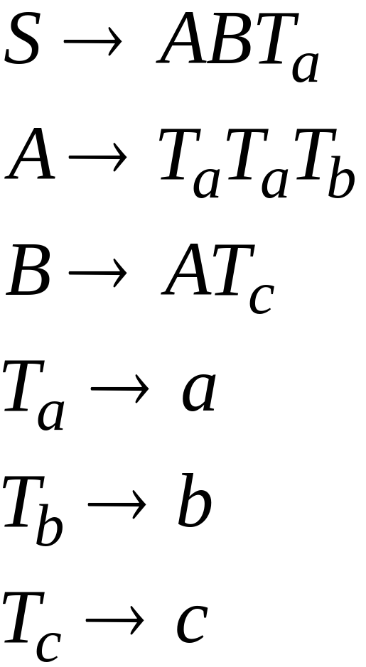
Introduce variables for terminals:
Costas Buch - RPI

Slide 30

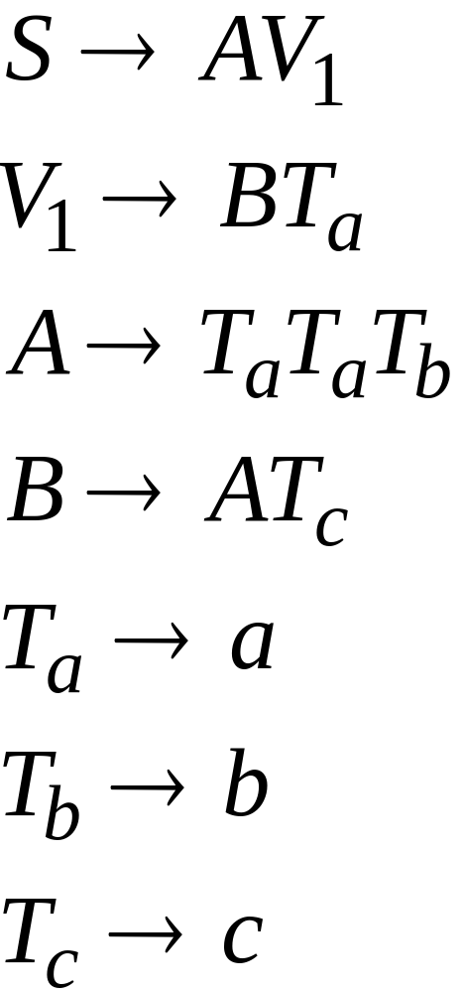
Introduce intermediate variable:
Costas Buch - RPI

Slide 31
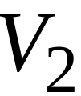
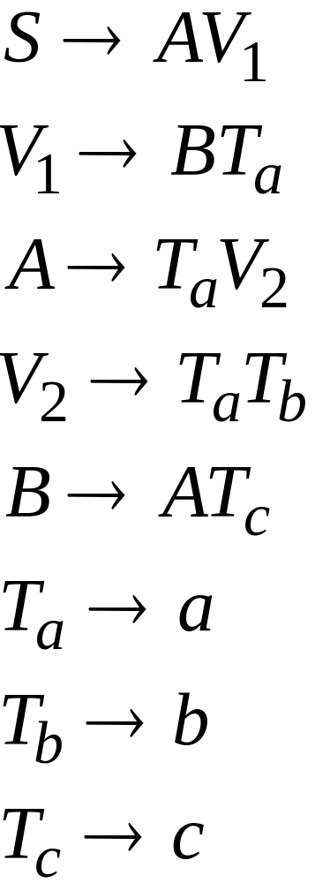
Introduce intermediate variable:
Costas Buch - RPI

Slide 32
Final grammar in Chomsky Normal Form:
Initial grammar
Costas Buch - RPI

Slide 33

In general:
From any context-free grammar
(which doesn’t produce )
not in Chomsky Normal Form
we can obtain:
An equivalent grammar
in Chomsky Normal Form
Costas Buch - RPI

Slide 34
The Procedure
First remove:
    Nullable variables
    Unit productions
Costas Buch - RPI

Slide 35

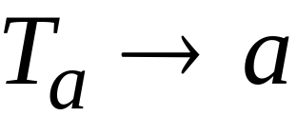

Then, for every symbol :
Add production
In productions: replace with
New variable:
Costas Buch - RPI

Slide 36
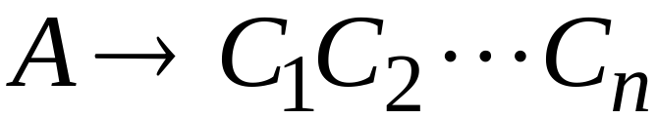
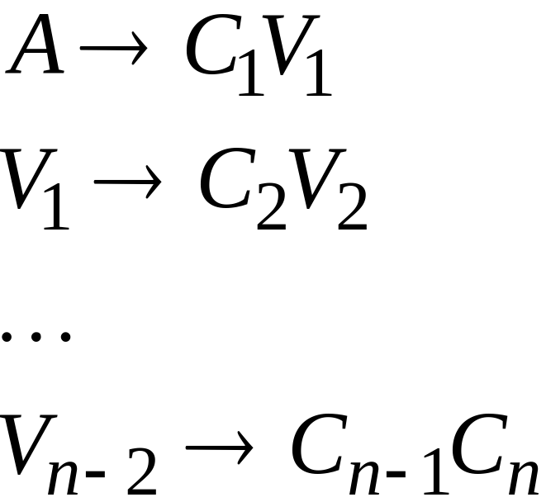
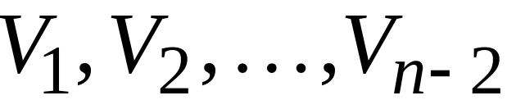
Replace any production
with
New intermediate variables:
Costas Buch - RPI

Slide 37

Theorem:
For any context-free grammar
(which doesn’t produce )
there is an equivalent grammar
in Chomsky Normal Form
Costas Buch - RPI

Slide 38
Observations
Chomsky normal forms are good
for parsing and proving theorems
It is very easy to find the Chomsky normal
form for any context-free grammar
Costas Buch - RPI

Slide 39
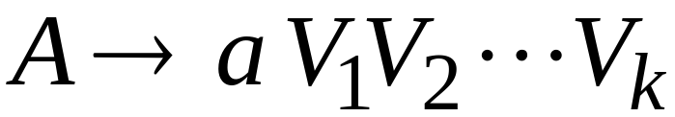

Greinbach Normal Form
All productions have form:
symbol
variables
Costas Buch - RPI

Slide 40
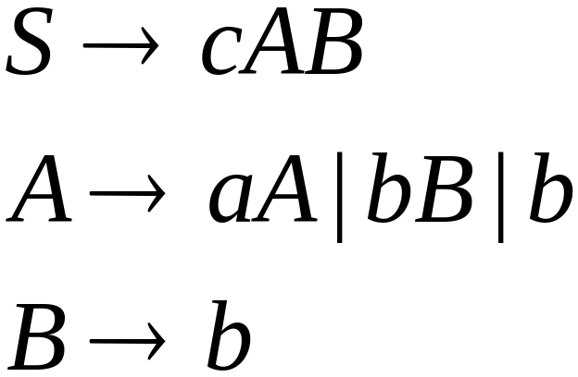
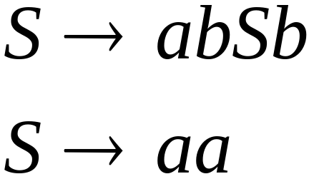
Examples:
Greinbach
Normal Form
Not Greinbach
Normal Form
Costas Buch - RPI

Slide 41
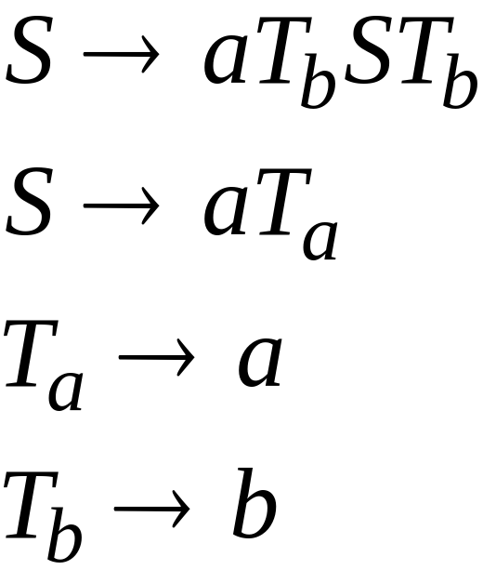
Conversion to Greinbach Normal Form:
Greinbach
Normal Form
Costas Buch - RPI

Slide 42
Theorem:
For any context-free grammar
(which doesn’t produce )
there is an equivalent grammar
in Greinbach Normal Form
Costas Buch - RPI

Slide 43
Observations
Greinbach normal forms are very good
for parsing
It is hard to find the Greinbach normal
form of any context-free grammar
Costas Buch - RPI

Slide 44
The CYK Parser
Costas Buch - RPI

Slide 45


The CYK Membership Algorithm
Input:
Grammar in Chomsky Normal Form
String
Output:
find if
Costas Buch - RPI

Slide 46
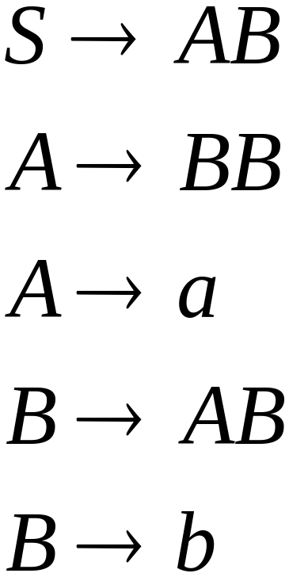

The Algorithm
Input example:
Grammar :
String :
Costas Buch - RPI

Slide 47
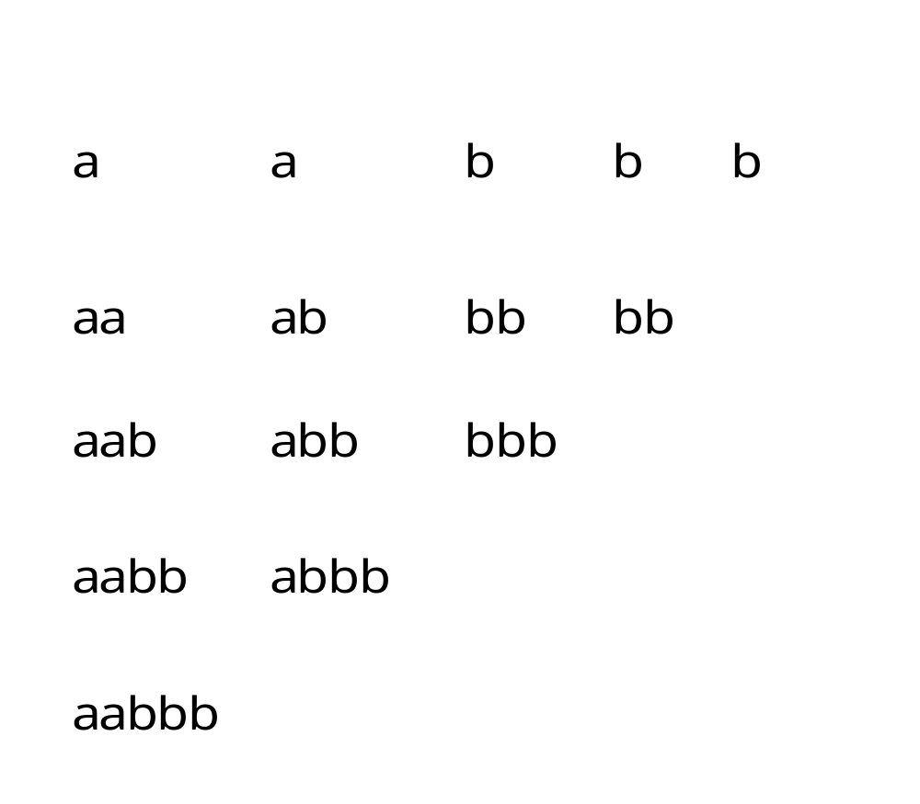
Costas Buch - RPI

Slide 48
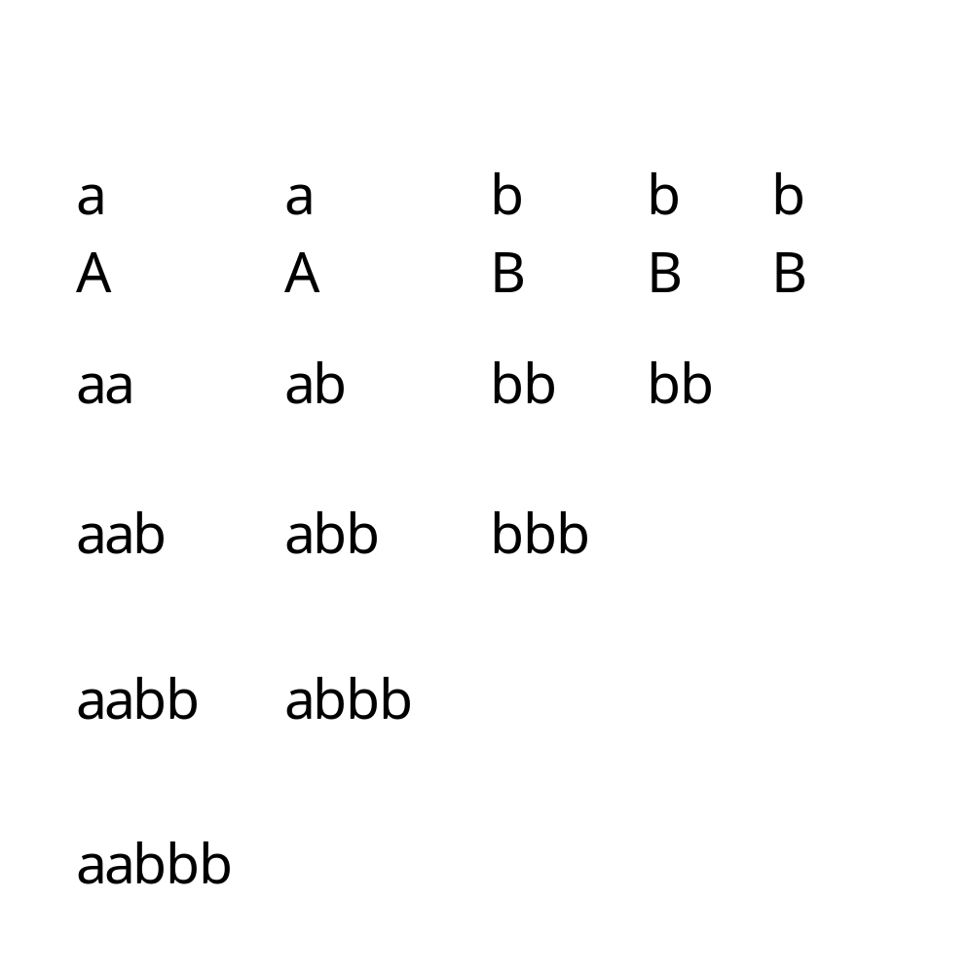
Costas Buch - RPI

Slide 49
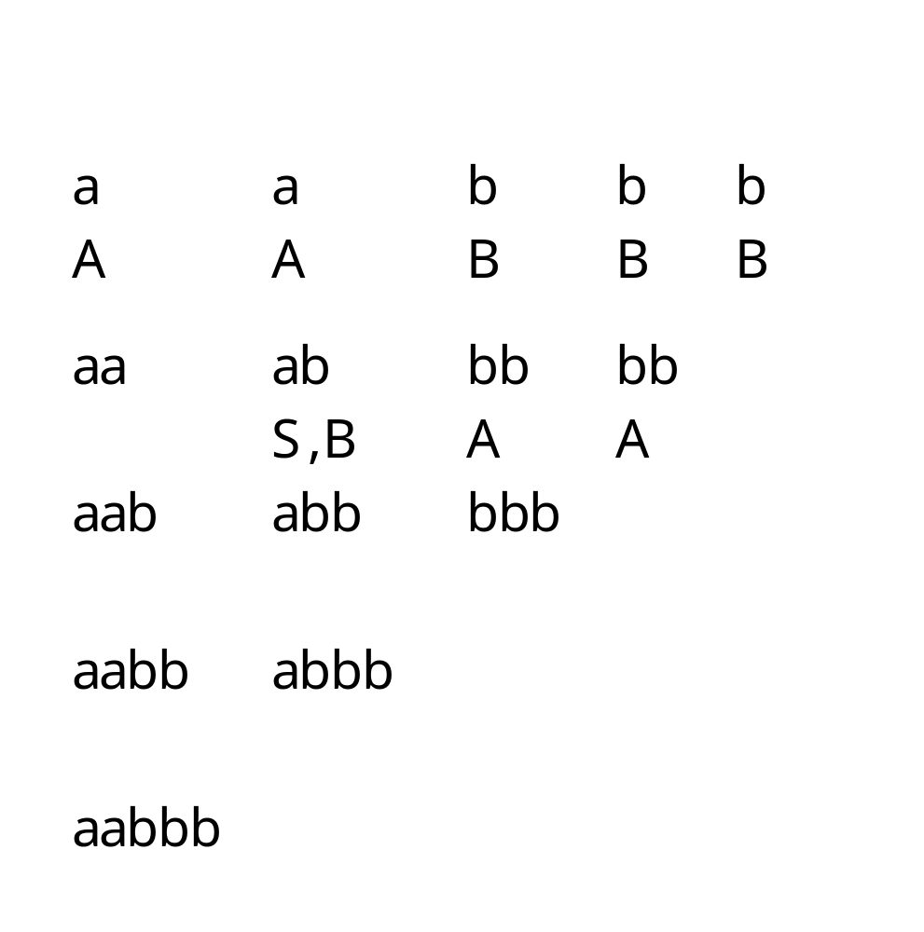
Costas Buch - RPI

Slide 50
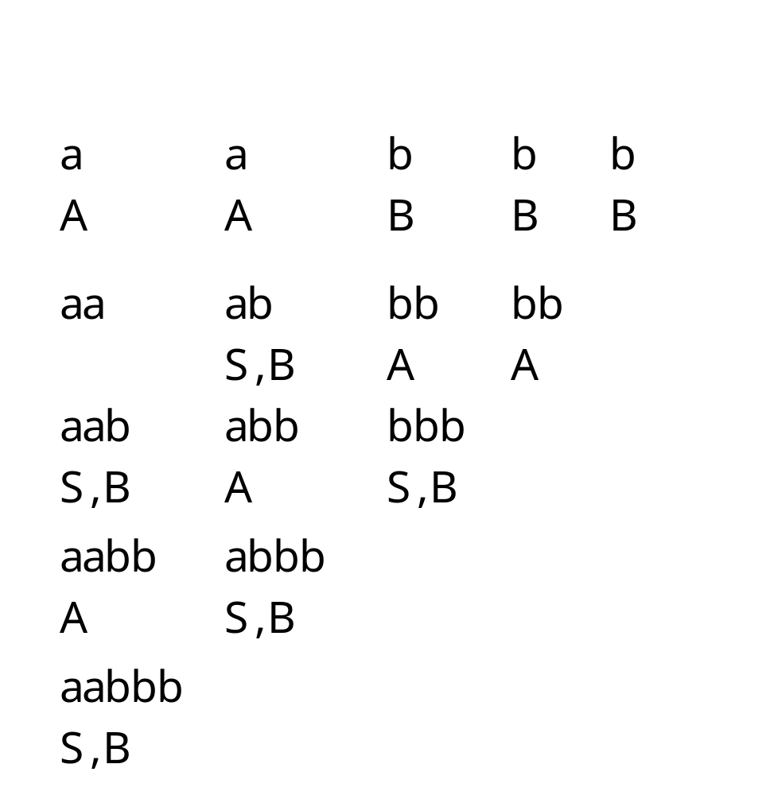
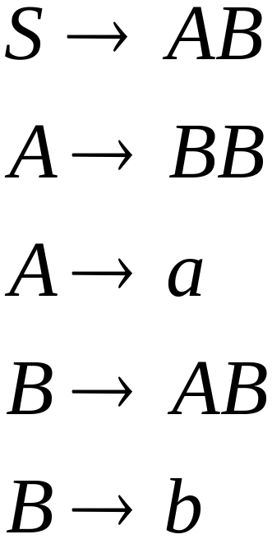
Costas Buch - RPI

Slide 51
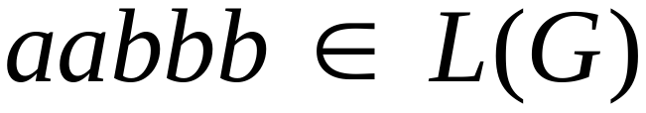
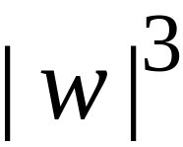
Therefore:
Time Complexity:
Observation:
The CYK algorithm can be
easily converted to a parser
(bottom up parser)
Costas Buch - RPI

