Slide 1
Generating fakes
Farid Karimli, Raul-Fikrat Azizli

Slide 2
Problem Statement
Create, design and train generative adversarial networks to generate images of digits and articles of clothing, to learn more about the mechanics of neural networks, their capabilities and applications.

Slide 3
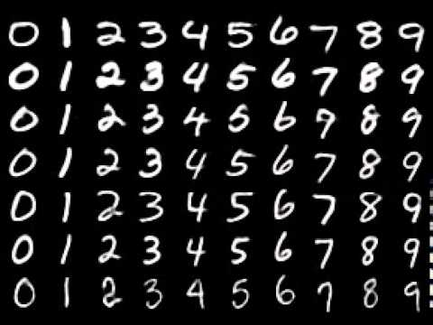
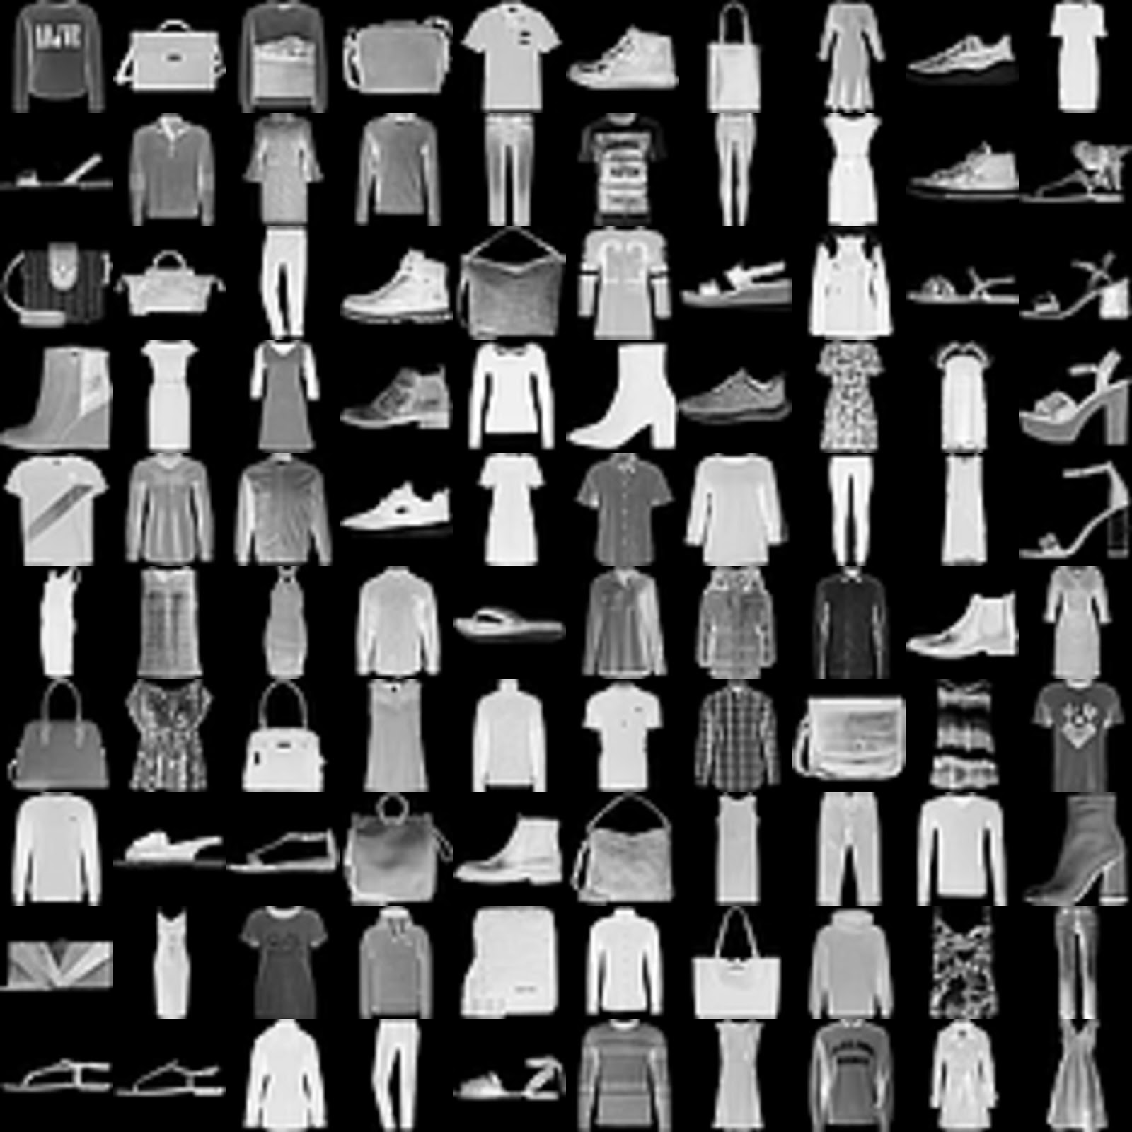
Methods
Developed several GANs , each with unique architectures, to create images that closely resemble real ones
Experimented with different noise dimensions, kernel sizes, amount and types of layers
Also tweaked the discriminator
Data: MNIST and Fashion MNIST

Slide 4


Challenge
Training time
Used multiple Google and Kaggle accounts
Steep learning curve in understanding how GANs work, specifically in code
Relied on online resources and the Tensorflow GAN tutorial

Slide 5
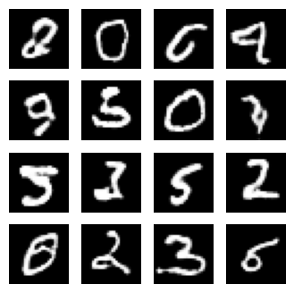
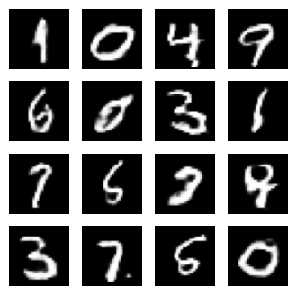
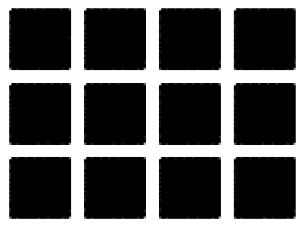
Results - MNIST
Version 1 Version 2 Version 3 (sigmoid)

Slide 6
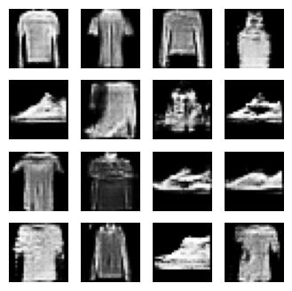
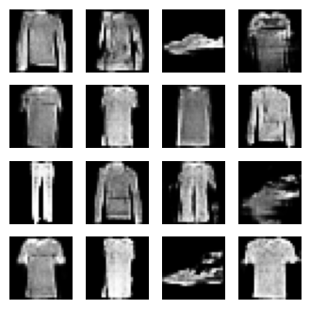
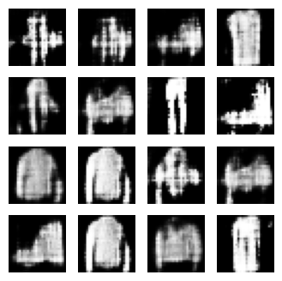
Results - Fashion MNIST (all at 100 epochs)
Version 1 Version 2 Version 3
More layers and different upscaling Not LeakyReLU

Slide 7
Conclusion
What we learned:
Using noise to create images
Learned about upscaling, Leaky ReLU, using your own loss functions and new neural network architectures
Practice using Keras and Tensorflow

Slide 8
Fun fact
Kaggle is much better than Google Colab for training
Colab Pro is not worth it

