Slide 1

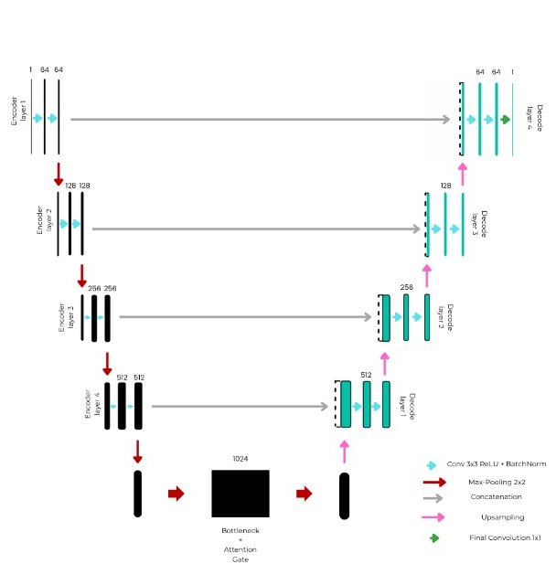
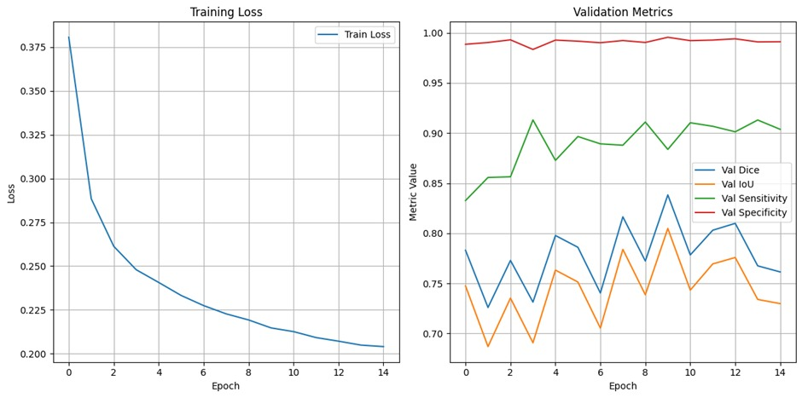
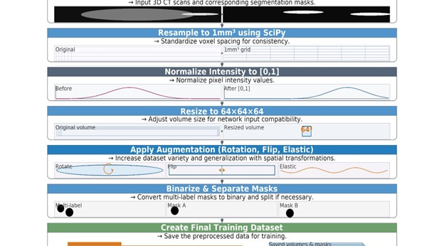
Liver Tumor Segmentation Using Attention U-Net
Hasnatur Rahman Khan (21-45355-2), Pritom Chowhan(21-45356-2), Kazi Al Kabid(21-45365-2), Farid Uz Zaman(21-45361-2)
Introduction
Liver cancer, especially hepatocellular carcinoma, needs accurate CT-based hepatic segmentation and lesion segmentation for real-time tumour monitoring, cancer staging, tumour planning and prognosis evaluation. Manual annotation is time consuming and operator-dependent and suffers from small, low-contrast tumours and image phase heterogeneity. presented here is a fast and reliable deep learning method for clinically consistent liver and lesion delineation
Result
On the validation set, the modified U-Net (Attention U-Net) obtained Dice = 0.84 and IoU = 0.80 for lesion segmentation and sensitivity = 0.88 and specificity = 0.99. Loss reduced monotonically and converged around epoch ~14, showing no overfitting artefacts. Clinically predicted masks are shown to closely follow the tumour surface with high resolution, performing well on moderately to larger sized lesions, whilst very small foci still pose a challenge.
Conclusion
This paper presents a clinical feasible and accurate liver and liver-lesion segmentation pipeline for CT using an Attention U-Net with hybrid loss. Specifically, strong negative predictive (i.e., low false positive) rate paired with good sensitivity to lesion location makes the method promising as part of a computer-aided planning or longitudinal follow up workstation. Upcoming extensions include 3D/2.5D context, domain adaptation between scanners and centres, modelling uncertainty, multi-modal integration.
Methods
We used LiTS17 dataset, and we applied two-stage pipeline: first, segment liver, then segment lesions inside the ROI (liver). Fourth generation arbitrary composite CTs were sampled to 1x1x1 mm, windowed to a liver-appropriate HU, normalised and re-sampled to 64x64x64 before being sliced into 2D axial slices. The baseline model is Attention U-Net trained using ComboLoss (0.7 BCE + 0.3 Dice), Adam (lr = 1e-4), 80/20 (89/22 volumes) train / validation split with early stopping and ReduceLROnPlateau schedule. Typical augmentations (flips and rotations) as well as elastic (grid) distortion were used for robustness.
References
[1] P. Bilic et al., “The Liver Tumor Segmentation Benchmark (LiTS),” Jan. 2019, doi: 10.1016/j.media.2022.102680.
[2] J. Jenisha and A. J. Dickson, “AUTOMATED LIVER TUMOR SEGMENTATION USING DEEP TRANSFER LEARNING AND ATTENTION MECHANISMS,” Journal International Journal of Research and Development (IJRD, no. 7, 2023, doi: 10.36713/epra2016.
[3] P. Bhandary, V. More, and R. Nagpure, “Liver Tumor Segmentation using Deep Learning Approach,” International Research Journal of Engineering and Technology, 2021, [Online]. Available: www.irjet.net
[4] H. Rahman, T. F. N. Bukht, A. Imran, J. Tariq, S. Tu, and A. Alzahrani, “A Deep Learning Approach for Liver and Tumor Segmentation in CT Images Using ResUNet,” Bioengineering, vol. 9, no. 8, Aug. 2022, doi: 10.3390/bioengineering9080368.
[5] N. Gruber, S. Antholzer, W. Jaschke, C. Kremser, and M. Haltmeier, “A Joint Deep Learning Approach for Automated Liver and Tumor Segmentation,” Feb. 2019, [Online]. Available: http://arxiv.org/abs/1902.07971
[6] S. Allgöwer and S. Ljungdahl, “Liver Tumor Segmentation Using Classical Algorithms & Deep Learning.” [Online]. Available: www.chalmers.se
[7] P. Bilic et al., “The Liver Tumor Segmentation Benchmark (LiTS),” Med Image Anal, vol. 84, Feb. 2023, doi: 10.1016/j.media.2022.102680.
[8] Y. A. Ayalew, K. A. Fante, and M. A. Mohammed, “Modified U-Net for liver cancer segmentation from computed tomography images with a new class balancing method,” BMC Biomed Eng, vol. 3, no. 1, Dec. 2021, doi: 10.1186/s42490-021-00050-y.
[9] H. Rahman, T. F. N. Bukht, A. Imran, J. Tariq, S. Tu, and A. Alzahrani, “A Deep Learning Approach for Liver and Tumor Segmentation in CT Images Using ResUNet,” Bioengineering, vol. 9, no. 8, Aug. 2022, doi: 10.3390/bioengineering9080368.
[10] P. Bhandary, V. More, and R. Nagpure, “Liver Tumor Segmentation using Deep Learning Approach,” International Research Journal of Engineering and Technology, 2021, [Online]. Available: www.irjet.net
Validation Metrics
Overlap and detection measures well accepted in medical image segmentation were used to evaluate the performance. We report the Dice coefficient of similarity and Intersection-over-Union (IoU) coefficient as quantitative mask agreement differences and the sensitivity (recall) of tumour detection and specificity to penalise false positives. To prevent overfitting, we use early stopping in the loss curves of these incremental reviewers.
Data Analysis
Masks: The collection of images consists of 111 annotated training CT volumes (and 20 performance test volumes) with in-plane resolution up to 512^2 slices and arbitrary numbers of slices; background, liver and tumours are annotated. Lesions come in a wide variety of sizes and contrasts giving rise to class volatility and boundary fuzziness, which compels thoughtful preprocessing, targeted ROI training and augmentation. Competent review cheques confirmed matching of CT-mask pairs, exclusion of corrupted studies and preservation of meaningful anatomy slices.
Comparison Table
Ref | Model Name | Results
[6] | U-Net | DSC (Dice Similarity Coefficient): 0.766, Recall: 0.796
[7] | U-Net + Tiramisu (Tversky Loss) | Dice Score: 0.57, VOE: 0.34, RVD: 0.02, ASSD: 0.95, MSSD: 6.81, RMSD: 1.60
[8] | Original U-Net | Dice = 0.9612%
[9] | ResUNet | 99.55% accuracy for liver segmentation. 99.6% accuracy for tumor segmentation, with a Dice coefficient of 99.2%
[10] | ResUNet | Dice coefficient of 0.9527 for liver segmentation and 0.77108 for tumor segmentation
Proposed Attention U-Net |  | Dice Coefficient 0.84 IoU(Intersection over Union) 0.80 Sensitivity 0.88 Specificity 0.99
Acknowledgement
We thank our supervisors and team members for advice, the organisers of LiTS for the dataset, and institutional support in the computing. All data were handled in accordance with ethical standards after de-identification; institutional approvals are indicated wherever necessary in the full thesis.
Department of Computer Science, Faculty of Science and Technology.
American International University-Bangladesh (AIUB)

