Slide 1
Teamspeak3
Group 12
Anggista amalia yashinta (08)
Farid aziz wicaksono (15)

Slide 2

Definition of teamspeak3
TeamSpeak3 is a application for audio communication between users on a chat channel, much like a telephone conference call.

Slide 3
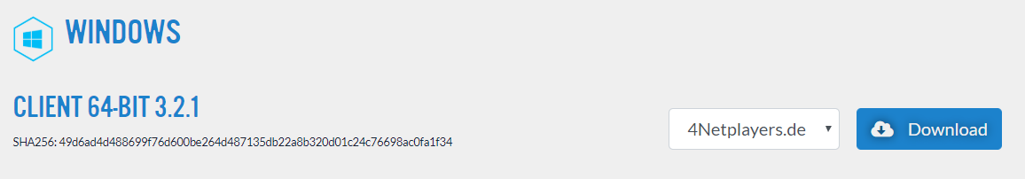
How to install ?
First you must download TeamSpeak3 Setup https://www.teamspeak.com/en/downloads#

Slide 4
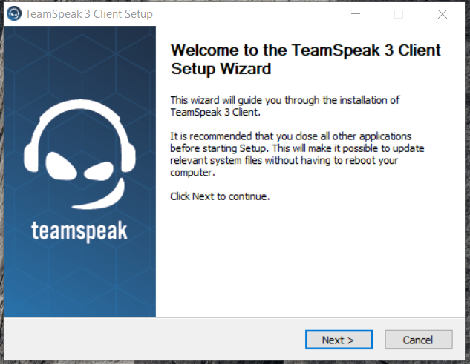
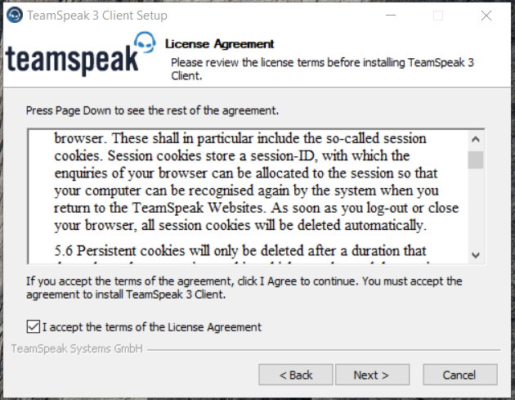
Run the TeamSpeak3 setup, click next Accept the terms of the License Agreement, click next

Slide 5
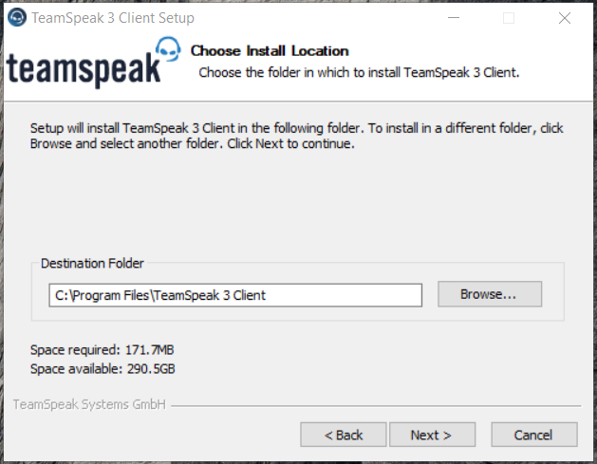

Select destination folder to install Click install

Slide 6

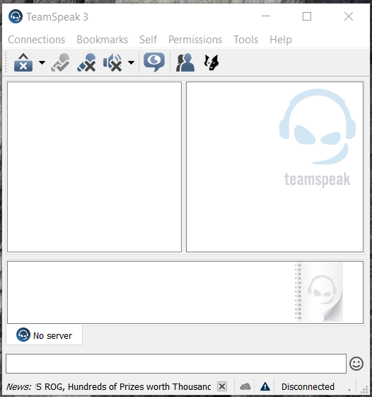
The installer is finished
TeamSpeak3

Slide 7
Experience or tips during the installation process
The installation of teamspeak3 in conditional internet speed
To be connected with the internet
Don’t much opened the app so quickly in doing download and install
To download the app, we also have to fit with the ram of our laptop

Slide 8
Terimakasih ☺

