Slide 1
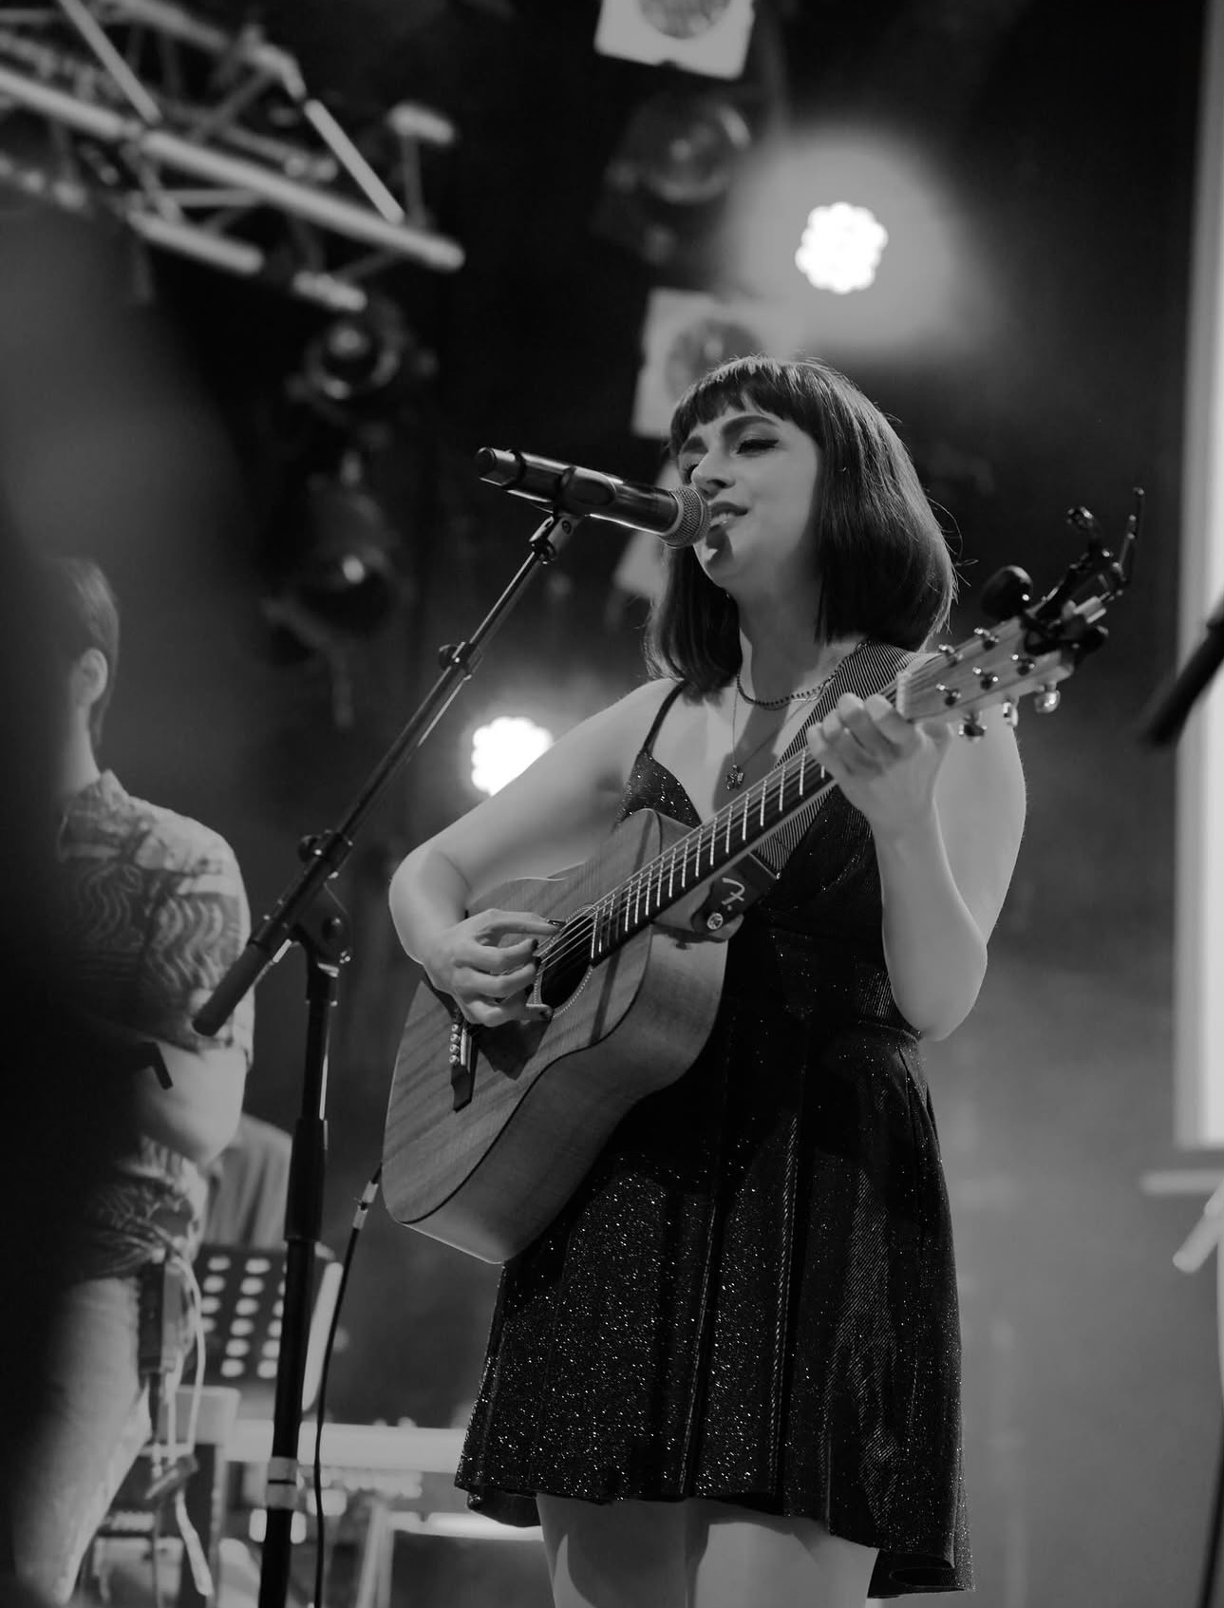
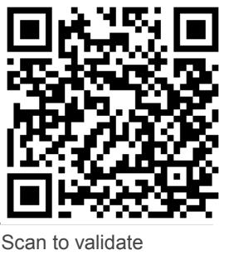

Marjan farsad
isa concert ticket
Reservation #:
Reserved At:
Saturday November 22
7 pm – 8:30 pm
Welcome to the Marjan Farsad Concert hosted by the Iranian Students Association at the University of Arkansas! We’re delighted to have you join us for an evening of music and art. Please arrive at least 15 minutes early to ensure a smooth seating experience.
ID | Guest Name | Seat Number
1
2

