Slide 1

FUNDAMENTALS OF DATABASES
MedPulseDB
Clinical Treatment and Diagnostic Management Database
Prepared by Student Name:farida arafa
ID:221001516

Slide 2

01 / RATIONALE
01
Problem and motivation
Clinical information loses value when it is fragmented across disconnected files.
FRAGMENTED RECORDS
Duplicate information and unclear ownership.
INTEGRITY RISK
Invalid references and weak business-rule control.
Patients, studies, specialists, treatments, diagnostic results, clinics, formulations, and stock need consistent identifiers and relationships. MedPulseDB turns those disconnected facts into one queryable relational system.
DATABASE RESPONSE
Keys, relationships, reusable views, and validation logic.

Slide 3

02 / Scope
Scope and users
01
02
03
04
Clinical records
Treatment workflow
Diagnostics
Inventory
Patients and study participation.
Specialists, sessions, formulations, and clinics.
Tests linked to treatment logs and studies.
Pharmacy stock quantities and locations.
Users: clinical coordinators · medical specialists · diagnostic staff · pharmacy staff · database administrators. Boundary: fictional educational data only.

Slide 4

03 / INTEGRITY
Requirements and business rules
03
01
PATIENT BEFORE STUDY
02
UNIQUE ASSIGNMENT
A clinical study must reference an existing patient profile through a foreign key.
The composite key in STUDY_APPOINTMENT prevents assigning the same specialist twice to one study.
03
TRACEABLE TREATMENT
04
CONTROLLED DELETION
Every treatment log belongs to a study, and every diagnostic test belongs to a treatment log.
Dependent study records cascade, while optional formulation and clinic references are set to NULL.
05
VALID STOCK QUANTITY
The stock trigger rejects an INSERT when AvailableUnits is negative.
Integrity principle: every operational record should remain identifiable, connected, and consistent with the clinical workflow.

Slide 5

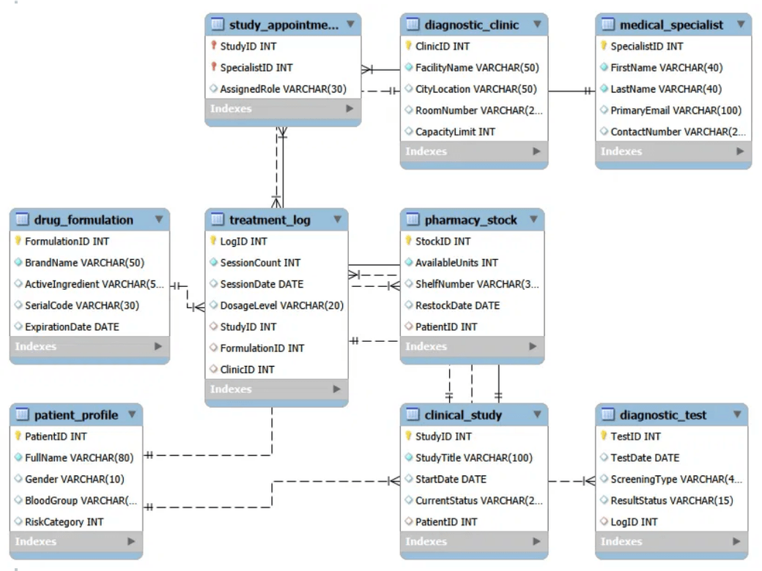
03 / CONCEPTUAL DESIGN
03
Entity overview
9 tables model the complete clinical-treatment workflow.
01
02
03
MEDICAL_SPECIALIST
DIAGNOSTIC_CLINIC
DRUG_FORMULATION
Staff identity and contact
Facility and capacity
Medication catalog
04
05
06
PATIENT_PROFILE
CLINICAL_STUDY
STUDY_APPOINTMENT
Patient and risk data
Study participation
Many-to-many resolver
07
08
09
TREATMENT_LOG
DIAGNOSTIC_TEST
PHARMACY_STOCK
Session history
Screening outcomes
Units and storage

Slide 6

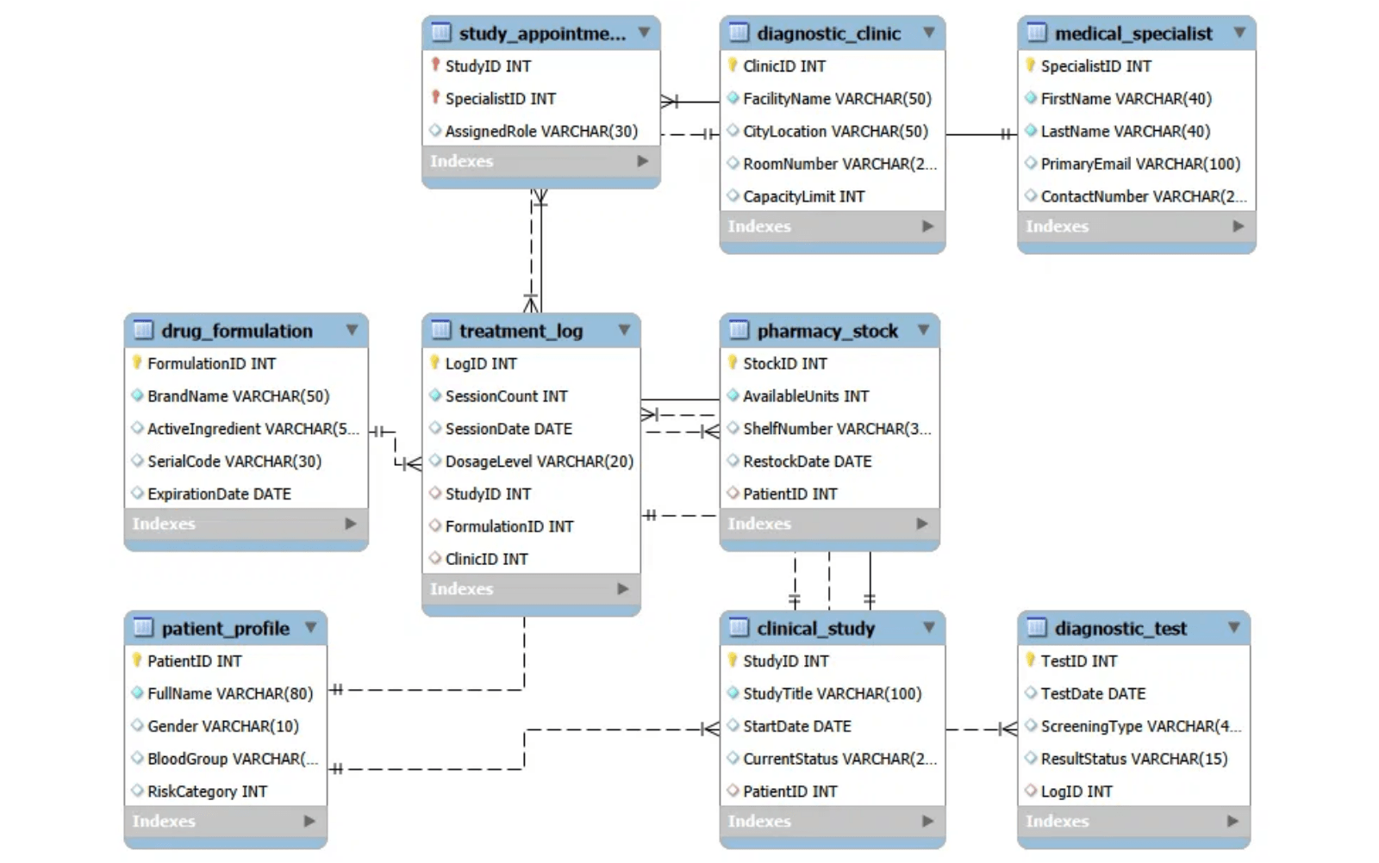
05 / CONCEPTUAL DESIGN
ER diagram
05
NINE ENTITIES
The model covers patients, studies, specialists, treatment logs, diagnostic tests, clinics, formulations, and pharmacy stock.
M:N RESOLVED
STUDY_APPOINTMENT resolves the many-to-many relationship between clinical studies and medical specialists.
CORE WORKFLOW
Patient → Study → Treatment Log → Diagnostic Test, with optional clinic and formulation references.

Slide 7

06 / RELATIONAL MAPPING
06
Relational schema and keys
01 — IDENTIFIERS
02 — ASSOCIATION
03 — INTEGRITY
Stable primary keys
Composite assignment key
References and actions
Auto-increment integers identify the main entities without depending on names, titles, or locations.
The associative table prevents a specialist from being assigned twice to the same study.
Foreign keys protect parent–child links. Specialist email is unique; dependent rows cascade, while optional history references set NULL.
PatientID · StudyID LogID · TestID
PRIMARY KEY (StudyID, SpecialistID)
ON DELETE CASCADE ON DELETE SET NULL
Design takeaway: keys make every record addressable, relationships enforce valid connections, and referential actions preserve the intended treatment history.

Slide 8

06 / SCHEMA QUALITY
Normalization to 3NF
The design separates facts so each value is stored once, depends on the correct key, and can be updated without creating conflicting copies.
01 · FIRST NORMAL FORM
02 · SECOND NORMAL FORM
03 · THIRD NORMAL FORM
Atomic values
Whole-key dependency
No transitive duplication
Every field contains one value. Repeating specialist assignments are not stored as a list inside a study record.
Non-key attributes depend on the complete primary key, not just part of it.
Patient, specialist, clinic, and formulation facts remain in their own entities rather than being copied into treatment records.
Decision:
each specialist assignment becomes
Decision:
AssignedRole
describes the complete
one row in
STUDY_APPOINTMENT
.
pair
(StudyID, SpecialistID)
.
Result: updates occur in one place and relationships are reconstructed through foreign keys.
Conclusion: MedPulseDB is substantially in 3NF under the stated project assumptions; controlled statuses could be further normalized into lookup tables in a production revision.

Slide 9

07 / IMPLEMENTATION
07
SQL implementation
01 · DDL
02 · DATA
03 · REPORTING
04 · LOGIC
05 · OPERATIONS
Create tables
›
Load records
›
Create views
›
Add objects
›
Run queries
Primary keys, foreign keys, data types, and referential actions.
Ten meaningful sample rows per main table for repeatable tests.
Reusable active-study and abnormal-test reports.
Stored procedure plus stock-validation trigger.
Retrieval, joins, aggregation, subqueries, and modifications.
REQUIRED SQL COVERAGE
REPRODUCIBLE EXECUTION
The final query script demonstrates the full requested operation set rather than only SELECT statements.
Run the scripts in dependency order from a clean MySQL 8.x database: tables → data → views → procedure/trigger → queries.
SELECT · JOIN · GROUP BY/HAVING · nested SELECT INSERT · UPDATE · DELETE · VIEW · CALL
Safety: UPDATE and DELETE examples are for disposable development data only.

Slide 10

08 / DATABASE OBJECTS
08
Views and advanced objects
REUSABLE REPORTING
REUSABLE AND EVENT LOGIC
Two views simplify recurring analysis
Procedure plus trigger
vw_active_clinical_studies
sp_GetStudiesByPatient(IN p_PatientID)
Joins studies to patients and returns only Active studies with patient risk information.
Accepts a patient identifier and returns that patient’s clinical studies through a reusable server-side routine.
vw_abnormal_test_results
trg_validate_stock_quantity
Joins tests, treatment logs, and studies to surface Abnormal results for clinical review.
Runs before pharmacy-stock insertion and rejects any negative AvailableUnits value with a database error.
LIVE DEMO
SELECT * FROM vw_active_clinical_studies; CALL sp_GetStudiesByPatient(1); INSERT INTO PHARMACY_STOCK (..., AvailableUnits, ...) VALUES (..., -1, ...); → rejected by trigger

Slide 11

09 / VERIFICATION
09
Testing and live demonstration
REPRESENTATIVE TEST CASES
LIVE-DEMO SEQUENCE
T01
Query active-study view
Only Active studies return.
01
LOAD AND COUNT
Show the clean execution order and ten-row sample coverage.
T02
Query abnormal-test view
Abnormal results include study context.
02
QUERY AND REPORT
Run a join, aggregation, both views, and the stored procedure.
T03
CALL sp_GetStudiesByPatient(1)
Studies for patient 1 return.
03
BREAK A RULE
Demonstrate trigger, foreign-key, and duplicate-key rejection.
T04
Insert AvailableUnits = -1
Trigger rejects the row.
04
CAPTURE EVIDENCE
T05
Use nonexistent PatientID
Foreign key rejects the row.
Save screenshots of successful statements and expected errors.
Defense standard: explain not only what succeeds, but also which constraint or database object causes each invalid operation to fail.

Slide 12
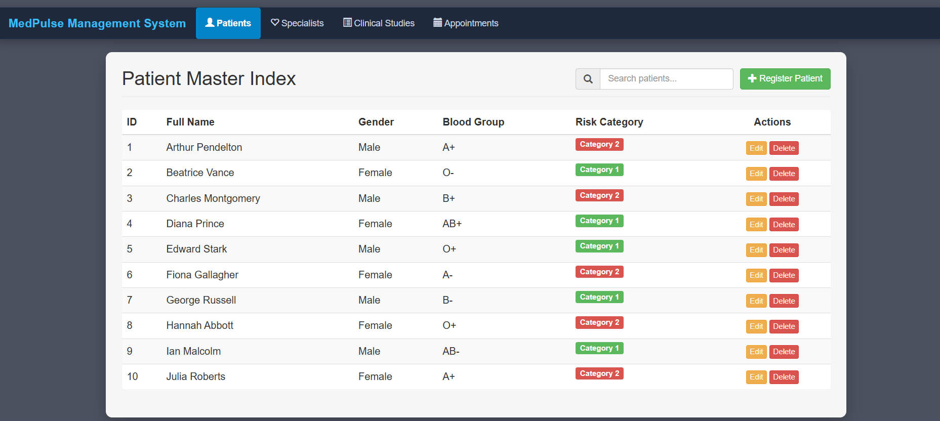
10 / UI

Slide 13

11 / CLOSING
11
Limitations, conclusion, and defense
RECOMMENDED NEXT STEPS
MedPulseDB completes the relational database lifecycle.
Strengthen controls
Add CHECK constraints, controlled lookup values, indexes, and an UPDATE trigger for stock.
The project connects clinical requirements to an ER model, a normalized relational schema, executable MySQL scripts, reusable views, a stored procedure, a validation trigger, and testable operations.
Improve inventory semantics
Link stock to formulations or inventory batches, then model patient allocation separately.
Prepare production scope
9
2
10+
Add authentication, audit history, consent, privacy controls, measurements, and appointment times.
meaningful tables
reporting views
SQL operation types and
tests

