Slide 1
14 THINKING INSIDE THE BOX

Slide 2
The parts of an element box
Box dimensions
Padding
Borders
Outlines
Margins
Display roles
Drop shadows

Slide 3
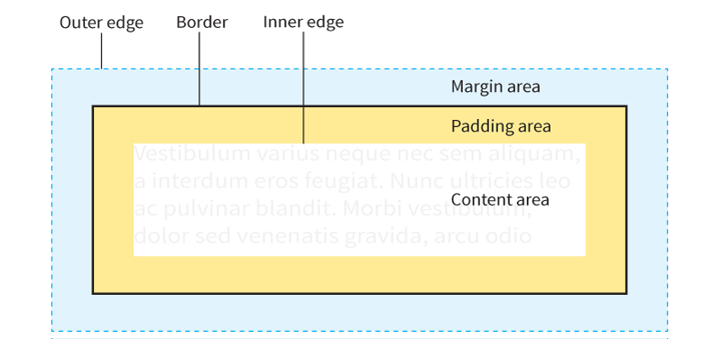
The Parts of an Element Box
NOTE: The margin is indicated with a blue shade and outline, but is invisible in the layout.
Notes:
Every element in a document, both block-level and inline, generates a rectangular element box.

Slide 4
Specifying Box Dimensions
width
Values: Length, percentage, auto
height
Values: Length, percentage, auto
Specify the dimensions of an element box with width and height properties

Slide 5
Box Sizing Models
box-sizing
Values: content-box, border-box
There are two methods for sizing an element box, specified with the box-sizing attribute:
Content-box sizing (default)
Applies width and height values to the content box only.
The resulting size of the element will be the dimensions you specify plus the amount of padding and borders that have been added to the element.
Border-box sizing
Applies width and height values to the border box (including the padding and content).
With this method, the resulting visible element box, including padding and borders, will be exactly the dimensions you specify.

Slide 6
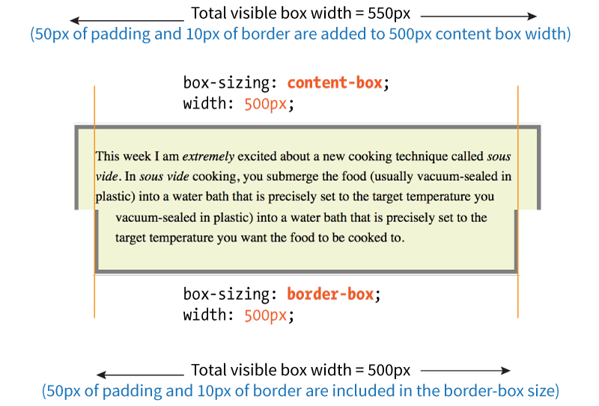
Box Sizing Models Compared

Slide 7
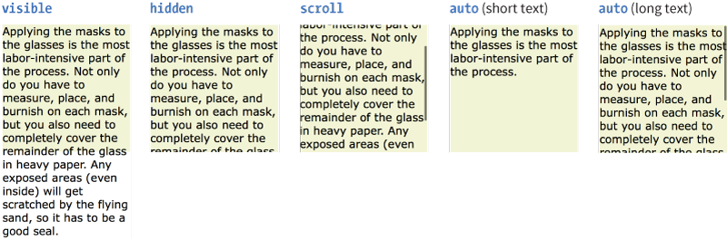
Overflow
overflow
Values: visible, hidden, scroll, auto
Specifies what to do when content doesn’t fit in a sized element box:
Notes:
VISIBLE
The default value is visible, which allows the content to hang out over the element box so that it all can be seen.
HIDDEN
When overflow is set to hidden, the content that does not fit gets clipped off and does not appear beyond the edges of the element’s content area
SCROLL
When scroll is specified, scrollbars are added to the element box to let users scroll through the content. Be aware that they may become

Slide 8
Padding
padding, padding-top, padding-right, padding-bottom, padding-left
Values: Length, percentage
An amount of space between the content area and the border (or the space the border would be if one isn’t specified).
You can add padding to one side at a time, or on all sides with the padding shorthand property.

Slide 9
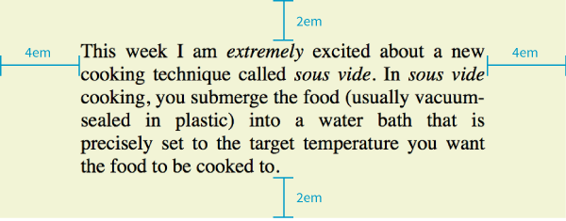
Padding (cont’d)
blockquote {
padding-top: 2em;
padding-right: 4em;
padding-bottom: 2em;
padding-left: 4em;
background-color: #D098D4; /*light green*/
}
Notes:
DEMO

Slide 10
Shorthand padding Property
The padding property adds space around 1, 2, 3, or 4 sides of the content using the clockwise top, right, bottom, left (TRouBLe) order:
padding: top right bottom left;
padding: 2em 4em 2em 4em;
(this shorthand produces the same result as the example on the previous slide)

Slide 11
Shorthand padding Property (cont’d)
If the left and right sides are the same, you can omit the last value, and the second value will be applied on both the left and right sides:
padding: top right+left bottom;
padding: 2em 4em 2em;
(this shorthand produces the same result as the examples on the two previous slides)

Slide 12
Shorthand padding Property (cont’d)
If the top and and bottom sides are also the same, you can omit the third value, and the first value will be applied on both the top and bottom:
padding: top+bottom right+left;
padding: 2em 4em;
(same result as previous examples)
If all sides are the same, provide one value, and it’s applied to all sides:
padding: all sides;
padding: 2em;
(2em padding all around)

Slide 13
Borders
A border is a line drawn around the content area and its (optional) padding.
The thickness of the border is included in the dimensions of the element box.
You define style, width (thickness), and color for borders.
Borders can be applied to single sides or all around

Slide 14
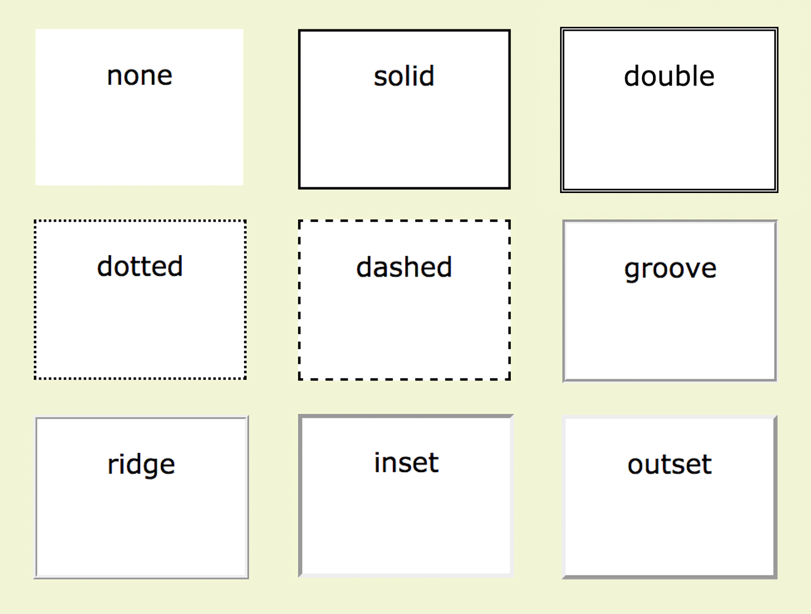
Border Style
border-style, border-top-style, border-right-style, border-bottom-style, border-left-style
Values: none, solid, hidden, dotted, dashed, double, groove, ridge, inset, outset
NOTE: The default is none, so if you don’t define a border style, it won’t appear.

Slide 15
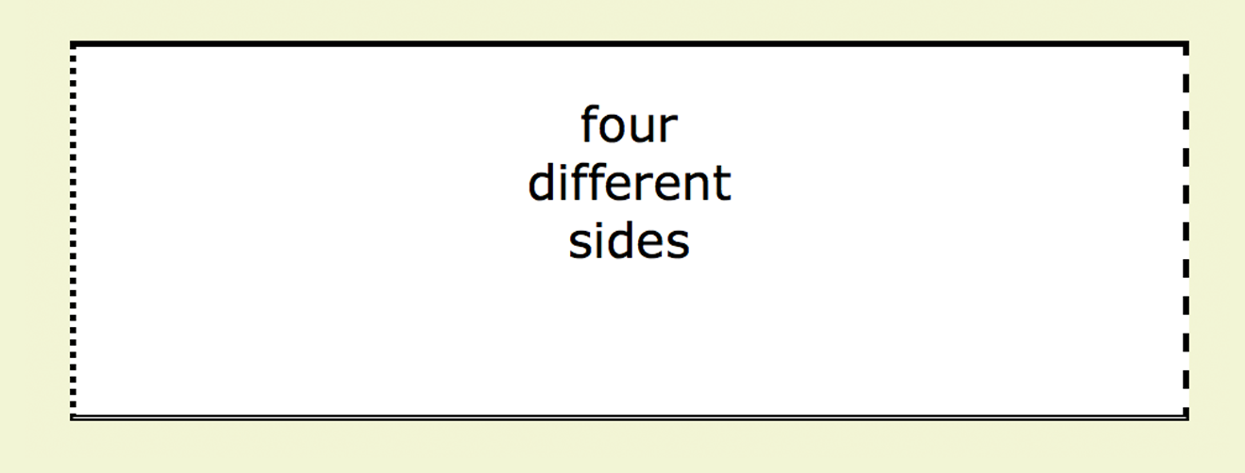
Border Style
border-style
The border-style shorthand uses the clockwise (TRouBLe) shorthand order. The following rules have the same effect:
div#silly {
border-top-style: solid;
border-right-style: dashed;
border-bottom-style: double;
border-left-style: dotted;
width: 300px;
height: 100px;
}
div#silly {
border-style: solid dashed double dotted;
}
Notes:
DEMO with p

Slide 16
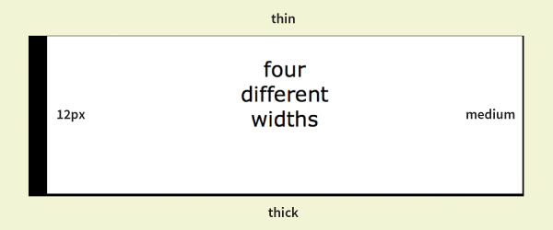
Border Width
border-width, border-top-width, border-right-width, border-bottom-width, border-left-width
Values: Length, thin, medium, thick
The border-width shorthand uses the clockwise (TRouBLe) order:
div#help {
border-width: thin medium thick 12px;
border-style: solid;
width: 300px;
height: 100px;
}
NOTE: The border-style property is required for the border to be rendered.
Notes:
DEMO

Slide 17
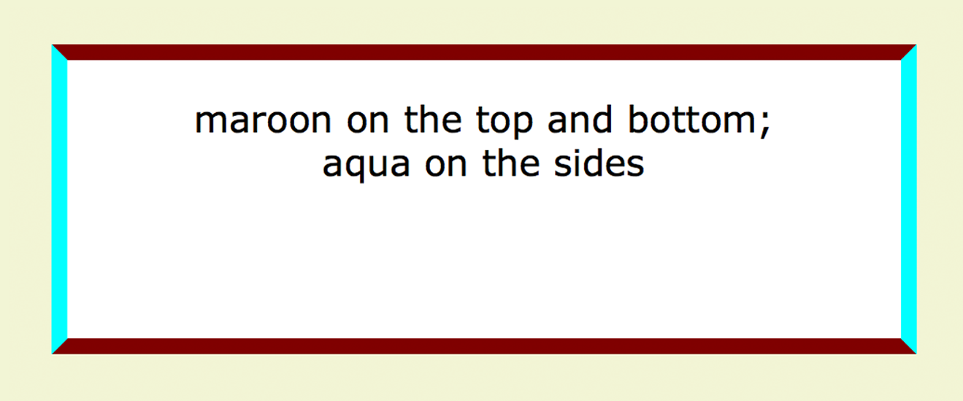
Border Color
border-color, border-top-color, border-right-color, border-bottom-color, border-left-color
Values: Color value (named or numeric)
The border-color properties override the color property:
div#special {
border-color: maroon aqua;
border-style: solid;
border-width: 6px;
width: 300px;
height: 100px;
}
NOTE: The border-style property is required for the border to be rendered.
Notes:
DEMO

Slide 18
Border Shorthand Properties
border, border-top, border-right, border-bottom, border-left
Values: border-style border-width border-color
Combine style, width, and color values in shorthand properties for each side or all around (border):
p.example {
border: 2px dotted aqua;
}
NOTE: The border-style property must be included in the shorthand for the border to be rendered.

Slide 19
Border Radius (Rounded Corners)
border-radius
Values: 1, 2, 3, or 4 length or percentage values
The border-radius property rounds off the corners of an element.
The value is a length or percentage value reflecting the radius of the curve.
Providing one value makes all the corners the same.
Four values are applied clockwise, starting from the top-left corner.

Slide 20
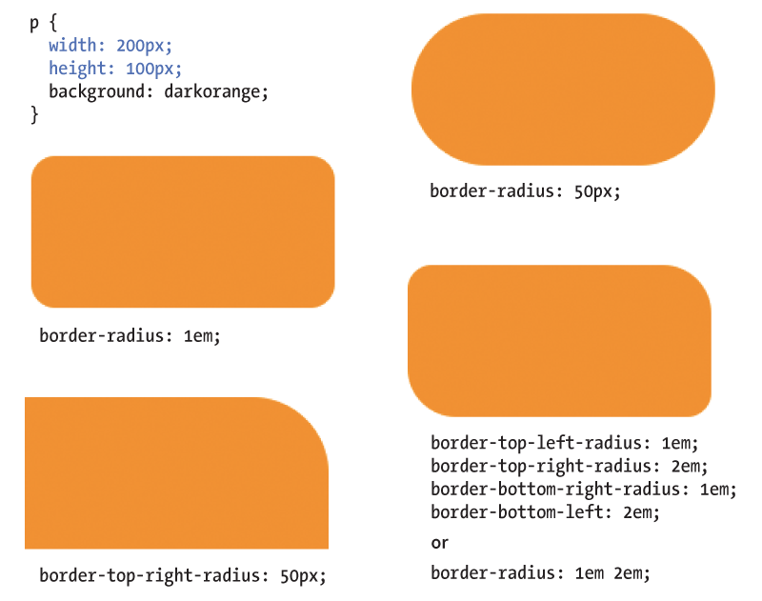
Border Radius (cont’d)
Notes:
DEMO with background-color and border-radius

Slide 21
Margins
margin, margin-top, margin-right, margin-bottom, margin-left
Values: Length, percentage
The margin is an amount of space added on the outside of the border. They keep elements from bumping into one another or the edge of the viewport.
The shorthand margin property works the same as the padding shorthand. Values are applied clockwise (TRouBLe order) and are repeated if fewer than 4 values are supplied.

Slide 22
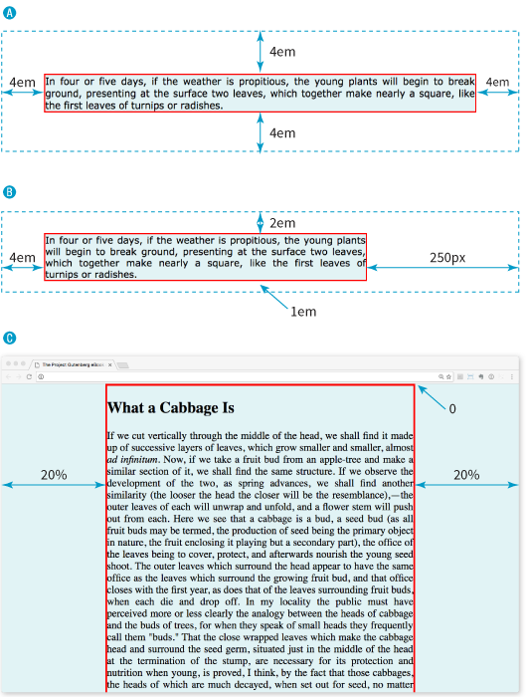
Margins (cont’d)
A p#A {
margin: 4em;
border: 2px solid red;
background: #e2f3f5;
}
B p#B {
margin-top: 2em;
margin-right: 250px;
margin-bottom: 1em;
margin-left: 4em;
border: 2px solid red;
background: #e2f3f5;
}
C body {
margin: 0 20%;
border: 3px solid red;
background-color: #e2f3f5;
}
Notes:
DEMO
Show difference of padding and margin

Slide 23
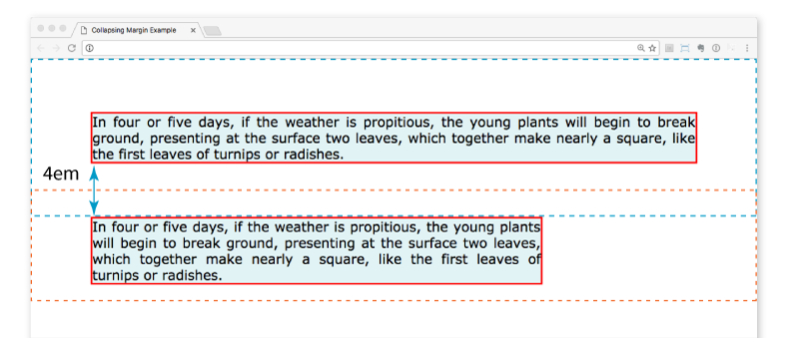
Margins (cont’d)
Top and bottom margins of neighboring elements collapse (they overlap instead of accumulating).
The top element has a bottom margin of 4em. The bottom element has a top margin of 2em. The resulting margin is 4em (the largest value).

Slide 24
Assigning Display Types
display
Values: inline | block | run-in | flex | grid | flow | flow-root | list-item | table | table-row-group | table-header-group | table-footer-group | table-row | table-cell | table-column-group | table-column | table-caption | ruby | ruby-base | ruby-text | ruby-base-container | ruby-text-container | inline-block | inline-table | inline-flex | inline-grid | contents | none
Assigns a display type that determines how the element box behaves in layouts.
Examples:
Make li (normally block elements) into inline elements so they line up in a horizontal menu: nav li { display: inline; }
Make an anchor (a) element (normally inline) display as a block so you can give it a width and height: nav li a { display: block; }

Slide 25
Box Drop Shadows
box-shadow
Values: horizontal-offset vertical-offset blur-distance spread-distance color inset, none
Applies a drop shadow around the visible element box.
The values are a horizontal and vertical offset, optional blur and spread values (in pixels), a color value, and the option to make it appear inset.

Slide 26
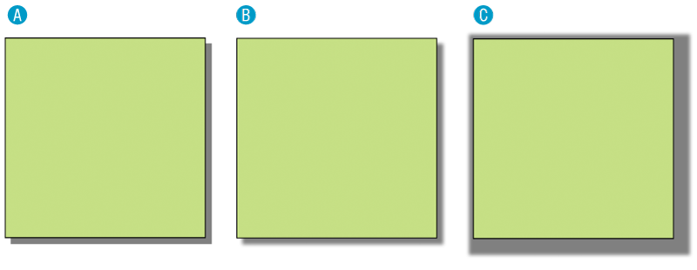
Box Drop Shadows (cont’d)
A box-shadow: 6px 6px gray;
B box-shadow: 6px 6px 5px gray; /* 5 pixel blur */
C box-shadow: 6px 6px 5px 10px gray; /* 5px blur,10px spread */

