Slide 1
15 FLOATING AND POSITIONING

Slide 2
Understanding normal flow
Floating elements to the left and right
Clearing and containing floated elements
Text wrap shapes
Positioning: Absolute, relative, fixed

Slide 3
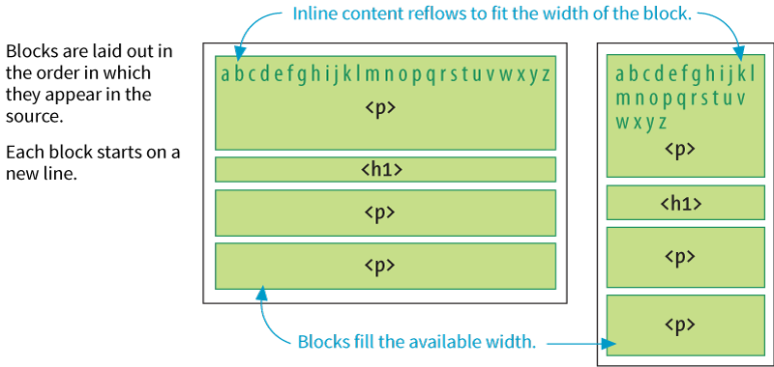
Normal Flow
In the normal flow, elements are laid out from top to bottom in the order in which they appear in the source and from left to right (in left-to-right reading languages).

Slide 4
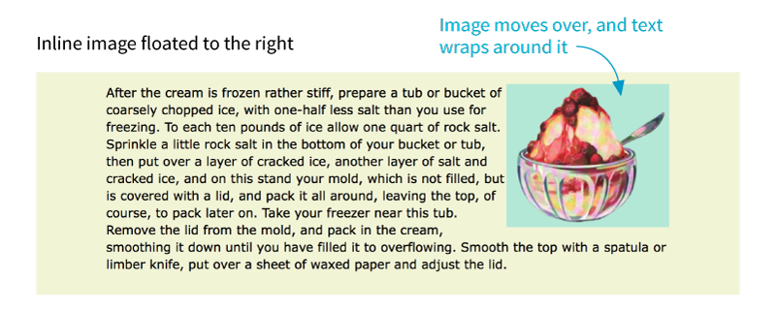
Floating
float
Values: left, right, none
Moves an element as far as possible to the left or right and allows the following content to wrap around it:
img { float: right; }
Notes:
DEMO

Slide 5
Floating (cont’d)
Floated elements are removed from the normal flow but influence the surrounding content.
Floated elements stay within the content area of the element that contains it.
Margins are always maintained (they don’t collapse) on all sides of floated elements.
You must provide a width for a floated text element (because default width is auto).
Elements don’t float higher than their reference in the source.

Slide 6
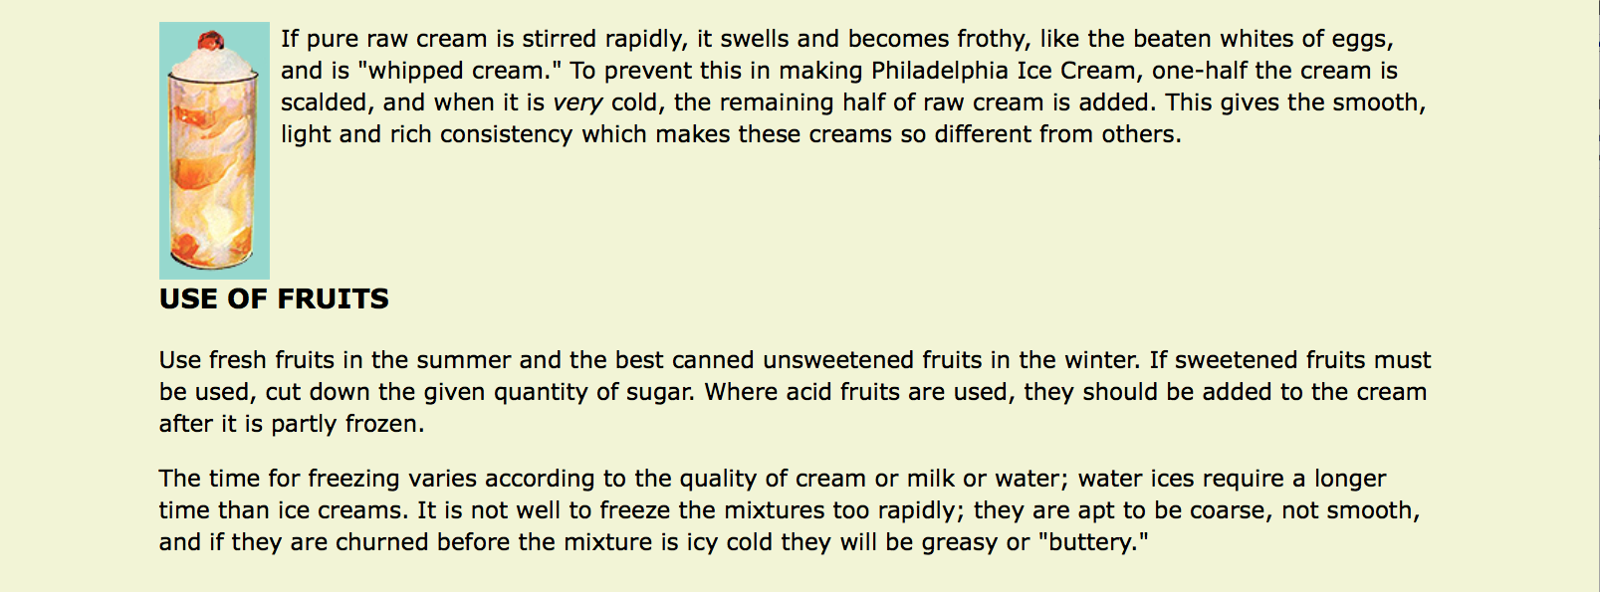
Clearing Floated Elements
clear
Values: left, right, both, none
Prevents an element from appearing next to a floated element and forces it to start against the next available “clear” space
img {
float: left;
margin-right: .5em;
}
h2 {
clear: left;
margin-top: 2em;
}
(The h2 is “cleared” and starts below the floated element.)
Notes:
DEMO

Slide 7
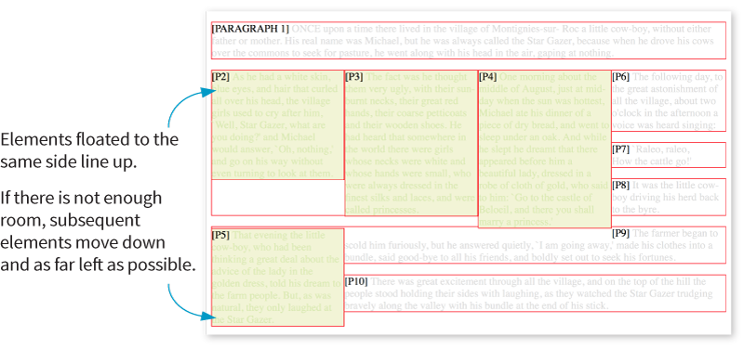
Floating Multiple Elements
When you float multiple elements, browsers follow rules in the spec to ensure they don’t overlap.
Floated elements will be placed as far left or right (as specified) and as high up as space allows.

Slide 8
CSS Shapes (Text Wrap)
shape-outside
Values: none, circle(), ellipse(), polygon(), url(), [margin-box | padding-box | content-box ]
Changes the shape of the text wrap to a circle or ellipse, a complex path, or based on transparent areas in an image
shape-margin
Values: length, percentage
Specifies an amount of space to hold between the image and the wrapped text

Slide 9
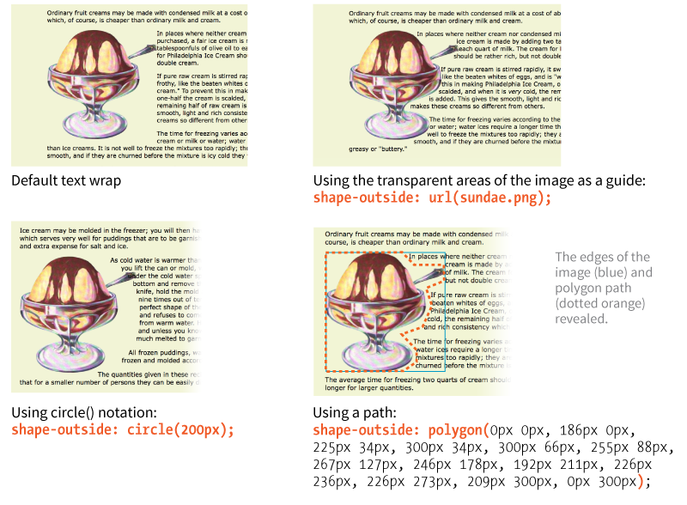
CSS Shapes (cont’d)

Slide 10
Positioning
position
Values: static, relative, absolute, fixed, sticky
Indicates that an element is to be positioned and specifies which positioning method to use
top, right, bottom, left
Values: length, percentage, auto
Offset properties that provide the distance the element should be moved away from that respective edge

Slide 11
Types of Positioning
Static: The default position in the flow
Relative: Moves the element relative to its original position
Absolute: Removes the element from the flow and places it relative to the viewport or other containing element
Fixed: Element stays in one position relative to the viewport
Sticky: Element starts in the flow but stays fixed once it scrolls to a particular position relative to the viewport

Slide 12
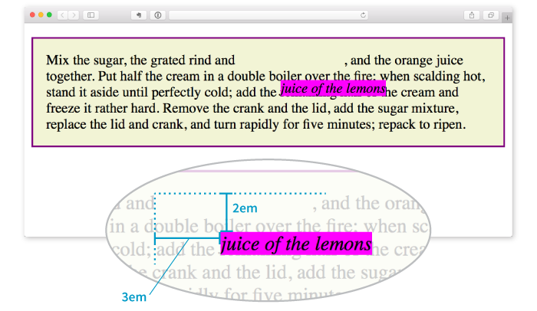
Relative Positioning
Moves the element relative to its original position
The space it originally occupied is preserved.
em {
position: relative;
top: 2em; /* moves it down */
left: 3em; /* moves it right */
background-color: fuchsia;
}

Slide 13
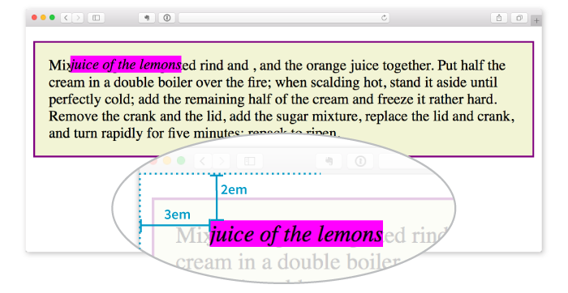
Absolute Positioning
Moves the element relative to the viewport or containing block element
The space it originally occupied is closed up.
em {
position: absolute;
top: 2em;
left: 3em;
background-color: fuchsia;
}

Slide 14
Containing Blocks
A positioned element serves as a containing block (or positioning context) for the elements it contains.
If a positioned element has an ancestor that has its position set to relative, absolute, or fixed, then its position will be relative to that containing block element.
If a positioned element is not contained within another positioned element, then it is placed relative to the initial containing block (the html element) and the viewport.

Slide 15
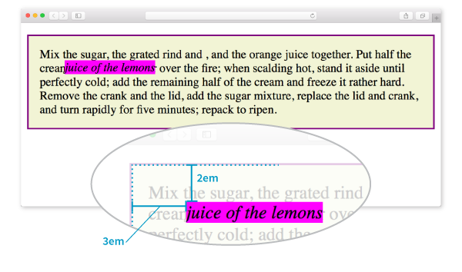
Containing Blocks (cont’d.)
p {
position: relative;
padding: 15px;
background-color: #F2F5D5;
border: 2px solid purple;
}
em {
position: absolute;
top: 2em;
left: 3em;
background-color: fuchsia;
}
The relatively positioned p element acts as a containing block for the em element.

Slide 16
Specifying Position
Position can be specified in length measurements (like pixels) or percentages.
The measurement moves it away from the positioning offset property provided (i.e., top: 200px; moves the element DOWN from the top edge).
Be careful not to overspecify. Two offset properties are usually enough.

Slide 17
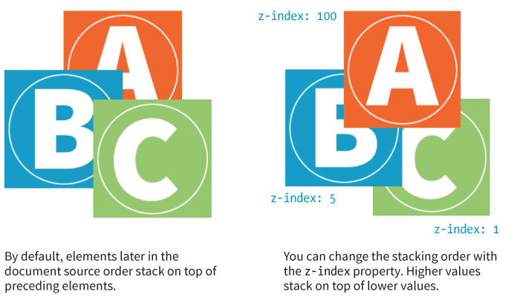
Stacking Order
z-index
Values: Number, auto
Notes:
DEMO
Include two images
Set their position to absolute
Set their width and height 100px
Set their left and top to 0px
Modify the z-index for each to see the difference

