Slide 1
16A CSS LAYOUT WITH FLEXBOX

Slide 2
Flexbox terminology
Flexbox containers
Flow: Flow direction and text wrap
Alignment on main and cross axes
Specifying how items in a flexbox "flex"
Changing the order of flex items

Slide 3
About Flexbox
Flexbox is a display mode that lays out elements along one axis (horizontal or vertical).
Useful for menu options, galleries, product listings, etc.
Items in a flexbox can expand, shrink, and/or wrap onto multiple lines, making it a great tool for responsive layouts.
Items can be reordered, so they aren't tied to the source order.
Flexbox can be used for individual components on a page or the whole page layout.

Slide 4
Flexbox Container
display: flex
To turn on Flexbox mode, set the element’s display to flex.
This makes the element a flexbox container.
All of its direct children become flex items in that container.
By default, items line up in the writing direction of the document (left to right rows in left-to-right reading languages).

Slide 5
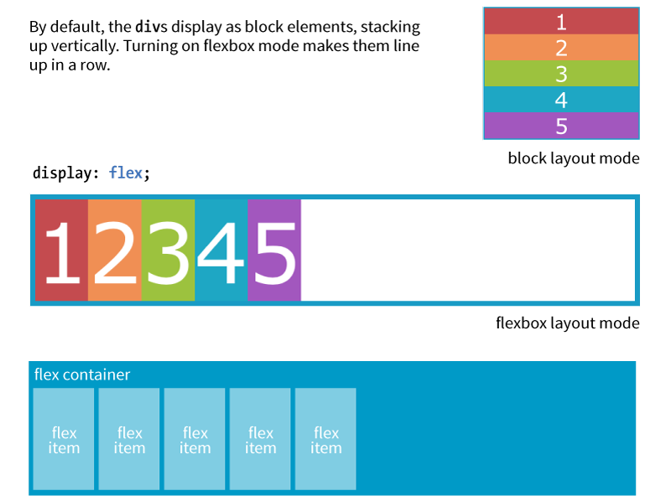
Flexbox Container (cont’d)
Notes:
DEMO
Use a ul and include 5 li in it.
Set li’ s class to flex-item and write the following in the CSS file.
Set ul’s class to flex-container and write the following in the CSS file.
.flex-item {
background: tomato;
padding: 5px;
width: 50px;
height: 50px;
margin: 5px;
line-height: 50px;
color: white;
font-weight: bold;
font-size: 2em;
text-align: center;
list-style-type: none;
}
.flex-container {
display: flex;
}

Slide 6
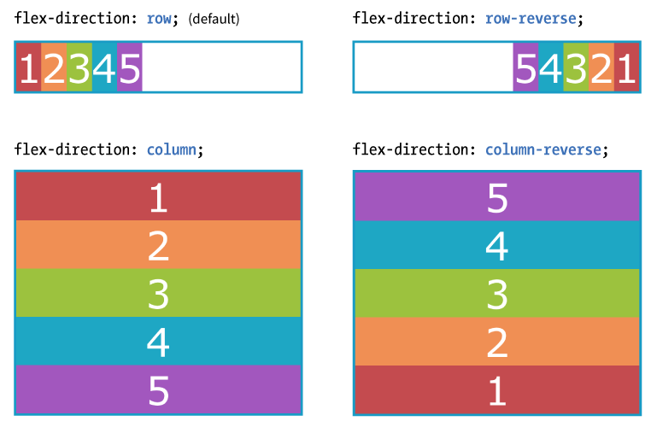
Rows and Columns (Direction)
flex-direction
Values: row, column, row-reverse, column-reverse
The default value is row (for L-to-R languages), but you can change the direction so items flow in columns or in reverse order:
Notes:
DEMO
Add flex-direction: row-reverse; in flex-container selector.

Slide 7
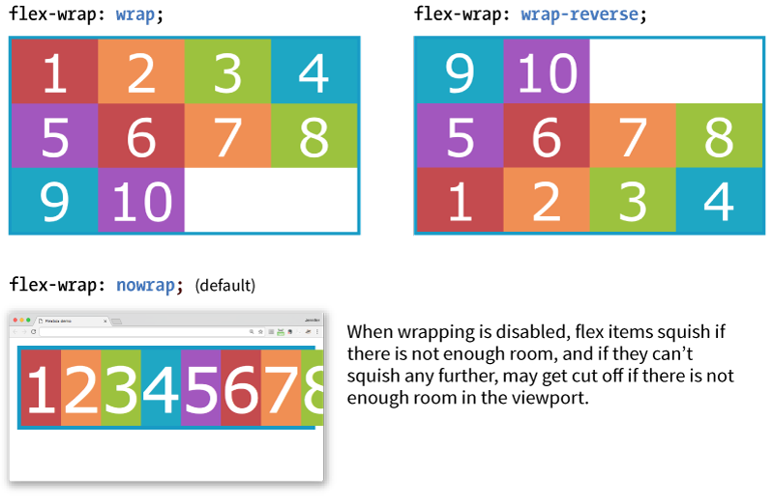
Wrapping Flex Lines
flex-wrap
Values: wrap, nowrap, wrap-reverse
Flex items line up on one axis, but you can allow that axis to wrap onto multiple lines with the flex-wrap property:
Notes:
DEMO
Add width: 140px; in flex-container selector.
Add flex-wrap: wrap; in flex-container selector.

Slide 8
Flex Flow (Direction + Wrap)
flex-flow
Values: Flex-direction flex-flow
The shorthand flex-flow property specifies both direction and wrap in one declaration.
Example
#container {
display: flex;
height: 350px;
flex-flow: column wrap;
}

Slide 9
Flexbox Alignment Terminology
Flexbox is “direction-agnostic,” so we talk in terms of main axis and cross axis instead of rows and columns.
The main axis runs in whatever direction the flow has been set.
The cross axis runs perpendicular to the main axis.
Both axes have a start, end, and size.

Slide 10
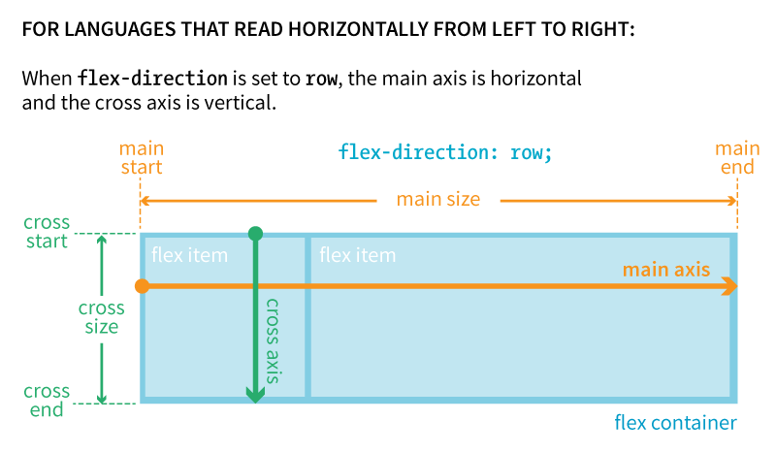
ROW: Main and Cross Axes

Slide 11
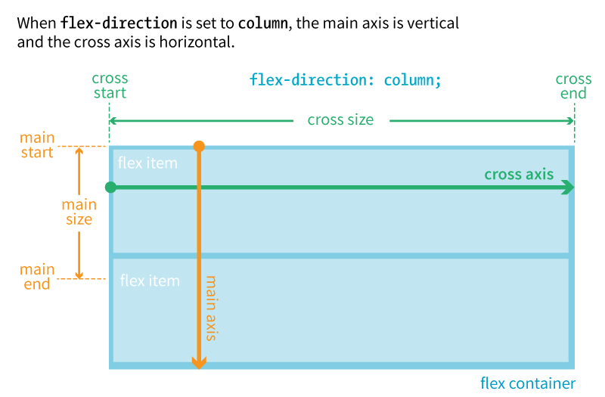
COLUMN: Main and Cross Axes

Slide 12
Aligning on the Main Axis
justify-content
Values: flex-start, flex-end, center, space-between, space-around
When there is space left over on the main axis, you can specify how the items align with the justify-content property (notice we say start and end instead of left/right or top/bottom).
The justify-content property applies to the flex container.
Example:
#container {
display: flex;
justify-content: flex-start;
}

Slide 13
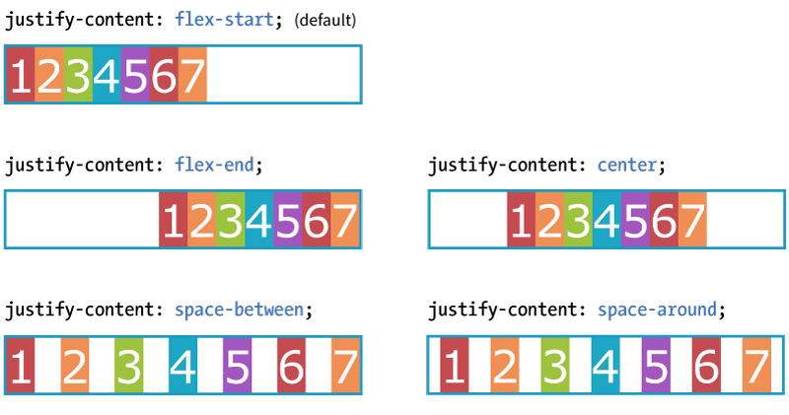
Aligning on the Main Axis (cont’d)
When the direction is row, and the main axis is horizontal
Notes:
DEMO

Slide 14
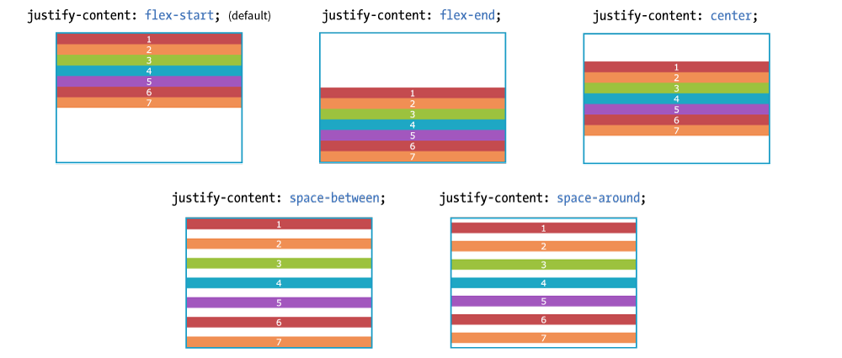
Aligning on the Main Axis (cont’d.)
When the direction is column, and the main axis is vertical
NOTE: I needed to specify a height on the container to create extra space on the main axis. By default, it’s just high enough to contain the content.

Slide 15
A WORD FROM THE AUTHOR
“Keeping the main and cross axes straight in your mind when changing between rows and columns is one of the trickiest parts of using Flexbox.
Once you master that, you’ve got it!”
—Jennifer Robbins

Slide 16
Aligning on the Cross Axis
align-items
Values: flex-start, flex-end, center, baseline, stretch
When there is space left over on the cross axis, you can specify how the items align with the align-items property.
The align-items property applies to the flex container.
Example:
#container {
display: flex;
flex-direction: row;
height: 200px;
align-items: flex-start;
}

Slide 17
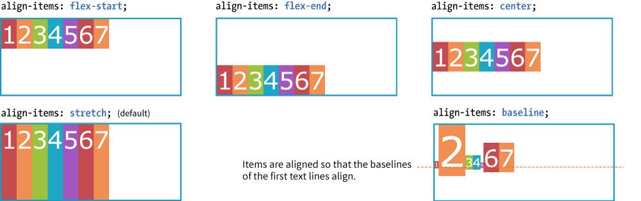
Aligning on the Cross Axis (cont’d)
When the direction is row, the main axis is horizontal, and the cross axis is vertical.
NOTE: I needed to specify a height on the container to create extra space on the cross axis. By default, it’s just high enough to contain the content.

Slide 18
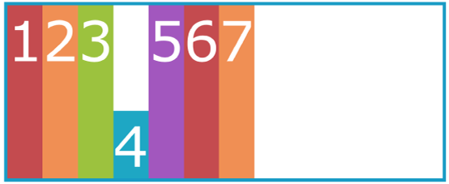
Aligning on the CROSS Axis (cont’d)
align-self
Values: flex-start, flex-end, center, baseline, stretch
Aligns an individual item on the cross axis. This is useful if one or more items should override the align-items setting for the container.
The align-self property applies to the flex item.
Example:
.box4 {
align-self: flex-end;
}

Slide 19
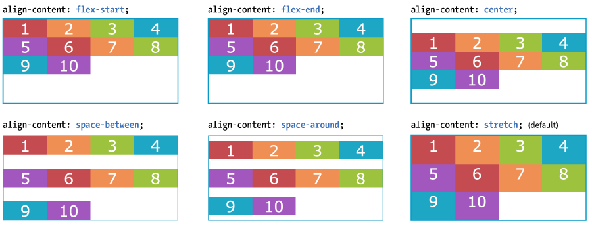
Aligning on the CROSS Axis (cont’d)
align-content
Values: flex-start, flex-end, center, space-around, space-between, stretch
When lines are set to wrap and there is extra space on the cross axis, use align-content to align the lines of content.
The align-content property applies to the flex container.

Slide 20
Aligning with Margins
Use a margin (set to auto) to put extra space on the side of particular flex items.
Example: Adding an auto margin to the right of the first flex item (the li with the logo) pushes the remaining li to the right:
ul {
display: flex;
align-items: center;
...
}
li.logo {
margin-right: auto;
}
Notes:
DEMO

Slide 21
Specifying How Items “Flex”
flex
Values: none, 'flex-grow flex-shrink flex-basis'
Items can resize (flex) to fill the available space on the main axis in the container.
The flex property identifies how much an item can grow and shrink and identifies a starting size
It distributes extra space in the container within items (compared to justify-content that distributes space between and around items).

Slide 22
flex Property Example
flex is a shorthand for separate flex-grow, flex-shrink, and flex-basis properties.
The values 1 and 0 work like on/off switches.
li {
flex: 1 0 200px;
}
In this example, list items in the flex container start at 200 pixels wide, are permitted to expand wider (flex-grow: 1), and are not permitted to shrink (flex-shrink: 0).
NOTE: The spec recommends always using the flex property and using individual properties only for overrides.

Slide 23
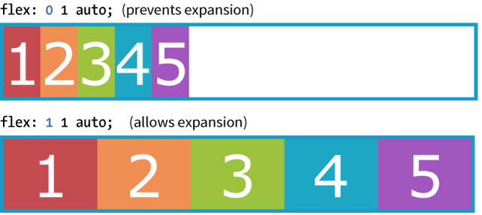
Expanding Items (flex-grow)
flex-grow
Values: Number
Specifies whether and in what proportion an item may stretch larger. 1 allows expansion; 0 prevents it.
flex-grow is applied to the flex item element.
Notes:
DEMO

Slide 24
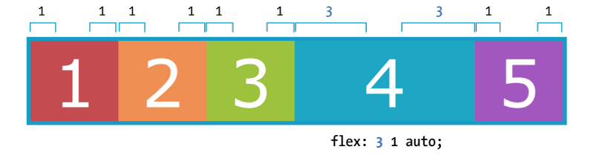
Expanding Items (cont’d)
Relative Flex
When the flex-basis has a value other than 0, higher integer values act as a ratio that applies more space within that item.
Example: A value of 3 assigns three times more space to box4 than items with a flex-grow value of 1. (Note that it isn't necessarily 3x as wide as the other items.)
.box4 { flex: 3 1 auto; }

Slide 25
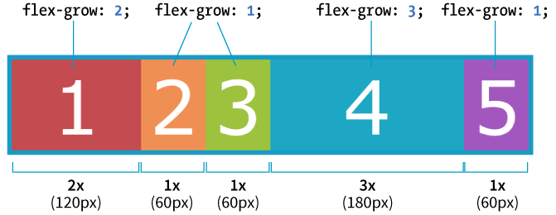
Expanding Items (cont’d.)
Absolute Flex
When the flex-basis is 0, items get sized proportionally according to the flex ratio.
Example: A value of 3 makes “box4” 3x as wide as the others when flex-basis: 0.
.box4 { flex: 3 1 0%; }

Slide 26
Shortcut flex Values
flex: initial (same as flex: 0 1 auto;) Prevents the item from growing, but allows it to shrink to fit the container
flex: auto (same as flex: 1 1 auto;) Allows items to be fully flexible as needed. Size is based on the width/height properties.
flex: none (same as flex: 0 0 auto;) Creates a completely inflexible item while sizing it to the width/height properties.
flex: integer (same as flex: integer 1 0px;) Creates a flexible item with absolute flex (so flex-grow integer values are applied proportionally)

Slide 27
Changing Item Order
order
Values: Number
Specifies the order in which a particular item should appear in the flow (independent of the HTML source order):
order is applied to the flex item element.
The default is 0. Items with the same order value are placed according to their order in the source.
Items with different order values are arranged from lowest to highest.
The specific number value doesn’t matter; only how it relates to other values (like z-index) matters.

Slide 28
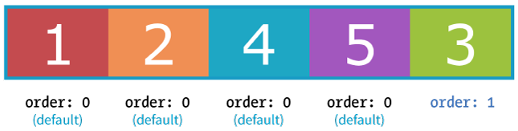
Changing Item Order (cont’d)
Example:
“box3” has a higher order value (1) than the others with default order of 0. It appears last in the line even though it’s third in the markup:
.box3 {
order: 1;
}

Slide 29
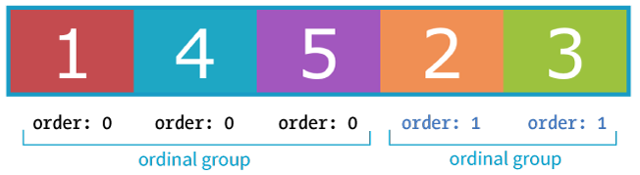
Changing Item Order (cont’d)
Ordinal groups
Items that share the same order value are called an ordinal group.
Ordinal groups stick together and are arranged from lowest value to highest:
.box2, .box3 {
order: 1;
}

Slide 30
Browser Support for Flexbox
The Flexbox spec changed over the years and was implemented by browsers along the way:
Current version (2012): display: flex; Supported by all current desktop and mobile browser versions
“Tweener” version (2011): display: flexbox; Supported by IE10 only
Old version (2009): display: box; Supported by Chrome <21, Safari 3.1–6, Firefox 2–21; iOS 3.2–6.1, Android 2.1–4.3

Slide 31
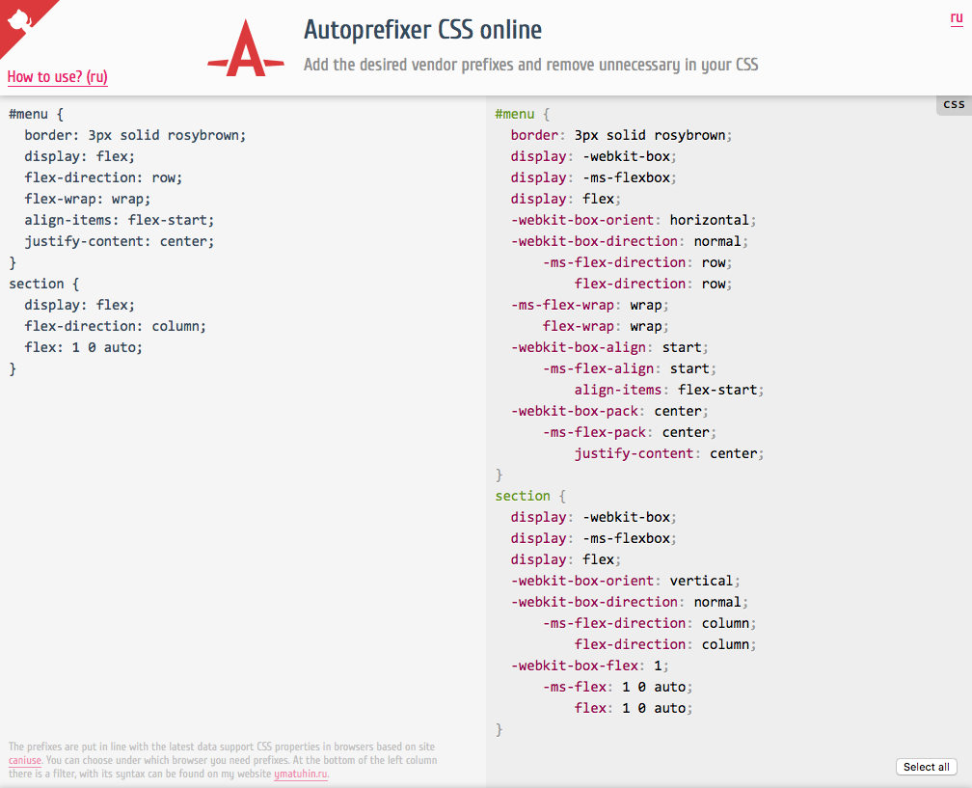
Browser Support (cont’d)
To ensure that Flexbox works across all supporting browsers, you need a lot of vendor prefixes and redundant declarations.
Use a tool like Autoprefixer to generate all that code for you (autoprefixer.github.io).
Notes:
UPDATE:
The majority of browsers do not need a prefix at this point.

Slide 32
Flexbox Property Review
Flex container properties
display
flex-flow
flex-direction
flex-wrap
justify-content
align-items
align-content
Flex item properties
align-self
flex
flex-grow
flex-shrink
flex-basis
order

