Slide 1
Chapter 5
The Cellular Concept
1

Slide 2



Outline
Cell Shape
Actual cell/Ideal cell
Signal Strength
Handoff Region
Cell Capacity
Traffic theory
Erlang B and Erlang C
Cell Structure
Frequency Reuse
Reuse Distance
Cochannel Interference
Cell Splitting
Cell Sectoring
2

Slide 3

Cell Shape
R
R
R
Cell
R
R
(a) Ideal cell
(b) Actual cell
(c) Different cell models
3

Slide 4

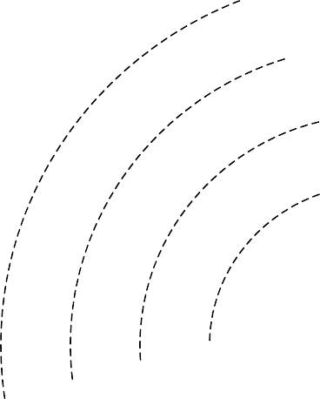
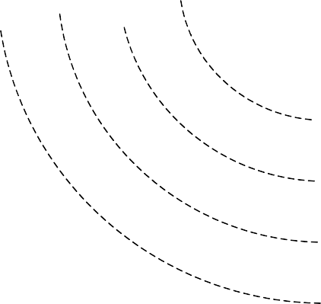
Signal Strength
Signal strength (in dB)
Cell i
Cell j
-60
-70
-80
-90
-100
-60
-70
-80
-90
-100
Select cell i on left of boundary Select cell j on right of boundary
Ideal boundary
4

Slide 5

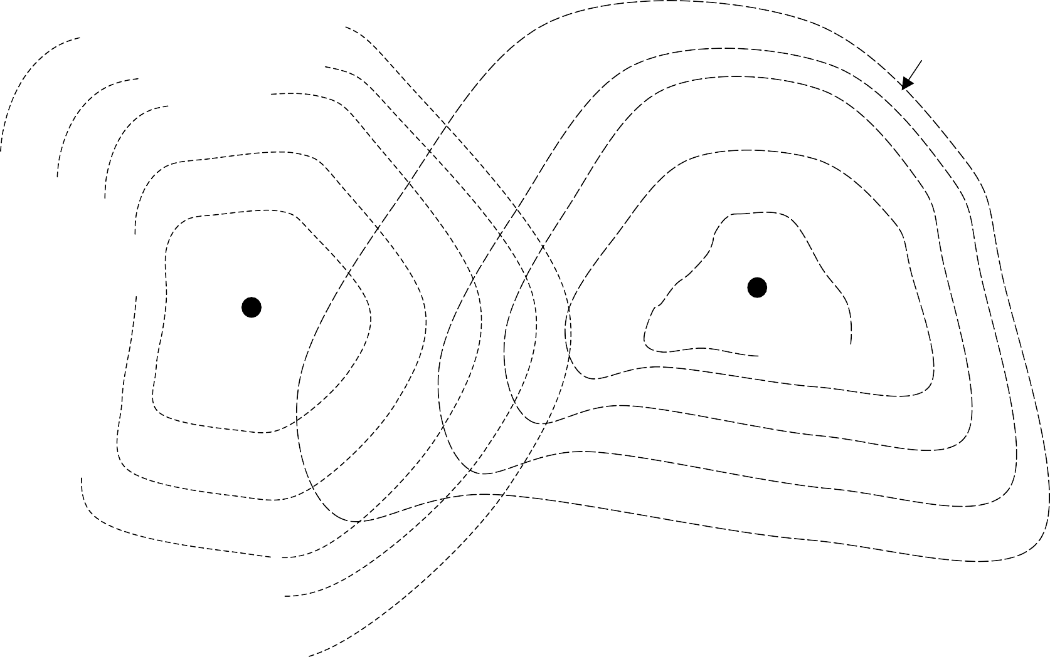
Signal Strength
Signal strength (in dB)
Cell i
Cell j
-60
-60
-70
-80
-70
-80
-90
-100
-90
-100
Signal strength contours indicating actual cell tiling. This happens because of terrain, presence of obstacles and signal attenuation in the atmosphere.
5

Slide 6

Handoff Region
Signal strength
Signal strength due to BS_{j}
due to BS_{i}
P_{i}(x)
P_{j}(x)
E
^{P}min
BS_{i}
MS BS
X₁ X₃ X X X X
j
5
th
4
2
By looking at the variation of signal strength from either base station it is possible to decide on the optimum area where handoff can take place.

Slide 7

Cell Capacity
Average number of MSs requesting service (Average arrival rate): λ
Average length of time MS requires service (Average holding time): T
Offered load: a = λT
e.g., in a cell with 100 MSs, on an average 30 requests are generated during an hour, with average holding time T=360 seconds.
Then, arrival rate λ=30/3600 requests/sec.
A channel kept busy for one hour is defined as one Erlang (a), i.e.,
_{a =} 30 Calls ⋅ 360 Sec _{= 3 Erlangs}
3600 Sec call

Slide 8

Cell Capacity
Average arrival rate during a short interval t is given by λt
Assuming Poisson distribution of service requests, the probability P(n, t) for n calls to arrive in an interval of length t is given by
(λ t )^{n}
P ( n , t ) = e
λ t
n !
Assuming μ to be the service rate, probability of each call to terminate during interval t is given by μt.
Thus, probability of a given call requires service for time t
or less is given by
s(t ) = 1 − e ^{− μ t}

Slide 9

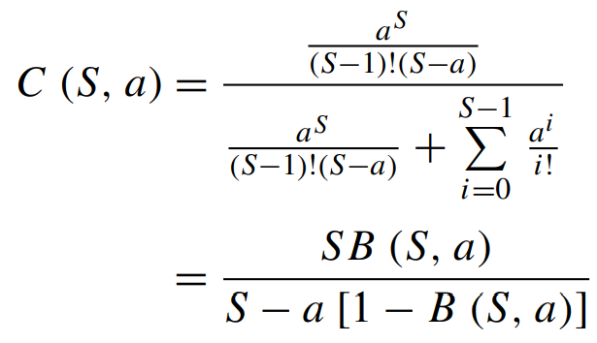
Erlang B and Erlang C
Probability of an arriving call being blocked is
S
B(S, a) = ª ⋅
1
_{a}i
,
Erlang B formula
S!
S
∑
i!
i=1
where S is the number of channels in a group.
Probability of an arriving call being delayed is
Erlang C formula
where C(S, a) is the probability of an arriving call being delayed with
a load and S channels.

Slide 10

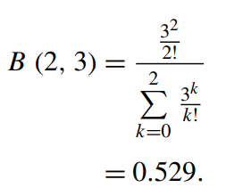
Efficiency (Utilization)
_{Efficiency =} Traffic nonblocked
Capacity
₌ Erlangs × portions of nonrouted traffic Number of trucks (channels)
Example: for previous example, if S=2, then
B(S, a) = 0.529, ------ Blocking probability, i.e., 60% calls are blocked.
Total number of rerouted calls = 30 x 0.6 = 18 Efficiency = 3(1-0.529)/2 = 0.7065

Slide 11

Cell Structure
F7 F2
F1 F2
F1 F2
F6 F1
F3
F1 F2
F3
F3
F3
F4
F5 F4
(a) Line Structure
(b) Plan Structure
Note:
Fx is set of frequency, i.e., frequency group.

Slide 12

Frequency Reuse
F7 F2
Same frequency can be used in multiple cell which are far apart
F7 F2
F6
F1
F3
F6
F1
F3
F5 F4 F7 F2
F5 F4 F7 F2
F1
F6 F1
F3
F1
F6 F1
F3
F5 F4
Reuse distance D
F5 F4
Fx: Set of frequency
7 cell reuse cluster

Slide 13


Reuse Distance
R
Cluster
For hexagonal cells, the reuse distance is given by
D = 3N R
where R is cell radius and N is the reuse pattern (the cluster size or the number of cells per cluster).
Reuse factor is
F7 F2
F1
F6
F3
F5 F4 F7 F2
F1
F6 F1
F3
D ₌
3N
Reuse distance D
F5 F4
R

Slide 14

Reuse Distance (Cont’d)
The cluster size or the number of cells per cluster is given by
N = i² + ij + j ²
j
where i and j are integers.
60º
i
N = 1, 3, 4, 7, 9, 12, 13, 16, 19, 21, 28, …, etc.
The popular value of N being 4 and 7.

Slide 15
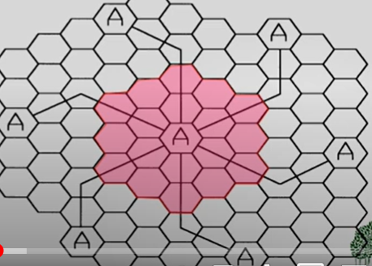
Reuse Distance (Cont’d
j = 2
i = 3
N = 9 + 3*2 + 4
= 19
15

Slide 16
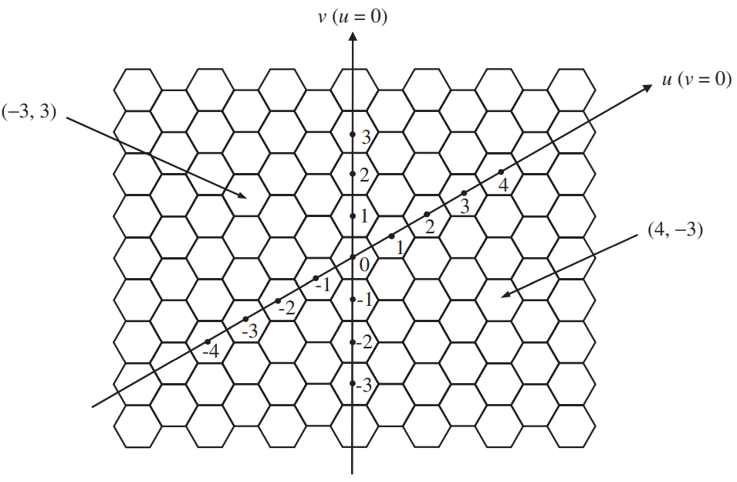
How to form a Cluster
16

Slide 17


How to form a Cluster
Here j = 1
N = The number of cell to be clustered
Frequency Label L whose center is at (u, v):
17

Slide 18
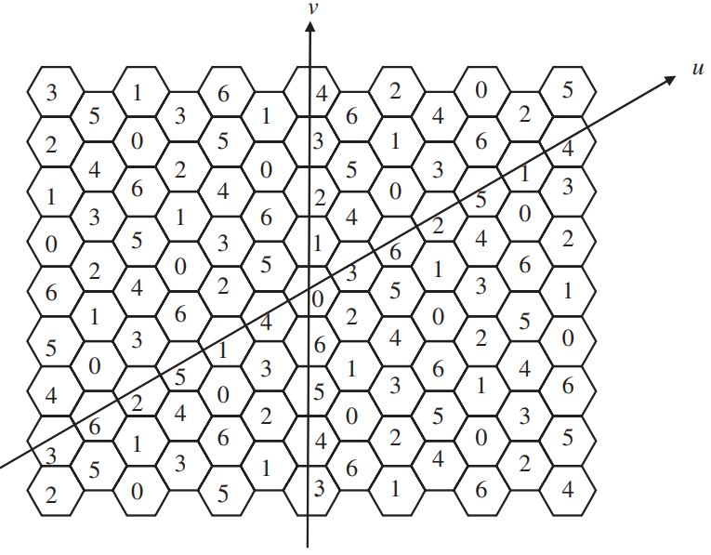


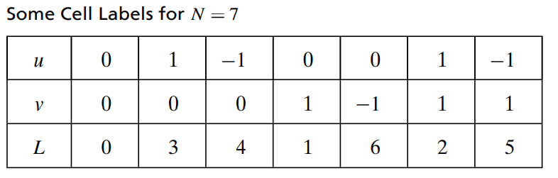
Example
N = The number of cell to be clustered
Given, N =7, Then i = 2
18

Slide 19

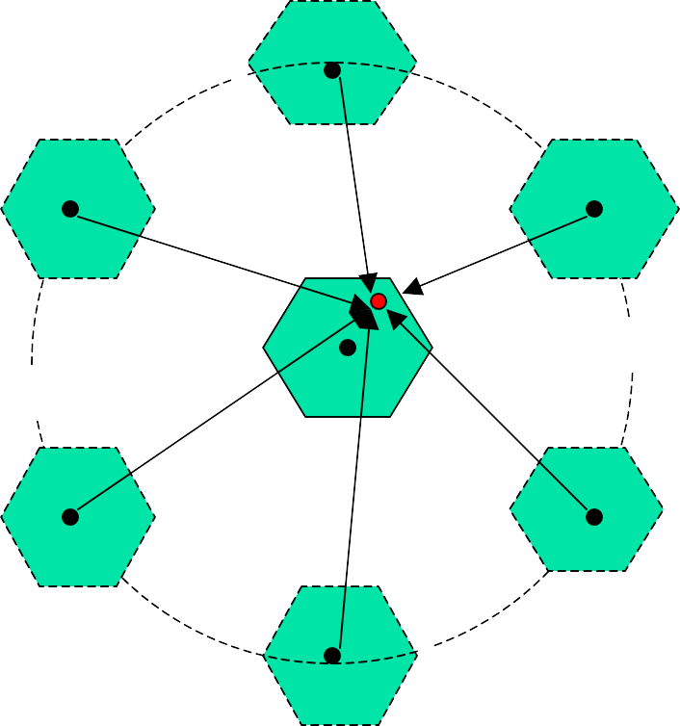
Cochannel Interference
First tier cochannel Base Station
Second tier cochannel Base Station
R
D₆
D₅
D₁
D₄
D₂
Mobile Station
D₃
D
Serving Base Station

Slide 20

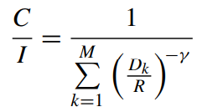
Cochannel Interference
Cochannel interference ratio is given by
C ₌ Carrier C I Interference
=
M
∑
I
k
k =1
where I is co-channel interference and M is the maximum number of co-channel interfering cells.
For M = 6, C/I is given by
where γ is the propagation path loss slope and γ = 2~5.

Slide 21

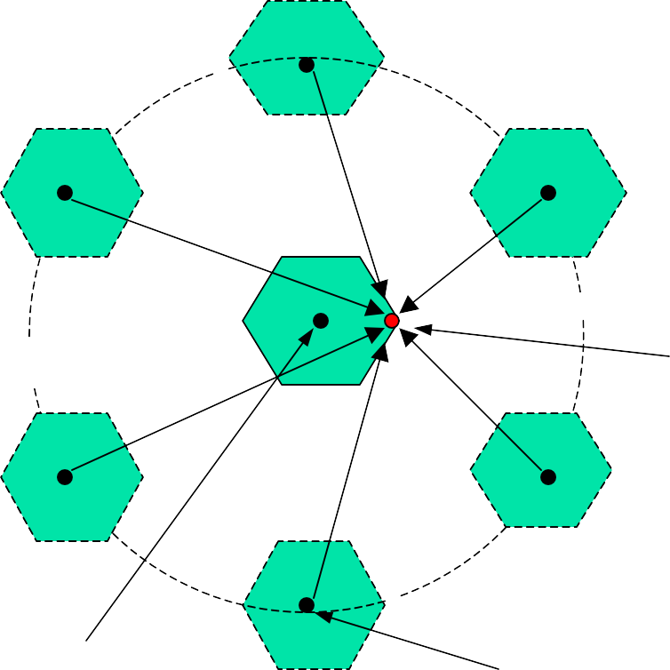

Worst Case of Cochannel Interference
D₆
R
D₅
D₁
D₄
Mobile Station
D₂
D₃
Serving Base Station
Co-channel Base Station
Here, q= D/R

Slide 22
Cell Splitting
The BSs of all cells transmit information at the same power level so that the net coverage area for each cell is the same.
Resource demand may depend on the density of users in a given area.
Need to split a cell into several small cells with the increased number of traffics.
Additional BSs need to be established at the center of each new cell so that higher density of calls can be handled effectively.
22

Slide 23

Cell Splitting
Large cell (low density)
Small cell (high density)
Smaller cell (higher density)
Depending on traffic patterns the smaller cells may be activated/deactivated in order to efficiently use cell resources.

Slide 24

Cell Sectoring by Antenna Design
c
c
120º
120º
a
b
a
b
(a). Omni
(b). 120º sector
(c). 120º sector (alternate)
d
f
90º
a
e
60º
a
c
d
b
b
c
(d). 90º sector
(e). 60º sector

Slide 25

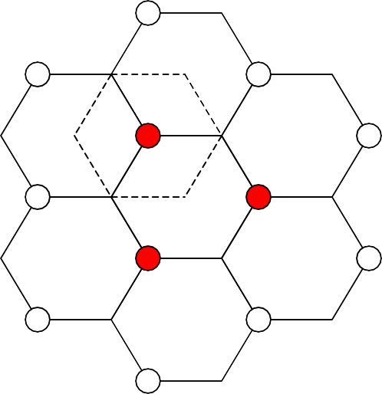
Cell Sectoring by Antenna Design
it requires coverage of a smaller area by each antenna and hence lower power is required in transmitting radio signals
It also helps in decreasing interference between co-channels
Placing directional transmitters at corners where three adjacent cells meet.
B
C
X
A

