Slide 1
Chapter 1
INTRODUCTION

Slide 2



The History of Mobile Radio Communication (1/3)
1880: Hertz – Initial demonstration of practical radio communication
1897: Marconi – Radio transmission to a tugboat over an 18 mi path
1921: Detroit Police Department: -- Police car radio dispatch (2 MHz frequency band)
1933: FCC (Federal Communications Commission) – Authorized four channels in the 30 to 40 MHz range
1938: FCC – Ruled for regular service
1946: Bell Telephone Laboratories – 152 MHz (Simplex)
1956: FCC – 450 MHz (Simplex)
1959: Bell Telephone Laboratories – Suggested 32 MHz band for high capacity mobile radio communication
1964: FCC – 152 MHz (Full Duplex)
1964: Bell Telephone Laboratories – Active research at 800 MHz
1969: FCC – 450 MHz (Full Duplex)
1974: FCC – 40 MHz bandwidth allocation in the 800 to 900 MHz range
1981: FCC – Release of cellular land mobile phone service in the 40 MHz bandwidth in the 800 to 900 MHz range for commercial operation

Slide 3

The History of Mobile Radio Communication (2/3)
1981: AT&T and RCC (Radio Common Carrier) reach an agreement to split 40 MHz spectrum into two 20 MHz bands. Band A belongs to nonwireline operators (RCC), and Band B belongs to wireline operators (telephone companies). Each market has two operators.
1982: AT&T is divested, and seven RBOCs (Regional Bell Operating Companies) are formed to manage the cellular operations
1982: MFJ (Modified Final Judgment) is issued by the government DOJ. All the operators were prohibited to (1) operate long-distance business, (2) provide information services, and (3) do manufacturing business
1983: Ameritech system in operation in Chicago
1984: Most RBOC markets in operation
1986: FCC allocates 5 MHz in extended band
1987: FCC makes lottery on the small MSA and all RSA licenses
1988: TDMA (Time Division Multiple Access) voted as a digital cellular standard in North America
1992: GSM (Groupe Speciale Mobile) operable in Germany D2 system

Slide 4

The History of Mobile Radio Communication (3/3)
1993: CDMA (Code Division Multiple Access) voted as another digital cellular standard in North America
1994: American TDMA operable in Seattle, Washington
1994: PDC (Personal Digital Cellular) operable in Tokyo, Japan
1994: Two of six broadband PCS (Personal Communication Service) license bands in auction
1995: CDMA operable in Hong Kong
1996: US Congress passes Telecommunication Reform Act Bill
1996: The auction money for six broadband PCS licensed bands (120 MHz) almost reaches 20 billion US dollars
1997: Broadband CDMA considered as one of the third generation mobile communication technologies for UMTS (Universal Mobile Telecommunication Systems) during the UMTS workshop conference held in Korea
1999: ITU (International Telecommunication Union) decides the next generation mobile communication systems
(e.g., W-CDMA, cdma2000, etc)

Slide 5


Applications
Washington, DC
Cincinnati, OH
Maintaining the telephone number across geographical areas in a wireless and mobile system

Slide 6

First Generation Cellular Systems and Services
1970s | Developments of radio and computer technologies for 800/900 MHz mobile communications
1976 | WARC (World Administrative Radio Conference) allocates spectrum for cellular radio
1979 | NTT (Nippon Telephone & Telegraph) introduces the first cellular system in Japan
1981 | NMT (Nordic Mobile Telephone) 900 system introduced by Ericsson Radio System AB and deployed in Scandinavia
1984 | AMPS (Advanced Mobile Phone Service) introduced by AT&T in North America

Slide 7

Second Generation Cellular Systems and Services
1982 | CEPT (Conference Europeenne des Post et Telecommunications) established GSM to define future Pan-European cellular Radio Standards
1990 | Interim Standard IS-54 (USDC) adopted by TIA (Telecommunications Industry Association)
1990 | Interim Standard IS-19B (NAMPS) adopted by TIA
1991 | Japanese PDC (Personal Digital Cellular) system standardized by the MPT (Ministry of Posts and Telecommunications)
1992 | Phase I GSM system is operational
1993 | Interim Standard IS-95 (CDMA) adopted by TIA
1994 | Interim Standard IS-136 adopted by TIA
1995 | PCS Licenses issued in North America
1996 | Phase II GSM operational
1997 | North American PCS deploys GSM, IS-54, IS-95
1999 | IS-54: North America IS-95: North America, Hong Kong, Israel, Japan, China, etc GSM: 110 countries

Slide 8

Third Generation Cellular Systems and Services (1/2)
IMT-2000 (International Mobile Telecommunications-2000):
Fulfill one's dream of anywhere, anytime communications a reality.
Key Features of IMT-2000 include:
High degree of commonality of design worldwide;
Compatibility of services within IMT-2000 and with the fixed networks;
High quality;
Small terminal for worldwide use;
Worldwide roaming capability;
Capability for multimedia applications, and a wide range of services and terminals.

Slide 9

Third Generation Cellular Systems and Services (2/2)
Important Component of IMT-2000 is ability to provide high bearer rate capabilities:
2 Mbps for fixed environment;
384 Kbps for indoor/outdoor and pedestrian environment;
144 kbps for vehicular environment.
Standardization Work:
In processing
Scheduled Service:
Started in October 2001 in Japan (W-CDMA)

Slide 10
1G , 2G and 3G
1G:
- Cell structure introduced
- Uses FDMA
- Only voice communication
2G:
- Uses TDMA and CDMA
- Included SMS and Data Services
3G:
- Video calling, web surfing, multimedia streaming

Slide 11

Subscriber Growth
3G Subscribers
Subscribers
2G Digital only Subscribers
1G Analogue only Subscribers
1990
1991
1992
1993
1994
1995
1996
1997
1998
1999
2000
2001
2002
2003
2004
2005
2006
2007
2008
2009
2010
Year

Slide 12

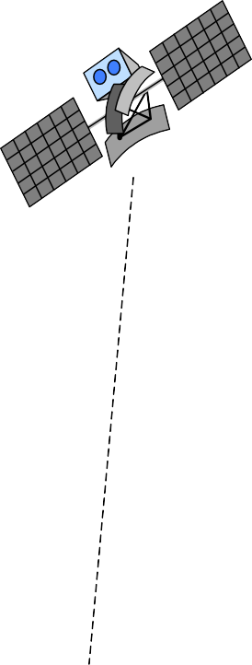
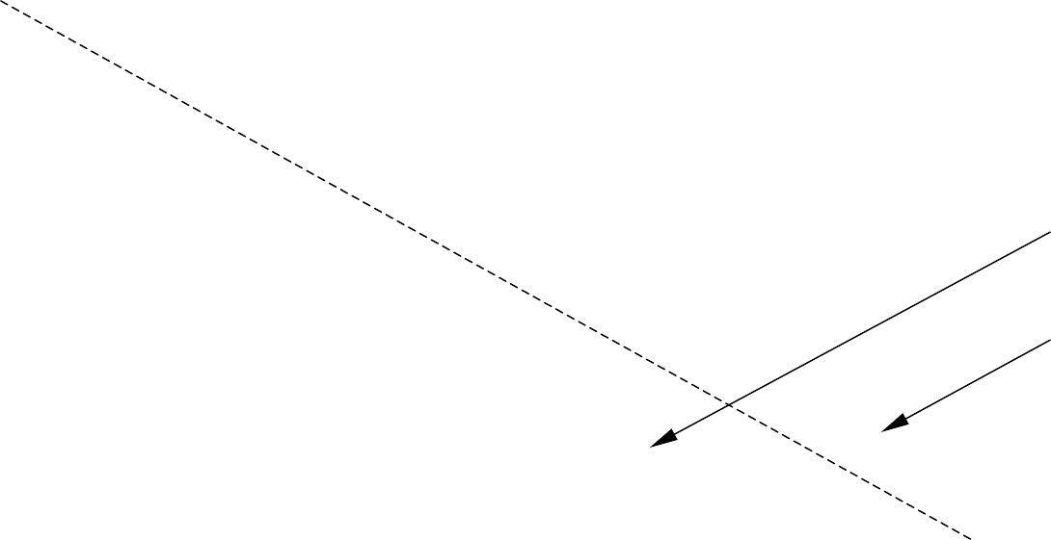
Coverage Aspect of Next Generation Mobile
Communication Systems
Satellite
In-Building
Urban Suburban
Global
Picocell
Microcell
Macrocell
Global

Slide 13

Wireless Technology and Associated Characteristics
Cellular
Wireless LAN/PAN
GPS
Home Networking
Ad Hoc Networks
Sensor Networks
Bluetooth

Slide 14



Fundamentals of Cellular Systems
Ideal cell area (2-10 km radius)
Cell
BS
MS
Alternative shape of a cell
MS
Hexagonal cell area used in most models
Illustration of a cell with a mobile station and a base station

Slide 15

FDMA (Frequency Division Multiple Access)
Frequency
User n
…
User 2
User 1
Time

Slide 16

FDMA Bandwidth Structure
 | 1 | 2 | 3 | 4 | … | n
Frequency
Total bandwidth

Slide 17

FDMA Channel Allocation
Frequency 1
User 1
Frequency 2
User 2
…
User n
…
Frequency n
Mobile Stations
Base Station

Slide 18

TDMA (Time Division Multiple Access)
Frequency
User 1 | User 2 | … | User n
Time

Slide 19

TDMA Frame Structure
1
2
3
4
…
n
Time
Frame

Slide 20

TDMA Frame Illustration for Multiple Users
User 1
Time 1
Time 2
User 2
…
…
…
Time n
User n
Mobile Stations
Base Station

Slide 21

CDMA (Code Division Multiple Access)
Frequency
User 2
User 1
. . .
User n
Time
Code

Slide 22

Transmitted and Received Signals in a CDMA System
Information bits
Code at transmitting end
Transmitted signal
Received signal
Code at receiving end
Decoded signal at the receiver

Slide 23

Frequency Hopping
Frequency
Combination of FDMA and TDMA
Frame
Slot
f₁
f₂ f₃
f₄ f₅
Time

Slide 24

Cellular System Infrastructure
Huge amount of power is required
Service area (Zone)
BS
Early wireless system: Large zone

Slide 25

Cellular System: Small Zone
BS
BS
Service area
BS
BS
BS
BS
BS

Slide 26

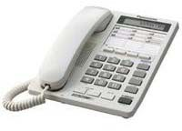
Cellular System Infrastructure
PSTN
Home phone
MSC
…
MSC
BSC
…
BSC
BSC
…
BSC
_{BS} MS
…
_{BS} MS
MS _{BS}
…
MS _{BS}

Slide 27

Control and Traffic Channels
Forward (downlink) control channel
Four simplex channels
are required:
- To transfer control message and traffic
Reverse (uplink) control channel
Forward (downlink) traffic channel
Reverse (uplink) traffic channel
Mobile Station
Base Station

Slide 28

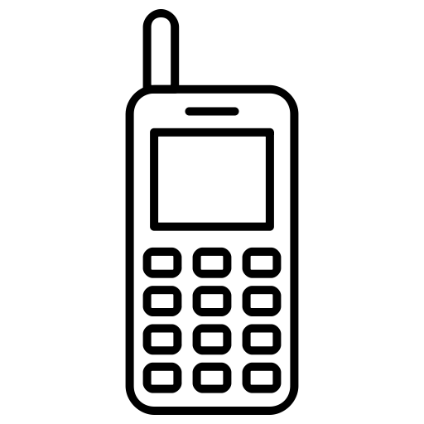
Steps for a Call Setup from MS to BS
BS
MS
Need to establish path
Frequency/time slot/code assigned (FDMA/TDMA/CDMA)
Control Information Acknowledgement
Start communication

Slide 29

Steps for a Call Setup from BS to MS
BS
MS
Call for MS # pending
Ready to establish a path
Use frequency/time slot/code (FDMA/TDMA/CDMA)
Ready for communication
Start communication

Slide 30

A Simplified Wireless Communication System Representation
Antenna
Information to be transmitted (Voice/Data)
Coding
Modulator
Transmitter
Carrier
Antenna
Information received (Voice/Data)
Decoding
Demodulator
Receiver
Carrier

Slide 31

Satellite Systems
Traditional Applications
Weather satellite
Radio and TV broadcasting
Military satellites
Telecommunication Applications
Global telephone connections
Backbone for global network
GPS

Slide 32

Network Architectures and Protocols
Systematic Signaling Steps for Information Exchange
Open Systems Interconnections (OSI)
Transmission Control Protocol (TCP)
Internet Protocol (IP)
Internet Protocol Version 4 (IPv4)
Internet Protocol Version 6 (IPv6) – Work in progress
Mobile IP

Slide 33
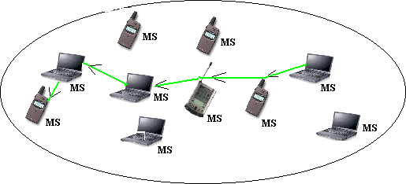
Ad Hoc Network

Slide 34

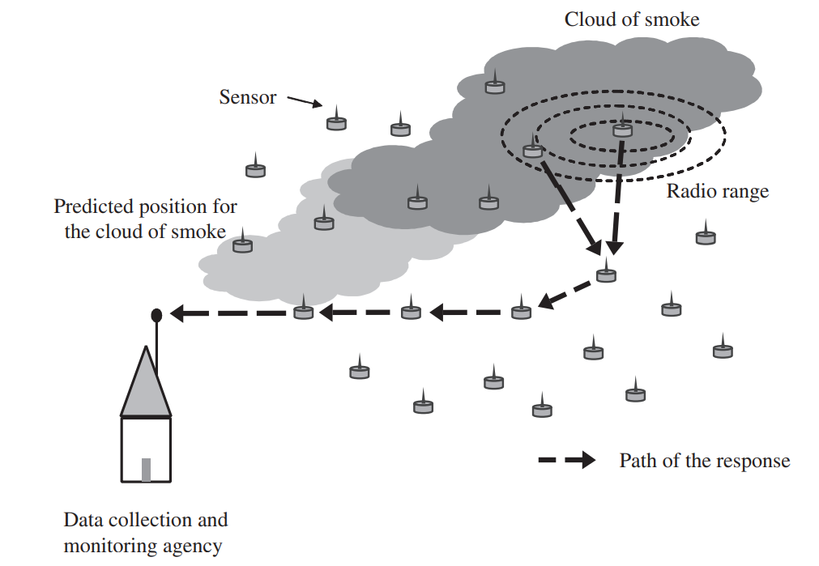
Wireless Sensor Network

Slide 35


Wireless Sensor Networks
Base station
Antenna
Target
Sensor

Slide 36
Wireless LAN and PAN
Wireless Local Area Network (LAN) using the IEEE 802.11
HiperLAN is a European Standard
Wireless Personal Area Network (PAN)
Bluetooth
HomeRF

