Slide 1

Web-based ”Agriculture Assist “
Department of Computer Science and Engineering (CSE)
Bangladesh University of Business and Technology (BUBT)
Notes:
73

Slide 2
Submitted By
Mehfuz Ahmed | 15162103151
Md Mosfequr Rahman | 15162103152
Supervised By
Shamim Ahmed
Assistant Professor, Department of CSE, (BUBT)
Notes:
73

Slide 3
Contents
Introduction
Existing Systems
Problem Statement
Implementation
Graphical Interface
Conclusions
Reference
Notes:
73

Slide 4
Introduction
Developing and testing innovative farming systems
Increase food production
Reducing the environmental footprint
Availability of agricultural information
precision agriculture technologies
Improve productivity and profitability
Notes:
73

Slide 5
Existing System
This web site has been created with the technical assistance of the Department of Agriculture Extension.
In the last years, the Initiative for Total Reform launched the largest agricultural web site in Bangla language
Green savers are conducting various philanthropic activities for the development of environment and

Slide 6
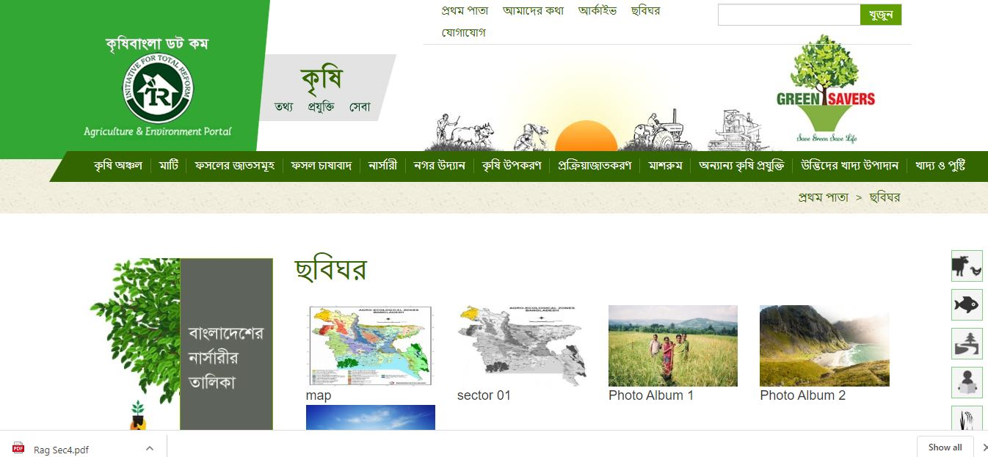
Existing System
কৃষি বাংলা

Slide 7
Existing System
In the private sector for the rapid expansion of modern agricultural technology and easy access to agriculture for all concerned with the use of Information
Communication Technology for the country's agricultural development.
Green savers are conducting various philanthropic activities for the development of environment and
urban agriculture in the country.

Slide 8
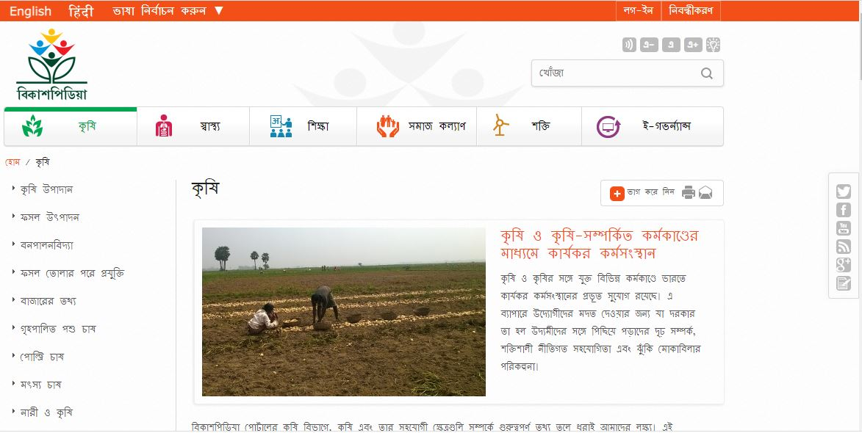
Existing System
বিকাশপিডিয়া

Slide 9
Problem Statement
Farmers do not know how to upload problems inside of the project
They did not know how to collect crop disease pictures
How they will follow the professor's answers and act according to that answer
From time to time, they will need to apply pesticides according to the professor answer

Slide 10
Implementation
Data-Flow Diagram (DFD)
Use case diagram
ER Diagram
Software requirements

Slide 11
Data Flow Diagram
Admin
Replay Answer
User
Registration
Problem
Login
Farmer
User
Professors

Slide 12
Use Case Diagram
Registration
Login
Homepage
Professor
Answer Queries
Upload problem
User List
Admin
Problem List
Farmer

Slide 13
ER Diagram
User type
Contact
contact
Address
Name
Address
Name
password
Registration
id
id
username
Professor
answer
Farmer
username
password
User
username
User
Contact
Admin
username
Login
Address
Name
id
password

Slide 14
Software Requirements
Development Language: PHP
Database Server: MySQL Server with version
Front End: Html , CSS
Back End : JavaScript, PHP

Slide 15
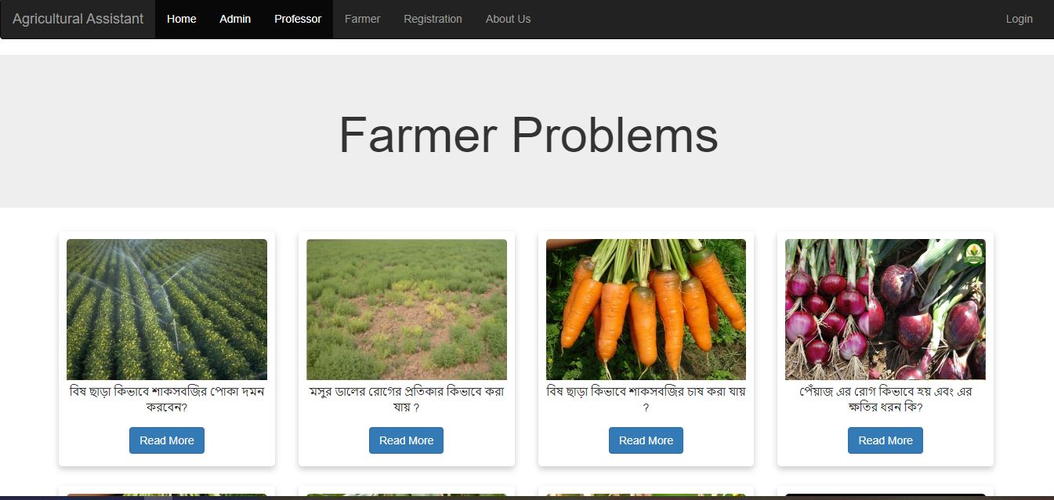
Graphical Interface
Homepage

Slide 16
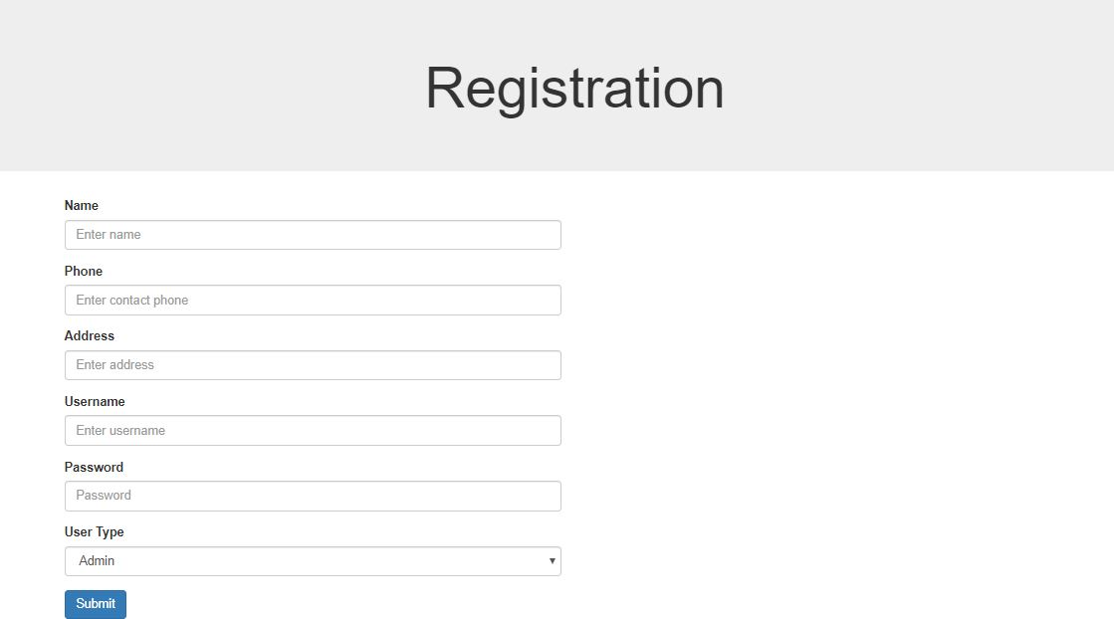
Graphical Interface
Registration Page
Notes:
73

Slide 17
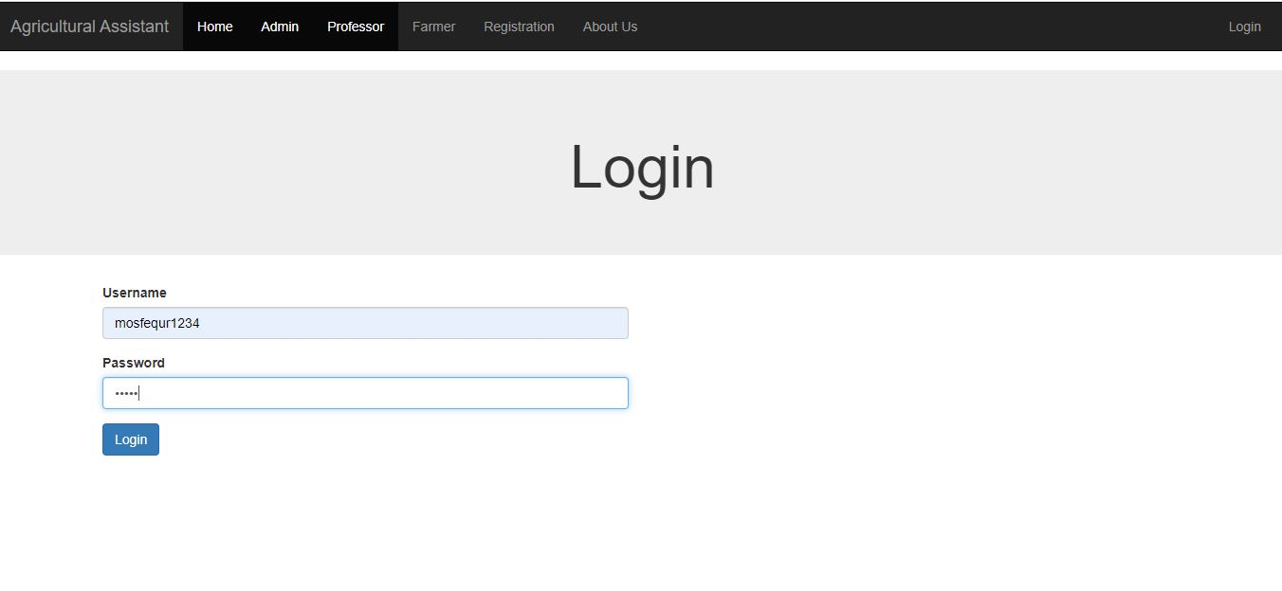
Graphical Interface
Login Page
Notes:
73

Slide 18
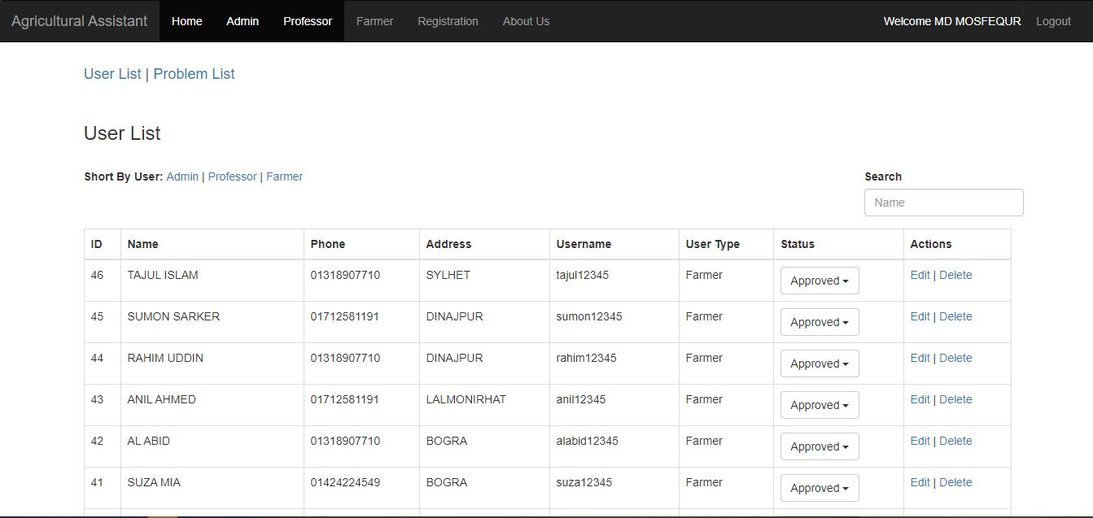
Graphical Interface
User List
Notes:
73

Slide 19
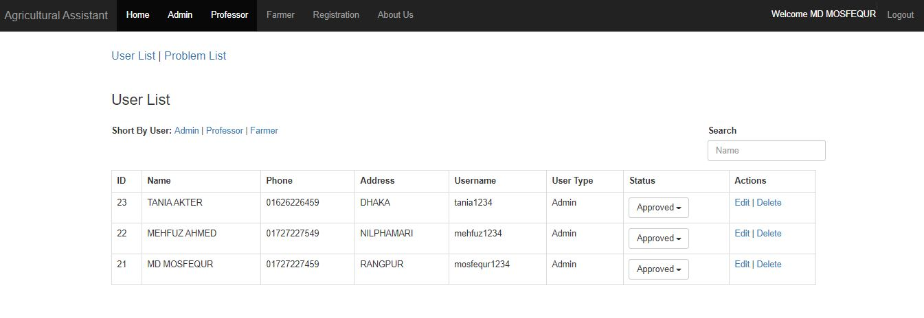
Graphical Interface
Admin list

Slide 20
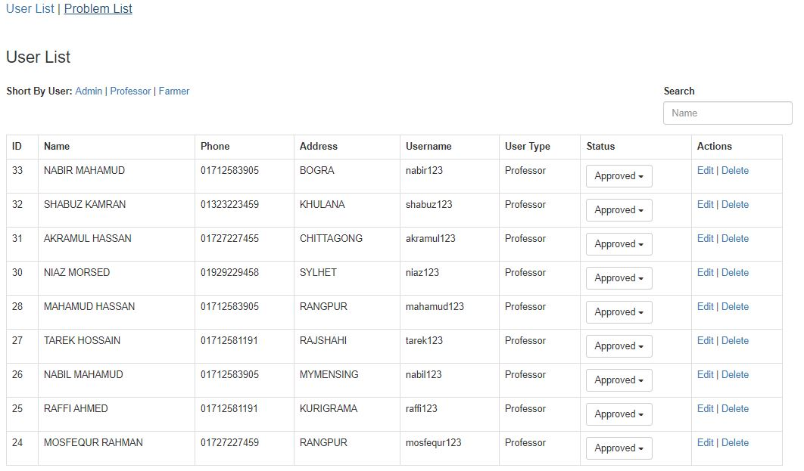
Graphical Interface
Professors list

Slide 21
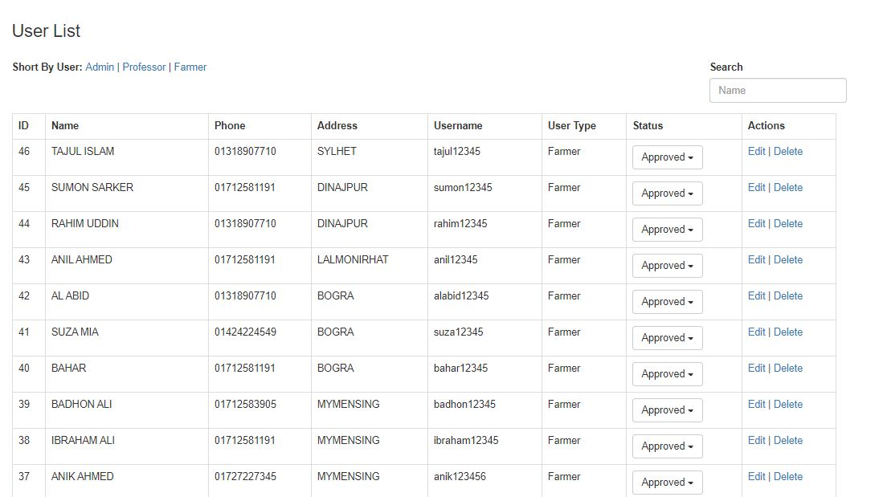
Graphical Interface
Farmer list

Slide 22
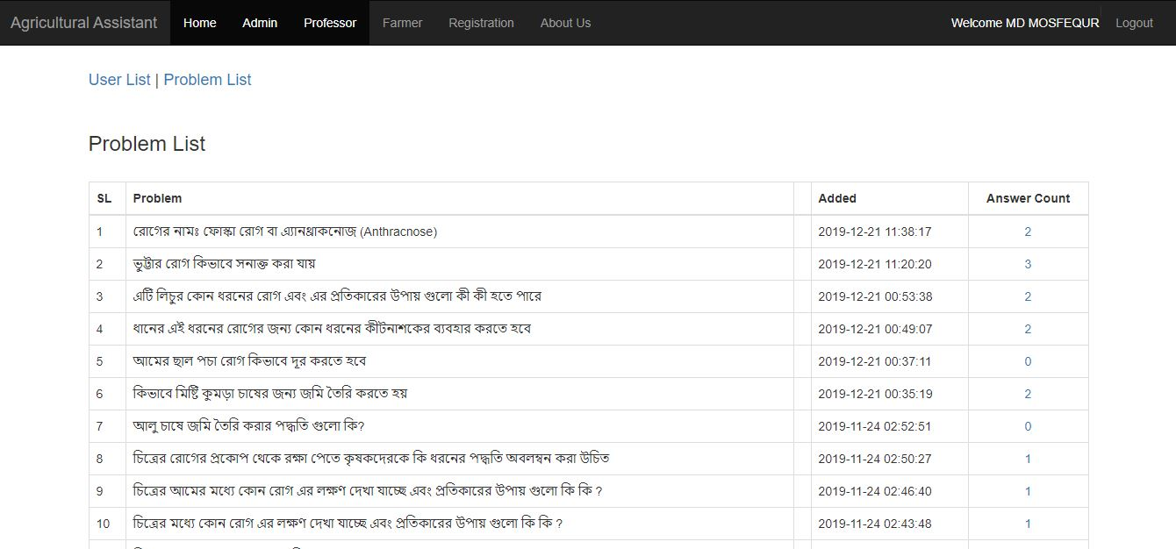
Graphical Interface
Problem List
Notes:
73

Slide 23
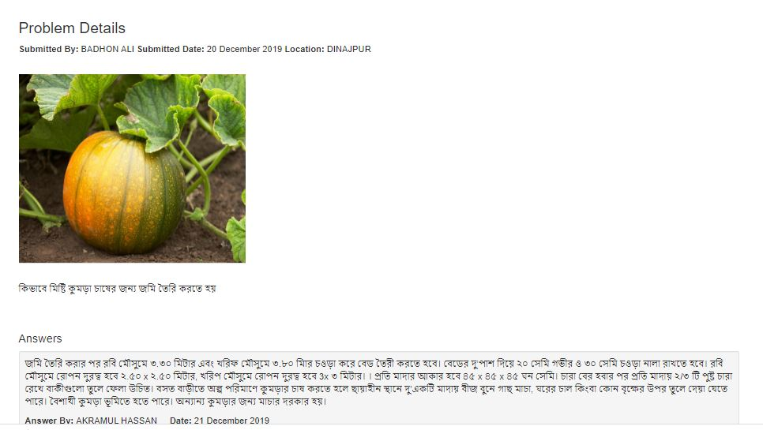
Graphical Interface
Problem Details
Notes:
81

Slide 24
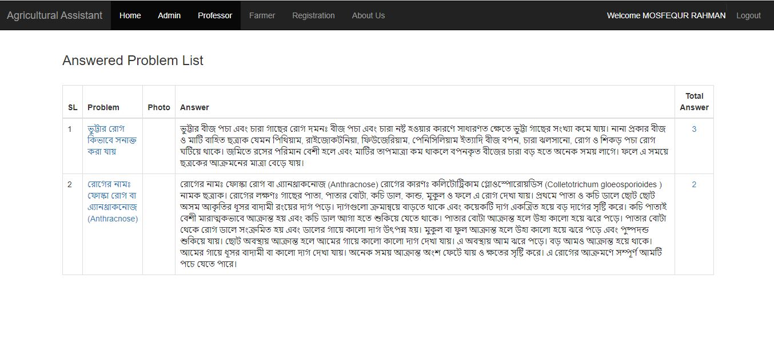
Graphical Interface
Answer List
Notes:
73

Slide 25
Advantages of this system
Its will help to resolve these problems
Save time and cost
It is user friendly
Hassle free
Notes:
73

Slide 26
Conclusion
This work is an initial step to show that the creation this kind of Agricultural Assist is feasible. The real benefits of this type of Agricultural Assist to agriculturally based country such as Bangladesh can be seen when it becomes operational, as planters, Farmers, Professors and Students will have access to up-to-date information.
Notes:
81

Slide 27
Future Work
Some additional features may be added to this system:
Remove Environmental Impacts
Improved Opportunity
Vulnerability Reduction
Distribution of Project Costs and Benefits
Notes:
81

Slide 28
Reference
https://www.krishibangla.com/album
https://moa.gov.bd/
https://www.bau.edu.bd
http://bn.vikaspedia.in/agriculture/
Notes:
81

Slide 29
The End
Thank you for your kind presence
Notes:
81

