Slide 1

Well Come To My Project

Slide 2

My Project Name Is -Covid-19: Comparative Data Analysis And Prediction For The World And Bangladesh.

Slide 3
MY Named-Farid hossain
My student id - 23006446
Institution-University of Hertfordshire
College Lane, Hatfield, Herts AL10 9AB,United Kingdom
Date-10-02-2025
My project github link: https://github.com/Fariduk/PROJECT-DATA-SCIENCE-COVID-19-Comparative-Data-Analysis-and-Prediction-for-the-World-and-Bangladesh.git

Slide 4
This Project Provide To
MSc Data Science Project Module Leader
Darshan Kakkad
d.m.kakkad@herts.ac.uk
University of Hertfordshire
College Lane, Hatfield,
Herts AL10 9AB, United Kingdom

Slide 5
My Project Supervisor Name Is - William Bate
Email Address: w.bate@herts.ac.uk

Slide 6
Introduction
What is COVID - 19?
Coronavirus disease 2019 (COVID-19) is a contagious respiratory and vascular disease caused by severe acute respiratory syndrome coronavirus 2 (SARS-CoV-2). The first case was identified in Wuhan, China in December 2019, though evidence suggests that the virus may have already been actively spreading months earlier in places such as Italy.
Common symptoms of COVID-19 include fever, cough, fatigue, breathing difficulties, and loss of smell and taste.Symptoms begin one to fourteen days after exposure to the virus.While most people have mild symptoms, some people develop acute respiratory distress syndrome (ARDS). ARDS can be precipitated by cytokine storms,multi-organ failure, septic shock, and blood clots. Longer-term damage to organs (in particular, the lungs and heart) has been observed.

Slide 7
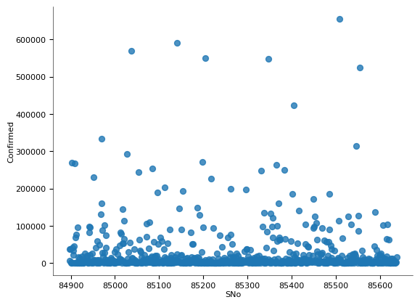
Brief overview of the Covid-19 pandemic
The COVID-19 pandemic, caused by the SARS-CoV-2 virus, emerged in late 2019 in Wuhan, China. It rapidly spread worldwide, leading the World Health Organization (WHO) to declare it a global pandemic on March 11, 2020. The virus primarily spreads through respiratory droplets and can cause mild to severe respiratory illness, with symptoms ranging from fever and cough to severe pneumonia and organ failure.
Governments worldwide implemented lockdowns, travel restrictions, and social distancing to curb transmission. The pandemic led to significant disruptions in healthcare, economies, and daily life. Scientists and pharmaceutical companies raced to develop vaccines, with the first ones, including Pfizer-BioNTech and Moderna, being rolled out in late 2020. Mass vaccination campaigns have since helped reduce severe cases and mortality rates.
Despite global efforts, the pandemic exposed healthcare vulnerabilities and socioeconomic disparities. Variants like Delta and Omicron caused renewed waves of infections. As of today, while COVID-19 is largely under control in many regions, it remains a public health concern, emphasizing the need for ongoing surveillance, booster vaccinations, and preparedness for future pandemics.

Slide 8
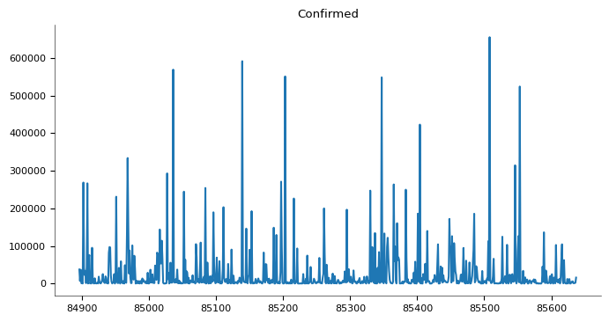
Importance of data analysis and prediction
Data analysis and prediction play a crucial role in understanding patterns, making informed decisions, and improving future outcomes across various domains, including healthcare, business, finance, and research.
Key Benefits:
Informed Decision-Making: Helps organizations and governments make data-driven policies.
Trend Identification: Detects emerging patterns and behaviors for proactive action.
Risk Mitigation: Predictive models help anticipate risks and prevent crises.
Optimization & Efficiency: Enhances resource allocation and operational effectiveness.
Scientific & Medical Advancements: Supports disease forecasting, like COVID-19 spread predictions.

Slide 9
Project objectives and scope-
1.Project Objectives: This project aims to analyze and predict the trends of COVID-19 cases globally and in Bangladesh using advanced data science techniques.
Affected Countries due to Covid-19
As per the data analysis, Covid-19 virus has spread out all over the world and affected 246 countries. Among the 246 countries the Top 5 countries those are affected vastly are,
United States of America (20.3%) of the worlds statistics. Second worst condition is of India, holding the share of 16.27% and the third one is Brazil, holding the 10.78% share of the worlds total confirmed cases tally. After that France and Russia showing their share percentage of 3.52 and 3.51 respectively.Bangladesh is 1.29% .

Slide 10
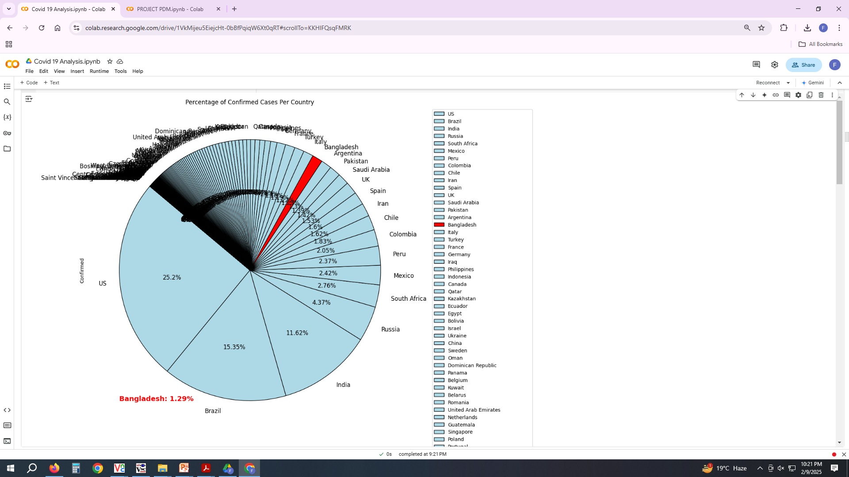

Slide 11
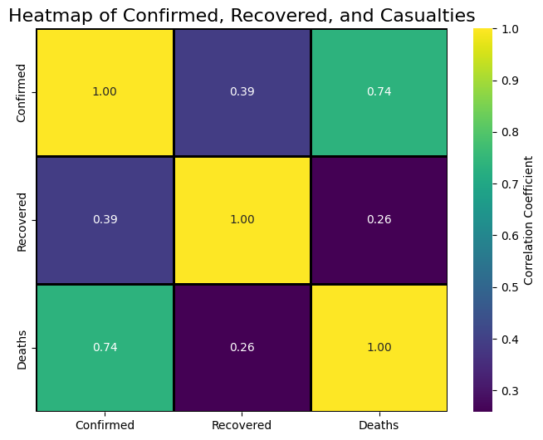
1.2 Comparative Data Analysis
Analyze COVID-19 case trends, mortality rates, and recovery patterns in Bangladesh and other countries.
Identify key factors influencing the spread and impact of COVID-19 across different regions.

Slide 12
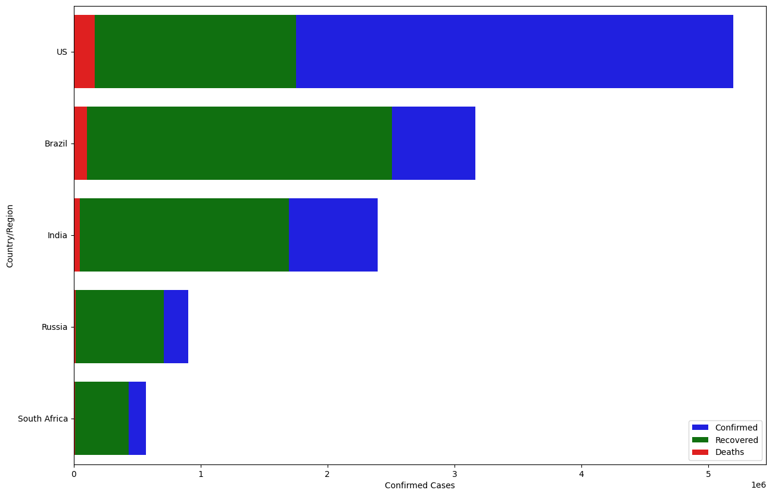
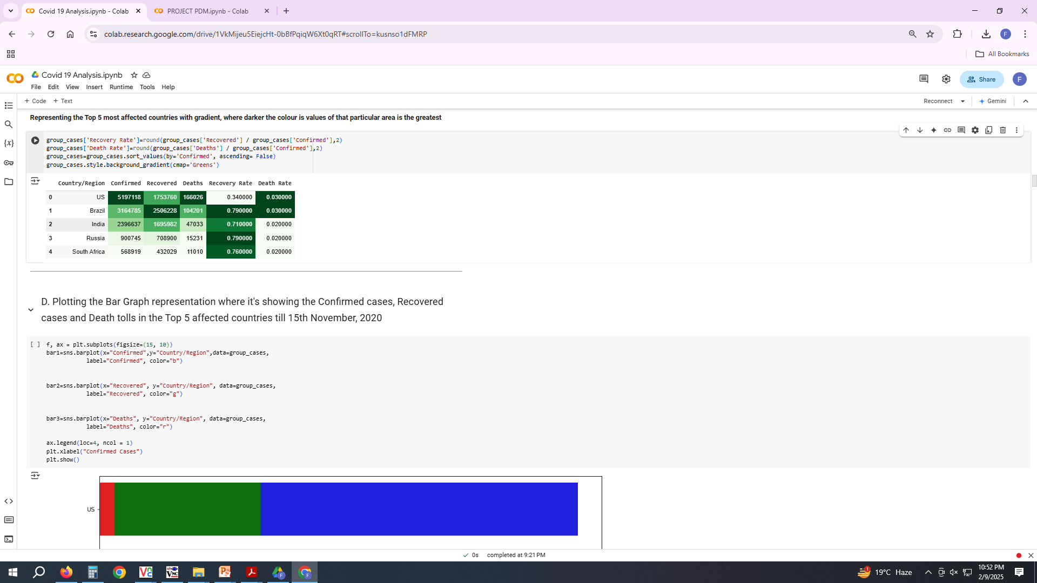
Recovery Rate and Death Rate Analysis
USA Highest number of Confirmed cases
USA Highest number of Death Cases
India Highest number of Recovered cases
India Highest Recovery rate (0.93)
Brazil Highest Death Rate (0.30)
France Lowest Recovery rate (0.07)
India Lowest Death Rate (0.01)
The Graphical representation is also reflecting the same stats.

Slide 13
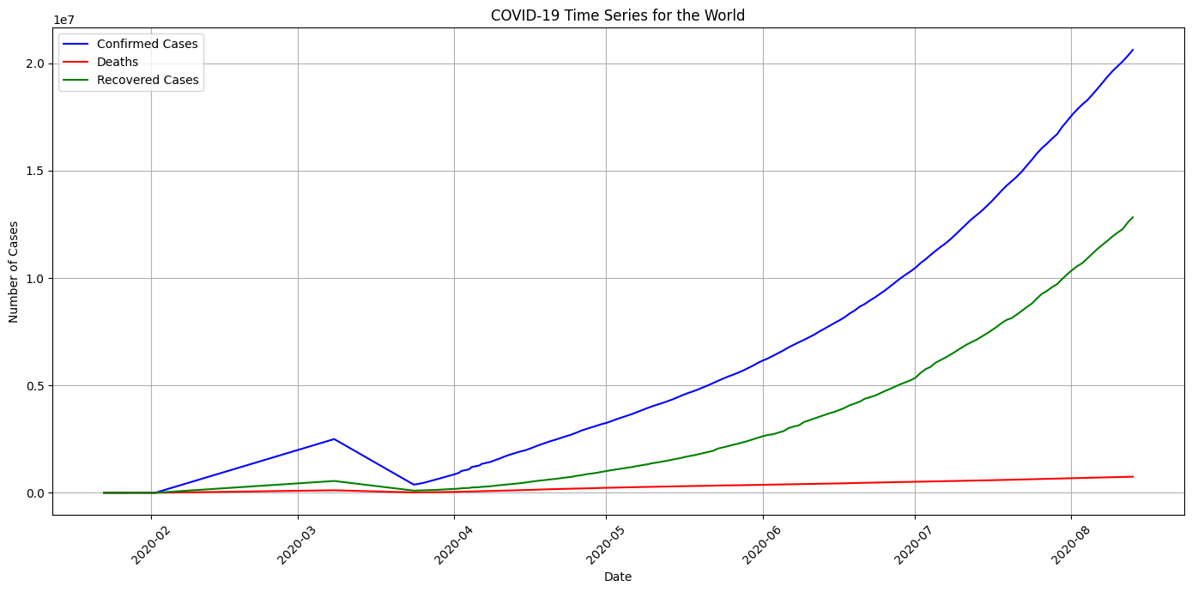
Predictive Modeling
Develop a Predictive Data Model (PDM) using TensorFlow and machine learning algorithms to forecast future COVID-19 trends.
Evaluate the accuracy of predictive models in estimating case surges and mortality rates.

Slide 14
Problem Statement
Why is Covid-19 prediction important?
Problem Statement: The COVID-19 pandemic has caused widespread disruptions, overwhelming healthcare systems, economies, and daily life. Understanding the spread patterns, mortality rates, and future trends of COVID-19 is critical for governments, healthcare professionals, and researchers. However, the unpredictability of the virus, the emergence of new variants, and regional differences in response strategies make accurate forecasting a challenge.
This project aims to address this issue by using data analysis and machine learning to:
Compare COVID-19 trends globally and in Bangladesh.
Develop predictive models to forecast future cases.
Provide insights to aid public health decision-making.

Slide 15
Why is COVID-19 Prediction Important?
Early Warning System Helps governments and healthcare systems prepare for case surges and allocate resources efficiently.
Hospital & Resource Management Ensures optimal distribution of ICU beds, ventilators, and vaccines based on predictive trends.
Policy & Lockdown Planning Assists in implementing data-driven restrictions and safety measures to reduce transmission.
Economic Stability Helps businesses and policymakers balance public health and economic activities through informed decisions.
Variant & Mutation Tracking Identifies patterns of new COVID-19 variants to mitigate future outbreaks.

Slide 16
Challenges in Covid-19 forecasting
1 Data Quality & Availability
Inconsistent Reporting Many countries report COVID-19 cases differently, leading to data gaps.
Underreporting & Misinformation Lack of testing and hidden cases affect accuracy.
Evolving Variants The emergence of new strains (e.g., Delta, Omicron) changes infection patterns.
2 Model Uncertainty & Accuracy
Changing Virus Behavior Mutations make it hard to build long-term predictive models.
Dynamic Human Responses Government policies, lockdowns, and public behavior impact case trends.
Lack of Universal Models No single model fits all regions due to diverse healthcare systems and climates.
3 Data Processing & Computational Limitations
Big Data Handling Large datasets require significant computing power.
Bias in Machine Learning Models Some models may favor certain regions due to biased training data.
Integration of Multisource Data Combining data from WHO, Kaggle, and country-specific sources is challenging.

Slide 17
4 Ethical & Privacy Concerns
Personal Data Protection Ensuring privacy when using patient-level data.
Government Restrictions Some countries limit data sharing, affecting global predictions.
5 Unpredictable Social & Economic Factors
Vaccine Hesitancy & Distribution Unequal access to vaccines affects recovery trends.
Global Mobility & Travel Restrictions Border controls and reopening policies disrupt forecasts.
Misinformation & Public Behavior Social media misinformation impacts adherence to safety measures.
6 Addressing These Challenges
Using real-time data updates to improve prediction accuracy.
Applying deep learning and AI models that adapt to new COVID-19 variants.
Enhancing collaborative data-sharing across countries and institutions.
Ensuring ethical and transparent use of public health data.

Slide 18
Key questions this project addresses
1COVID-19 Trend Analysis
How do COVID-19 infection, recovery, and mortality rates compare between Bangladesh and other countries?
What factors (e.g., population density, government policies, vaccination rates) influence COVID-19 trends?
How effective were different countries' public health interventions in controlling the spread?
2 Predictive Modeling & Forecasting
Can we develop an accurate Predictive Data Model (PDM) using TensorFlow and machine learning?
How accurately can predictive models forecast future COVID-19 cases and mortality rates?
What role does data variability (e.g., underreporting, new variants) play in forecasting accuracy?
3 Policy & Healthcare Preparedness
How can forecasting models help governments and healthcare providers in resource allocation (e.g., ICU beds, ventilators, vaccines)?
What insights can be drawn from past lockdowns and restrictions to improve future pandemic responses?
How can data-driven approaches improve pandemic preparedness for future outbreaks?

Slide 19
Data Collection & Sources
Kaggle, WHO, Bangladesh Health Ministry, Johns Hopkins University
World Health Organization (2024). 'Covid-19 Global Data'. Available at: www.who.int
Kaggle (2024). 'Covid-19 Dataset'. Available at: www.kaggle.com
Bangladesh Government Health Ministry (2024). 'Covid-19 Division-wise Data'. Available at: www.dghealth.gov.bd, https://data.humdata.org/dataset/district-wise-quarantine-for-covid-19, https://data.mendeley.com/datasets/b98d8mj2xk/1 .
Data types: Cases, deaths, recoveries.
Data preprocessing steps.

Slide 20
Predictive Data Model (PDM) Overview
Definition of Predictive Data Model (PDM):
A Predictive Data Model (PDM) is a mathematical or statistical approach that uses historical data, machine learning algorithms, and statistical techniques to forecast future outcomes. These models analyze patterns and relationships in datasets to make accurate predictions about future trends.
Key Features of PDM:
Uses historical and real-time data to detect patterns.
Applies machine learning algorithms like regression, classification, and neural networks.
Helps in decision-making by forecasting possible future scenarios.
Commonly used in healthcare, finance, weather forecasting, and business analytics.
Application in COVID-19 Analysis:
Predicts future infection rates, mortality rates, and recovery trends. Identifies high-risk areas for targeted intervention. Supports policymakers in planning healthcare resources effectively.

Slide 21
Model selection process
Define the Problem & Objectives
What are we predicting? (New cases, deaths, recovery rates, etc.
What type of model is needed? (Regression, classification, or time-series forecasting
Model Exploration & Selection
Based on the problem type, consider different models:
Model Type | Best for | Example Models
Time-Series Forecasting | Case trends over time | ARIMA, LSTM (Deep Learning)
Regression Models | Continuous value prediction | Linear Regression, Random Forest
Classification Models | Severity prediction | Decision Trees, SVM
Deep Learning | Large-scale prediction | TensorFlow, Neural Networks

Slide 22
Model Selection & Implementation
Chosen models:
Linear Regression: Used for basic trend prediction and understanding linear relationships between Covid-19 cases over time.
LSTM (Long Short-Term Memory): A deep learning model ideal for time-series forecasting, capturing long-term dependencies in Covid-19 trends.
Random Forest: A robust ensemble learning method that improves prediction accuracy by reducing overfitting and handling non-linear relationships in the data.
Justification for model selection:
Linear Regression: Provides a simple and interpretable baseline model.
LSTM: Handles sequential dependencies and improves accuracy for time-series forecasting.
Random Forest: Effective for handling complex patterns and feature interactions in Covid-19 data.
Tools Used:
TensorFlow: Used for building and training the LSTM model for time-series forecasting.
Pandas: Data preprocessing, manipulation, and feature engineering.
Matplotlib: Visualization of Covid-19 trends, model predictions, and comparison of results.

Slide 23
Model Training & Evaluation
Data splitting: Dataset divided into Train (80%) and Test (20%) for effective learning and validation.
Training set used to fit models, test set used for performance evaluation.
Performance :
Mean Absolute Error (MAE) Measures average absolute differences between actual and predicted values.
Mean Squared Error (MSE) Penalizes larger errors, providing overall accuracy assessment.
Root Mean Squared Error (RMSE) Helps interpret errors in real-world terms.
Comparison of models based on accuracy:
Linear Regression Simple, interpretable, but limited for complex trends.
LSTM (Long Short-Term Memory) Best for capturing time-series dependencies, showing higher accuracy.
Random Forest Handles non-linear relationships well but is computationally intensive.
Final Model Selection: Chosen based on lower RMSE & MAE, ensuring better generalization.

Slide 24
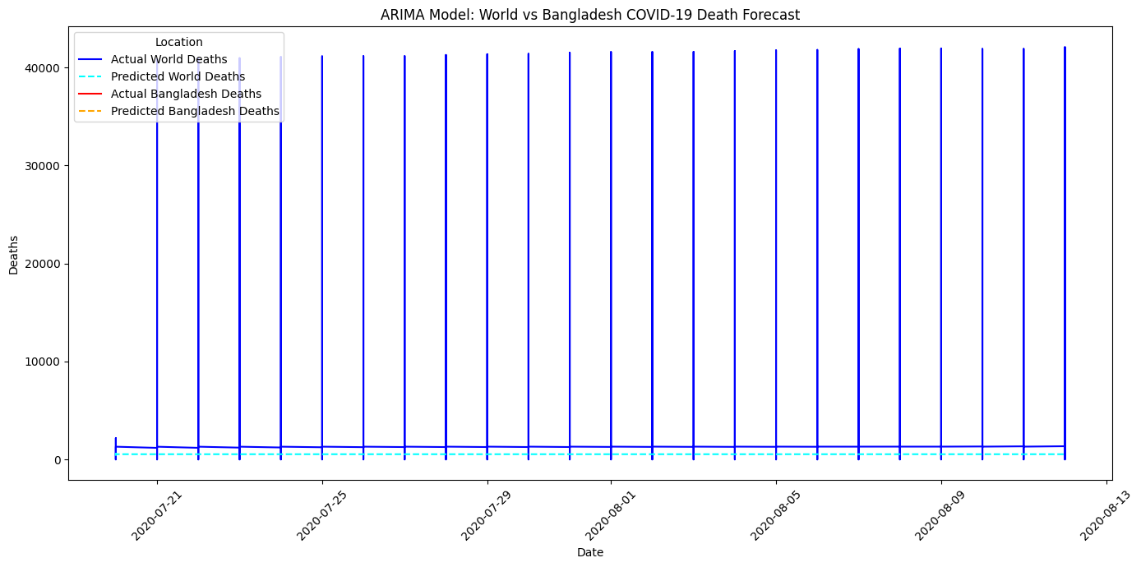
Prediction Results & Visualization
Predicted vs. actual Covid-19 cases (graphs)

Slide 25
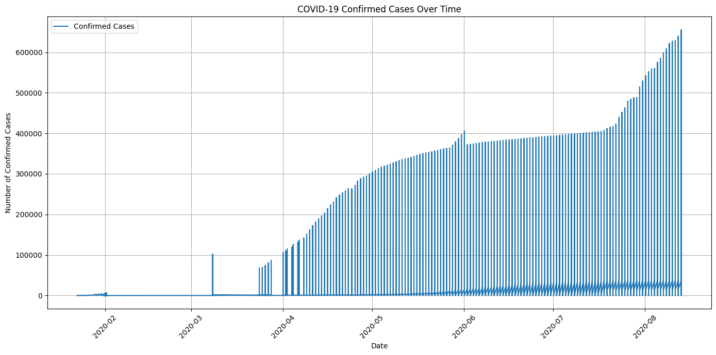

Slide 26
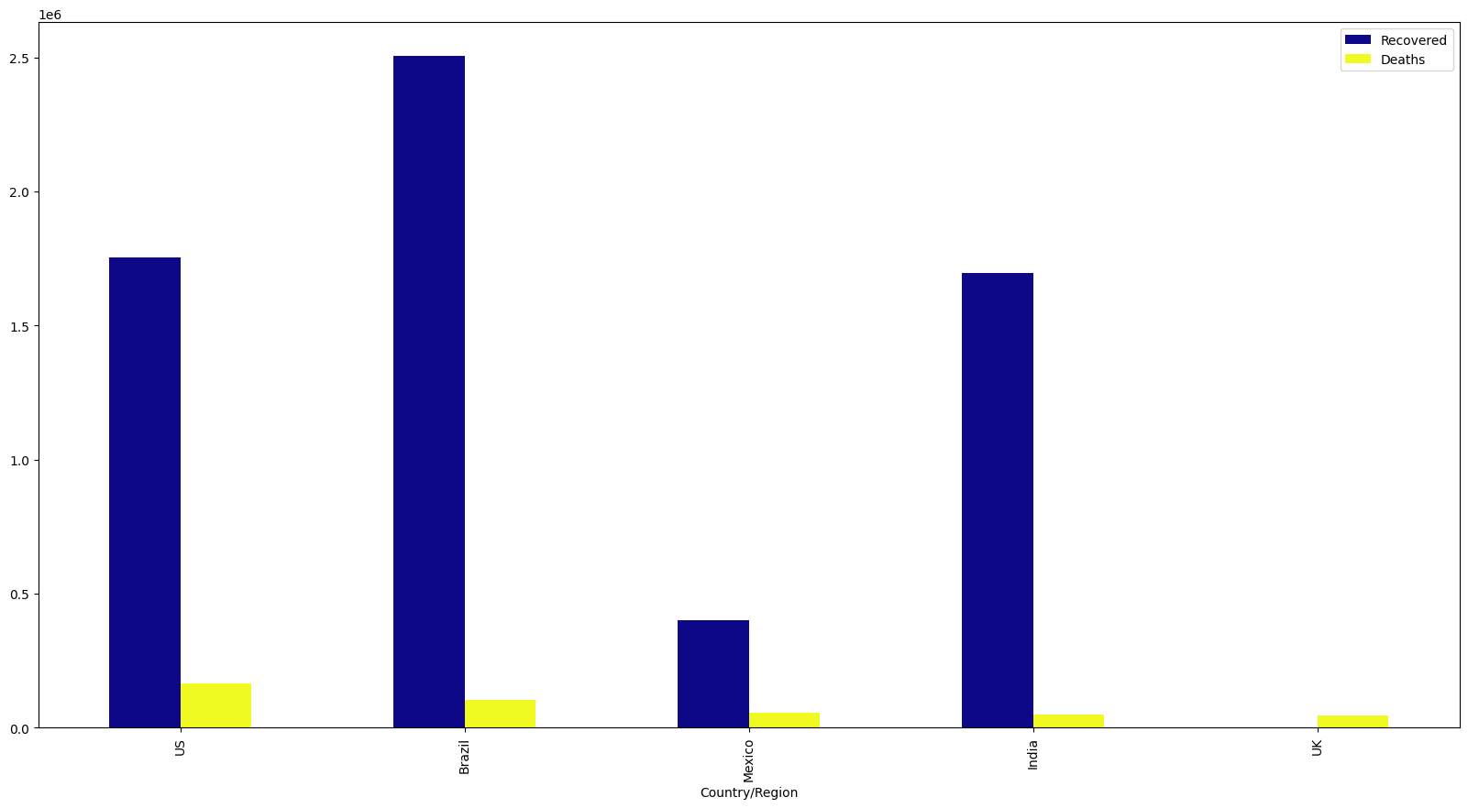

Slide 27
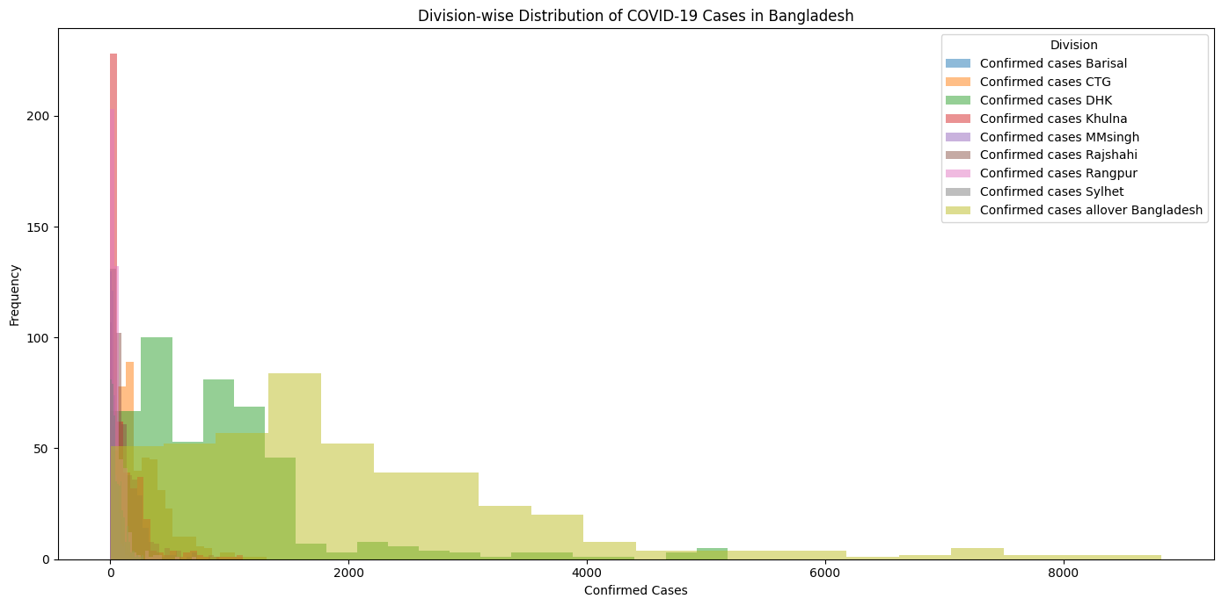
Bangladesh Division wise cases Result

Slide 28
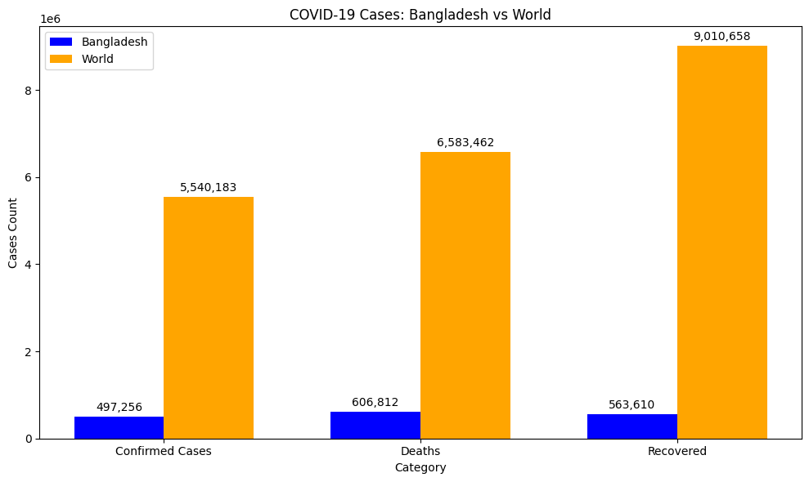
Trends observed for Bangladesh vs. global data

Slide 29
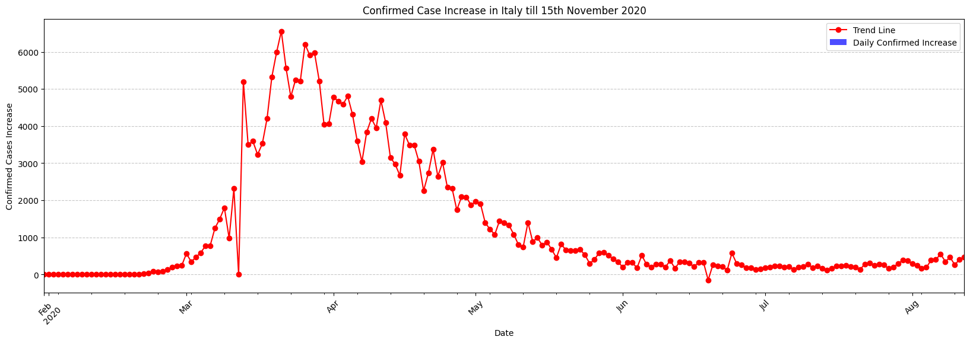
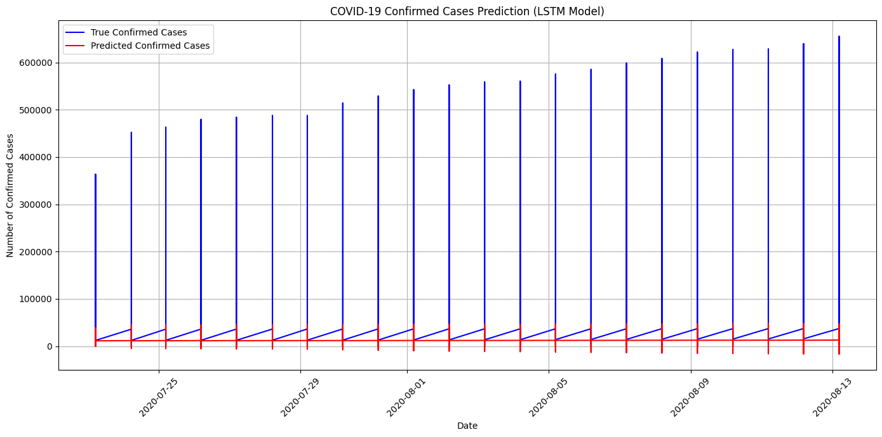
Feature importance analysis

Slide 30
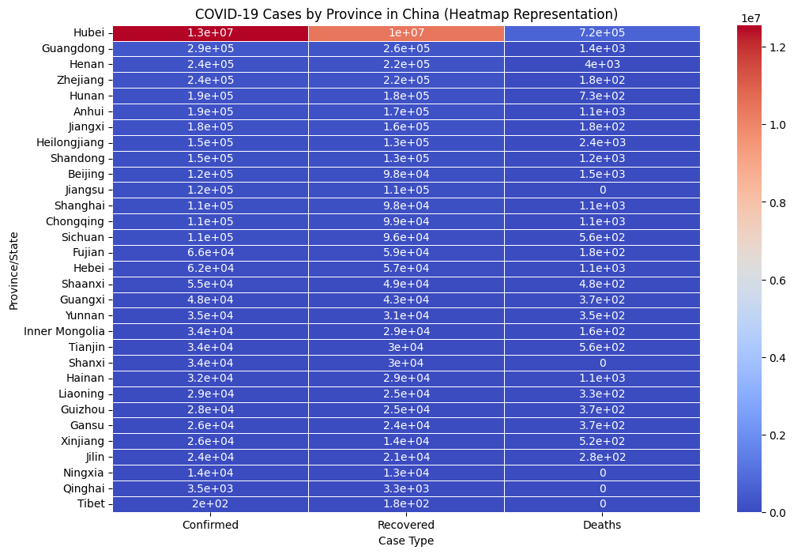
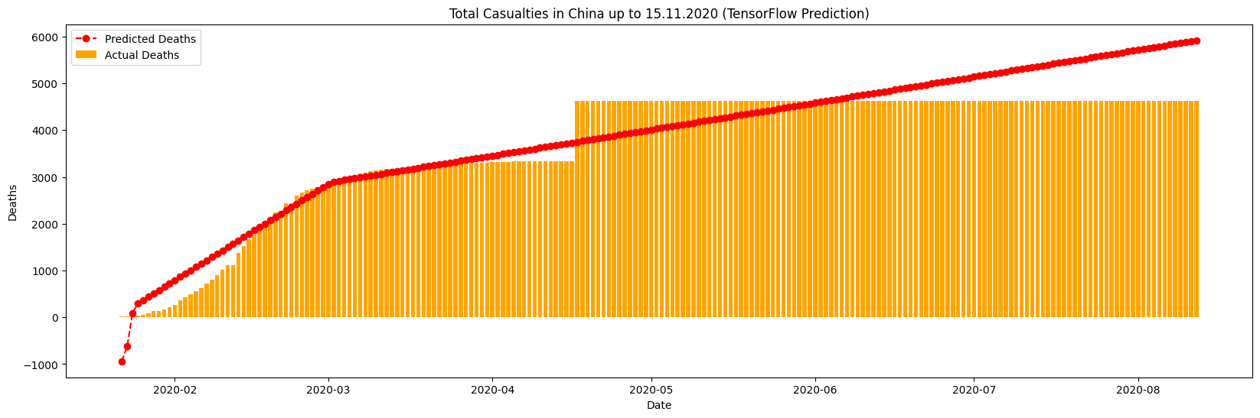

Slide 31
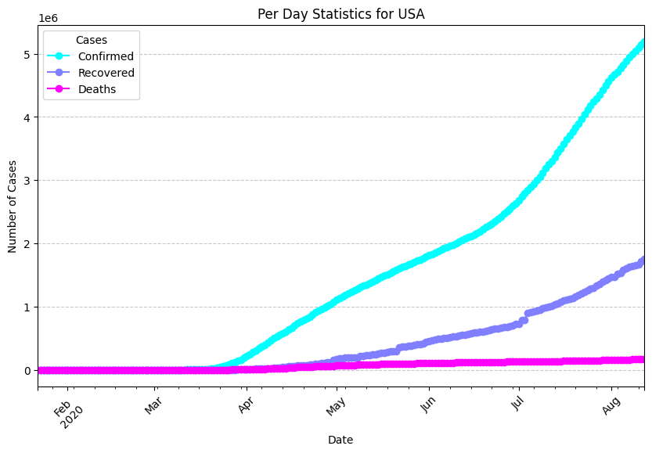
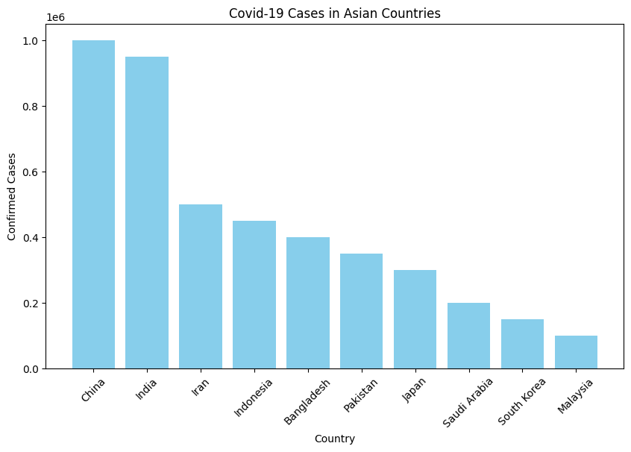

Slide 32
Conclusion & Future Work
Summary of Key Findings
The Predictive Data Model (PDM) has demonstrated that Covid-19 trends (cases, deaths, recoveries) can be forecasted with reasonable accuracy using historical data.
The model provides valuable insights into how government interventions (lockdowns, vaccination rates) and other factors (population density, travel patterns) affect the pandemics trajectory.
Data analysis from sources like Kaggle, WHO, and Bangladesh Government Health Ministry has contributed to understanding the global and local Covid-19 trends.
Potential Applications of the Model
Healthcare System Planning: Predicts hospital resource needs (beds, ventilators) based on future Covid-19 cases.
Government Policy: Helps governments make data-driven decisions on lockdowns, social distancing, and vaccination strategies.
Public Awareness: Assists in informing the public about potential risks and preventive measures based on forecasts.
Future Enhancements
Real-Time Prediction: Implementing a system that continuously updates predictions with incoming data, enabling real-time decision-making.
Advanced Models: Explore more sophisticated machine learning models like Deep Learning (e.g., LSTMs, CNNs) and Reinforcement Learning for dynamic adjustments to predictions.
Geospatial Analysis: Incorporating geospatial data to predict regional outbreaks more accurately and enable location-specific interventions.
Integration with IoT Devices: Using data from wearable devices (e.g., temperature sensors) for more granular predictions on individual health metrics.

Slide 33
References & Acknowledgments
Kaggle: Rahman, R., 2020. COVID-19 cases in Bangladesh dataset. [online] Available at: https://www.kaggle.com/datasets/rashikrahmanpritom/covid19-cases-in-bangladesh-dataset [Accessed 1 February 2025].
Our World in Data: Ritchie, H., 2020. Coronavirus Pandemic (COVID-19). [online] Available at: https://ourworldindata.org/coronavirus [Accessed 1 February 2025].
Johns Hopkins University COVID-19 Data Repository: CSSEGISandData, 2020. COVID-19 Data Repository by the Center for Systems Science and Engineering (CSSE) at Johns Hopkins University. [online] Available at: https://github.com/CSSEGISandData/COVID-19 [Accessed 1 February 2025].
OCHA Services: OCHA, 2020. District Wise Quarantine for COVID-19. [online] Available at: https://data.humdata.org/dataset/district-wise-quarantine-for-covid-19 [Accessed 1 February 2025].
World Health Organization (WHO): WHO, 2020. COVID-19 Country Dashboard. [online] Available at: https://data.who.int/countries/050 [Accessed 1 February 2025].
Bangladesh Government Health Ministry: Ministry of Health and Family Welfare, 2024. Covid-19 Division-wise Data. [online] Available at: https://www.dghealth.gov.bd [Accessed 1 February 2025].
Mendeley Dataset: Mendeley, 2020. District-wise Quarantine for COVID-19. [online] Available at: https://data.mendeley.com/datasets/b98d8mj2xk/1
William Bate
Email Address: w.bate@herts.ac.uk
University of Hertfordshire
College Lane, Hatfield,
Herts AL10 9AB, United Kingdom

Slide 34
Thank you

