Slide 1
The Notorious BIg Data
Product delivery
16 juni
TEAM red : MAX (se), MELIH(se), FaRIDUlLAH (se), Herish (se)
Docent: Peter Odenhoven

Slide 2

Index
Recap Big-data
Master Plan Demo
https://big-data.faridullah.com/
Demo

Slide 3
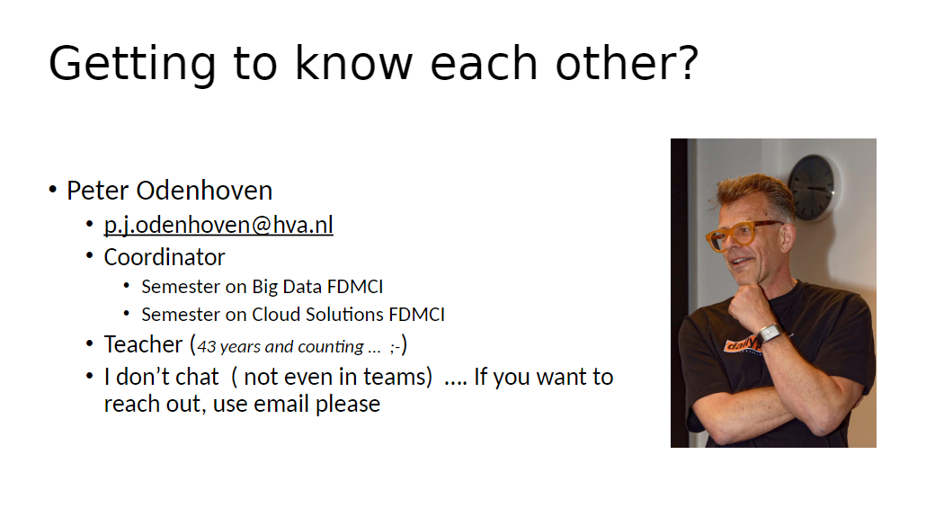
Big-Data

Slide 4
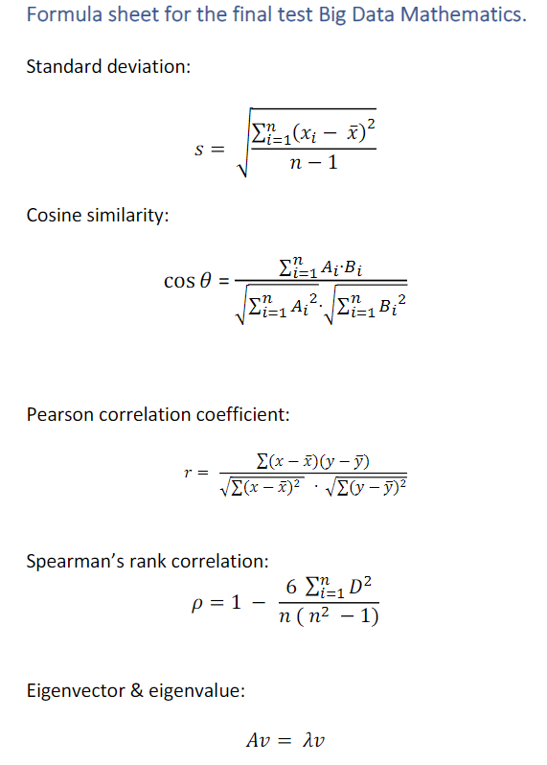

Cheat-sheets

Slide 5
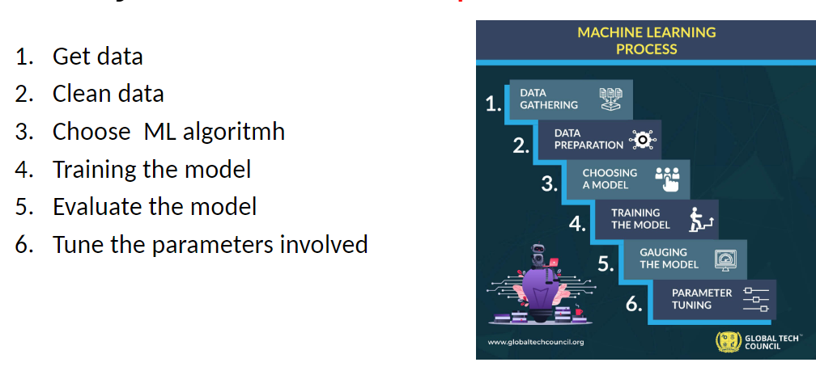
Machine learning

Slide 6
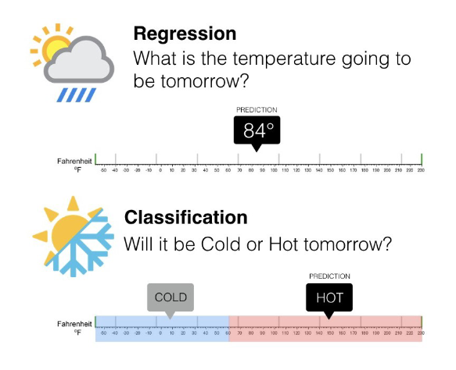
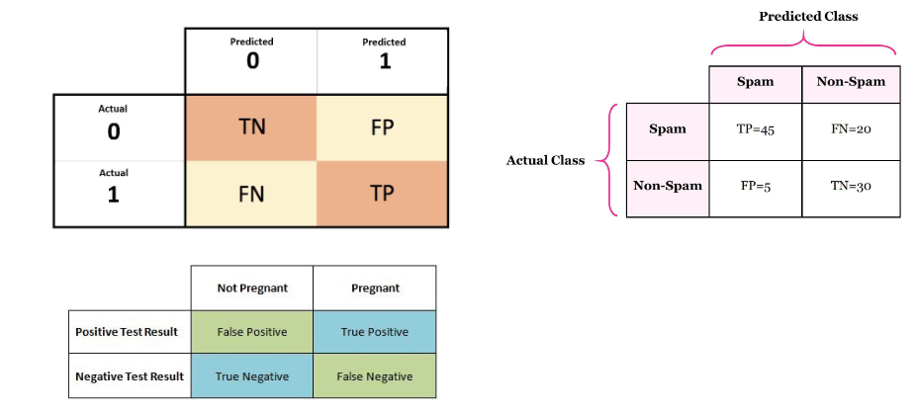
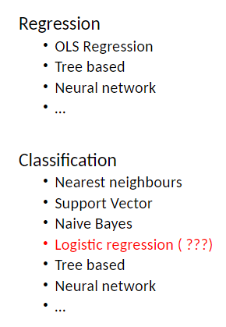
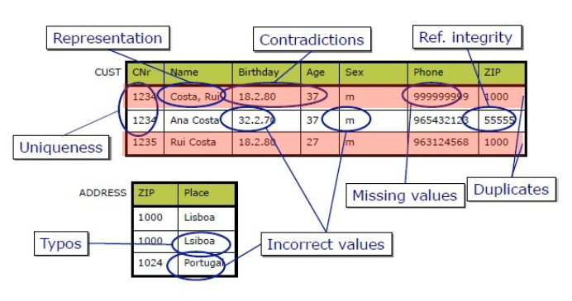

Slide 7





Sprint’s
Herish
Melih
kristalliseren
Max
Faridullah

Slide 8


DEMO

Slide 9
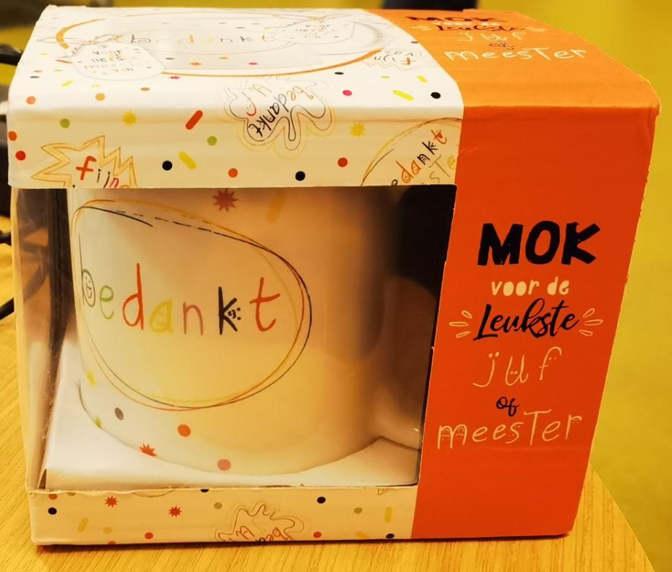
Vragen?

