Slide 1
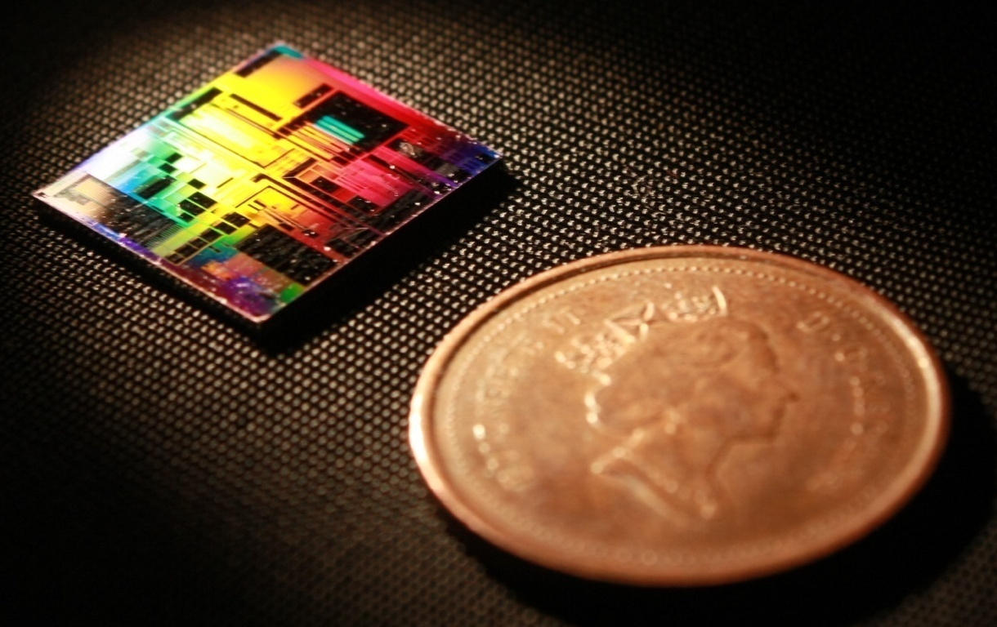
SiEPIC-TOOLS: Process Control Monitors Structure
Mustafa Hammood
The University of British Columbia

Slide 2
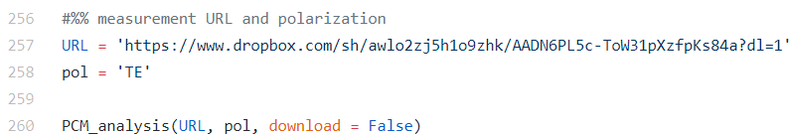
Automated report generation
Load URL of automated measurements
Load polarization of automated measurements
Run!
https://github.com/SiEPIC-Kits/SiEPIC_Photonics_Package/tree/master/SiEPIC_Photonics_Package/PCM_analysis

Slide 3
Objectives
Assess propagation losses of waveguides (TE+TM)
Straight waveguides
Spiral waveguides
Sub-wavelength waveguide
Assess side-wall roughness
Assess performance of different devices:
Bragg waveguides
dW vs bandwidth- what’s the real conclusion here? reproducibility?
Contra-DCs
Analyze the spectrum – watch for self-reflection
Proximity effects + writing jitter
Assess insertion losses of contra-DCs
Cut-back structures
PRBGs for sidewall angle?

