Slide 1
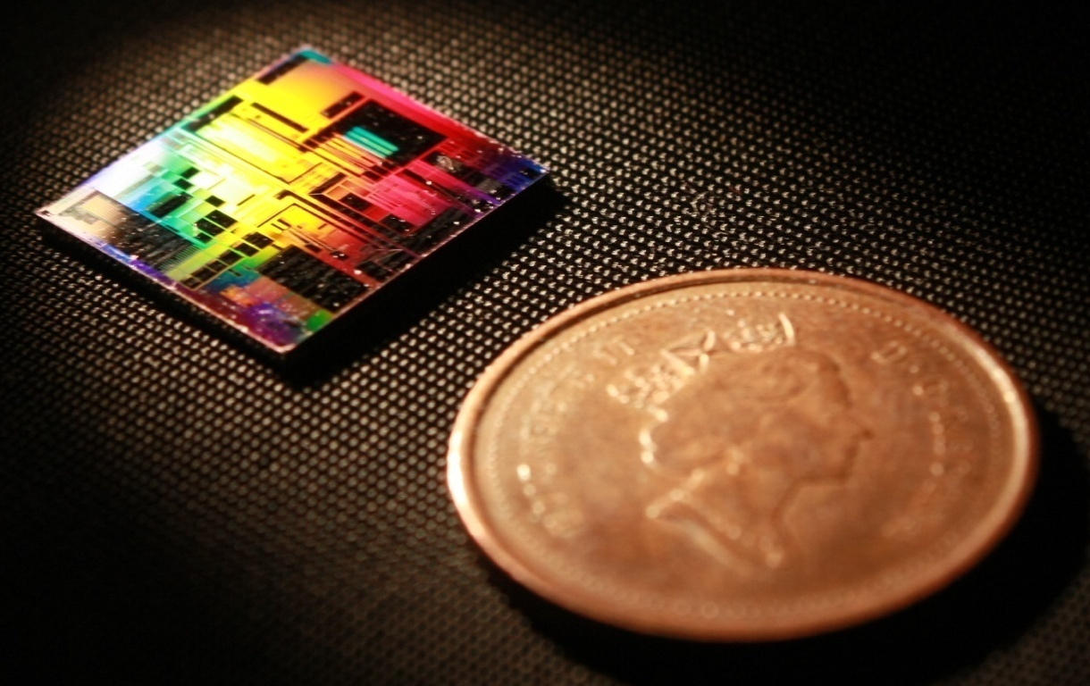
SiEPIC-TOOLS: Contra-Directional Couplers Designer Module
Mustafa Hammood
The University of British Columbia

Slide 2
Table of Contents
Motivation
Design challenges and objectives
Design and simulation: approach and flow
Layout PCell design
MODE supermodes analysis
FDTD bandstructure simulation
Analytical calculations: Coupled mode theory and transfer matrix method
SiEPIC TOOLS Demo

