Slide 1
ELC 200 Day 22

Slide 2
Agenda
Assignment 7 DUE
  Corrected
    15 A’s, 1 B (late) and 1 non-submit
Assignment 8 Posted
  Due April 26
Assignment 9 will assigned next week
ECommerce Initiative Frameworks
  Guidelines
  Due May 10 @ 8 AM
Finish Discussion on E-Security and the USA Patriot Act
Begin Discussion on Encryption

Slide 3
End of days? (subject to change)
April 19
  Chap 13 eSecurity
  Chap 14 Encryption
April 23
  Chap 14 Encryption
April 26
  Chap 15 Getting the money
  Student Course Evaluations
  Assignment 8 Due
April 30
  Review
May 3
  Quiz 4
  Assignment 9 Due
May 10
  8 AM eCommerce frameworks due
  Student presentations
    5 Mins each

Slide 4

E-Security and the USA Patriot Act

Slide 5
Ethics Assignment 7
Assignment7.doc
Equal Credit Opportunity Act
The Equal Credit Opportunity Act guarantees equal opportunity to all customers of credit card companies, banks, loan and finance companies, retail stores and credit unions. Discrimination on the basis of race, color, sex, religion, national origin, marital status, age (provided the consumer has the capacity to enter into a binding contract), receipt of public assistance or the fact that the consumer has in good faith exercised any right under the Consumer Credit Protection Act is strictly prohibited.
The following summarizes some of the key protections under the Act:
In general, creditors cannot ask you for your race, sex, or national origin, nor can they use these factors when deciding whether to give you a loan or other credit. However, if you apply for a mortgage, the lender is required to ask you about these facts. Your answers may be used to help enforce laws against discrimination. Even so, you aren't required to give this information.
You're entitled to your own credit history - in your individual name - even if you are married. This can be important if you should ever need credit on your own. However, if you share credit with your spouse, you will share your partner's credit record as well.
If you apply for unsecured credit on your own, your marital status is off-limits.
You don't have to tell a creditor you're divorced or you're receiving support payments. However, a lender has a legitimate interest in your ability to repay your debts. Therefore, you may have to disclose any alimony, maintenance or child support you're obligated to pay. You must also list any support payments you receive if you want them to be counted as income on your application.
As long as you're old enough to sign a legal contract, your age can't be used against you.
A creditor cannot discriminate against you if you receive public assistance. However, a creditor can verify any income you list on a credit application.

Slide 6
Assignment 8
Security for Your eBusiness
  Identify and quantify in monetary terms the critical assets in your company that may be at risk form the dangers listed in Chapter 13. (you should identify at a bare minimum 5 assets)
  For each of the critical assets at risk, what steps could you take to protect your company from the risks?
  For of the steps and possible solutions you identify in question 2, find out how much it would cost to implement the steps or solution.
  Is the cost of fixing the problems make sense in relation to potential monetary loss of not fixing the security problem?
  Could you purchase anti-hacker insurance for your company? If so, from where and how much would it cost?

Slide 7
Maine’s Anti-Hacker laws
§432. Criminal invasion of computer privacy
1. A person is guilty of criminal invasion of computer privacy if the person intentionally accesses any computer resource knowing that the person is not authorized to do so. [1989, c. 620 (new).]
2. Criminal invasion of computer privacy is a Class D crime. [1989, c. 620 (new).]
  §433. Aggravated criminal invasion of computer privacy
  1. A person is guilty of aggravated criminal invasion of computer privacy if the person:
  A. Intentionally makes an unauthorized copy of any computer program, computer software or computer information, knowing that the person is not authorized to do so; [1989, c. 620 (new).]
  B. Intentionally or knowingly damages any computer resource of another person, having no reasonable ground to believe that the person has the right to do so; or [1989, c. 620 (new).]
  C. Intentionally or knowingly introduces or allows the introduction of a computer virus into any computer resource, having no reasonable ground to believe that the person has the right to do so. [1989, c. 620 (new).][1989, c. 620 (new).]
  2. Aggravated criminal invasion of computer privacy is a Class C crime. [1989, c. 620 (new).]

Slide 8

Spyware
Software that sits on your computer
  Monitors everything that you do and sends out reports to Marketing agencies
  Usually ties to a POP-UP server
Top Spyware
  I-Look Up
  CoolWebSearch
  N-CASE
  GATOR
  DoubleClick
If you have ever loaded up ICQ Loaded on your PC you have Spyware
If you have ever had KAZAA loaded on your PC you have Spyware
If you have loaded Quicken or TurboTax you have Spyware
  C-Dilla

Slide 9
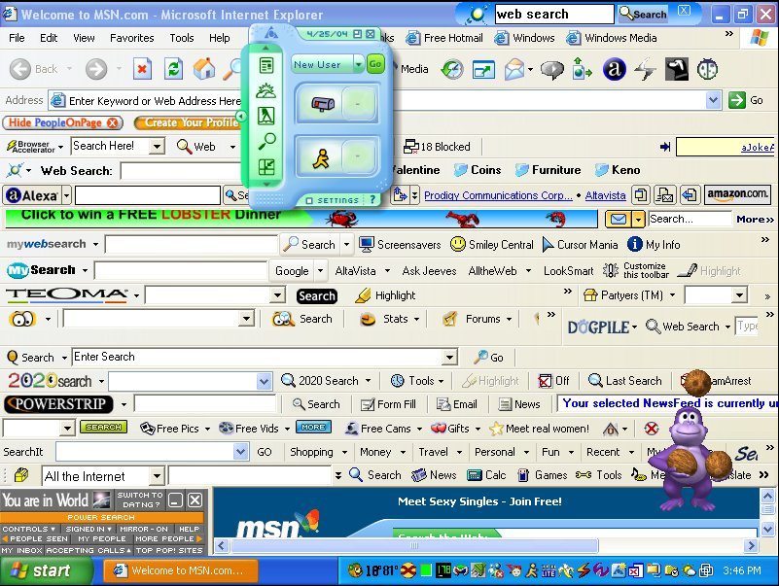
Spyware infestation. Taken by Brandon Waddell.

Slide 10
Spyware and Adware
Spyware is software the user unknowingly installs through an e-mail attachment or downloading an infected file that could be used for illicit reasons
Adware is software that sneaks into a user’s hard disk installed by Internet advertising companies to promote pop-up ads and release information for advertisers on the outside

Slide 11
Spyware Solutions
Enforce strict user Web policies on surfing and downloading activities
Install a desktop firewall on every laptop and desktop - http://www.zonelabs.com
Do not give users administrator privileges
Configure an e-mail gateway to block all executable e-mail attachments
Ensure desktop antivirus software signatures are up to date - http://www.grisoft.com

Slide 12
Spyware Solutions (Cont’d)
Use commercial antispyware sofware to detect and remove existing spyware program - http://www.spybot.com
  Keeping Your PC Spyware Free.pdf
Enforce the usage of higher security settings in Internet browsers to prevent sites that cause spyware infection
Use pop-up blockers that lead to Web sites low trustworthiness
Educate your employees and staff about spyware threats be creating an active out-reach with groups and organizations, including the Consortium of Anti-Spyware Technology (COAST)

Slide 13
Compliance Legislation
The Gramm-Leach-Billey Act
  Protects personal data
The VISA USA Cardholder Information Security Program
  Personal data must be encrypted
The Sarbanes-Oxley Act
  Executives must vouch for effectiveness of controls
The Basel II Capital Accords
  Internal accord specifying cash and risk reporting

Slide 14
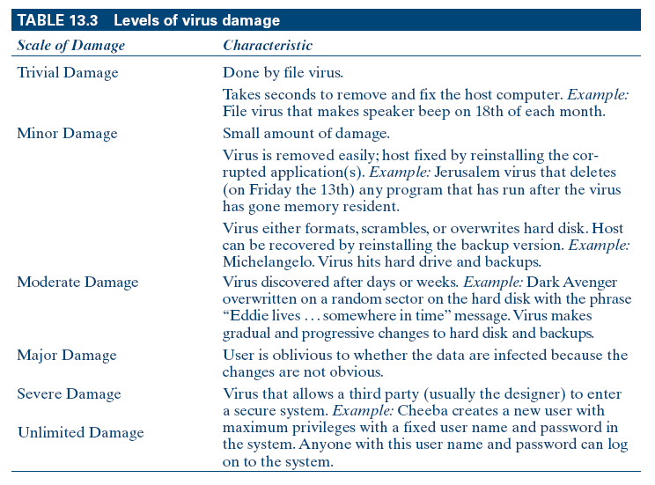
Levels of Virus Damage

Slide 15
Steps for Antivirus Strategy
Establish a set of simple enforceable rules for others to follow
Educate and train users on how to check for viruses on a disk
Inform users of the existing and potential threats to the company’s systems and the sensitivity of information they contain
Periodically update the latest antivirus software

Slide 16
Steps to Prevent E-Commerce Fraud
Be aware of corporate critical assets and who might be after the assets
Investigate common attacks and electronic-fraud schemes that could be used against the company’s critical assets
Install strong encryption such as public key infrastructure (PKI)
Develop a program for evidence collection (called forensics) via committed investigators

Slide 17
Steps to Prevent E-Commerce Fraud (Cont’d)
Ensure maintenance of strong and reliable transaction, network, and Internet service provider logs
Conduct penetration testing to judge the integrity of existing security
Investigate the availability of cyber-fraud insurance to provide coverage for potential losses

Slide 18
Security Protection and Recovery
Install proper firewall(s) to protect data
Ensure that your network is configured properly
Protect your most sensitive data through encryption
Maintain and update all antivirus programs on your PC or terminal
Restrict access to your files by “need to know’
Assign unique IDs to authorized personnel and track all IDs on a daily basis
Ensure that your system administrators have contemporary security skills
Enforce and update company information security policy and inform employees of any changes in policy

Slide 19
Creating Strong Password
Include at least one capital letter and one lowercase letter in the password
Mix numbers with letters. Short passwords won’t do anymore.
Stay away from passwords that are anywhere near your birthday, your last name, spouse’s name, too obvious a name, too well-known a name, or too common a name
No dictionary names - hackers have dictionaries
Change your password often
Disable an employee’s password the moment that person leaves

Slide 20
Firewalls and Security
Firewalls can be used to protect a corporation’s network in a number of ways
  Protect against authenticated log-ins
  Block all unsecured access to the internal network
  Separate groups within an organization
Firewalls ensure
  Data integrity
  Authentication
  Confidentiality

Slide 21
Firewall Design and Implementation Issues
Policy
Level of monitoring and control the organization wants
Financial and administrative
Whether the company wants internal firewalls installed
Security policy
Deny policy
Filtering ability
Scalability
Authentication
Recognizing dangerous services
Effective audit logs

Slide 22
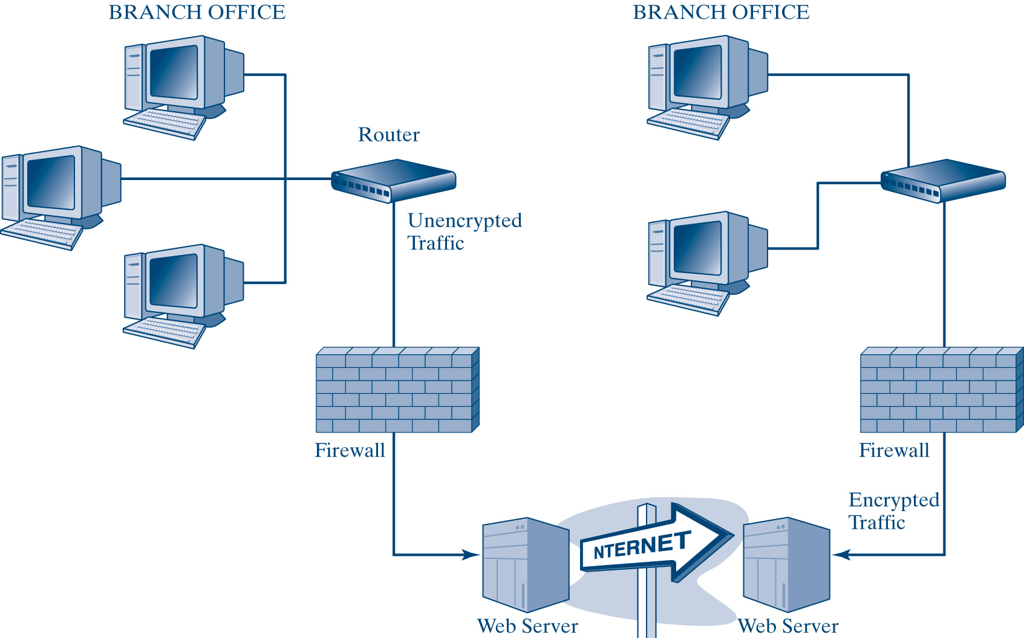
Corporate Networks and Firewalls

Slide 23
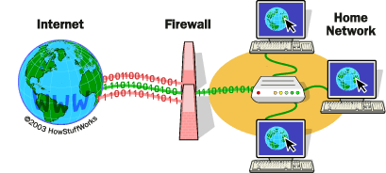
How Firewalls Work
Firewall check Packets in and out of Networks
  Decide which packets go through and which don’t
  Work in both directions
  Only one part of Security

Slide 24

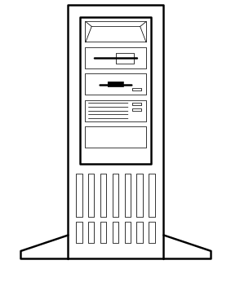



Firewalls
Attack Prevention System
Attack
Message
Hardened
Client PC
Firewall
Attack
Message
X
Internet
Stops Most
Attack Messages
Attacker
Hardened Server
With Permissions
Corporate Network
Notes:
Another type of defense is the attack prevention system, which attempts to stop attack messages from reaching their targets, which usually are internal host computers.
The chief tool in stopping such penetration attacks to is install a firewall at the border between the secure internal network and the unsecure external network, usually the Internet.
Sometimes, there also are internal firewalls between highly sensitive subnets and the rest of a site’s network. These internal firewalls are designed to stop employee attacks.
In addition, both client and server hosts can be “hardened” to make them more difficult to attack.

Slide 25
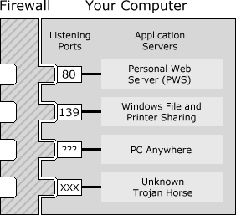


How Personal Firewalls work
Software version of a standard Hardware firewall
Controls packets in and out of one PC in much the same way as a Hardware Firewall does

Slide 26
Cycle of Recovery from Attack
Attack detection and vulnerability assessment
Damage assessment <> evidence collection
Correction and recovery
Vigilance and corrective feedback

Slide 27
Biometric Security
Biometrics is the science and technology of quantifying and statistically scrutinizing biological data
Biometrics enhance authentication
Biometric devices ensure that the person who encrypts data is the only one who can decrypt and has access to the data
Applying biometric technology on a smart card also would increase the level of confidence in the security
When considering biometric technologies for future use, management does need to implement a cost-effective system appropriate for their particular circumstance

Slide 28
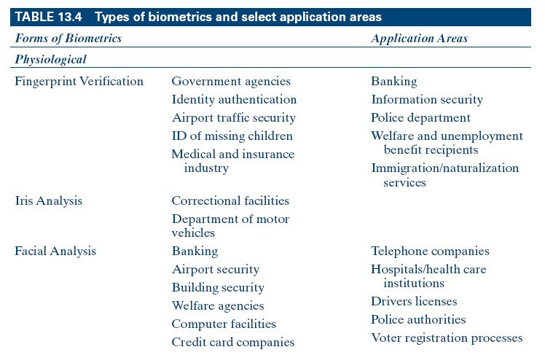
Types of Biometrics and
Select Application Areas

Slide 29
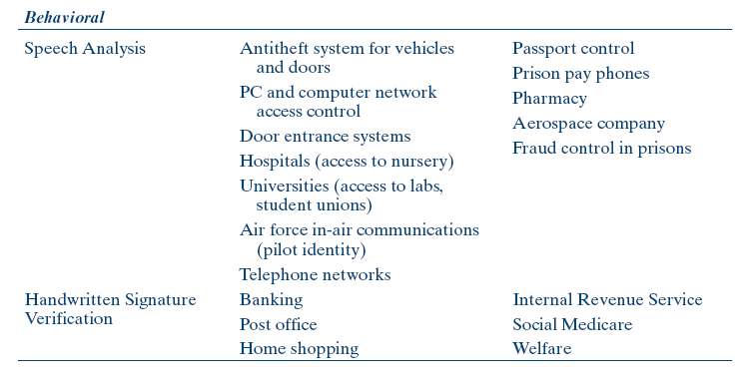
Types of Biometrics and
Select Application Areas (Cont’d)

Slide 30
Terrorism
How Modern Terrorism Uses the Internet
http://www.state.gov/s/ct/rls/fs/37191.htm
Abu Nidal Organization (ANO)
Abu Sayyaf Group
Al-Aqsa Martyrs Brigade
Ansar al-Islam
Armed Islamic Group (GIA)
Asbat al-Ansar
Aum Shinrikyo
Basque Fatherland and Liberty (ETA)
Communist Party of the Philippines/New People's Army (CPP/NPA)
Continuity Irish Republican Army
Gama’a al-Islamiyya (Islamic Group)
HAMAS (Islamic Resistance Movement)
Harakat ul-Mujahidin (HUM)
Hizballah (Party of God)
Islamic Jihad Group
Islamic Movement of Uzbekistan (IMU)
Jaish-e-Mohammed (JEM) (Army of Mohammed)
Jemaah Islamiya organization (JI)
al-Jihad (Egyptian Islamic Jihad)
Kahane Chai (Kach)
Kongra-Gel (KGK, formerly Kurdistan Workers' Party, PKK, KADEK
Lashkar-e Tayyiba (LT) (Army of the Righteous)
Lashkar i Jhangvi
Liberation Tigers of Tamil Eelam (LTTE)
Libyan Islamic Fighting Group (LIFG)
Moroccan Islamic Combatant Group (GICM)
Mujahedin-e Khalq Organization (MEK)
National Liberation Army (ELN)
Palestine Liberation Front (PLF)
Palestinian Islamic Jihad (PIJ)
Popular Front for the Liberation of Palestine (PFLF)
PFLP-General Command (PFLP-GC)
al-Qa’ida
Real IRA
Revolutionary Armed Forces of Colombia (FARC)
Revolutionary Nuclei (formerly ELA)
Revolutionary Organization 17 November
Revolutionary People’s Liberation Party/Front (DHKP/C)
Salafist Group for Call and Combat (GSPC)
Shining Path (Sendero Luminoso, SL)
Tanzim Qa'idat al-Jihad fi Bilad al-Rafidayn (QJBR) (al-Qaida in Iraq) (formerly Jama'at al-Tawhid wa'al-Jihad, JTJ, al-Zarqawi Network)
United Self-Defense Forces of Colombia (AUC)

Slide 31
National Strategy to Secure Cyberspace
The National Strategy to Secure Cyberspace articulates five national priorities including:
  I. A National Cyberspace Security Response System;
  II. A National Cyberspace Security Threat and Vulnerability Reduction Program;
  III. A National Cyberspace Security Awareness and Training Program;
  IV. Securing Governments’ Cyberspace;
  V. National Security and International Cyberspace Security Cooperation.
  cyberspace_strategy.pdf

Slide 32
USA Patriot Act
Uniting and Strengthening America by Providing Appropriate Tools Required to Intercept and Obstruct Terrorism Act of 2001
Enacted Oct, 2001 and was to last for 4 years
USA Patriot Act Improvement And Reauthorization Act Of 2005
  Signed March 2006
ACLU repsonse
  Expands terrorism laws to include “domestic terrorism” which could subject political organizations to surveillance, wiretapping, harassment, and criminal action for political advocacy.
  Expands the ability of law enforcement to conduct secret searches, gives them wide powers of phone and Internet surveillance, and access to highly personal medical, financial, mental health, and student records with minimal judicial oversight.
  Allows FBI Agents to investigate American citizens for criminal matters without probable cause of crime if they say it is for “intelligence purposes.”
  Permits non-citizens to be jailed based on mere suspicion and to be denied re-admission to the US for engaging in free speech. Suspects convicted of no crime may be detained indefinitely in six month increments without meaningful judicial review.

Slide 33
Implications for Management
The Internet is becoming an increasingly filtered channel of communication
Information security continues to be deemphasized or ignored by management at all levels of the organization
Changes in the identification of threats, the growing advancement of technologies, and the identification of new threats continue to shift the organizational security focus
Any serious profile should begin with a valid security policy, which is then translated into an effective security plan with a focus on prevention, detection, and correction of threats

Slide 34

Encryption: A Matter of Trust

Slide 35
The focus of this chapter is on several learning objectives
Understanding the basic algorithm used in encryption
Issues in public-key cryptography
Tools used for authentication and trust
Brief coverage of the main Internet security protocols and standards
Implications and future of encryption in e-commerce

Slide 36
What Is Encryption?
A way to transform a message so that only the sender and recipient can read, see, or understand it
Plaintext (cleartext): the message that is being protected
Encrypt (encipher): transform a plaintext into ciphertext
Encryption: a mathematical procedure that scrambles data so that it is extremely difficult for anyone other than authorized recipients to recover the original message
Key: a series of electronic signals stored on a PC’s hard disk or transmitted as blips of data over transmission lines
  Plaintext + key = ciphertext
  Ciphetext – key = Plaintext

Slide 37

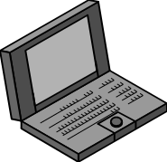
Symmetric Key Encryption
Symmetric
Key
Message
“Hello”
Encryption
Method &
Key
Encrypted Message
Interceptor
Network
Party A
Party B
Encryption uses a
non-secret encryption method and
a secret key

Slide 38
Public-Key Infrastructure (PKI)
Creates the ability to authenticate users, maintain privacy, ensure data integrity, and process transactions without the risk of repudiation
PKI satisfies four security needs
  Authentication - identifies or verifies that the senders of messages are, in fact, who they claim to be
  Integrity - verifies that neither the purchase amount not the goods bought are changed or lost during transmission
  Nonrepudiation - prevents sender and vendor in a transaction of communication activity from later falsely denying that the transaction occurred
  Privacy - shields communications from unauthorized viewing or access

Slide 39
Basic Encryption Algorithm
Both sender and receiver have to know the rules used to transform the original message or transaction into its coded form
A set of rules for encoding and decoding messages is called a cipher (or cyper)
A message can be decrypted only if the decryption key matches the encryption key
A 6-bit key allows for only 64 possible numeric combinations(2⁶)
The standard 56-bit DES encryption code can be cracked on a high-speed computer in a few hours
100 bit key has 2¹⁰⁰ possible keys

Slide 40
Classes of Algorithms
Secret-key (symmetric) encryption: encryption system in which sender and receiver possess the same key; the key used to encrypt a message also can be used to decrypt it
Stream cipher: a symmetric algorithm that encrypts a single bit of plaintext at a time
Block cipher: a symmetric algorithm that encrypts a number of bits as a single unit
Public-key (asymmetric) encryption: encoding/decoding using two mathematically related keys or key-pairs; one public key and one private key
Key-pairs can be used in two ways:
  To provide message confidentiality
  To prove the authenticity of the message originator

Slide 41
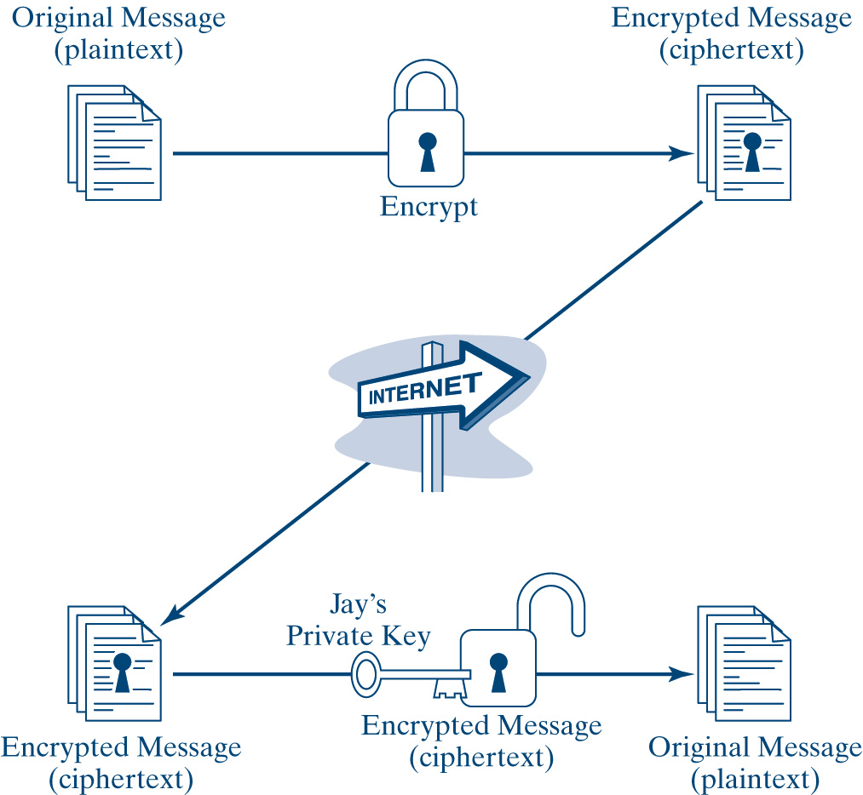
Message Confidentiality
Using a Key-Pair

Slide 42

Public Key Encryption
Public Key Encryption for Confidentiality
Encrypt with
Party B’s Public Key
Encrypted
Message
Decrypt with
Party B’s Private Key
Note:
Four keys are used to encrypt
and decrypt in both directions
Party A
Party B
Decrypt with
Party A’s Private Key
Encrypted
Message
Encrypt with
Party A’s Public Key

Slide 43
Common Cryptosystems
RSA Algorithm is the most commonly used public-key algorithm, although it is vulnerable to attack
Data Encryption Standards (DES) is a popular secret-key encryption system; the first to be widely adopted commercially
Triple DES (3DES) is a stronger version of DES that uses three 56-bit keys to encrypt each block of plaintext
RC4 is a variable-length cipher widely used on the Internet as a bulk encryption cipher in SSL protocol
IDEA is a strong encryption algorithm using a 128-bit key to encrypt 64-bit blocks; resistant to brute-force attack

Slide 44
Major Attacks on Cryptosystems
Chosen-plaintext attack
Known-plaintext attack
Ciphertext-only attack
Third-party attack

Slide 45
Authentication and Trust
Digital Signature is a special signature for signing electronic correspondence, produced by encrypting the message digest with the sender’s private key
Authentication is verifying that a message or document, in fact, comes from the claimed sender
Hash function is a formula that converts a message of a given length into a string of digits called a message digest
Cryptographic hash functions are generally used to construct the message digest

Slide 46
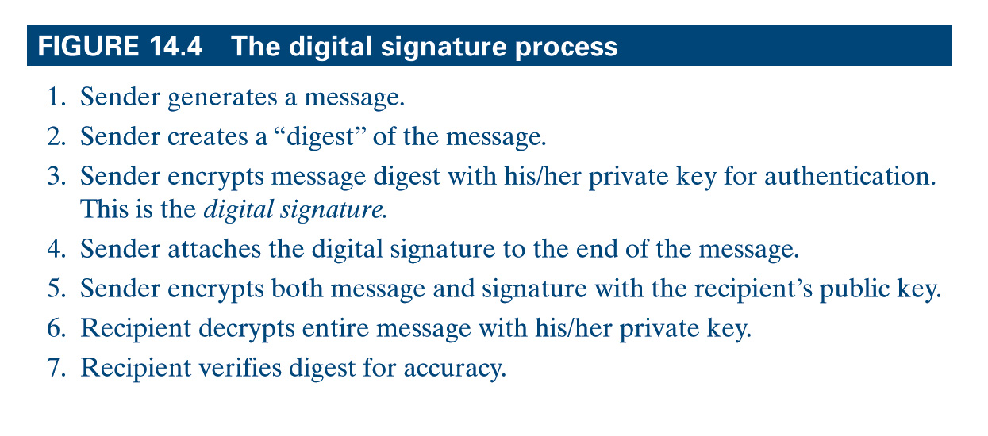
The Digital Signature Process

Slide 47
Digital Certificates
Digital certificates are the heart of secure online transactions
A digital certificate is a software program that can be installed in a browser
Your digital certificate identifies you to Web sites equipped to check it automatically
Digital certificate is an electronic document issued by a certificate authority to establish a merchant’s identity
Certificate authority (CA) is a trusted entity that issues and revokes public-key certificates and manages key-pairs

Slide 48
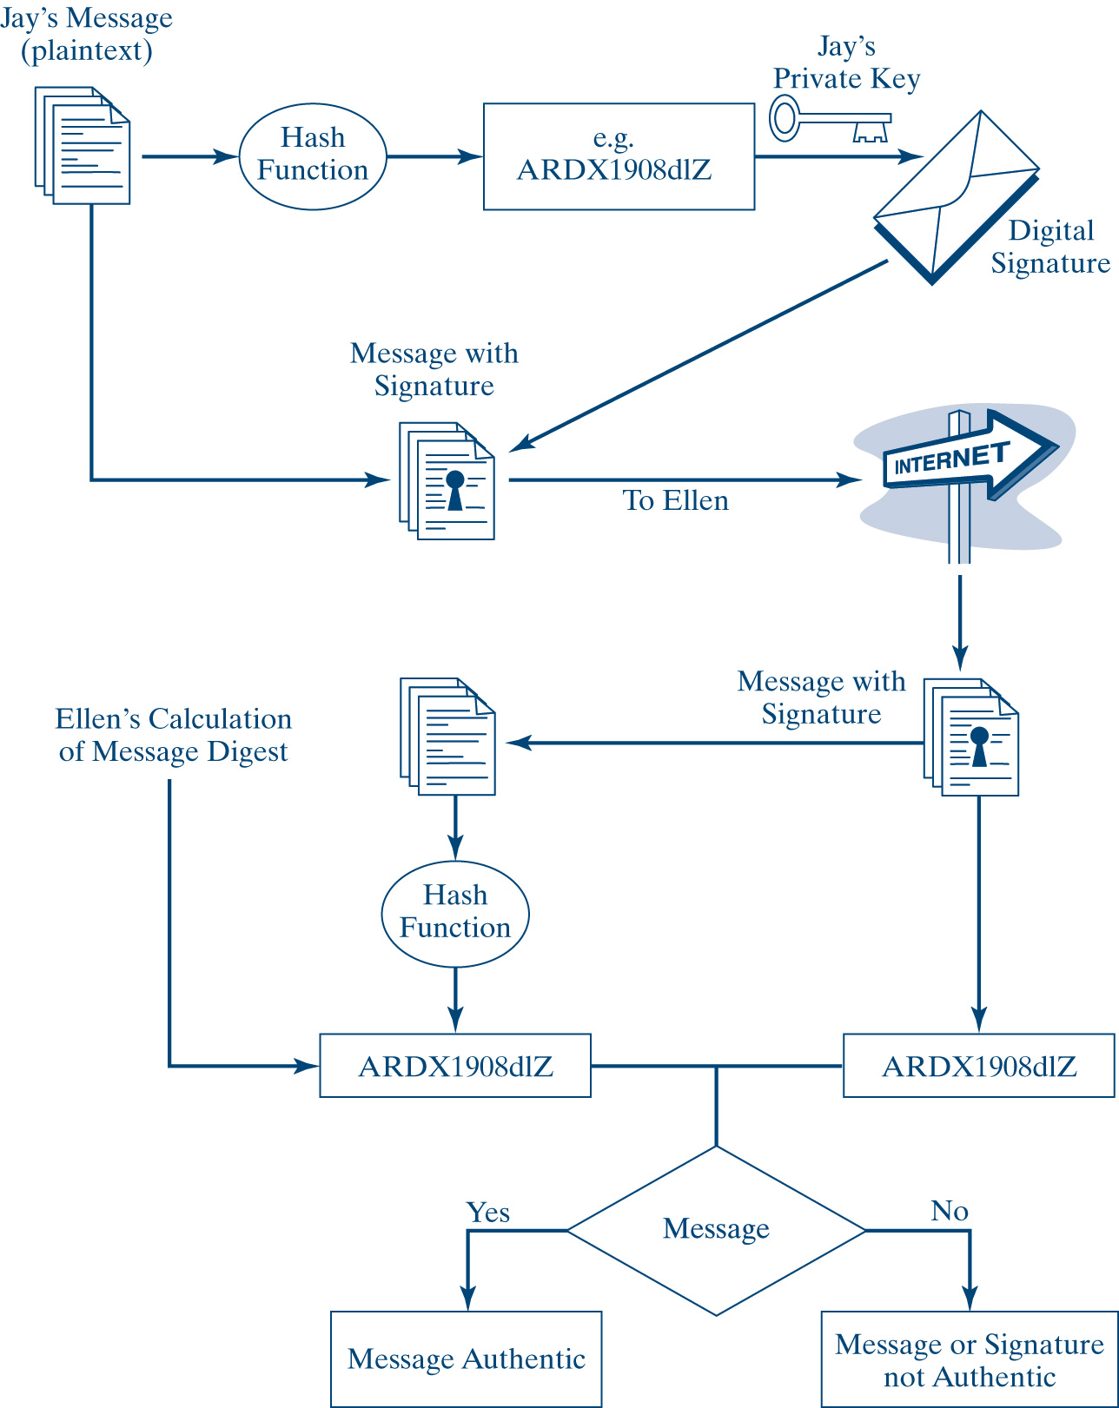
Verifying a Digital Signature

Slide 49
Four Classes of Digital Certificates
Class 1 certificates contain minimum checks on the user’s background
Class 2 certificates check for information like real name, Social Security number, and the date of birth
Class 3 certificates are the strongest type
Class 4 certificates are the most thorough

Slide 50
Managing Cryptographic Keys
Key management is the process of making keys known to the systems that need them and making sure keys are protected against disclosure or substitution
Key Life Cycle
  Key generation and registration
  Key distribution
  Key backup and recovery
    Key escrow: location where keys held in trust by a third party reside
    Notary service: company that provides encryption-oriented services including key escrow, key recovery, time stamping, trusted intermediary, and archiving
  Key revocation and destruction

Slide 51
Third-Party Services
Certificate authority verifies certificates intended for use by other distinct legal entities
Certificate policy is a set of rules that identifies how, when, and for what reasons certificates are used within the assigned organization
Directory service is a repository that distributes certificates as requested by message originators

Slide 52
Internet Security Protocols
Two key protocols for secure World Wide Web transactions are:
  Secure Socket Layer (SSL) is a portocol for secure Web transactions, secures data packets at the network layer
  Secure HTTP (S-HTTP) is a protocol that secures Web transactions and nothing else
Secure Electronic Transaction (SET) is a protocol used for handling funds transfers from credit card issuers to a merchant’s bank account
  A digital certificate customers can request from their issuing bank by filling out a form on the bank’s Web site
  A digital wallet is an online shopping device that seals personal information in a free plug-in that can be invoked when making a purchase

Slide 53
Secure E-mail
Pretty Good Privacy (PGP) is a protocol that encrypts the data with a one-time algorithm and then encrypts the key to the algorithm using public-key cryptography
S/MIME (Multipurpose Internet Mail Extension) is a powerful protocol that provides security for different data types and attachments to e-mails
Message Security Protocol (MSP) is a protocol that secures e-mail attachments across multiple platforms

Slide 54
Implications for E-Commerce
Developing high-powered and reliable encryption methods is a top priority for many organizations
Most encryption systems have prevention as the sole means of defense
Merchants face a number of choices when considering encryption methods
A major concern is the cost associated with different encryption methods
Government regulations present considerable problems for businesses

Slide 55
Chapter Summary
Encryption addresses message transmission security requirements
Encryption satisfies requirements for authentication, integrity, and nonrepudiation
There are two classes of key-based algorithms
  Secret key
  Public key
Cryptoanalysis is the science of deciphering encrypted messages without knowing the right key

Slide 56
Chapter Summary (Cont’d)
One way to implement public-key authentication is to send a digital signature with each message
A digital certificate is an electronic document issued by a certificate authority (CA) to establish a merchant’s identity by verifying its name and public key
Security measures installed to minimize vulnerability to the exchange of information includes
  SSL
  SHTTP
  SET
  S/MIME

