Slide 1
ELC 200 Day 3

Slide 2
Agenda
Questions??
Signed Contracts
Blackboard
Finish Discussion on The Dawn of Maturing Industry
Begin Discussion on the World Wide Web
Assignment 1 posted
  Due September 17 @11:05 AM
Assignment 2 will be posted by September 18

Slide 3
Role of E-strategy
For a successful e-commerce business:
  Identify the critical success factors (CSFs)
    A sound strategy that has the full support of top management
    A clear goal of long-term customer relationships and value
    Making full use of the Internet and related technologies
    A scalable and integrated business process and infrastructure

Slide 4
Role of E-strategy – cont’d
Develop a realistic strategy for the business
    Sustainable business strategy based on unique opportunities to provide value for the firm
    Requires a clear understanding of the company, the industry and available Internet technologies
    Strategy should be difficult to duplicate, have high barriers to entry for competitors, and high switching costs to customers
    Be realistic

Slide 5
Assignment 1
Due Jan 29 at 12:30
Use WebCT to download the assignment and to upload your answers.
  Save a copy since the same material can be incorporated in the eCommerce Initiative paper that will be due at the end of the semester.
assignment1.doc

Slide 6
Value Chain in E-commerce
Value Chain: a way of organizing the activities of a business so that each activity adds value (value-added activity) or productivity to the total operation of the business.
  Michael Porter
    Competitive Advantage: Creating and Sustaining Superior Performance
A strategic tool for identifying how the critical components of a business tie together to deliver value for the business across the value-chain process.

Slide 7
Value Chain in E-commerce - cont’d
Organizations are open systems
  They do not consist of isolated sets of functions
  They are a chain of value-creating activities that assure competitive advantages by delivering value to the customer
Depicts the series of interdependent activities of a business
A business evaluates its value to find opportunities for improving the value activities

Slide 8
Competitive Advantage
Competitive advantage is achieved when an organization links the activities in its value chain more cheaply and effectively than its competitors.

Slide 9
Value Chain Primary Activities
Inbound logistics
Operations
Outbound logistics
Marketing and sales
Service

Slide 10
Value Chain Support Activities
Corporate infrastructure
Human resources
Technology development
Procurement

Slide 11
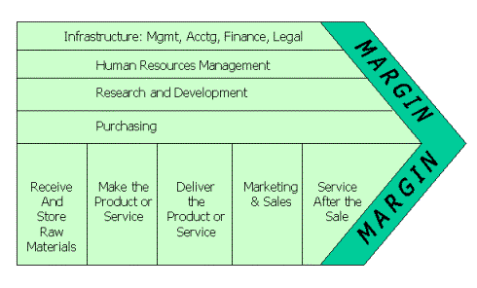

Slide 12
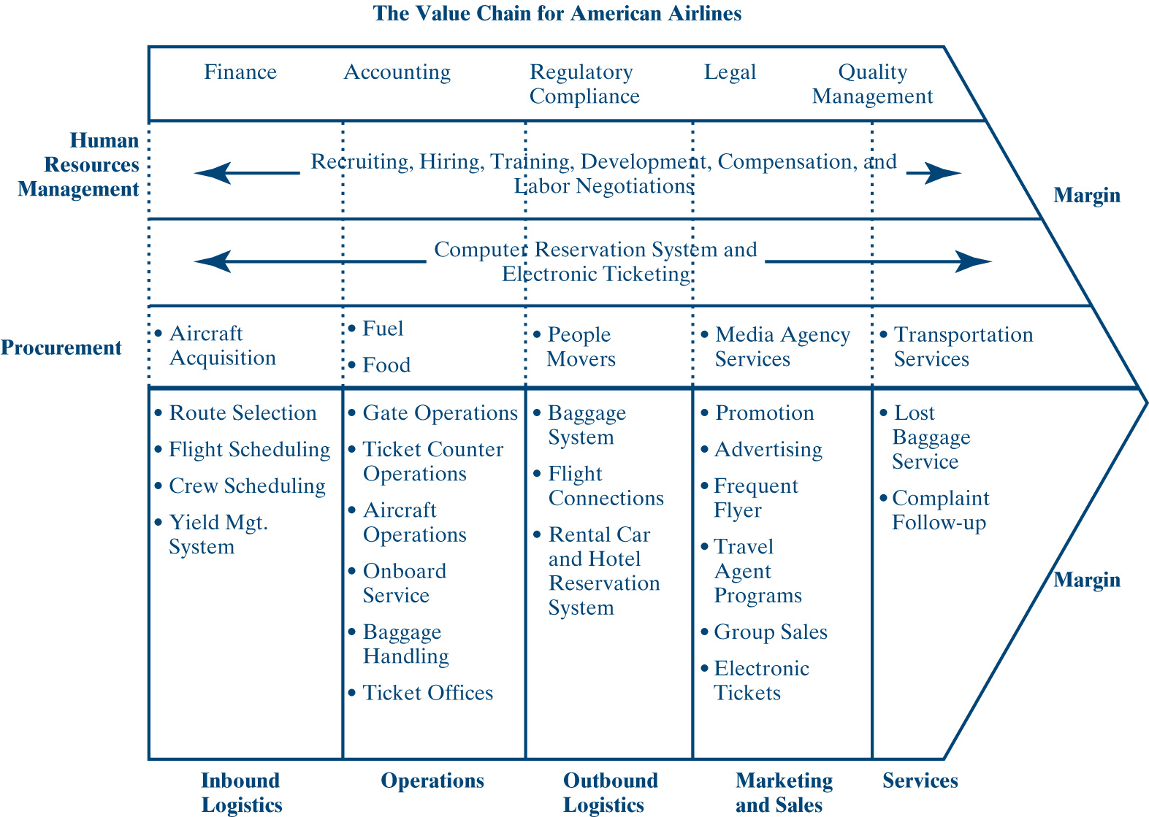
Value Chain for American Airlines

Slide 13
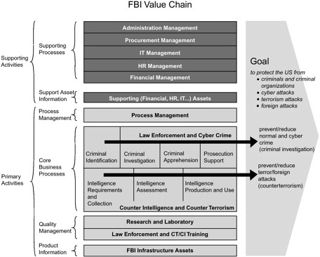
FBI Value Chain
Source: http://www.nap.edu/books/0309092248/html/19.html

Slide 14
Analyzing Value Chain Activities
What type of activity is being performed? Does it add value? Does it ensure the quality of other activities?
How does the activity add value to the customer?
Could the same activity be reconfigured or performed in a different way?
What inputs are used? Is the expected output being produced?
Is the activity vital? Could it be outsourced, deleted completely, or combined with another activity?
How does information flow into and out of the activity?
Is the activity a source of competitive advantage?
Does the activity fit the overall goals of the organization?

Slide 15
E-commerce Value Chain
The E-commerce Value Chain means identifying:
  The competitive forces within the company’s e-commerce environment
  The business model it will use
  Identifying the value activities that help the e-commerce value chain do its homework
E-commerce views information technology as part of a company’s value chain

Slide 16
Roles for E-commerce
Reducing costs
Improving product quality and integrity
Promoting a loyal customer base
Creating a quick and efficient way of selling products and services
Incorporate information technology and telecommunications to improve overall productivity
Web sites are used to provide and collect information between the e-merchant and the customer
  Competitive pricing information
  Invoicing facilitates online payment flows
  Customized products or orders can be shipped and delivered by independent shippers directly to the customer

Slide 17
Trend in E-commerce
Integrate the entire transaction life cycle, from the time the consumer purchases the product on the Web site to the time the product is actually received

Slide 18
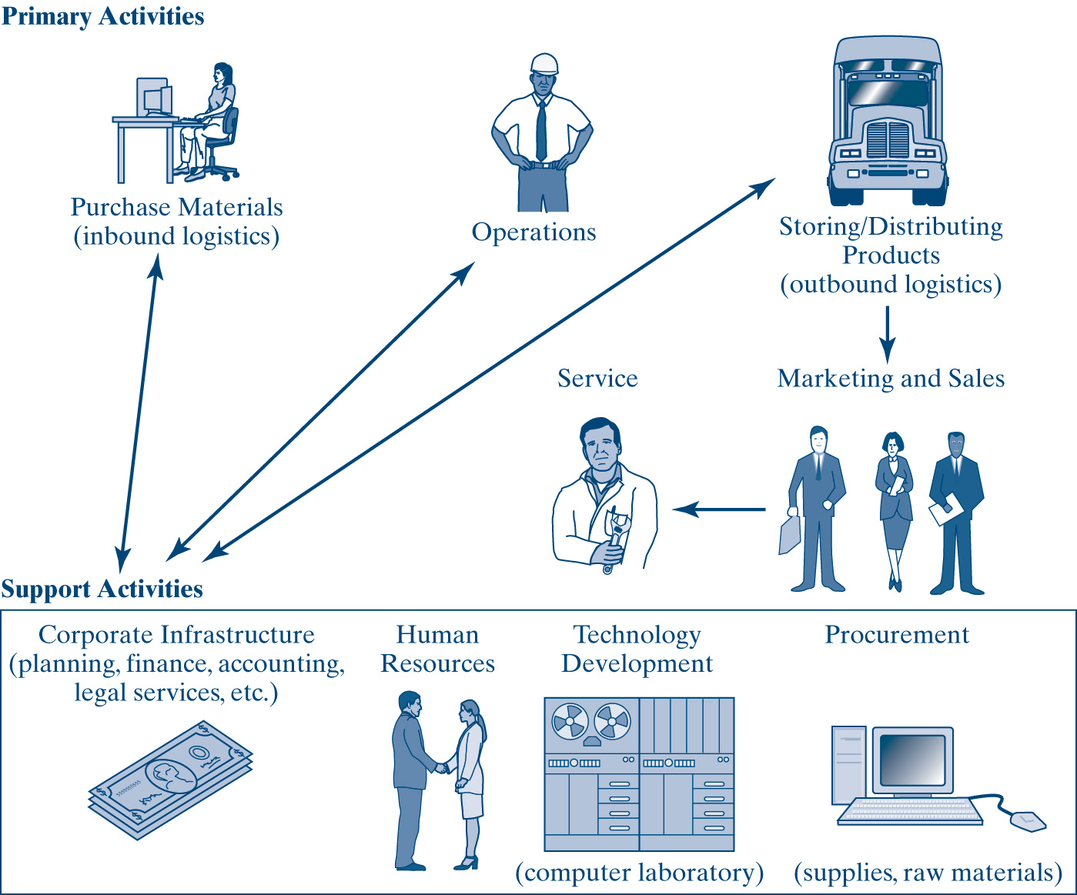
A Generic E-commerce Model

Slide 19
Network types
Networks
  an interconnected system of things or people
An internet
  an interconnected system of networks
The Internet
  a global internet; A network of computer networks which operates world-wide using a common set of communications protocols. The is only one Internet but many internets.
Extranet
  A private internet that connects an organization withes its external partners and consistent for the purpose of collaborative information sharing
Intranet
  A private internet that connects an organization’s internal information producers and consumers

Slide 20
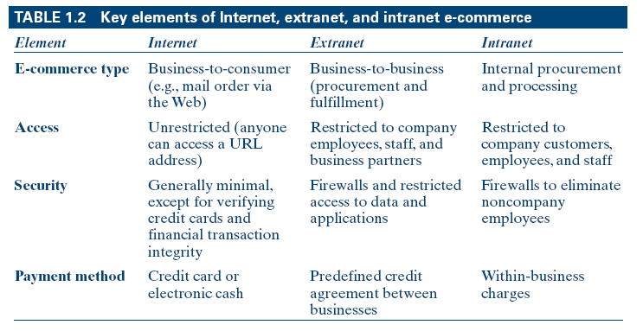
Key Elements of Internet, Extranet, and Intranet E-commerce

Slide 21
Path to Successful E-commerce
The path to success is integration of the various links (departments) in the (value) chain to work together for a common objective - profitability and customer satisfaction.
  Supplier links with manufacturing
  Manufacturing adds value by the finished products
  Finished products are then made available to sales
  Finished products
  Sales add value by advertising and selling the products to the customer
  Today, ERP software integrates information about finished products, costs, sales figures, accounting and human resources

Slide 22
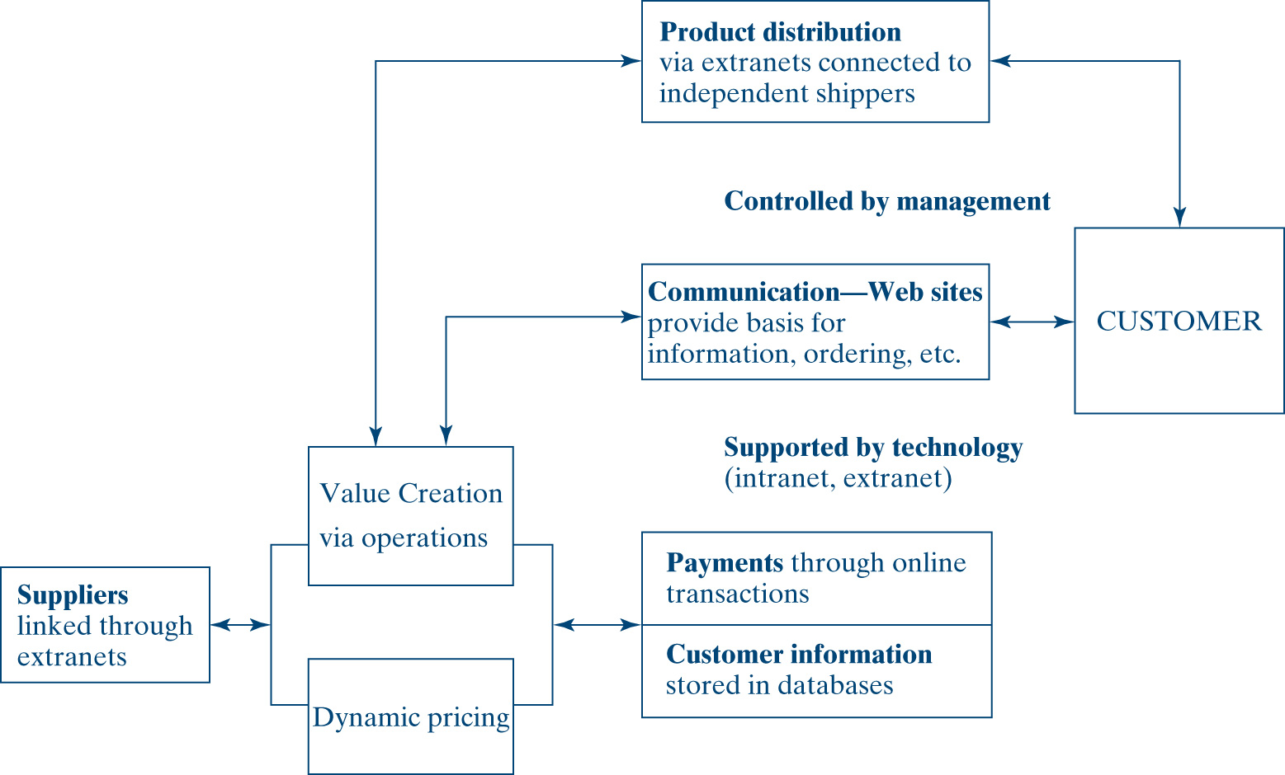
An Integrated Approach to
E-commerce

Slide 23
E-commerce Application
Business-to-Consumer (Internet)
Business-to-Business (Internet and Extranet)
Supply-Chain Management (Extranet)
Business-within-Business (Intranet)
Business-to-Government (B2G)

Slide 24
Business-to-Consumer (Internet)
The consumer’s use of a merchant’s Web storefront or Web site
Modeled on the traditional shopping experience
Shopping cart is used to hold goods until the customer is ready to check out
  Online order form supported by the appropriate software
Checkout is order and payment processing

Slide 25
Business-to-Business (Internet and Extranet)
Business-to-Business e-commerce is industrial marketing among the processes it handles are fulfillment and procurement
Companies can conveniently and quickly check their suppliers’ inventories or make instant purchases
Competing online should also force prices for materials and supplies to drop dramatically
B2B often use an extranet: a shared intranet vendors, contractors, suppliers, and key customers

Slide 26
Supply-Chain Management
Integrating the networking and communication infrastructure between businesses and suppliers
Having the right product in the right place, at the right time, at the right price, and in the right condition
Delivery of customer and economic value through integrated management of the flow of physical goods and related information
Designed to improve organizational processes by optimizing the flow of goods, information, and services between buyers and suppliers in the value chain

Slide 27
Supply-Chain Management – cont’d
SCM is:
  Collaboration among business partners
  Coordination of logistics for timely delivery of goods or products
  Cooperation among businesses and suppliers to make sure orders and inquiries are filled correctly
  Connectivity through networking infrastructure to ensure speed and good response time at all times

Slide 28
Business-within-Business (Intranet)
Strictly a “within company” type of information exchange
  Restricted to internal employees and customers
  Firewalls to keep out non employees
E-mail replaces paper for the communication of messages, order acknowledgement and approvals, and other forms of correspondence
The intranet becomes a facilitator for the exchange of information and services among the departments or divisions of a company
Different departments with different PCs or local area networks can interact on an intranet

Slide 29
Benefits of an Intranet
Low development and maintenance costs
Environmentally friendly because it is company-specific
Availability and sharing of information
Timely, current information
Quick and easy dissemination of information

Slide 30
Business-to-Government (B2G)
The government market is strikingly similar to B2B.
Huge potential for savings in $1.8 trillion federal and $1 trillion state and local expenditures
Changing the status quo in government is not so easy
  Changes to employee tasks and job restructuring often create resistance
  Tax savings potential is not easily recognized
  Committing to technology means constant need for upgrades and additional costs

Slide 31
E-commerce Business Models
Storefront Model
  amazon.com
Click-and-Mortar Model
  Sears.com
Built to Order Merchant Model
  dell.com
Service Provider Model
  Hrblock.com
Subscription-based Access Model
  Wsj.com
Prepaid Access Model
  Public access Wifi
Broker Model
  Etrade.com
Advertiser Model
  Google.com
Portal Site Model
  Yahoo.com
Free Access Model
  Netzero.net
Virtual Mall Model
  Virtualmall.ca
Virtual Community Model
  Myspace.com
Infomediary Model
  Cnn.com

Slide 32
Managerial Implications
It is people and managerial talent that matter
There is a new focus on building a productive organizational culture, managing change and results, building intellectual capital, creating future leaders, managing organizational learning, and pushing growth and innovation
The real asset is information and how it is used to create value for the customer
The top challenge in managing e-business is understanding the consumer

Slide 33
Chapter Summary
Electronic commerce (EC) is the ability to deliver products, services, information, or payments via networks such as the Internet and the World Wide Web.
Electronic business connects critical business systems directly to key constituents
The rise of specialized Web sites and Web logs (blogs) generated opportunities to read and write on a vast array of topics
Several drivers promote EC: digital convergence
Advantages of EC

Slide 34
Chapter Summary (continued)
Limitations of EC
A value chain is a way of organizing the activities of a business so that each activity provides added value or productivity to the total operation of the business.
The transaction life cycle includes three major e-commerce applications: Business-to-Consumer (B2C), Business-to-Business (B2B), and Business-within-Business.
An intranet wires the company for information exchange.
Success in the E-commerce field depends on attracting and keeping qualified technical people and managerial talent.
There are several types of specialized Web sites on the Internet. Each site is based on a business model as a way of doing business to sustain a business - generated revenue.

Slide 35

The World Wide Web

Slide 36
The focus of this chapter is on several learning objectives
The rising tide of the Internet
The makeup of the Web
The main Web search elements
The main elements of Web research and Web research tips
The search process and some important facts to remember about Web research
How to optimize Web sites
The role of the ISP
Web fundamentals including the makeup of the URL
Internet services

Slide 37
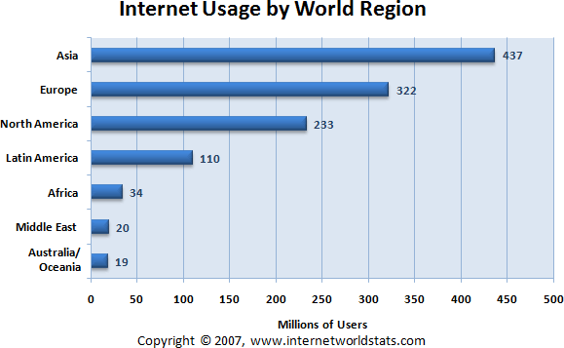
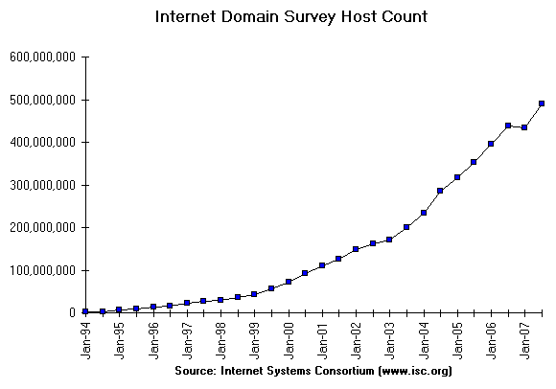
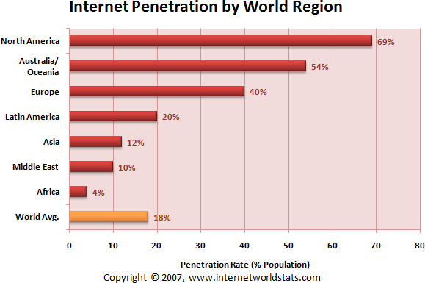
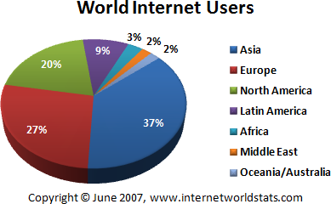

Slide 38
The Beginnings of the Internet
Internet is the infrastructure that links thousands of networks together
Internet owes its existence to the Pentagon and the cold war
  Original networked sites were military installations, universities, and business firms with defense department contracts
  Initial goal was to design a network that would maintain the safe transition of data between military computers at select sites through redundant communication routes

Slide 39
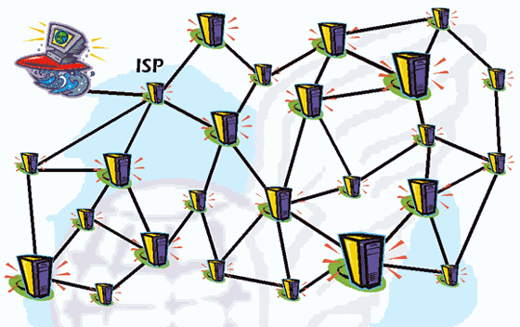
Source: http://www.glossar.de/glossar/1frame.htm?

Slide 40
The Beginnings of the Internet (cont'd)
Researchers devised a way of bundling information into packets that carried the network address of the recipient
  Each packet is sent into a so-called network “cloud” across the vast array of computers on the network
  Each computer checks to see if the information belongs to any of its clients and forwards it to the next computer to which it might belong
  Once claimed by the right computer, the packet is opened to reveal the message
  This message delivery system is moved by a protocol
  Packet Switching Demo http://www.pbs.org/opb/nerds2.0.1/geek_glossary/packet_switching_flash.html

Slide 41
The Beginnings of the Internet (cont'd)
  At first, Internet traffic was government related and government subsidized: No ordinary person or company could use the Internet
    April 1995 the U.S. government relinquished control of the Internet to independent governing bodies, which relaxed entry for almost everyone
    2002_0918_Internet_History_and_Growth.ppt

Slide 42
The Beginnings of the Internet (cont'd)
  The Internet today offers a variety of services including:
    E-mail
    File transfer
    Interest group membership
    Multimedia displays
    Real-time broadcasting
    Shopping opportunities
    Access to remote computers
    Quick and easy transmission of information among computers worldwide

Slide 43
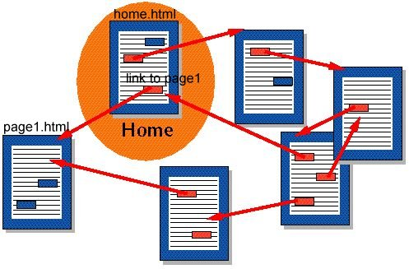
The Making of the World Wide Web
Tim Berners-Lee wrote a program that allowed information highlighted in a document to link to other documents on a computer network with a mouse click
Hypertext is text that contains keywords to connect to other documents
Keywords called links, also referred to as hyperlink, connects current document to another location in the same document or to another document on the same host computer
Hypertext for the Web can be generated with a language called HyperText Markup Language (HTML)

Slide 44
The Making of the World Wide Web (cont'd)
The World Wide Web (also known as the Web) is the universe of network-accessible information and the embodiment of the human knowledge
  A cluster of software, protocols, and standards
  An organization of files designed around a group of Internet servers programmed to handle requests from browser software that resides on users’ PC
  Single document can be perceived to stretch - weblike - throughout the world (See www.w3.org/www)
When a document is accessed the components are pulled from different computer worldwide and integrated in the document displayed on the user’s screen

Slide 45
Physical Structure of the Internet
Physical structure, or architecture, of the Internet is hierarchical
  High-speed backbones are at the top
  Bulk of Internet traffic is fed onto the backbone via network access points (NAPs)
  Regional and individual networks at the bottom
  http://www.nthelp.com/maps.htm
  http://www.caida.org/tools/visualization/mapnet/Backbones/
The Internet uses a common set of communication protocols called the TCP/IP (transmission control protocol / Internet protocol) suite that provide the basis for operating the Internet

Slide 46
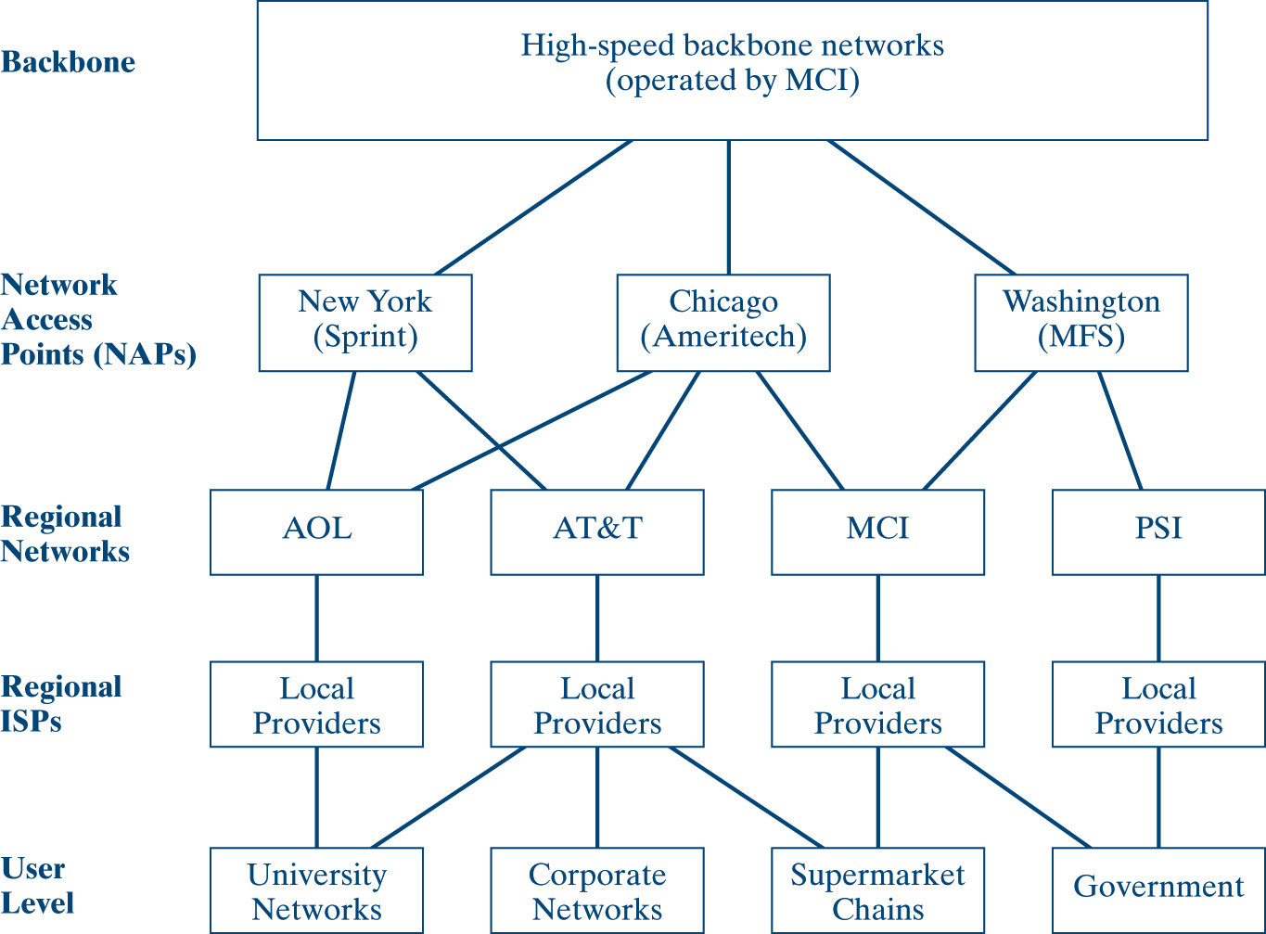
General Internet Network Architecture

Slide 47


Fort Kent to Standish ME on the Internet
Flag | Location | Country | Region | Code | City | Time Zone | Map Reference | IP Address
 | USMEORON | United States | Maine | ME | Orono | -05:00 | North America | 130.111.66.1
 | USMERUMF | United States | Maine | ME | Rumford | -05:00 | North America | 130.111.2.26
 | USMEPORT | United States | Maine | ME | Portland | -05:00 | North America | 24.39.51.65
 | USMEPORT | United States | Maine | ME | Portland | -05:00 | North America | 24.39.4.6
 | USNYSYRA | United States | New York | NY | Syracuse | -05:00 | North America | 24.24.7.149
 | USNYSYRA | United States | New York | NY | Syracuse | -05:00 | North America | 24.24.7.170
 | USILCHIC | United States | Illinois | IL | Chicago | -06:00 | North America | 4.79.0.73
 | USMNMINA | United States | Minnesota | MN | Minneapolis | -06:00 | North America | 4.69.132.246
 | USMNMINA | United States | Minnesota | MN | Minneapolis | -06:00 | North America | 4.69.132.250
 | USILCHIC | United States | Illinois | IL | Chicago | -06:00 | North America | 4.69.134.74
 | USILCHIC | United States | Illinois | IL | Chicago | -06:00 | North America | 4.69.134.121
 | USMNMINA | United States | Minnesota | MN | Minneapolis | -06:00 | North America | 4.69.132.93
 | USILCHIC | United States | Illinois | IL | Chicago | -06:00 | North America | 4.69.134.182
 | USMDCOLU | United States | Maryland | MD | Columbia | -05:00 | North America | 4.68.121.41
 | USNCEISL | United States | North Carolina | NC | Emerald Isle | -05:00 | North America | 4.79.29.186
 | USILCHIC | United States | Illinois | IL | Chicago | -06:00 | North America | 137.118.63.254
 | We are unable to locate the IP address "137.118.99.6" at this time. |  |  |  |  |  |  | 137.118.99.6

Slide 48
Key Protocols Accessible on the Web
E-mail - the protocol for e-mail is Simple Mail Transport Protocol, or SMTP
HTTP - Hypertext Transfer Protocol makes possible transmission of hypertext over networks
VoIP - Voice over Internet Protocol makes it possible to place a telephone call over the Web

Slide 49
Web Search Elements
Internet contains thousands of Web sites dedicated to tens of thousands of topics
Key elements that make the search process feasible:
  Browser
  Plug-Ins
  Search Engine

Slide 50
The Browser (cont'd)
A browser is a piece of software that allows users to navigate the Web
  Netscape Navigator
  Microsoft Internet Explorer
  Firefox
  Opera
  Winwap

Slide 51
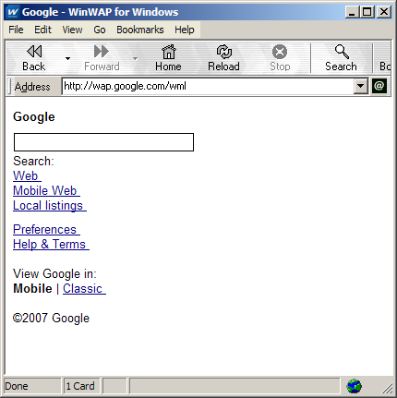
The Browser (cont'd)
A browser is a Web client program that uses Hypertext Transfer Protocol (HTTP) to make requests of Web servers throughout the Internet on behalf of the browser user
  Text-only mode such as Lynx
  Graphic mode involves a graphical software program that retrieves text, audio, and video

Slide 52
Plug-Ins
Software programs configured to a Web browser to improve its capabilities
Working together with plug-ins, browsers today offer seamless multimedia experiences
A popular plug-in on the Web is Adobe Acrobat Reader
Microsoft developed software called Active X, which makes plug-ins unnecessary
  This software makes it possible to embed animated objects and data on Web pages
  Being a Microsoft product, Active X works best with Microsoft’s Internet Explorer browser

Slide 53
Multimedia
Since 1999, it is now common to use the Web to listen to audio and watch video - prerecorded or live off the Internet
Streaming media is audio or video that begin to play as it downloads (streaming), done through buffering
  Buffering is used to minimize the wait time between downloading and actual viewing of the material
RealPlayer and Windows Media Player are alternative options for the broadcast of real-time (live) events
Shockwave is multimedia software that allows for an entire multimedia display of audio, graphics, animation, and sound
Live Cam software essentially is a video camera that digitizes images and transmits them in real time to a Web server
Chat programs make it convenient for people to “talk” to each other in real time by typing messages and receiving responses (i.e. America Online’s Instant Messenger)

Slide 54
The Search Engine
A search process begins with a search engine:
a Web site or a database, along with the tools to generate that database and search its contents for “keywords” that describe what you’re looking for.

Slide 55
Other Definitions for Search Engines
  A software program that collects and indexes Internet resources and provides a keyword search system allowing the user to identify and retrieve resources based on words, phrases, or patterns within those documents
  A Web-based system for searching the information available on the Web
  An automated system that relies on a software agent (otherwise known as spiders, robots or crawlers) that explores the World Wide Web following links from site to site and catalogs relevant text and content, storing Web pages and creating a customized index based on the user’s query of the search engine’s database

Slide 56
More on Search Engines
Two main elements of Web research are indexes and search engines
An index can help a searcher acquire general information or gain a feel for the general topic
An index can be hierarchical or alphabetical
    Hierarchical indexing leads from general to specific topics
    Alphabetical indexing contains sources that focus on a specific topic or area of concern

Slide 57
Other Components of a Web Search Engine
A spider is a program that roams the Web from link to link, identifying and scanning pages
A spider is software unique to a search engine that allows users to query the index and returns results in relevancy-ranked order (alphabetical)
Search Engine Improvements:
  First-generation search engine returns results in schematic order, constructing a term relevancy rating of each hit and presenting search results in this order, also called “on the page” ranking.
  Second-generation search engine organizes search results by peer ranking concept, domain, or site rather than by relevancy, also called “off the page” information.

Slide 58
Search Facts to Remember
People look up Web sites with search engines.
People usually use bookmarks to visit their favorite Web sites.
A Web site must be quick and current.
A Web site should address the privacy and navigation concerns of the user.
The “bottleneck” problem
People are reluctant to pay to surf a Web site.

Slide 59
Search Engines Are Getting Smarter
Experts are working feverishly at making search engines more intelligent
An example of incorporating “intelligence” into search engines is a software agent called Query Tracker that supplements a user’s query with its own, and it gains in performance with prolonged use and feedback.
Another intelligent search engine application is IBM’s WebFountain that determines whether an entity is a person’s name, a corporate logo, a product, or a discount and then goes ahead and attaches a metadata tag to it.
On the drawing board is “thinking in pictures” as an alternative way to search the Web

Slide 60
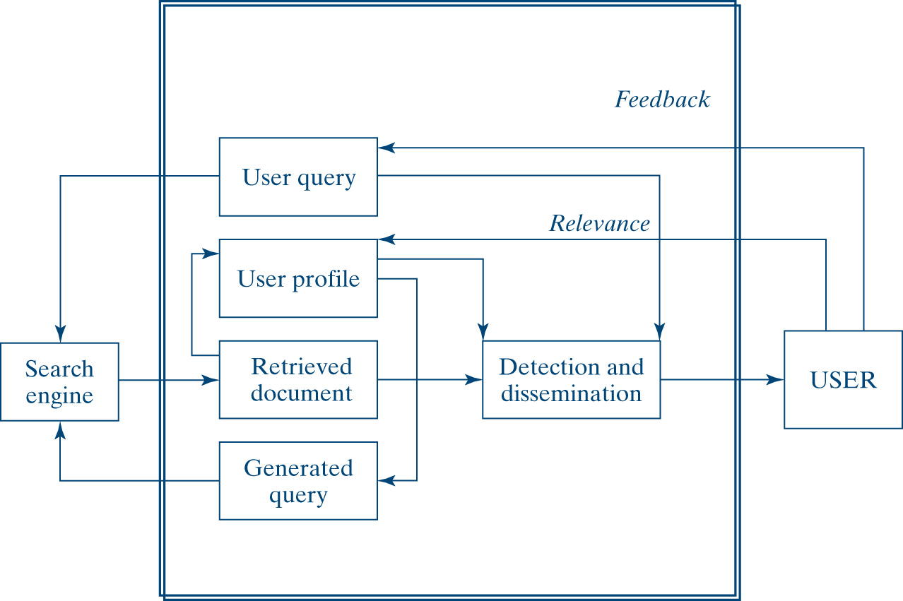
Query Tracker
Source: Adapted from Anthes, Gary H., “Search For Tomorrow” Computerworld, April 5, 2004, 26.

Slide 61
Search Engine Optimization
A way of trying to increase the number of visitors to a Web site by ranking high in the search results displayed by a search engine
One way to optimize is via hyperlinks

Slide 62
Tips for Search Engine Optimization
General keywords are nowhere as good as specific keyword phrases
Check the Web site of the competition for ideas
Think of what visitors would search for in the page you’re optimizing
Include the most important keyword phrases in heading tags on your page
Finalize the list of keyword phrases for the pages you optimize
The title tag of your page is the most important factor to consider
Visitors as well as search engines read your pages by looking at keywords to see what you have to offer
Many people have a false impression that good metatags are all that is needed to achieve good listings in the search engine
There are two metatags that can help in listing your Web site: meta keywords and meta descriptions

Slide 63
Internet Service Providers
Internet service provider (ISP) is a company that links users to the Internet for a fee
Services offered by ISPs
  Linking consumers and businesses to the Internet
  Monitoring and maintaining customers’ Web sites
  Providing network management and system integration
  Providing backbone access services for other ISPs (like PSI and UUNET)
  Offering payment systems for online purchases

Slide 64
Internet Service Providers (cont'd)
Initially, the cost for Internet access often exceeded $1,000 per month
Many of today’s ISPs offer unlimited access for as low as $5 per month
Many local governments are funding the use of the Internet because of its political, educational, and commercial benefits
The problem for some ISPs is sudden growth without advance planning to accommodate that growth
A well managed ISP requires:
  Professional management
  A highly skilled technical staff
  Healthy budget to bring the technology in line with the voracious
  Ensure a balance between creativity and control and between managing growth and a stable technical infrastructure appetite of today’s consumer

Slide 65
Stability and Reliability of the Web
No one single agency or company owns the Internet
Each company on the Internet owns its own network
Links between these companies and the Internet are owned by telephone companies and ISPs
The organization that coordinates Internet functions is the Internet Society
Internet is designed to be indefinitely extendable
Reliability depends primarily on the quality of service providers’ equipment

Slide 66
Web Fundamentals
The WWW is a global network of millions of Web servers and Web browsers connected by the hypertext transfer protocol (HTTP)
The WWW is a giant client/server system
  Content is held by Web servers and requested by clients or browsers
  Clients display the information sent by the Web server on their monitors
  Web servers provide pages of multimedia information in seconds
  The most important element of a Web site is its links to other pages within the site or across sites

Slide 67
Web Fundamentals - URLs and HTTP
Uniform Resource Locators (URLs) are central to the Web in e-commerce
A URL such as http://www.virginia.edu consists of two key parts:
  http:// (Hypertext Transport Protocol) is a protocol designator
  www.virginia.edu is the server name:
    www after the double slash tells the network that the material requested is located on a dedicated Web server
    Virginia is the name of the Web site requested
    Edu is a code for the domain of the Web server indicating that the site is an educational institution

Slide 68
Security Protocols
Two main security protocols
  Secure Sockets Layer (SSL) is a protocol for transmitting private information in a secure way over the Internet
  Secure HTTP (S-HTTP) provides various security features such as client/server authentication and allows Web clients and servers to specify privacy capabilities
Security is a major concern

Slide 69
Key Terms for Internet Literacy
Internet service provider (ISP) is a company that links users to the Internet for a fee; the entrance ramp to the Internet.
A Browser is a software program loaded on a PC that allows you to access or read information stored on the Internet. It is the client program that enables you to interface with the Internet.
Server is the destination point on the Internet where the information you are seeking is stored.
Electronic mail (e-mail) is probably the most popular and abused network application across all user categories.

Slide 70
Key Terms for Internet Literacy (cont’d )
File transfer protocol (FTP) is a standard protocol that allows you to copy files from computer to computer
Telnet is a basic Internet protocol that allows you to log on to a computer and access files from a remote location as if they were local files
Bulletin board systems (BBS) is a computer-based meeting and announcement system that allows local people to exchange information free of charge. A BBS generally has a simple interface to the Internet for users to access services like e-mail and NetNews.

Slide 71
Key Terms for Internet Literacy (cont'd)
Web pages are written in a language called Hypertext Markup Language (HTML)
  Language specifies display features that visually structure a page
  Best known for publishing static information (flows in one direction)
How to allow the user to interact with a Web site?
  Common gateway interface (CGI) scripts execute a process on the server. When executed, the script passes data (posted form) provided by the customer for verification and action.
  Java programming language or Java makes it possible for the customer to interact directly with the program on the screen.

Slide 72
Managerial Implications
The Web has changed the way business and information technology work together.
E-commerce is transforming the Internet from a “browse-and-surf” environment into a mammoth information exchange.
The important thing is to keep an eye on the technologies, as they evolve, and to be familiar with the changes before taking a dive into the Internet.
Strategize first, test the waters, and be sure you have a unique product supported by qualified staff to follow up on the Web traffic that it attracts.

Slide 73
Chapter Summary
The Web is the fastest growing, most user-friendly, and most commercially popular technology to date.
The Internet owes its existence to the Pentagon, where it originally was created for military research.
The Internet is physically hierarchical. High-speed backbones are at the top, with regional and individual networks at the bottom.
Internet service providers link commercial traffic to its destination.

Slide 74
Chapter Summary (cont’d)
The Internet has many uses; it also has many limitations.
World Wide Web is a global hypertext network of millions of Web servers and browsers connected by hypertext transfer protocol (HTTP) and its many derivatives.
It is important to learn the language of the Internet before starting an e-commerce project.
The Internet and the Web have changed the way business and technology work together.

