Slide 1

IRIS TUMOR DETECTION USING CNN
Presented by :
Gaana Shree S
Fariha Naaz
Yogesh Rai
Charmika Mittapally
Gayathri Tati

Slide 2

AGENDA
INTRODUCTION
PROBLEM STATEMENT
PROPOSED SOLUTION
MODEL ARCHITECTURE
NOVELTY
RESULTS
CONCLUSION
FUTURE SCOPE

Slide 3

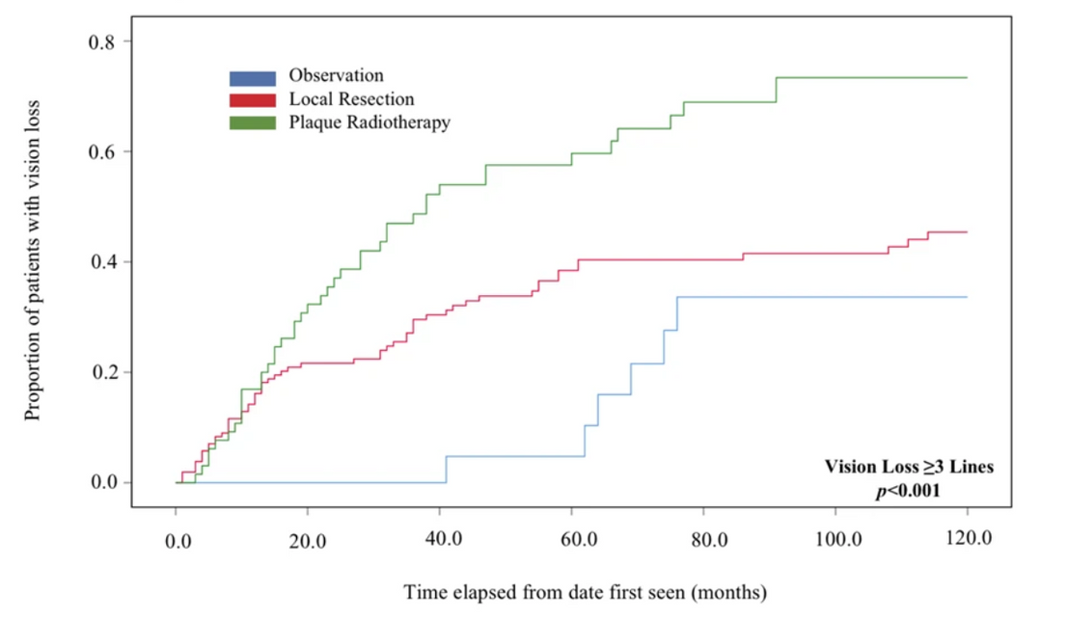
INTRODUCTION
Every 1 in thousand Indians are diagnosed with iris tumor. Initially it affect a person’s lifestyle by partially visual impartiality within a period of 2 years these tumor lead to permanent blindness.

Slide 4
PROBLEM STATEMENT
Inaccessibility of Advanced Medical Diagnostics in Resource-Limited Settings
High Computational Costs of Existing Diagnostic Models
Citizens in rural areas do not have facilities to access and undergo diagnosis of Iris tumor.
The cost of eye cancer diagnosis typically starts at around 101,000.

Slide 5
PROPOSED SOLUTION
Techniques such as converting images to grayscale, removing noise with median filtering, and detecting edges using the Canny algorithm. This helps improve the quality of the images for better detection.
Use deep learning models to automatically classify iris tumor images. Leverage pre-trained models that have learned from large image datasets to improve accuracy
The model can be deployed on mobile or cloud platforms, making it accessible for healthcare providers in both urban and rural areas.

Slide 6
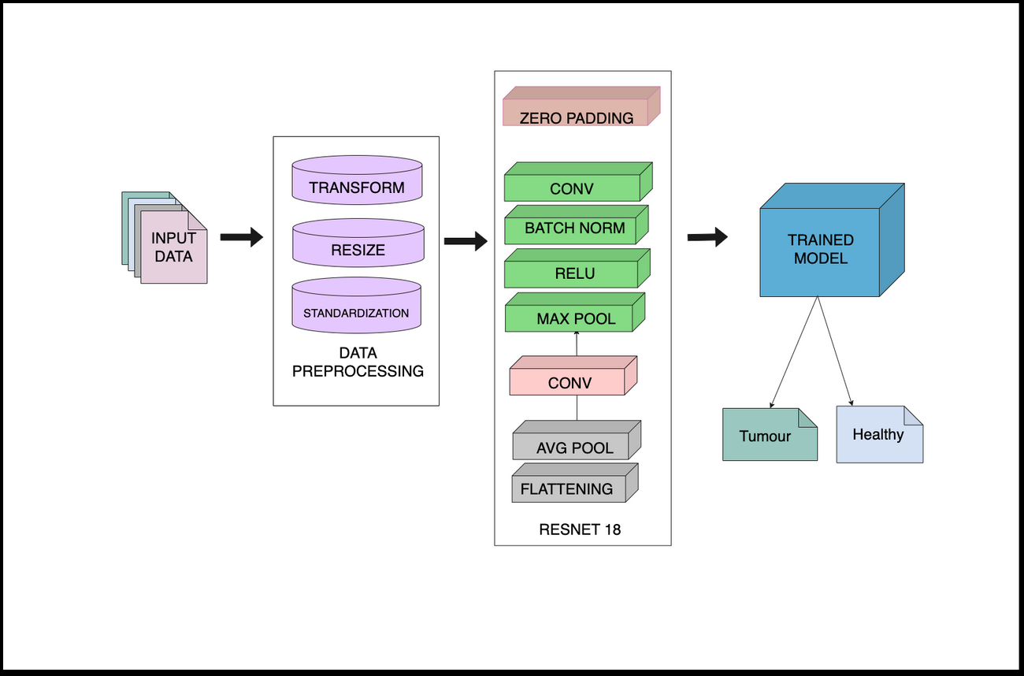
MODEL ARCHITECTURE
Pre-trained Weights for Faster Learning: The model leverages pre-trained weights from ResNet18, allowing it to learn faster and achieve higher accuracy, especially with limited iris tumor data.
Regularization with Dropout: A dropout layer is included in the classifier to prevent overfitting, improving the model's generalization to new, unseen data.

Slide 7
NOVELTY
Deep Learning for Iris Tumor Detection: The model uses ResNet18 for high-accuracy detection of iris tumors, applying transfer learning to specialize in medical image classification.
Web Deployment for Easy Access:Deploying the model on a website allows users to upload iris images and receive instant, automated results, making detection accessible to everyone.
Affordable and Scalable: The web-based model reduces the need for expensive equipment, making it a cost-effective solution that can reach underserved areas.

Slide 8
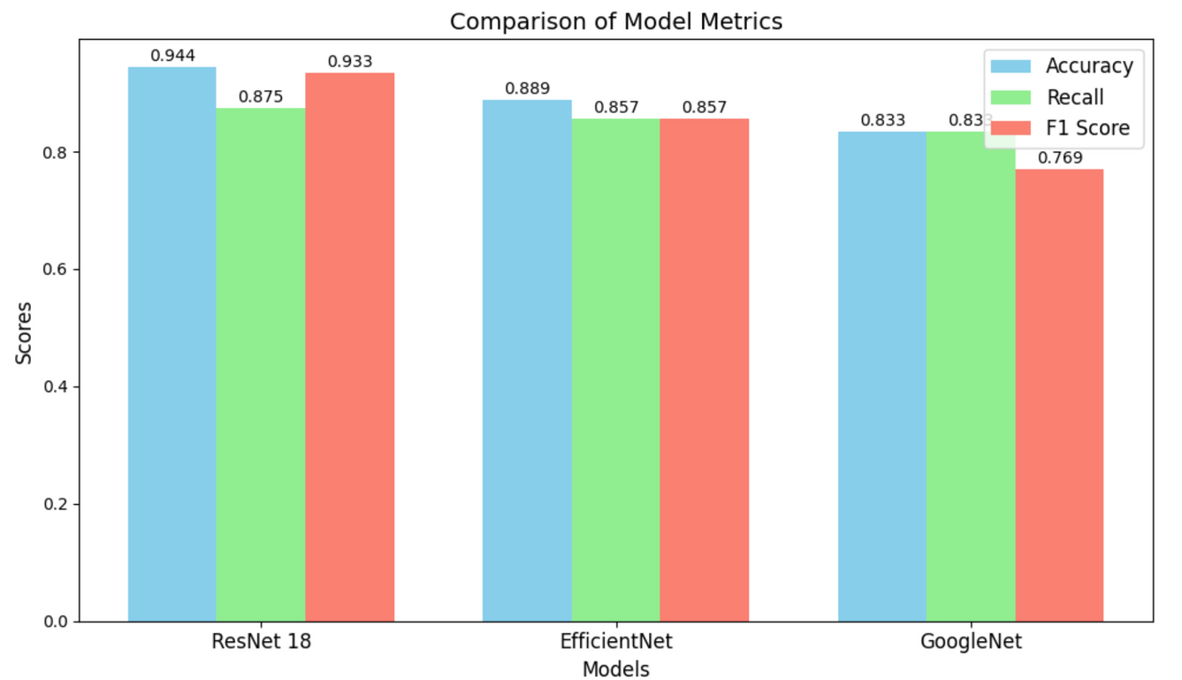
RESULTS
Achieved 94.44% accuracy in iris tumor detection, ensuring reliable and precise results for real-time diagnosis.

Slide 9
CONCLUSION
Cost-effective and scalable for use in underserved areas
Automates the detection process, speeding up diagnosis and reducing the chances of human error
By hosting the model on a web platform, it becomes easily accessible for healthcare professionals and the general public, regardless of location.
The model provides precise results with a 94.44% accuracy rate, ensuring dependable diagnosis in real-time.

Slide 10
FUTURE SCOPE
The framework can be extended to detect other medical conditions, making it a scalable solution for a wide range of healthcare applications.
The model could be integrated with wearable health devices to provide continuous monitoring and early detection of eye-related conditions
Future improvements could include using explainable AI techniques, allowing doctors to understand the model's predictions and increasing trust in the system.

Slide 11
REFERENCES
Abdulkader Helwan, ITDS: Iris Tumor Detection System using Image Processing Techniques, International Journal of Scientific and Engineering Research.
Kamil Dimililer, Yoney Kirsal Ever, Haithm Ratemi, Intelligent eye Tumour Detection System, Procedia Computer Science.
Foran DJ, Chen W, Kurc T, Gupta R, Kaczmarzyk JR, Torre-Healy A, Bremer E, Ajjarapu S, Do N, Harris G, Stroup A, Durbin E, Salt JH. An Intelligent Search and Retrieval System (IRIS) and Clinical and Research Repository for Decision Support Based on Machine Learning and Joint Kernel-based Supervised Hashing. Cancer Inform
M. Saravanan, D. Kalpanapriya. A Novel Iris Cancer Detection usingwavelet and wavelet packet Transform. Research J. Pharm. and Tech.
Nitin Rahuja, Sudarshan K. Valluru, A Comparative Analysis of DeepNeural Network Models using Transfer Learning for Electrocardiogram Signal Classification.
Mitamura M, Kase S, Suimon Y, Ito T, Ishida S. A Case of Metastatic Iris Tumor Observed With Anterior Segment Optical Coherence Tomography Before and After Radiation Therapy.
Iris Detection Using Segmentation Techniques, Dr. Mohammad Shabaz, International Journal of Computer Sciences and Engineering

Slide 12
THANK YOU

