Slide 1

Inter-city Bus Route Finder
Presented to:
Dr. Md. Hasanuzzaman
Ms. Anna Fariha
Presented by:
Salsabil Ahmed Khan (Roll-11)
Fariha Moomtaheen (Roll-23)

Slide 2

Overview
Shows route between two cities of Bangladesh
Route can be searched based on 3 criteria
Helps select bus based on requirement

Slide 3
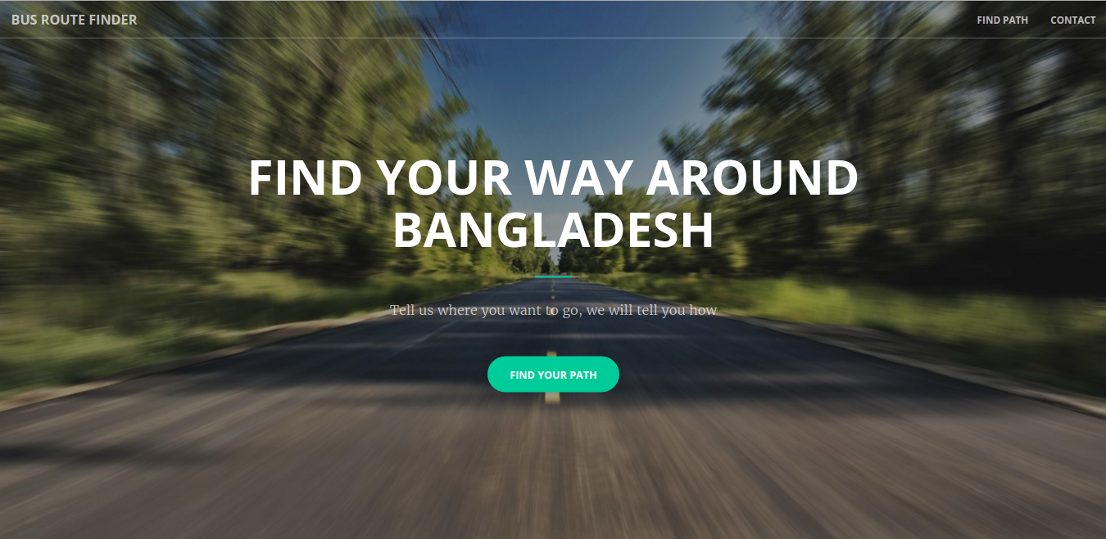
Home

Slide 4
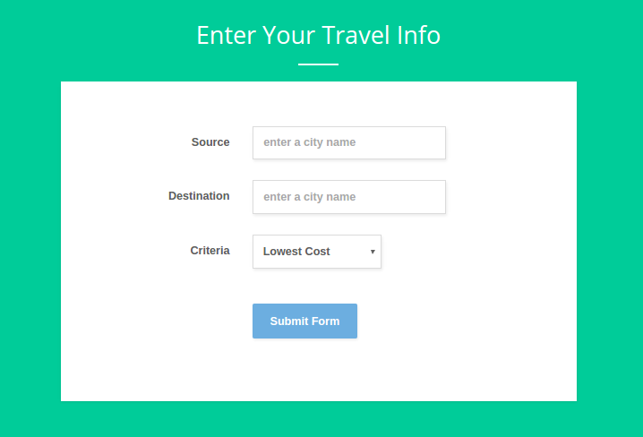
Find Route

Slide 5
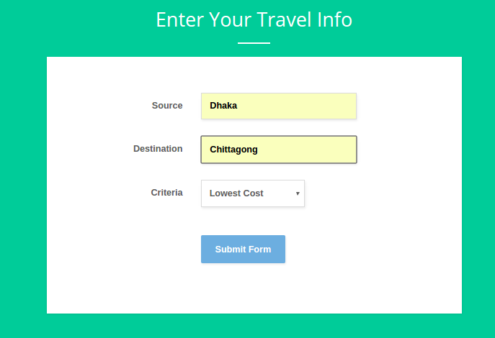
Find Route : Lowest Cost

Slide 6
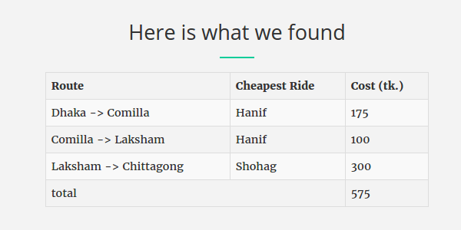
Result: Lowest Cost

Slide 7
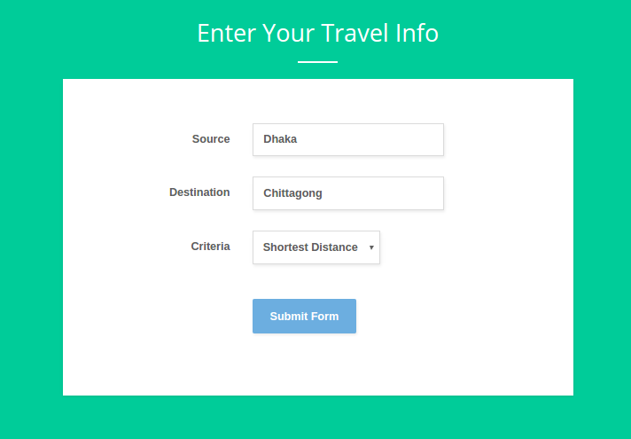
Find Route: Shortest Distance

Slide 8
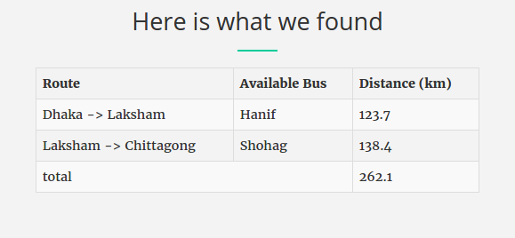
Result: Shortest Distance

Slide 9
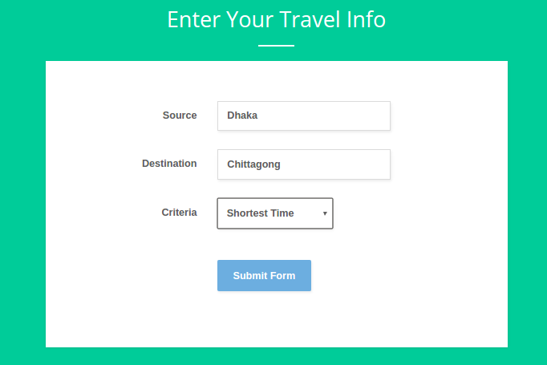
Find Route: Shortest Time

Slide 10
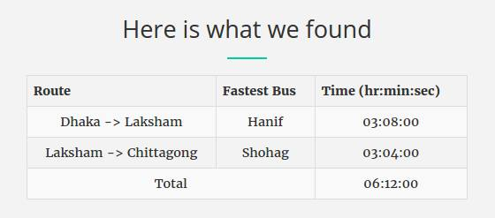
Result: Shortest Time

Slide 11

Limitation
The route is not showed in map.
Arrival and departure time are not mentioned.

Slide 12

Conclusion
We will try to overcome our shortcomings in the future. This site will definitely help the travellers of our country find the best way to reach their destination in the comfort they prefer.

Slide 13


