Slide 1
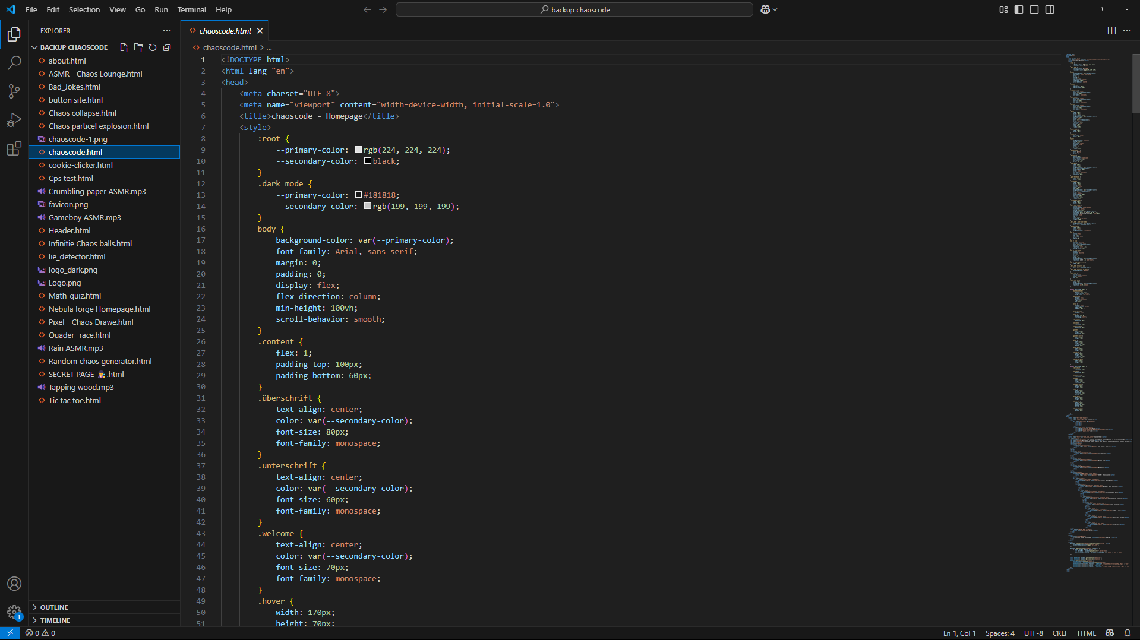
Our Project :
Welcome to Chaoscode

Slide 2
hello everyone! We are Nebual Forge and we wat to show you our English project our website called Chaoscode!
→ Hallo zusammen! Wir sind Nebula Forge und wir möchten euch unser Englischprojekt vorstelen: unsere Webseite namens Chaoscode!

Slide 3
Our task was to create a website in English. It Had to be creative fun, and fully written in English.
→ Unsere Aufgabe war es, eine Webseite auf Englisch zu erstellen. Sie sollte kreativ, lustig und komplett auf Englisch sein.

Slide 4
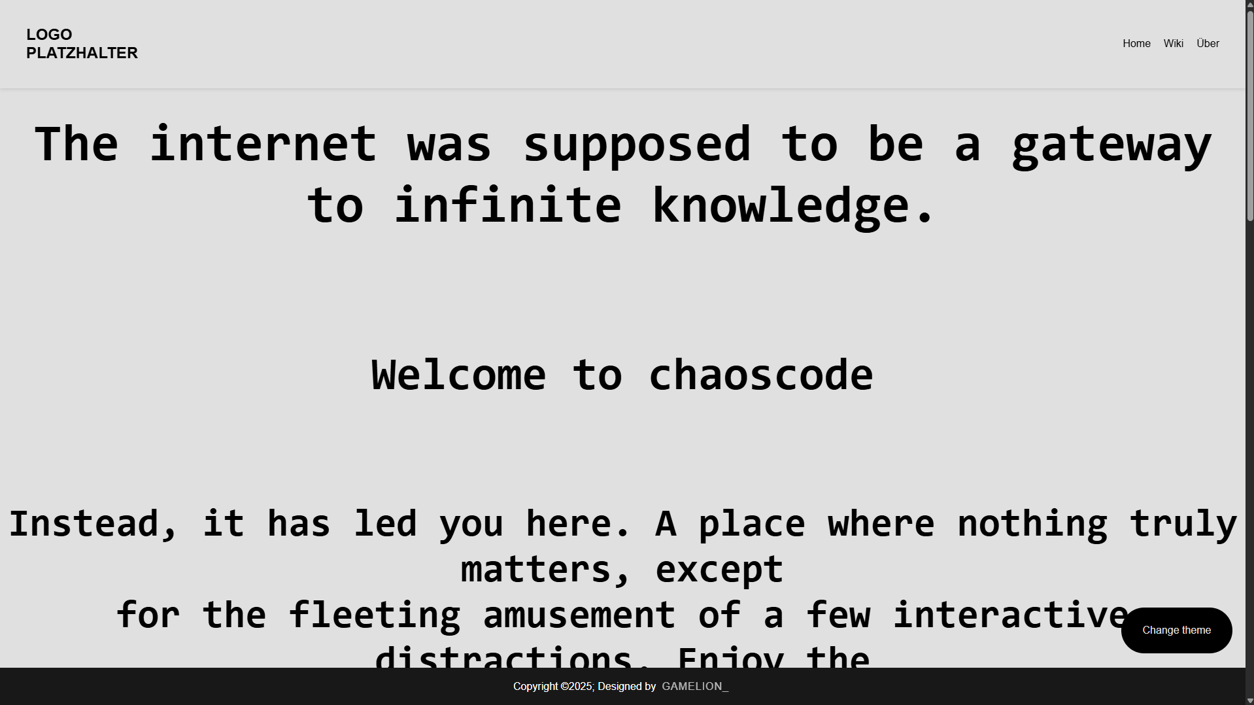
What is Chaoscode?
Chaoscode its a website where we publish fun coing projects, mini-games, and crazy ideas. Everything is made by us!
→ Chaoscode ist eine Webseite, auf der wir lustige Coding-Projekte, Mini-Spiele und verrückte Ideen veröffentlichen. Alles stammt von uns selbst!

Slide 5
Why did we choose this topic?
We love programming, games, and Creative chaos. So we thought why not combin everything into one project?
→ Wir lieben Programmieren, Spiele und kreatives Chaos. Also dachten wir: Warum nicht alles in einem Projekt vereinen?

Slide 6
What did we learn?
How to buid a website with HTML, CSS, and JavaScript
How to write clear English texts
How to work together as team
→ Wie man eine Webseite mit HTML, CSS und JavaScript baut
→ Wie man klare englische Texte schreibt
→ Wie man als Team zusammenarbeitet

Slide 7
What can you find on our website?
Our website includes
Mini-games (lik Pixel Runner)
Funny experiments (like The Random Button)
Small tools (like a Meme Generator)
→ Unsere Webseite beinhaltet:
→ Mini-Spiele (wie Pixel Runner)
→ Lustige Experimente (wie den Random Button)
→ Kleine Tools (wie einen Meme-Generator)

Slide 8
How we built our website

Slide 9
Our website was created using three main languages: HTML, CSS, and JavaScript.
HTML (HyperText Makup Language) is the structure of our website. It defines the content like titles, buttons, and text.
CSS (Cascading Style Sheets makes everything look nice. We used it to add colors, fonts, spacing, and layout.
JavaScript adds interactivity. Thanks to JavaScript, our buttons do things, pages react to clicks, and funny animations can happen!
We combined all three to build a fun and interactive website that works in any browser. It was challenging at times, but we learned a lot about how websites really work.

Slide 10
Sooo... that was our website: Chaoscode!
A mix of coding, creativity, memes, and madness – made by us, for fun, and maybe even for the internet
We hope you enjoyed our little chaos tour!
If you have questions, ideas, or just want to press our random buttons – come talk to us!
Thank you and stay chaotic

Slide 11
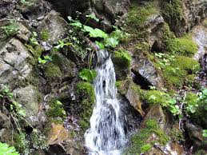
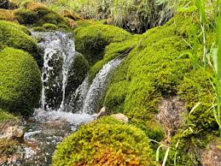

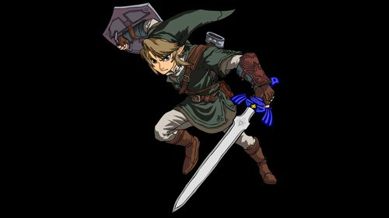
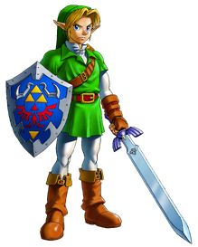
Quellen & Links :
Our Website Chaoscode :

