Slide 1
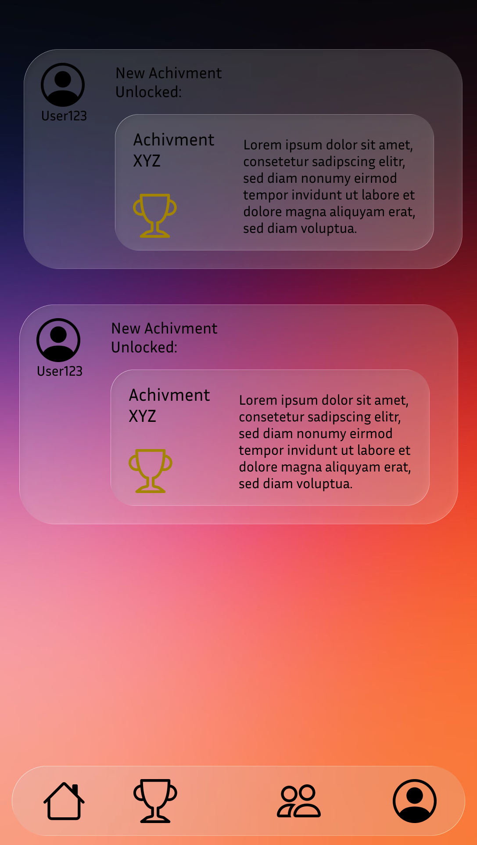
Upmark
Show your reallife achievements.
Upmark is a social app that lets you showcase your reallife achievements. Track your pogress share milestones with friends, and see how others are leveling up all in one clean, modern platform. Celebrate your wins, big or small, and stay motivaeted every day.

Slide 2
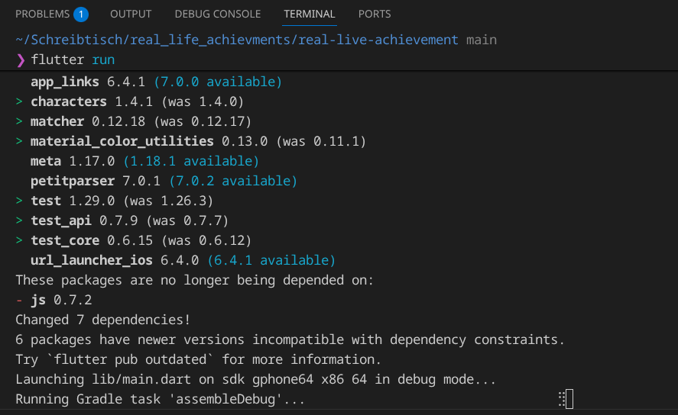
The Mission
Unlike other social apps, Upmark is about sharing unfiltered moments and comparing yourself to each other.
As developers, we have long wished for such an app where you can view and compare achievements you have collected in real life.
So we decided to simply develop them ourselves.

Slide 3
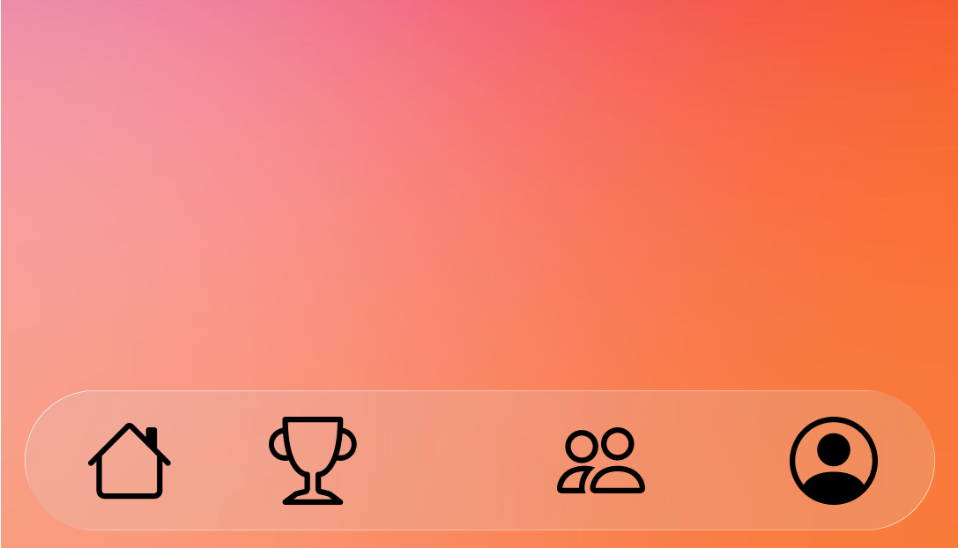
How it Works
Once you've created an account, it's actually quite easy; the app tracks your movement data and awards you achievements when you've completed the corresponding mission, for example: visit 5 different countries = traveler I.

Slide 4
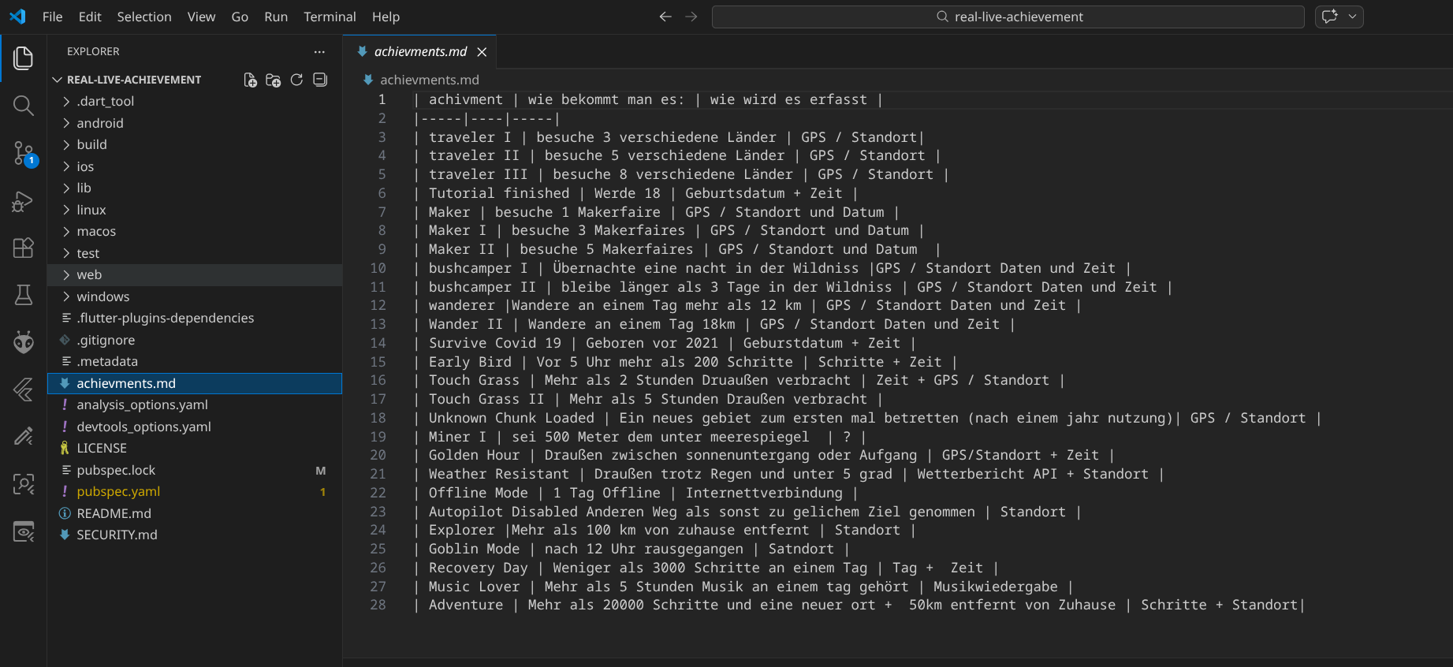
The Desing:
We have already planned and designed the appealing design; it consists mainly of transparent objects such as the NAV bar.

Slide 5

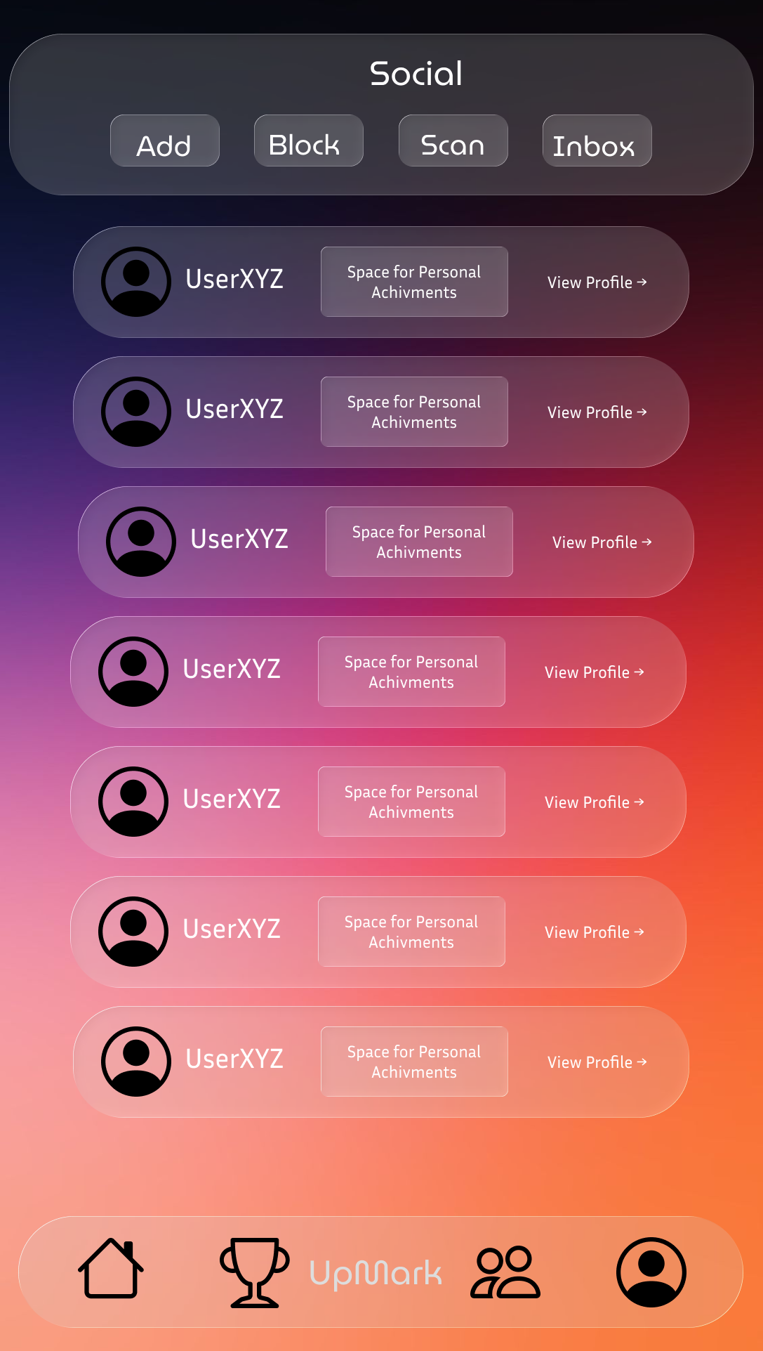
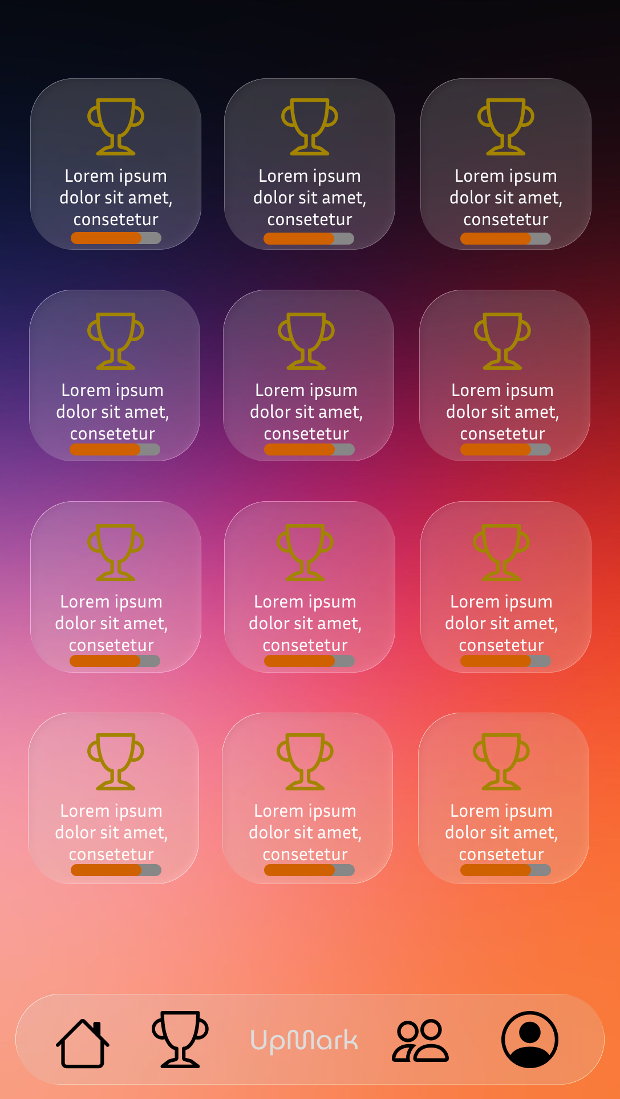
Home + Feed:
Here you have an overview of everything and can see when one of your friends has unlocked a new achievement.
Social:
In the Social Menu you will find an overview of all your friends and can view their achievements.
Achievements:
Here you have an overview of your personally unlocked achievements.

Slide 6
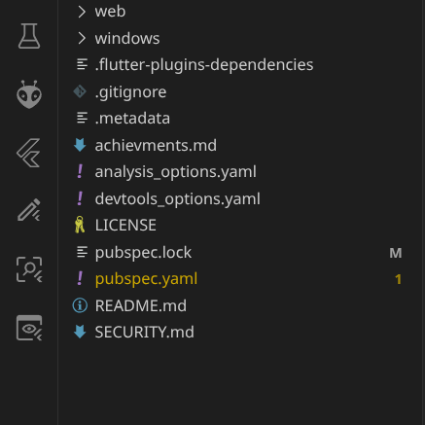
What we've already done + what we'll do next:
Now that we've finished planning the design, we'll get to work implementing the app using the DARF & Flatter programming language.The app launch is planned for before the summer holidays, but could be delayed or brought forward depending on development issues.
Upmark

