Slide 1
Algorithms for the survey

Slide 2
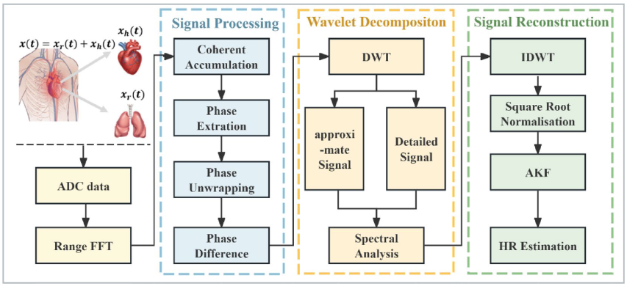
Detection of vital signs based on millimeter wave radar

Slide 3
FMCW Millimeter-Wave Radar-Based Remote Monitoring of Vital Signs in Multiple Subjects
First FFT
IIR filter
0.1-0.5 Hz
MUSIC for BR
Identify peaks (people)
IIR filter
0.8-2 Hz
Extract phase
2DFFT for HR
Unwrap and phase diff
Sliding Average Filter

Slide 4
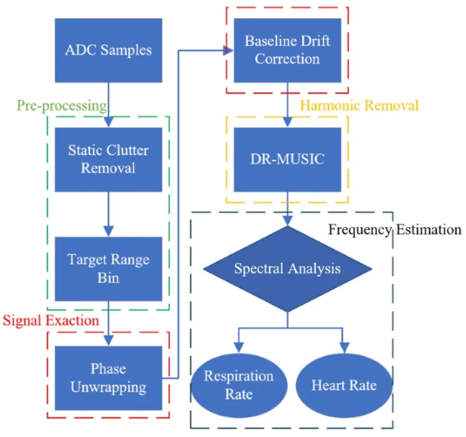
A high precision vital signs detection method based on millimeter wave radar

Slide 5
RF Vital Sign Sensing under Free Body Movement (only static)
First FFT
FFT and get highest peak
Band-pass filter
0.1-0.5 Hz
Identify peaks (people)
FFT and get highest peak
Band-pass filter
0.8-2 Hz
Extract phase
Unwrap and phase diff
Should we consider this algorithm int the survey?

Slide 6
Remote Monitoring of Human Vital Signs Based on 77-GHz mm-Wave FMCW Radar (Hongjia)

Slide 7
Vital-sign monitoring and spatial tracking of multiple people using a contactless radar-based sensor
First FFT
Identify peaks (people)
Extract phase with linear demodulation
Attenuate artifacts
Average windows and calculate BR with FFT
Wavelet separation with sliding window
Average windows and calculate HR with FFT

