Slide 1

Arabic Sentiments Analysis
Supervised by:
Ali Alkhathlan

Slide 2
Content
Tittle and project aim.
Problem definition.
Suggested solution.
Schedule of project.
Milestones of the project.
Project timeline.
Literature search and bibliography.
Equipment or software will be used

Slide 3
Tittle and project aims
The project discusses Arabic Sentiments Analysis according to different aspects:
The number of Arabic internet users
Sentiment Analysis in the Arabic language
The importance of the Arabic language
The Arabic users' contributions
The project aims to:
Enhance Arabic Sentiment Analysis progressing
Develop a software system for Arabic Sentiments Analysis

Slide 4
Problem definition
The problem is that we need to make a machine recognize the compliments reviews and the criticism reviews so that we can use these classified reviews to get many benefits.

Slide 5
Suggested solution
The solution:
Build an Arabic sentiments analysis system, that predicate if the review is positive, negative and natural.
The system is going through 4 phases:
Data preprocessing.
Text conversion to numbers.
Training.
Testing.

Slide 6
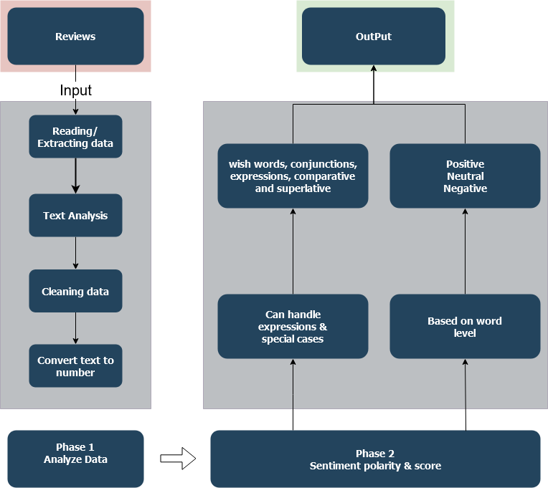
Arabic sentiments analysis architecture

Slide 7
Data preprocessing
Filtering.
Normalization.
Misspelling.
repeated letters.
Balance the data

Slide 8
Text conversion to number (BOW)
Conutvectorizer
(1-gram, 2-gram, 3-gram)
TF-IDF
(1-gram, 2-gram, 3-gram)

Slide 9
countvectorizer
Is Count the number of times each word appears in a document
Example :
“this book is good”, “this movie is bad”, “the app is not good”.
“this book is good”
“this movie is bad”
“the app is not good”

Slide 10
TF-IDF
What is TF-IDF?
Its like countvectorizer but instead of Count the number of times each word appears in the document its TF*IDF score.
TF-IDF is an information retrieval technique that weighs a term’s frequency (TF) and its inverse document frequency (IDF). Each word or term that occurs in the text has its respective TF and IDF score. The product of the TF and IDF scores of a term is called the TF-IDF weight of that term.
Put simply, the higher the TF-IDF score (weight), the rarer the term and vice versa.

Slide 11



The difference between 1-gram, 2-gram and 3-gram
“the app is not good”
1-gram
2-gram
3-gram
3-gram

Slide 12
training
Training phase is building a machine learning model with 4 machine learning algorithm.
Logistic regression.
Support vector machine.
Random forest.
Naïve bayas

Slide 13
testing
At the end of training phase, we compute the accuracy or the error measure.
So, the testing phase is repeating the training phase and with some techniques to increase accuracy and decrease error.

Slide 14
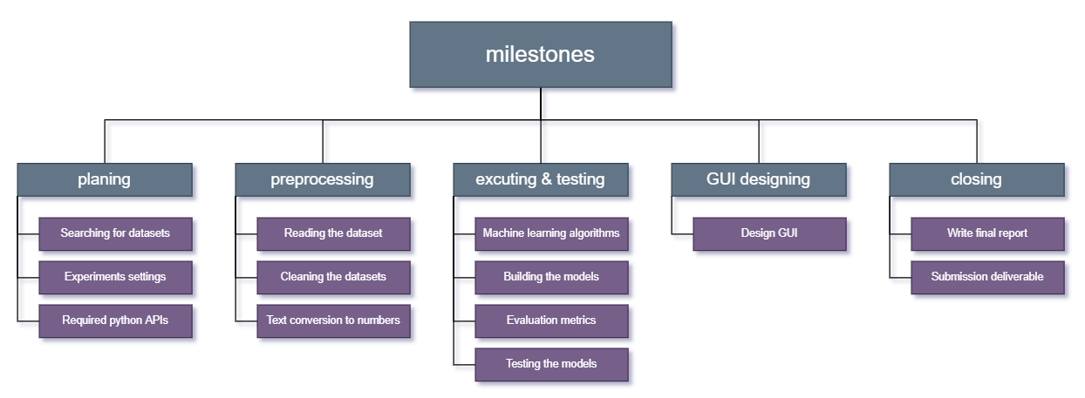
Milestones of the project

Slide 15
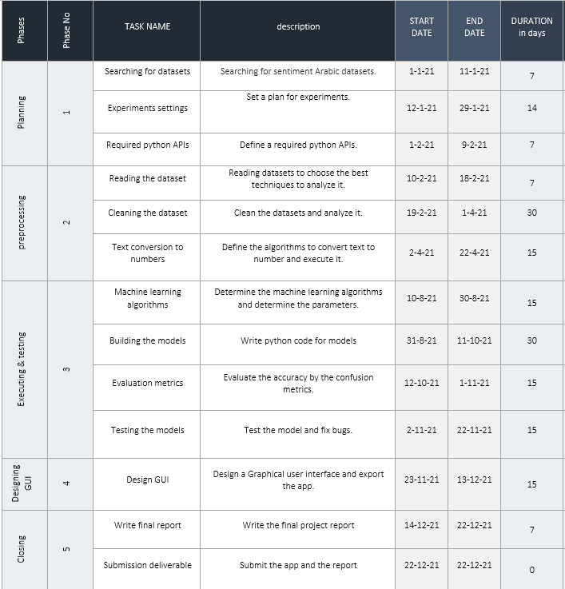
Project Schedule

Slide 16
Phase 1..(Planning)
Searching for datasets:
Searching for Arabic sentiments datasets on the internet, the datasets should be a review data not just ae Arabic text.
Experiment's settings:
Set the experiments plan and how many experiment we need to do.
Required python APIs:
Define and the APIs we need to perform the machine learning algorithms and data preprocessing methods (Scikit-learn API, NumPy API, etc...)

Slide 17

Phase 2..(preprocessing)
Reading the dataset:
Read the datasets and define how to process it and analyze it
Cleaning the dataset:
Clean the data from misspelling ,filtering it from dashes and dots (hyphen, em dash ,en dash, etc..) and do some preprocessing techniques .
Text conversion to numbers:
Convert the text to number by using BOW(Bag Of Word) approach.

Slide 18
Phase 3..(Executing & testing)
Machine learning algorithms:
Studying and implement the Machine Learning algorithms.
Building the models:
Writing a python code and running the model.
Evaluation metrics:
Evaluate the accuracy by using some evaluation methods (confusion matrix, F1-score ,etc...)
Testing the models:
Test the model and enhance the accuracy.

Slide 19
Phase 4..(Design GUI)
Design GUI:
Design the GUI and create a GUI app that take a text review as string and make predicate.

Slide 20
Phase 6..(Closing)
Write final report
Write final project report.
Submission deliverable
Submit the project report and GUI app.

Slide 21
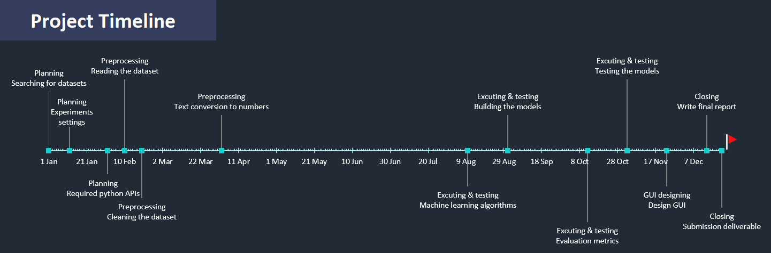
Project Timeline

Slide 22
Literature Search and Bibliography
We prepared for the project by searching in google scholar and we choose these three-research papers:
[ Mohammad S. Hasan, Shahnoor C. Eshan], An application of Machine Learning to Detect Abusive Bengali Text.
[Anjuman Prabhat, Vikas Khullar], Sentiment classification on Big Data using Naïve Bayes and Logistic Regression.
[Sarah O. Alhumoud, Mawaheb I. Altuwaijri, Tarfa M. Albuhairi, Wejdan M. Alohaideb], Survey on Arabic Sentiment Analysis in Twitter.
[Doaa Mohey El-Din], Enhancement Bag-of-Words Model for Solving the Challenges of Sentiment Analysis
[Ibrahim Awajan , Mumtazimah Mohamad ], A Review on Sentiment Analysis in Arabic Using Document Level

Slide 23
Equipment or software will be used
The equipment will be used:
Aziz supercomputer.
Because machine learning algorithms computational expensive
The software will be used:
Python programing language.
NumPy API, for linear algebra operation.
Scikit-learn API, for machine learning and conversion text to number algorithms.
Pandas API, for data preprocessing.
PyCharm IDE, for python programing language.
IntelliJ IDE, for GUI and UX/UI designing.
These software and equipment can change in the future.

Slide 24
What do we intend to carry out in the future?
Explore deeper and more advanced approaches to enhance the quality of text analysis
Applying and investigating possible directions of improvements.

