Slide 1
C++ Course
By: Faris Hassan

Slide 2
Introduction to Computers and Programming
Computer concept
Systems Software
Computer Components
Software-Programs
Machine Language & Programming Languages
Integrated Development Environments (IDEs)
C++ introduction

Slide 3
Computer Concept
Computer, Program, Programmer

Slide 4
Computer:
Programmable machine designed to follow instructions (Program)
Program:
Instructions in computer memory to make it do something
Programmer:
person who writes instructions (programs) to make computer perform a task

Slide 5
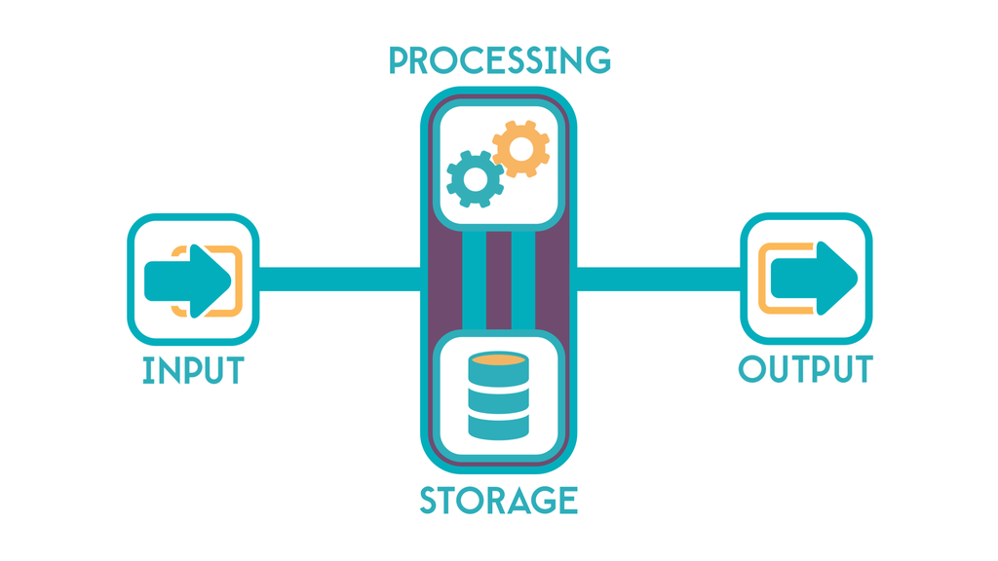
Computer System

Slide 6
Computer Components
Hardware and Software

Slide 7
Computer
Software
Hardware
Not Sensible
Can be modified Easily
Sensible
Can not be modified easily

Slide 8
Hardware
CPU, Main Memory, Secondary Memory

Slide 9
Central Processing Unit (CPU)
Arithmetic and Logic Unit:
High speed numeric Calculations.
True/False Decisions.
Control Unit:
Retrieves and decodes Program instructions.
Coordinates activates of all other parts of the computer.

Slide 10
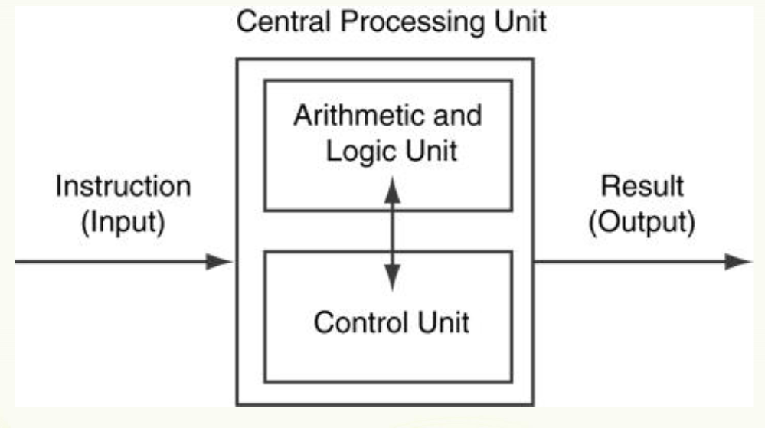
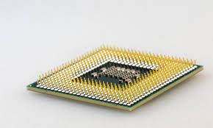
Central Processing Unit (CPU)

Slide 11
Main Memory
It is volatile
Main memory is erased when program terminator computer is turned off
Also called Random Access Memory (RAM)
Organized as follows:
Bit: smallest piece of memory.
Byte: 8 consecutive bits. (Bytes are accessed using addresses.)

Slide 12
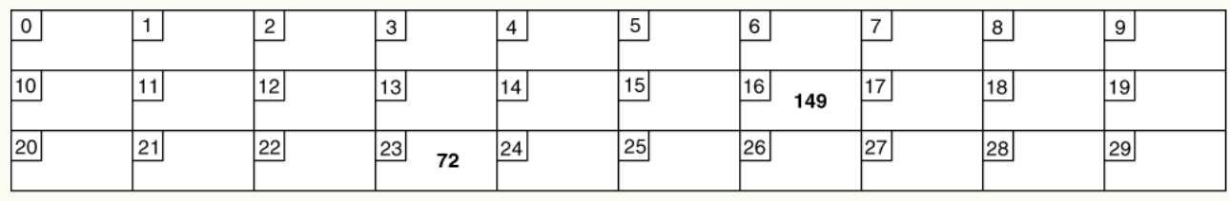
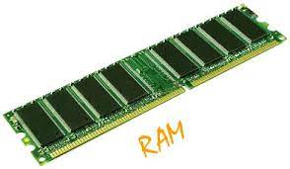
Main Memory
Addresses:
Each byte in memory is identified by a unique number known as an address.

Slide 13
Secondary Storage
Non-volatile:
data retained when program is not running or computer is turned off
Examples:
Magnetic: traditional hard drives that use a moveable mechanical arm to read/write.
Solid-state: data stored in chips, no moving parts.
Optical: CD-ROM, DVD
Flash drives: connected to the USB port

Slide 14
System Software
System Software and Application Software

Slide 15
System Software
System software
Application software
programs that manage the computer hardware and the programs that run on them.
Examples:
operating systems (Windows, Linux, Mac)
utility programs (Antivirus, File management)
software development tools (code editors, Compilers)
programs that provide services to the user.
Examples:
Microsoft Word
Games
programs to solve specific problems

Slide 16
Machine Language
High and Low Languages

Slide 17
Machine Language
Programmers Write an Algorithms (instructions) to the computer to follow.
Programmers write with High-Level Languages and it is translated to Low-Level Language which computer can understand it.

Slide 18
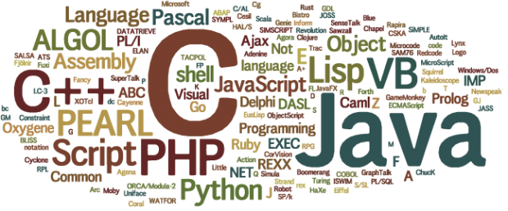
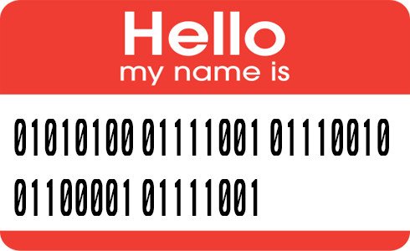
Machine Language

Slide 19
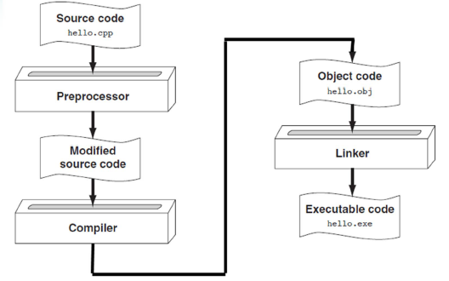
Translation between High to Low

Slide 20
Integrated Development Environments (IDEs)

Slide 21
Integrated Development Environments (IDEs)
An integrated development environment
combine all the tools needed to write, compile, and debug a program into a single software
Examples:
Microsoft Visual Studio 2022
Turbo C++ Explorer
Code Blocks

Slide 22

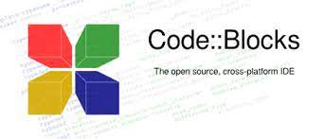
Integrated Development Environments (IDEs)

Slide 23
C++ Introduction
History, Benefits, Fields

Slide 24
C++ History
C++ was developed by Bjarne Stroustrup at Bell Laboratories
in 1979
C++ is an attempt to add object-oriented features (plus other improvements)
C, earlier it was called as “C with Objects”.
As the language developed, Stroustrup named it as C++ in 1983.

Slide 25
C++ Benefits
C++ is an Efficient and Fast Language
Suitable for Big Projects
Community Support of C++
High Salary Packages
Career Opportunities
C++ has Abundant Library Support
C++ in Operating Systems

Slide 26
C++ Fields
Programming Architect
Quality Analyst
Game Programmer
Software Developer Engineer
Backend Developer
Embedded Engineer
Bioinformatician

Slide 27
Thank you
By: Faris Hassan

