Slide 1

DATABASE(lecture-3)
By: Faris Hassan

Slide 2
Revision:
Characteristics of Database Management System.
Advantages of DMBS.
Disadvantages of DBMS.
Components of DBMS.

Slide 3
Content:
Database Models
Types of Database Models
ER-Model
Basic Concept
Attributes
keys

Slide 4
DBMS Model

Slide 5
DBMS Models
Logical design
Physical design

Slide 6
DBMS Model
A Database model defines the logical design and the structure of a database (physical Design) and defines how Data will be stored, accessed and updated in a database management system.
The Relational Model is the most widely used database model.

Slide 7
Types of DBMS Model
Network model
Entity-Relationship model
Relational model
Hierarchical model

Slide 8
Hierarchical Model:
This Database model organized data into a tree-like-structure, with a single root, to which all the other data is linked. The Hierarchy starts from the ROOT data, and expands like a tree, adding child nodes to the parent nodes.
In this model, a child node will only have a single parent node. This model efficiently describes many real-world relationships like index of book, recipes etc.…
In Hierarchical model, data is organized into tree-like structure with one-to-many relationship between two different types of data.

Slide 9
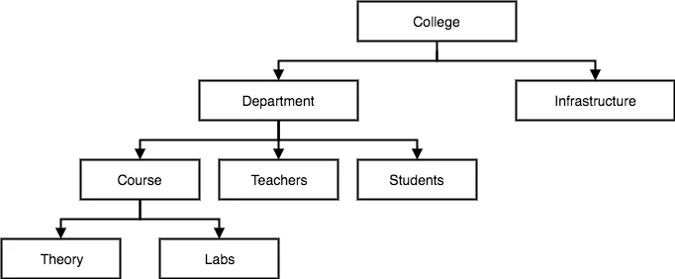
Hierarchical Model Diagram:

Slide 10
Network Model:
This is an extension of the Hierarchical model. In this model data is organized more-like a graph, and are allowed to have more than one parent node.
In this database model data is more related as more relationships are established In this database model. Also, as the data is more related, hence accessing the data is also easier and fast. This database model was used to map many-to-many relationships.
This was the most widely used Database model, before Relational Model was introduced.

Slide 11
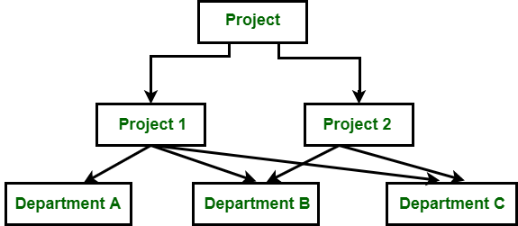
Network Model Diagram:

Slide 12
Entity-Relationship Model:
In this Database model, relationships are created by dividing objects of interest into entity and it’s characteristics into attributes.(different entities are related using relationships).
ER model are defined to represent the Relationships into pictoriall form to make ti easier for different stakeholders to understand, this model is good to design a database which can then be turned into tables in relational mode.

Slide 13
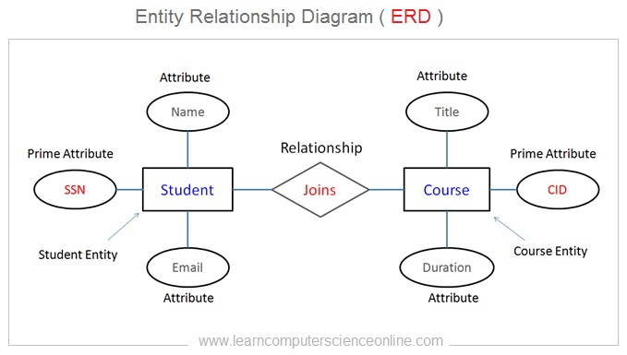
Entity-Relationship Model Diagram:

Slide 14
Relational Model:
In this model, data is organized in two-dimensional tables and the relationship is maintained by storing a common field.
This model was introduced by Edgar Frank codd in 1970, and since then it has been the most widely used database model, in fac, we can say the only database model used around the world.
The base structure of Data in the Relational model is tables . All the information related to particular type is stored in rows of that table.
Tables are also known as relation in the relational model.

Slide 15
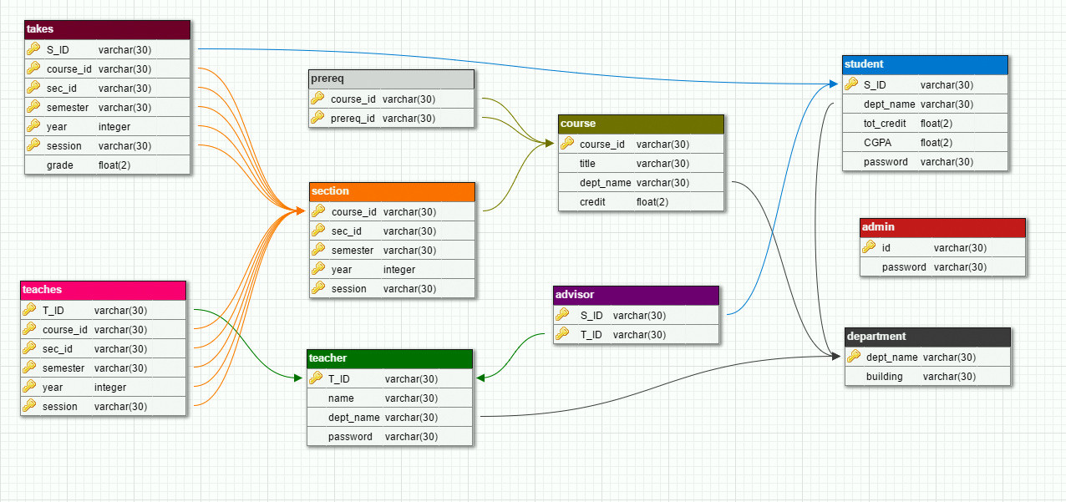
Relational Model Diagram:

Slide 16
ER Model

Slide 17
Content:
Basic Concept
Attributes
keys

Slide 18
Basic concept:
Entity-Relationship model is a model used for design and Representation of Relationships between data.
The main Data objects are termed as Entitles, with their details defined as attributes, some of these attributes are important and used to identify the entity and different entities are related using relationships.

Slide 19
Difference between:
An Entity:
Is generally a Real-world object which has characteristics and holds relationships in DBMS.
An Entity set:
is set of Entities of the same type.

Slide 20
ER Attributes

Slide 21
ER Attributes:
They are the characteristics of the Entity.
Types of ER-Attributes:
Simple attribute
Composite attribute
Derived attribute
Single valued attribute
Multi-valued attribute

Slide 22
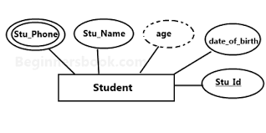
Simple Attribute:
The attribute with values that are atomic and can't be broken down further are simple attribute.

Slide 23
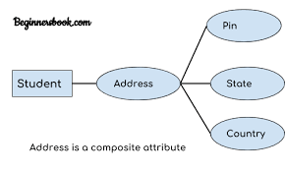
Composite Attribute:
A composite attribute is made up of more than one simple attribute.

Slide 24
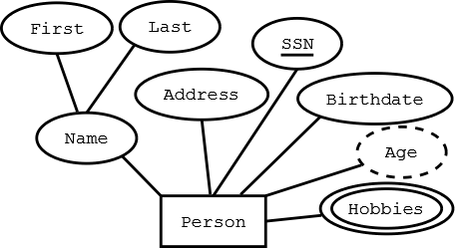
Derived Attribute:
These are the attributes, which are not presented in the whole database management system, but are derived using other attributes
example:
average age of students in a class

Slide 25
Single-valued Attribute:
As the name suggest, they have a single value.
Example:
Suppose the “gender” is an attribute in our design. For most applications we would say that gender is single valued; at any given point in time would say that gender is single valued; at any given point in time there is just on value (male, female) recorded for gender for person.

Slide 26
Multi-valued Attribute:
They can have multiple values
Example: employee degree

Slide 27
ER Model keys:

Slide 28
ER Model keys:
Keys are very important part of Relational database model. They are used to establish and Identify relationships between tables and also to uniquely identiufy any record or row of data inside a table.
A key can be a single attribute or a group of attributes, where the combination many act as a key.

Slide 29
Why we need keys?
In the real world applications, number of tables required for storing the data is huge, and the different tables are related to each other as well.
Tables generally extends to thousands of records stored in them, unsorted and unorganized.
keys are defined to easily identify any row of data in a table.

Slide 30
Types of keys:
Super key
Candidate key
Primary key
Composite key
Secondary or Alternative key

Slide 31
Super key:
is defined as set of attributes within a table that can uniquely identify each record within a table.
Student id | Student name | Phone no | age
1 | Ahmed | 798132464 | 16
2 | Mohamed | 561323587 | 17
3 | Ali | 876123775 | 18
4 | Ahmed | 745123345 | 19

Slide 32
Candidate key:
Candidate keys are defined as the minimal sset of fields which can uniquely identify each record in a table.
It’s an attribute or set of attributes that can act as primary key for a table to uniquely identify each record in a table. There can be more than one candidate key.
Student id | Student name | Phone no | age
1 | Ahmed | 798132464 | 16
2 | Mohamed | 561323587 | 17
3 | Ali | 876123775 | 18
4 | Ahmed | 745123345 | 19

Slide 33
Primary key:
Primary key is a candidate key that is most appropriate to become the main key for any table. It is a key that can uniquely identify each record in a table.
Student id | Student name | Phone no | age
1 | Ahmed | 798132464 | 16
2 | Mohamed | 561323587 | 17
3 | Ali | 876123775 | 18
4 | Ahmed | 745123345 | 19

Slide 34
Composite key:
key that consists of two or more attributes that uniquely identify any record in a table is called Composite key. But the attributes which is together form the composite key are not a key independently or individually.
Student id | Student name | Phone no | age
1 | Ahmed | 798132464 | 16
2 | Mohamed | 561323587 | 17
3 | Ali | 876123775 | 18
4 | Ahmed | 745123345 | 19

Slide 35
Secondary or Alternative key:
The Candidate key which are not selected as primary key are known ass secondary key or Alternative key.
Student id | Student name | Phone no | age
1 | Ahmed | 798132464 | 16
2 | Mohamed | 561323587 | 17
3 | Ali | 876123775 | 18
4 | Ahmed | 745123345 | 19

Slide 36
Data really powers everything that we do.”
— Jeff Weiner

Slide 37
Thank you..

