Slide 1

DATABASE(lecture-4)
By: Faris Hassan

Slide 2
Revision:
Database Models
Types of Database Models
ER-Model
Basic Concept
Attributes
keys

Slide 3
Content:
ER Model: Relationship
ER Model: Creating ER Diagram
Components of ER Diagram
Types of Relationships
ER Model: Generalization and Specialization.

Slide 4
ER Model: Relationship

Slide 5
ER Model: Relationship
When an Entity is related to another Entity, they are said to have a relationships. For Example: A class is related to student entity, because students study is a classes, hence this is a relationship.
Depending upon the number of entities involved, a Degree is assigned to relationships. For Example: if 2 Entities are involved, it is said to be Binary Relationship, if 3 Entities are involved, it’s said to be Ternary relationship and so on.

Slide 6
Creating ER Diagram

Slide 7
ER Model: Creating ER Diagram
ER diagram is visual representation of data that describes how data is related to each other. In ER Model, we disintegrate Data into entities, attributes and setup relationships between entities, all this can be represented usually using ER Diagram. For Example: anyone can see and understand what the diagram wants to convey.

Slide 8
Components of ER Diagram

Slide 9
Components of ER Diagram:
Entity, Attributes relationships etc. form the components of ER Diagram and there are defined symbols and shapes to represent each one of them.

Slide 10
Diagram shapes:
Entity
Relationships between Entities (weak and strong)
Attributes for any Entity
Key Attribute for any Entity
Derived Attribute for any Entity
Multivalued Attribute for any Entity
Composite Attribute

Slide 11
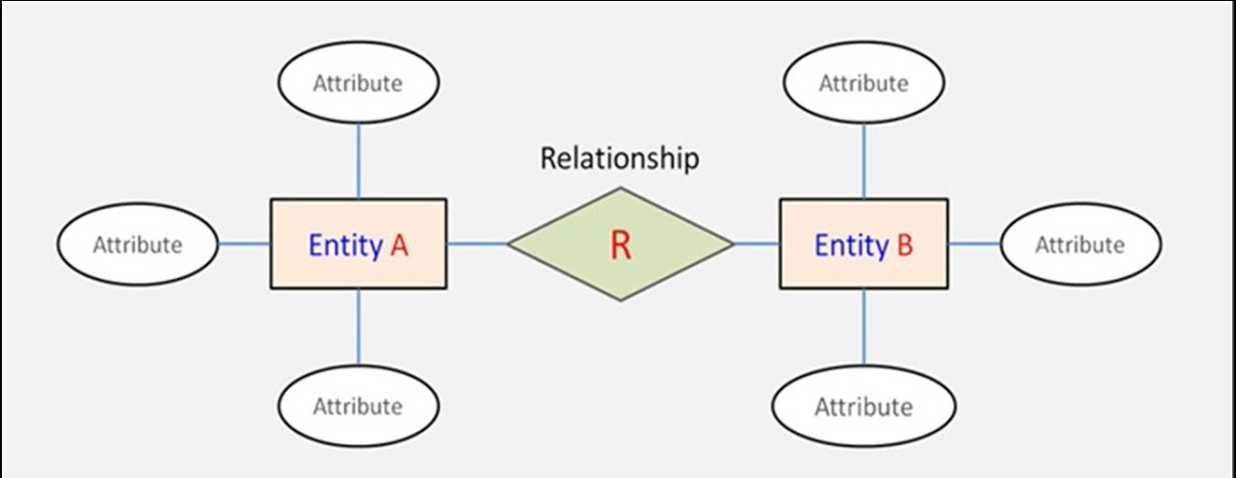
Entity:
simple rectangular box represented as Entity.

Slide 12
Relationships between Entities:
Rhombus is used to setup relationship between two or more entities.

Slide 13
Attributes for any Entity:
Ellipse is used to represent attributes of any Entity.
It is connected to the Entity.

Slide 14
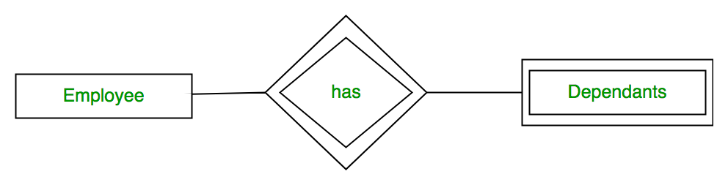
Weak Entity:
A weak Entity is represented using double rectangular boxes.
It is generally connected to another Entity,

Slide 15
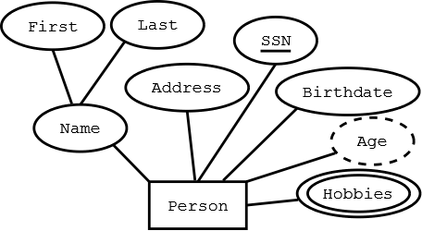
Derived Attributes for any Entity:
Derived attributes are those which are derived based on other attributes, For example: age can be derived from date of birth. To represent a derived attribute, another dotted ellipse is created inside the main ellipse.

Slide 16
Multi-valued Attributes for any Entity:
Double Ellipse, one inside another, represents the attributes which can have multiple values.

Slide 17
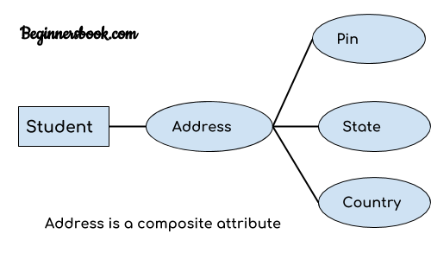
Composite Attributes:
A composite attribute is the attribute, which also has attributes.

Slide 18
ER Model: Relationship

Slide 19
Relationship:
A relationship describes relation between Entities. Relationships is represented using diamonds or Rhombus.

Slide 20
Relationship
Many to one
Many to many
recursive
Ternary
One to many

Slide 21
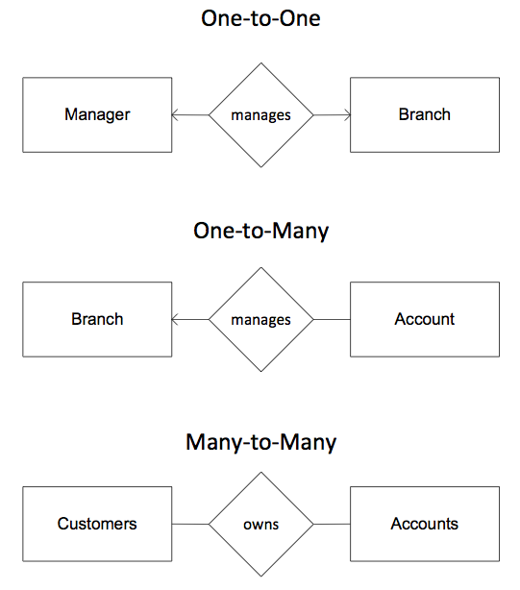
One to One Relationship:
This type of relationship is rarely seen in real world.

Slide 22
One to Many Relationship:
The one to many Relationship means that 1 Entity can have many Relationships with other Entities For Example: This means that 1 student can apply for many courses, but a course can only have 1 student.

Slide 23
Many to One Relationship:
It reflects business rule that many entities can be associated with just one Entity. For example: student enrolls for only one course but a course can have many students.

Slide 24
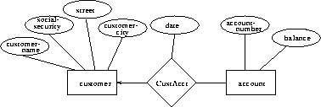
Many to Many Relationship:
This diagram represent that one student can enroll for more than one course, and, a course can have more than 1 students enrolled in it.

Slide 25
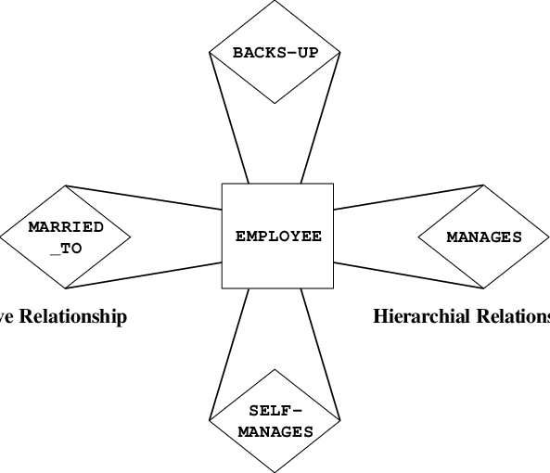
Recursive Relationship:
When an Entity is related with itself is known as Recursive Relationship.

Slide 26
Ternary Relationship:
Relationship of degree three is called Ternary Relationship.
A Ternary Relationship involves 3 Entities. In such relationships we always consider two entities together and then look upon the third.

Slide 27
Generalization and Specialization:

Slide 28
Generalization and Specialization:
As the complexity of data is increased in the late 1980, it became more and more difficult to use the traditional ER Model for database modeling, hence some improvements or enhancements were made to existing ER Model to make it able to Handle the Complex applications better. Hence, as part of the enhanced ER Model along with other improvements three new concepts were added to existing ER Model they were:
Generalization
Specialization
Aggregation

Slide 29
Generalization:
Generalization is a Bottom-up approach in which two lower levels Entities combine to form a higher level Entity. In generalization, the higher level entity can also, combine with other lower level entities to make further higher level Entity.
It’s more like Superclass and Subclass system, but the only difference is the approach, which is bottom-up hence, Entities are combined to form a more generalized Entity, in other words Sub-class are combined to form a Superclass.

Slide 30
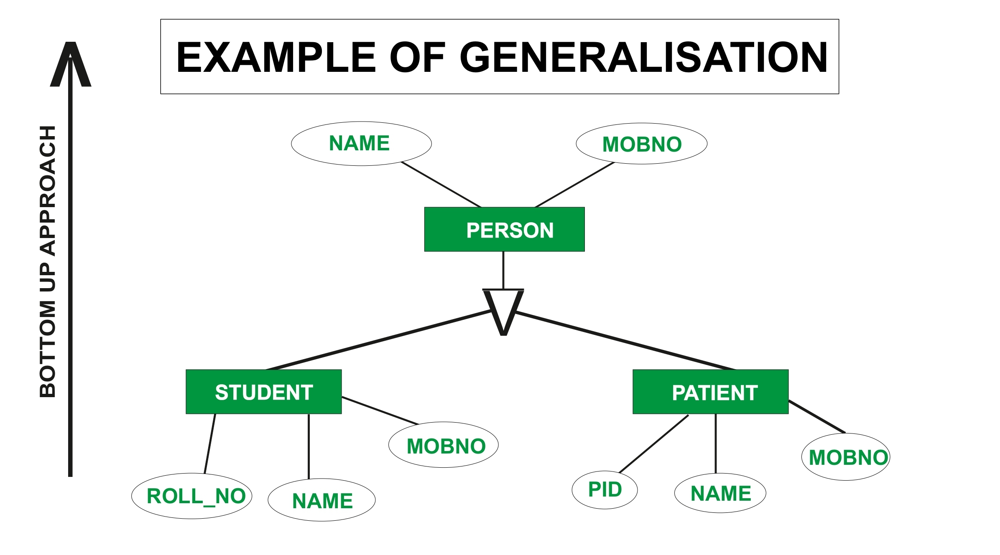
Generalization:

Slide 31
Specialization:
Specialization is opposite to Generalization. It is a Top-down approach in which one higher level Entity can be broken down into lower level entity. In Specialization, a higher level entity may not have any lower level entity sets, it’s possible.

Slide 32
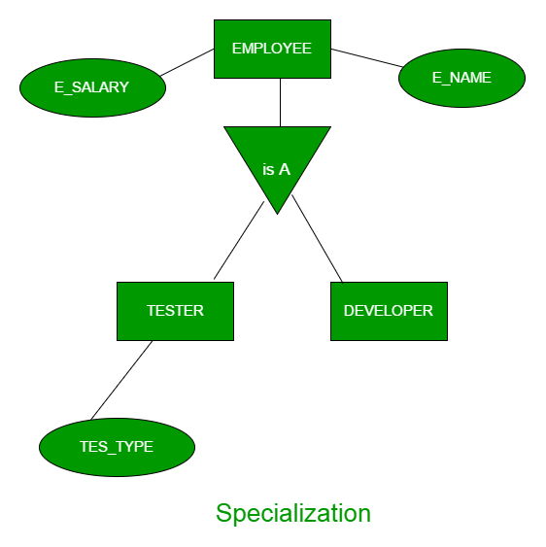
Specialization :

Slide 33
Aggregation:
Aggregation is process when relation between two entities is treated as a Single Entity.
The Relationship between center and courses together, is acting as an Entity, which is in relationship with another Entity Visitor.

Slide 34
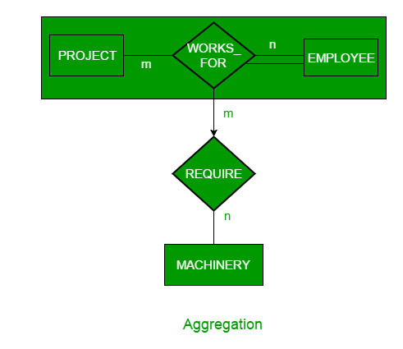
Aggregation :

Slide 35
The ledger, is distributed database - it's called a Blockchain - is held in the cloud by all the parties involved. It can't be broken by any of them. It's cryptographically too strong. You would have to compromise the entire network to take over Bitcoin.
- Naval Ravikant

Slide 36
Thank you..

