Slide 1

Database(lecture-2)
By: Faris Hassan

Slide 2
Revision:
Difference between Data and Information.
What is Database?
History of Database.
What is DBMS?

Slide 3
Content:
Characteristics of Database Management System.
Advantages of DMBS.
Disadvantages of DBMS.
Components of DBMS.

Slide 4
Characteristic of DBMS

Slide 5
Characteristic of DBMS:
Data stored into Tables.
Reduced Redundancy.
Data consistency.
Support Multiple users and concurrent Access.
Query Language.
Security.
DBMS Support Transactions.

Slide 6
Data stored into Tables:
Data is never directly stored into the Database.
Data is stored into tables, created inside the Database.

Slide 7
Reduced Redundancy:
DBMS follows NORMALIZATION which divides the data in such a way that repetition is minimum.

Slide 8
Data consistency:
Data is being continuously updated and added.
Maintain the consistency of data can become a challenge, but, DBMS handle it all by itself.

Slide 9
Support Multiple users and concurrent Access:
DBMS allows multiple users to work on it (update, insert, delete data) at the same time and still manages to maintain the data consistency.

Slide 10
Query Language:
DBMS provide users with a simple Query Language, using which data can be easily updated, inserted, deleted in the database.

Slide 11
Security:
DBMS also takes care of the security of Data protecting the data from unauthorized access. In a typical DBMS, we can create user accounts with different access permissions, using which we can easily secure our data by restricting user access.
Security.

Slide 12
DBMS Support Transactions:
Which allows us to better handle and manage data integrity in real world applications where multi-threading is extensively used.

Slide 13
Advantages of DBMS

Slide 14
Advantages of DBMS:
Segregation (separation) of application program.
Minimal data duplicity or data redundancy.
Easy retrieve of Data using Query language.
Reduced development time and maintenance needed.
Cloud Datacenters. (we are now capable with dealing with almost infinite data )
Seamles Integration into the applications programming languages.

Slide 15
Disadvantages of DBMS

Slide 16
Disadvantages of DBMS:
It’s complexity.
High Cost.
They are large in size.

Slide 17
Components of DBMS

Slide 18
Components of DBMS
procedures
software
Database access language
Hardware
users

Slide 19
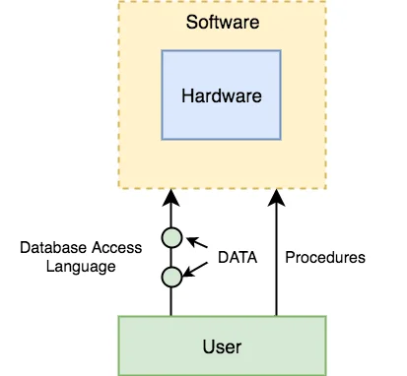
Diagram of components of DBMS:

Slide 20
Hardware:
Computer Hard disk, i/o channels for data and any other physical component involved before any data is successfully stored into the memory.
when we run Oracle or MYSQL on out personal computer, then our computer is hard disk for the database.
Our computer keyboard, RAM, ROM all becomes part of the DBMS Hardware.

Slide 21
Software:
This is the main component.
DBMS software is more like a cover around the physical database, which provides us with an easy to use interface to store, access and update data.
DBMS software is capable of understanding the Database Access Languages and interpret it into actual Database commands to execute them on the Database.

Slide 22
Data:
Data is the resource or the material for which DBMS was designed.
The motive behind creation DBMS was to Store and utilize data.
The user saved Data is presented and Metadata is stored.
Metadata: is information stored by the DBMS to better understand the data stored in it. (is the data about the data)

Slide 23
procedures:
Procedures refer to general instructions to use a database management system. This includes procedures to setup and install DBMS.
To login and logout of DBMS software, to manage database, to take backups, generate reports…etc.

Slide 24
Database Access Language:
Database Access language is a simple language designed to write command to access, insert, update and delete data stored in any database.
A user can write commands in the Database Access language and submit it to the DBMS for execution, which is the translated and executed by DBMS.
User can create new Database, table, insert, delete data….etc.

Slide 25
User:
Application programmer or software developer
End users
Database Administrator

Slide 26
Database Administrator: (DBA)
Is the one who manages the complete database management system.
DBA also take care of the security of DBMS it’s availability, managing the license keys, managing user accounts and access…etc.

Slide 27
Application programmer or software developer:
This user group is involved in developing and designing the parts of DBMS.

Slide 28
End User:
These days all the modern applications, web or mobile, store are users of data. (why?)
Applications are programmed in such a way that they collect user data and store the data on DBMS system running on their servers.
End users are the one who store, retrieve, update and delete data.

Slide 29
“With data collection, ‘the sooner the better’ is always the best answer.”
- Marissa Mayer

Slide 30
Thank you..

