Slide 1
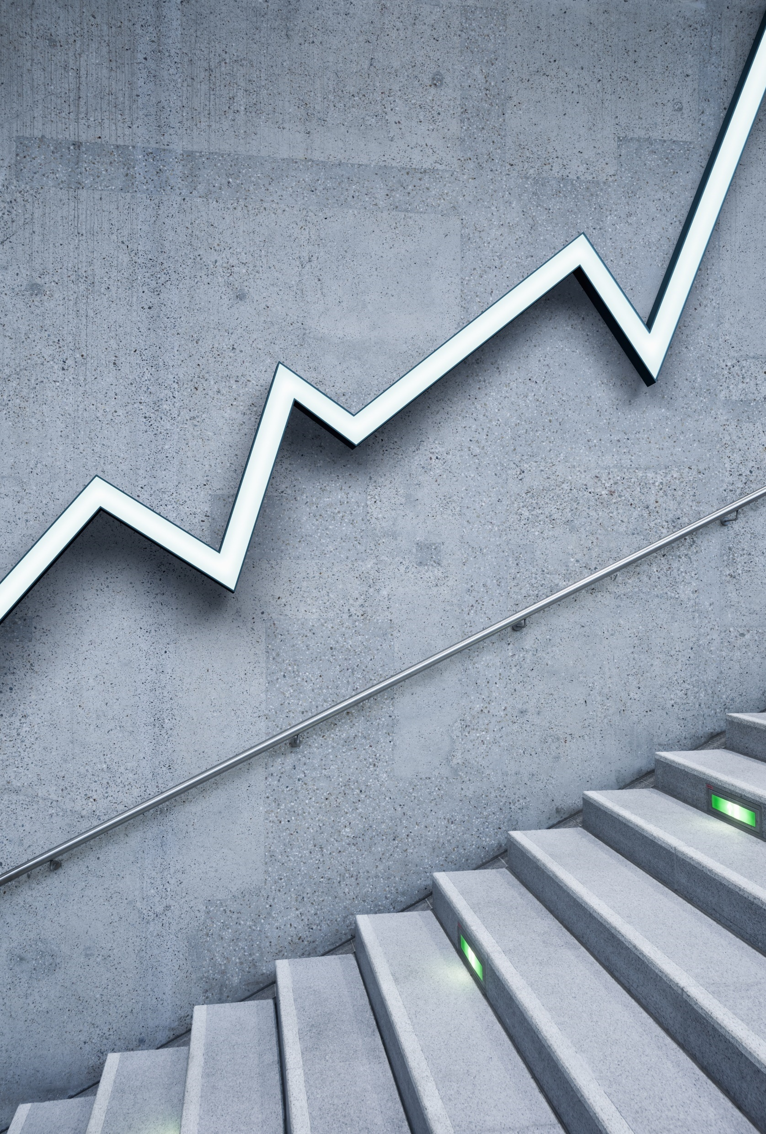
DATABASE
By: Faris Hassan

Slide 2
Database Concepts:
Overview of DBMS
Components of DBMS
Database Architecture
Types of Database Model

Slide 3
What is the difference between?
DATA
information

Slide 4
What is Data?

Slide 5
What is Data?
Data is nothing but facts and statistics stored or free flowing over a network, generally It’s raw and unprocessed.

Slide 6
What is processed?

Slide 7
What is Data?
Data is nothing but facts and statistics stored or free flowing over a network, generally It’s raw and unprocessed.
Example:
The website uses your IP-Address as a data when you accept the cookies.

Slide 8
Information:
Data becomes information when it is processed.
When the data is turned int something meaningful.
Example:
Summation
Division
Cookie data saved when you visit the website once again.

Slide 9
What is Database?

Slide 10
What is Database?
A collection of related data organized in a way that data can be easily accessed, managed and updated.
Database can be software based or hardware based, with one sole purpose (storing data).

Slide 11
Uses of Data:
Store data
Update data
Creating tables
Retrieve data
Delete data

Slide 12
History of Database

Slide 13
History of Database:
During early computer days, Data was collected and stored on tapes, which were mostly write only, which means once data is stored on it, it can never be read again or overwrite on it.
Larry Ellison, the co-founder of oracle was amongst the first few that realized the need of a software based Database Management system.

Slide 14
What is DBMS?

Slide 15
What is DBMS?
Database Management System.
is a software that allows creation, definition and manipulation of Database, allowing users to store, process and analyze Data easily.
Provides us with an INTERFACE or a tool, to preform various operation like Creating tables in the database and a lot more.

Slide 16
Examples of DBMS:
MySQL
IBM DB2
Oracle
Postgre Sql
Sql Server
Amzon Simple DB (cloud based)…etc.

Slide 17
DBMS Uses:
Provides Security and protection to the database.
Maintains data consistency in case of multiple users.

Slide 18
“Data is a precious thing and will last longer than the systems themselves.”
-Tim Berners

Slide 19
The End…

