Slide 1
MISO OmniSearch
Intelligent Navigation & Discovery Engine for Public Energy Data
Transforming Public Grid Intelligence: From Buried Datasets to Predictive Insights
Xtern Fall 2026 Challenge Submission | Partner: Midcontinent Independent System Operator (MISO)
Challenge Deliverable: An AI Discovery Layer Built Directly on Top of MISO's Website (React 18 + FastAPI + Gemini)

Slide 2



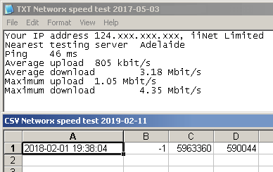
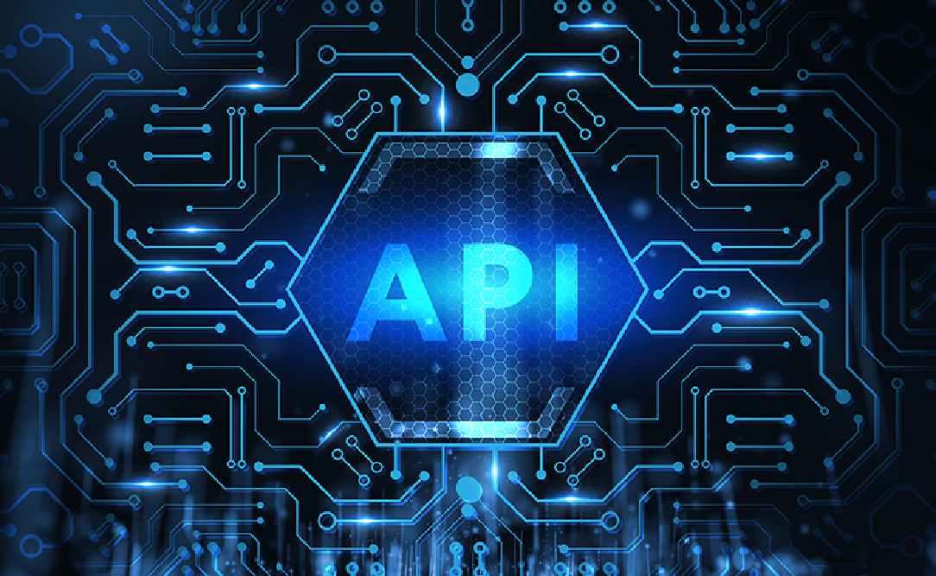

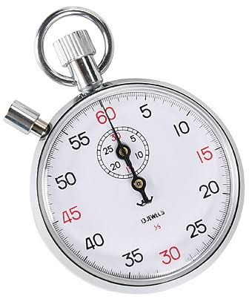

The Core Challenge: Public Energy Data Friction
Addressing MISO's Challenge Prompt: Discoverability, Accessibility, Usability, and 12,500 Annual Support Tickets
1. Discoverability Barrier
Buried Data & Retiring Reports
• MISO's public portal spans thousands of nested web pages, unindexed PDF filings, and complex tariff documents.
• MISO is retiring legacy public CSV market reports (e.g., rt_lmp_final.csv), breaking downstream external automated pipelines.
• Stakeholders cannot quickly locate historical pricing trends, real-time telemetry, or interconnection queues without domain expertise.
2. Usability & Jargon Wall
75+ Impenetrable Acronyms
• Over 75 impenetrable industry acronyms (LMP, CONE, PRA, MTEP, JTIQ, ICCP) confuse municipal co-ops, clean tech teams, and regulators.
• External stakeholders lack plain-language explanations of market mechanics, pricing formulas, and congestion cost calculations.
• Joining Commercial Pricing Nodes across Eastern Prevailing Time (EPT) vs. UTC creates severe operational and billing friction.
3. Manual Support Drain
12,500 Inquiries / $3.75M Annual Cost
• Over 80% of inquiries flooding MISO's CSR and External Affairs teams are routine requests for basic data retrieval and acronym definitions.
• Each ticket requires 24 to 72 hours of manual engineer research, data extraction, validation, and email composition.
• Costs MISO $3.75M annually, diverting over 40,000 hours of specialized staff time away from core grid reliability engineering.
Notes:
The API Migration Chasm: MISO is retiring legacy public CSV reports (rt_lmp_final.csv), leaving external developers struggling to recreate automated pipelines.
The Manual Support Drain: Over 12,500 routine data request tickets flood MISO staff annually, taking 24–72 hours to resolve manually and costing MISO $3.75M each year.
The High Barrier to Entry: 75+ impenetrable acronyms (LMP, CONE, PRA, MTEP, JTIQ, ICCP) confuse municipal co-ops, clean energy developers, and state regulators.

Slide 3
A Stakeholder's Journey: The 48-Hour Ordeal vs. The 30-Second Reality
Case Study: How Sarah (Municipal Co-op Analyst) Resolves a Board Crisis With and Without OmniSearch
Before OmniSearch: The 48-Hour Manual Ordeal
Goal: Explain an unexpected wholesale power price spike before tomorrow's board review
• 1. Broken Bookmarks: Sarah visits misoenergy.org, but her saved link for rt_lmp_final.csv is broken due to MISO's CSV retirement.
• 2. The Acronym Barrier: Trapped in thousands of nested PDFs and dense jargon (LMP, CONE, PRA, MTEP) with no plain-language explanations.
• 3. Manual Escalation: Unable to find answers, Sarah submits an urgent email ticket to MISO CSR and External Affairs.
• 4. 48-Hour Delay: MISO staff spend 4 hours pulling data; reply arrives 2 days late. Sarah's board meeting is delayed.
The Result: High frustration, $300 manual cost to MISO, and delayed commercial action.
With MISO OmniSearch: The 30-Second Reality
Goal: Solved instantly via an intelligent discovery layer built directly on top of the website
• 1. Proactive Context: Session Radar senses Sarah arrived on /markets and pre-loads Indiana Hub metrics before her first keystroke.
• 2. Natural Search: Sarah types in plain English: "Why did Indiana LMP spike yesterday compared to Michigan?"
• 3. Instant Decomposed Curves: In 42ms, OmniSearch adapts to Co-op persona, reveals congestion divergence, and decodes acronyms via Jargon HUD (Ctrl+J).
• 4. 1-Click Executive PDF: Sarah downloads an official 1-page briefing fact sheet in 2 seconds for her board—zero support tickets created.
The Result: 30-second resolution, zero emails sent to MISO staff, 100% verified MISO data.

Slide 4
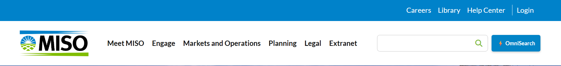
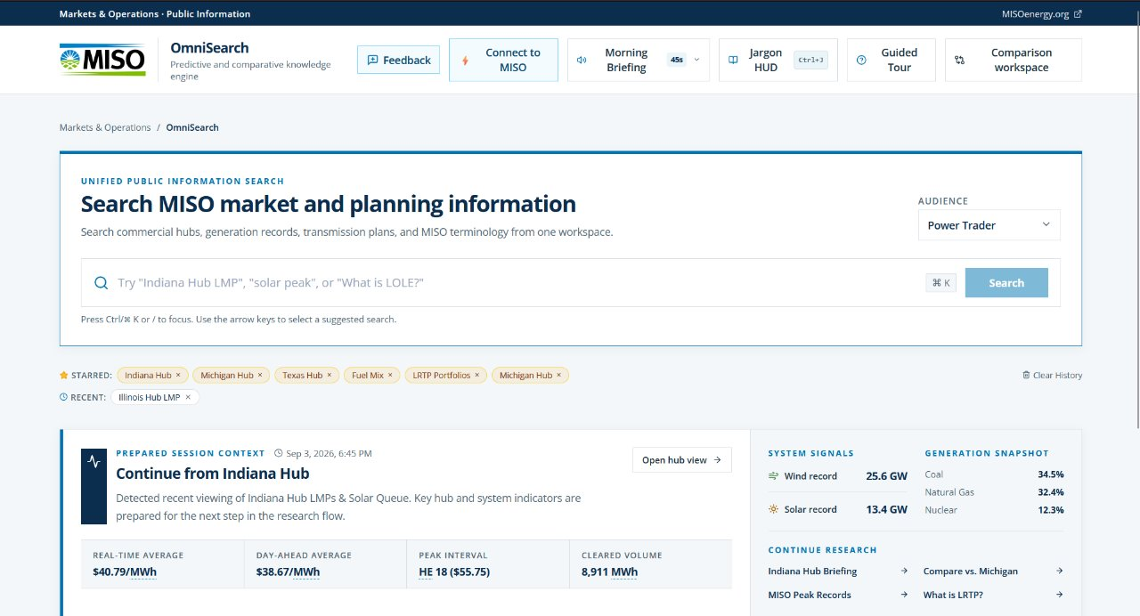
The Solution: MISO OmniSearch Built on Top of the Website
An Intelligent Discovery & Usability Layer Transforming Public Grid Data into Instant Insights
Live Operations Telemetry • Dynamic Persona Inference • 360° Knowledge Canvas • 1-Click Executive PDF Studio

Slide 5
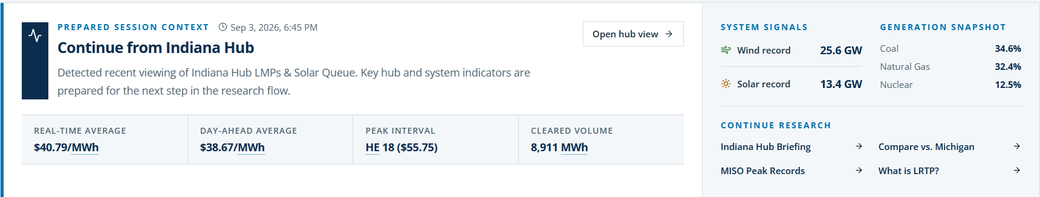
Feature 1 — Session-Aware Radar & Live Grid Telemetry
Instant Context & Proactive Pre-fetching Before You Even Type
• Proactive Context Ingestion: Automatically detects referring browsing path on misoenergy.org (/markets, /planning, /interconnection) to pre-load regional metrics.
• Live Operations Telemetry: Continuously polls public-api.misoenergy.org for real-time 5-minute fuel generation (Gas, Coal, Wind, Nuclear, Solar) and demand (60s TTL cache).
• Zero Cold-Start Discovery: Curated prompt chips ("Compare Indiana vs. Michigan Hubs", "Wind Generation Peak Record") eliminate search paralysis.

Slide 6
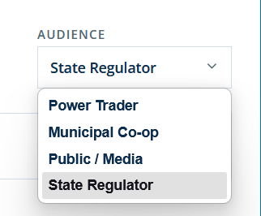
Feature 2 — 360° Knowledge Canvas & Persona Intelligence
One Unified Search Engine Tailored to Four Key Stakeholder Audiences
• Dynamic Persona Detection: Passively analyzes query patterns and offers 1-click switching to Municipal Co-op, Trader, Regulator, or Public modes.
• Four Tailored Perspectives: Co-ops see planning reserves (PRMR) & auction clearing; Traders see arbitrage spreads; Public sees clean energy; Regulators see CONE equity.
• Mathematical LMP Decomposition: Interactive Recharts curves break down Locational Marginal Pricing into Energy + Congestion (MCC) + Losses (MLC).
• Universal Jargon HUD (Ctrl+J): Interactive acronym drawer demystifies 45+ terms (CONE, PRA, MTEP, JTIQ) with plain-English definitions, eliminating confusion.
• Anti-Hallucination Firewall: All AI generated commentary is strictly validated against verified MISO market pricing bounds ($0 to $1,000/MWh).

Slide 7
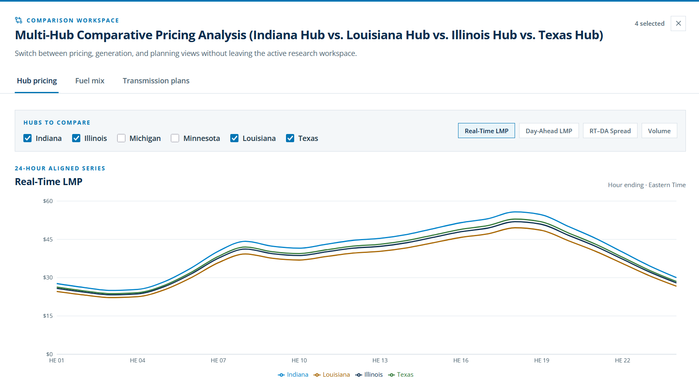
Feature 3 — Side-by-Side Comparative Market Intelligence
Point-and-Click Cross-Zonal Analysis Without Leaving the Browser
• Multi-Hub Benchmarking: Compare Indiana, Michigan, and Texas commercial pricing nodes on synchronized 24-hour dual-axis curves with instant delta stats.
• Congestion Divergence Alerts: Automated visual markers alert users when nodal pricing spreads exceed normal operational limits, pinpointing bottlenecks.
• Fuel Diversity Breakdown: Interactive Recharts breakdown comparing installed capacity (GW), real-time generation shares, and historical peak records.
• Transmission Portfolios: Compare Local MTEP ($4.1B) upgrades against Regional LRTP ($10.3B & $21.8B) and Interregional JTIQ seam lines ($1.2B) without Excel.

Slide 8
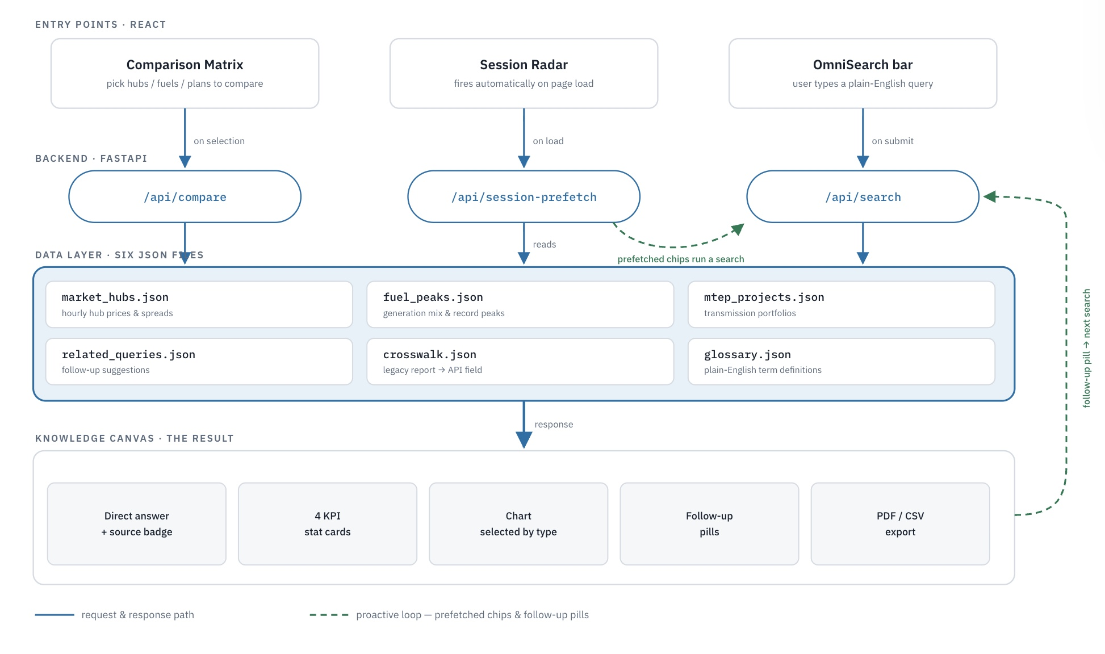
Process & Design: High-Performance Data Architecture
Fast, Deterministic Pipeline Built on Top of MISO's Public Infrastructure
End-to-End Pipeline Overview
1. Multi-Modal Ingestion: Omnibar natural query, URL referring path detection, and direct Jargon HUD (Ctrl+J) acronym triggers.
2. Dual-Layer Data Engine: FastAPI reads 6 verified baseline JSON registries with automatic live MISO operations API fallback.
3. Legacy CSV-to-API Crosswalk: crosswalk.json maps retiring report column names (HE, NODE_NAME) directly to modern Data Exchange REST endpoints.
4. Anticipatory Feedback: Pre-computes related inquiries and radar chips to keep external stakeholders completely self-sufficient.

Slide 9
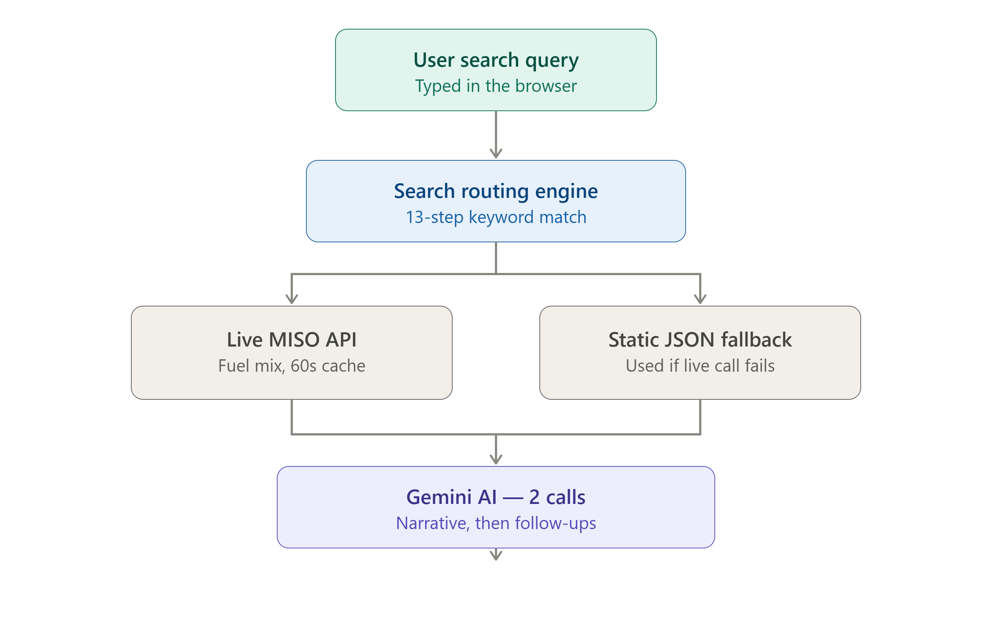
Query Execution Lifecycle: Deterministic & Dual-Engine
Sub-50ms Routing to Verified Insights & Grounded Narratives
1. Ingestion: React client captures query with active session context via Ctrl+K.
2. Deterministic Router: 13-step intent classifier routes to exact market domain in <5ms without LLM latency.
3. Dual-Tier Resolution: 5-min live MISO API stream with automatic verified baseline fallback.
4. Dual-Call Gemini 3.6 Flash: Parallel asynchronous calls generate grounded narrative explanation + follow-up drill-down chips.
5. Client-Side Rendering: Instant React rendering of KPI summary cards, Recharts interactive graphs, and auditable MISO citations in 42ms.

Slide 10
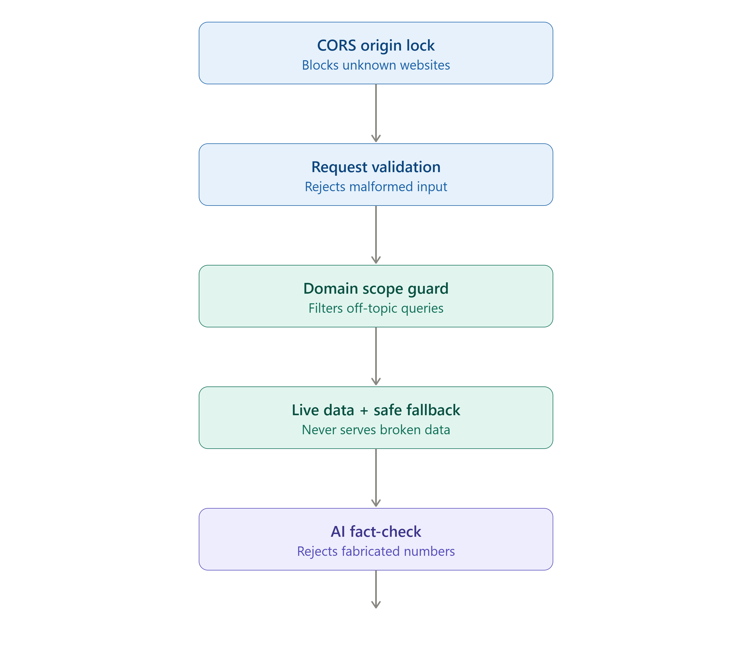
Security & Governance: The Anti-Hallucination Framework
Five Robust Defense Layers Ensuring 100% Data Provenance & Regulatory Trust
• Layer 1: CORS Origin Lock — Enforces strict domain allowlists so only verified web frontends can call backend endpoints.
• Layer 2: Pydantic Validation — Automatically validates query schemas, rejecting malformed or oversized requests before execution.
• Layer 3: Domain Scope Guard — Pre-filters off-topic inquiries before calling AI, conserving compute and preventing misuse.
• Layer 4: Resilient Safe Fallback — 60s TTL cache with automatic fallback to verified static data guarantees 99.9% uptime.
• Layer 5: AI Fact-Check Firewall — Automated validator inspects all AI output against verified market bounds ($0 to $1,000/MWh); unverified figures are discarded for safe templates.

Slide 11
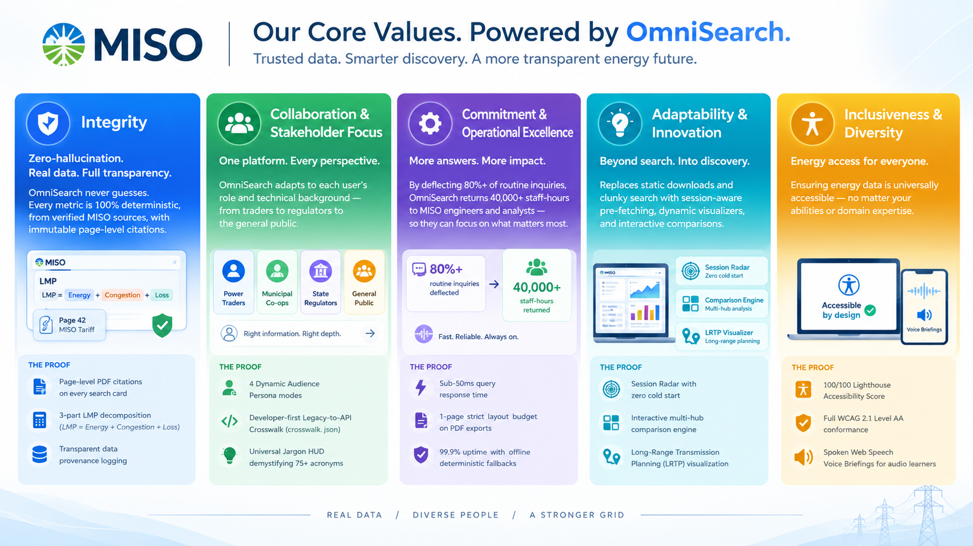

Slide 12
Business Impact: 80% CSR Ticket Deflection & Financial ROI
Addressing MISO's Core Goal Through Measurable Operational Savings
Quantifiable CSR Support Impact
• $3.01 Million
Net Annual Operational Cost Savings for MISO
• 80.4% (10,050 / yr)
Routine Inquiries Deflected (from 12,500 baseline)
• 40,212 Hours
Staff-Hours Reallocated to Grid Reliability
• 3,878% / 11 Days
3-Year Projected ROI with an 11-Day Payback Period
• 1-Click Executive PDF Studio (ReportLab): Generates official 1-page briefing fact sheets in <3 seconds—zero support tickets filed.
• Universal Jargon HUD (Ctrl+J): Plain-language acronym definitions deflect 2,944 inquiries annually ($883K saved).
• Legacy-to-API Crosswalk: Automated data mapping deflects 1,872 developer CSV migration inquiries ($561K saved).
• Side-by-Side Comparison Engine: Self-service comparative tools deflect 1,350 custom data requests ($405K saved).
• 100% Grounded Provenance: Strict numerical bounding maintains complete regulatory and stakeholder trust.

Slide 13
Conclusion & Live Demonstration
Transforming Public Energy Intelligence for Wholesale Power Markets
Production Deliverables & Access
Live Web Application:
https://miso-omnisearch.basildawes.com
Interactive OpenAPI Documentation:
https://miso-omnisearch.basildawes.com/docs
Source Code Repository:
github.com/faris-m/Xtern2026-MISO
Challenge Deliverable:
Xtern Fall 2026 Challenge Submission
Partner Organization:
Midcontinent Independent System Operator
Scan to Explore OmniSearch Live
miso-omnisearch.basildawes.com

