Slide 1
MISO OmniSearch
Subtitle

Slide 2

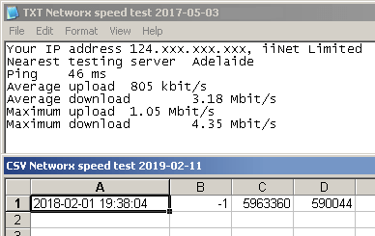


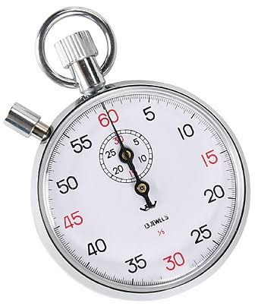



The PROBLEM
Notes:
The API Migration Chasm: MISO is retiring legacy public CSV reports (rt_lmp_final.csv), leaving external developers struggling to recreate automated pipelines.
The Manual Support Drain: Over 12,500 routine data request tickets flood MISO staff annually, taking 24–72 hours to resolve manually and costing MISO $3.75M each year.
The High Barrier to Entry: 75+ impenetrable acronyms (LMP, CONE, PRA, MTEP, JTIQ, ICCP) confuse municipal co-ops, clean energy developers, and state regulators.

Slide 3
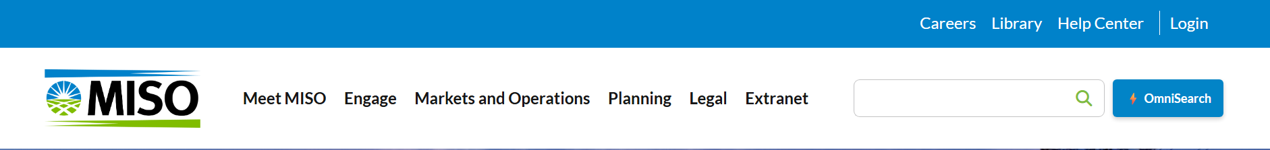
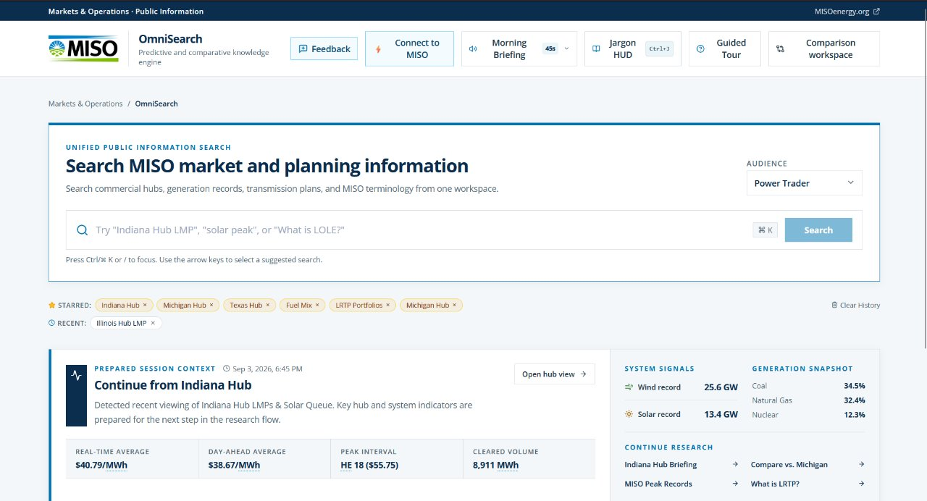
OmniSearch– An Intelligent AI Engine

Slide 4
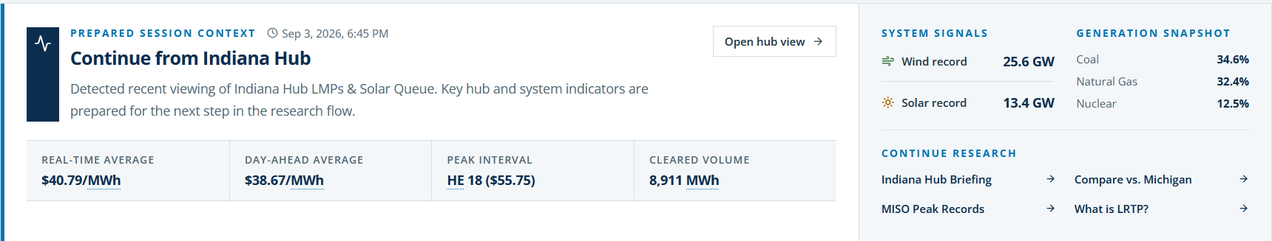
Feature 1 – Session Aware Radar
Instant Context Before You Even Type
Pre-loads real-time vs. day-ahead price averages and 24-hour volume automatically.
Provides quick-start research chips eliminating the "blank search bar syndrome."

Slide 5
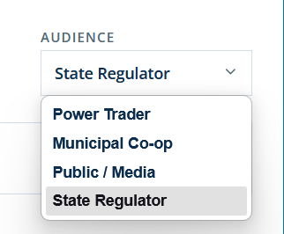
Feature 2 - 360° Knowledge Canvas & Persona Tailoring
Power Trader: Arbitrage spreads, marginal congestion costs, volatility indicators.
Municipal Co-op: Baseload rate stability, planning reserves, auction clearing.
Public / Media: Clean energy percentages, historical peaks, plain-English context.
State Regulator: Interstate transmission equity, cost-of-new-entry compliance

Slide 6
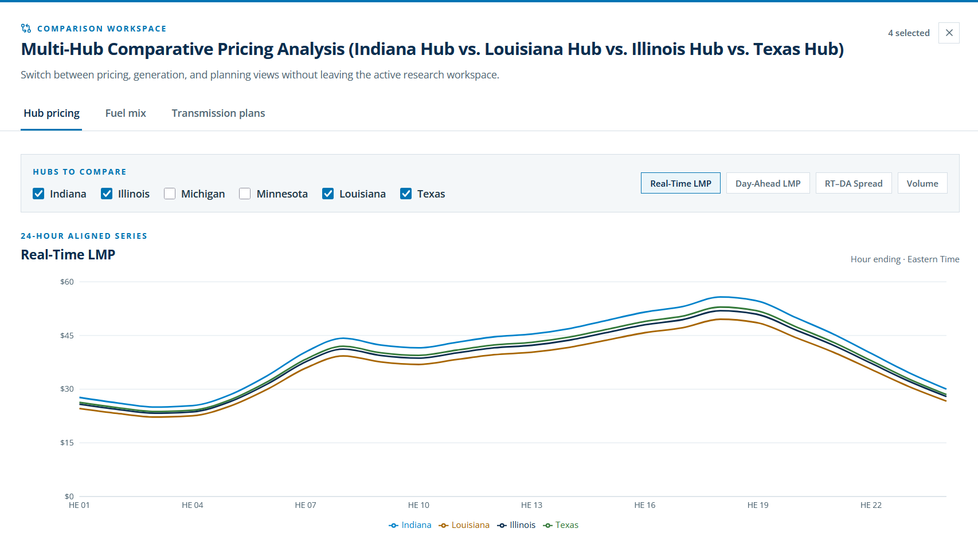
Feature 3 - Side-by-Side Comparison Engine
Hub-to-Hub: Compare Indiana vs. Michigan vs. Texas with synchronized 24-hour curves.
Fuel Diversity: Compare installed GW, capacity factors, and emissions profiles.
Transmission Expansion: Compare Local MTEP ($4.1B) vs. Regional LRTP ($10.3B) vs. Interregional JTIQ ($1.2B).

Slide 7
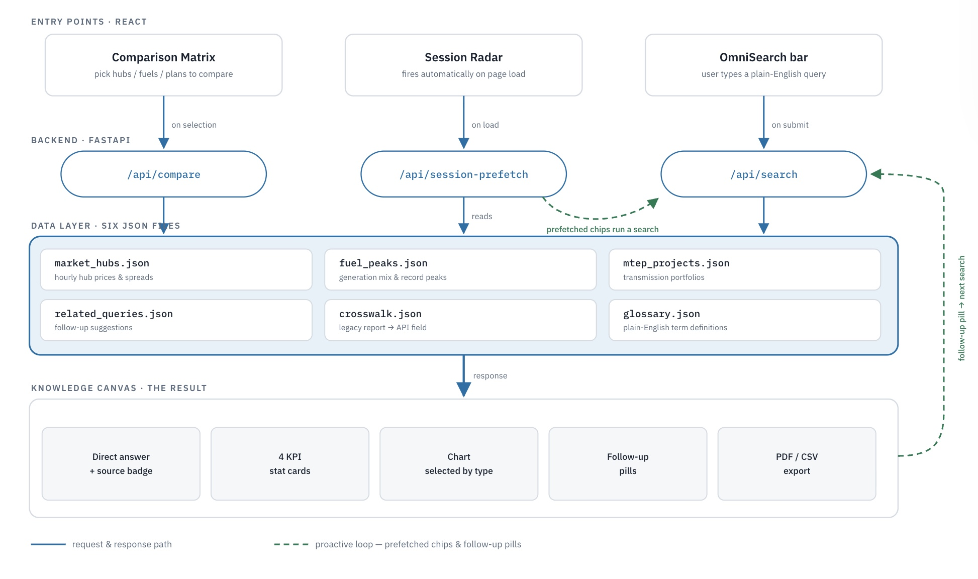
OmniSearch Data Flow
How a search flows through OmniSearch...
Three entry points feed one search pipeline that reads six JSON data files and returns a single result canvas plus two loops that make the tool feel like it is one step ahead of the user.

Slide 8
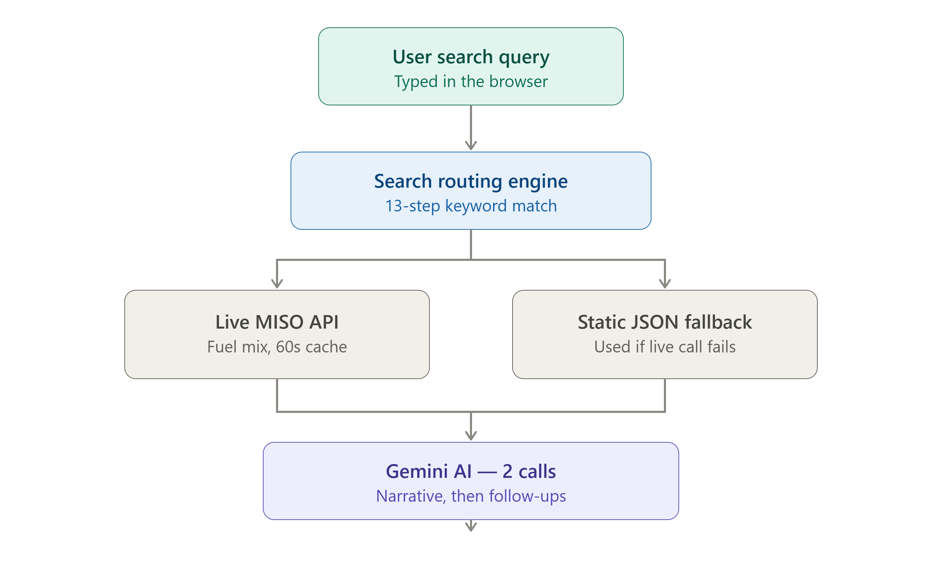
Security
User types a query in the search bar (browser)
Backend runs a 13-step keyword-matching router to classify the query type
Numeric data is pulled from two possible sources:
Live MISO public API (fuel mix, refreshed every 60 seconds)
Static verified JSON baseline (used automatically if live call fails)
Gemini AI generates the response in two separate calls:
The narrative answer text
The suggested follow-up questions
Result renders as KPI cards + interactive chart + source citation

Slide 9
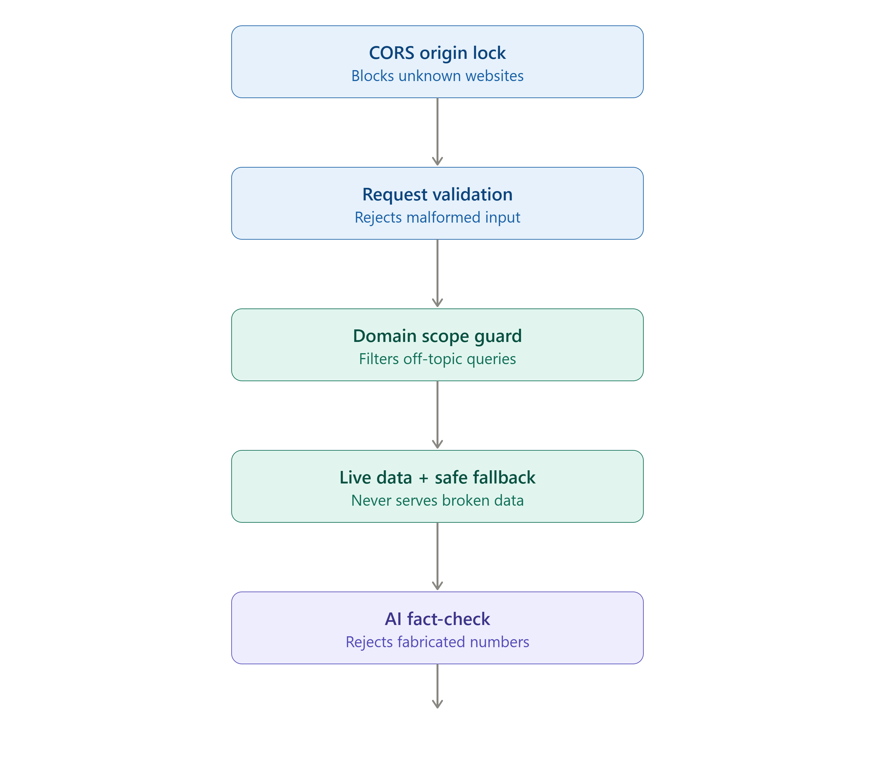
Security
Five layers of protection before any response reaches the user
CORS origin lock — only approved website origins can call the API
Request validation — malformed or empty queries rejectedimmediately (Pydantic)
Domain scope guard — off-topic queries filtered out before an AI callis even made
Live data + safe fallback — if the live MISO feed fails, static verifieddata is served instead — never a broken response
AI fact-check — every AI-written answer is scanned for suspiciousdollar figures; if a number can't be traced to real data, the response isdiscarded and a safe template is used instead

Slide 10
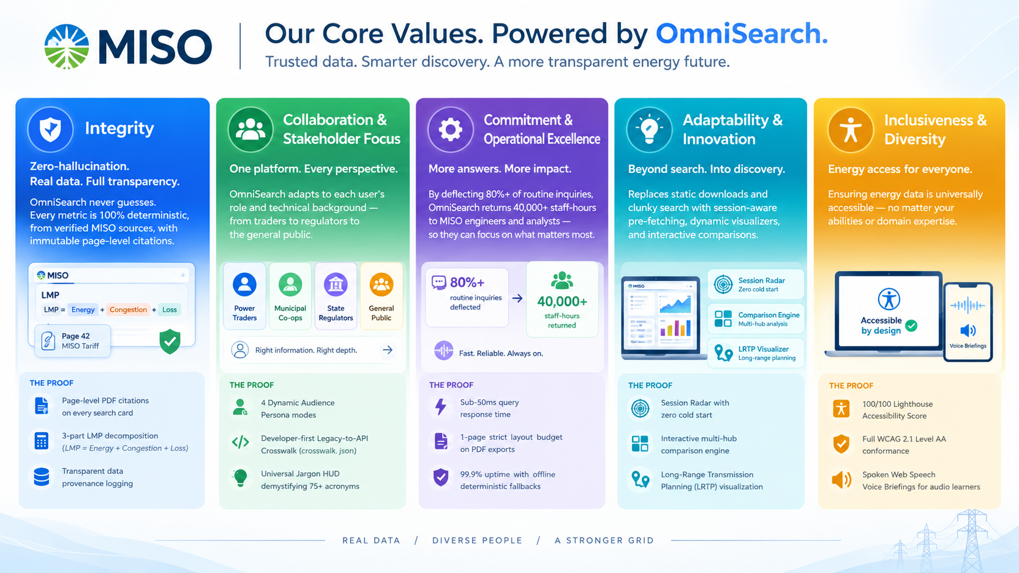

Slide 11
Executive
Summary
Complex grid data -> instant, auditable insights. Zero hallucination.
Eases API migration
Enterprise-ready 1-page executive PDF fact sheets in under 3 seconds
Accessible to all, no matter your preferred learning style or disabilities
Quantifiable ROI

Slide 12
Questions?
miso-omnisearch.basildawes.com

