Slide 1

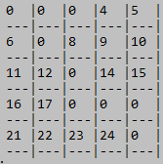
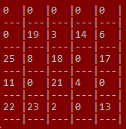
Bingo junior!!!

Slide 2

Presented by:
Farisa Benta Safir
ID : 16172103049
Jannatul Ferdows Modina
ID : 16172103078
Intake: 35
Section: 02
Department of CSE
BUBT.

Slide 3
We gladLY thank to our project supervisor:
Nahid Newaz Assistant Professor Dept. of CSE BUBT.

Slide 4
introduction
It’s a console based game.
It’s a single and a double player game.
We used to play BINGO using our paper and pen at the very beginning of our student life. Still we feel nostalgic while we play this game. So

Slide 5
Objectives of the project:
To create a project (console game) using C-programming language and their features.
To implement features like control statement, conditional statement, 2D array, loops statement, random function etc.
To make the program easy while running it.
To concise the memory of program as far as possible.
To get an idea about making a simple project using C.
To be able to solve problems by Compiling and Debugging.

Slide 6

Game rules:
There are two mode:
Single Player
Double Player

Slide 7
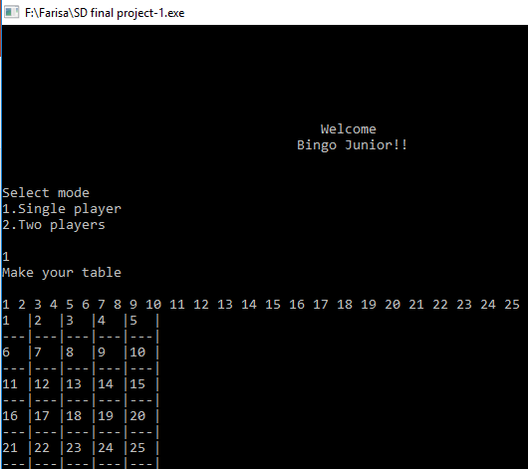
game rules
For single player:
Run the game & press 1 for playing in single mode.
For making table insert integers from 1 to 25 (use the integers only ones)
By giving a number start your game and continue until you win or loose.
For wining the game make one line 0 in your table vertically or horizontally or diagonally.

Slide 8
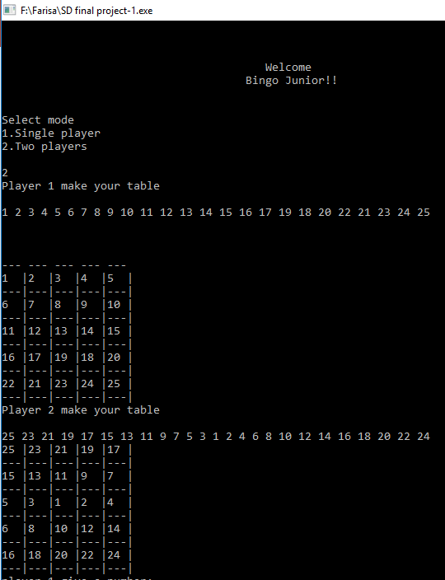
Game rules:
For double player:
Run the game & press 2 for playing in double mode.
For making table insert integers from 1 to 25 (use the integers only ones). Both 2 player.
While player one give a number then the game start and continue until anyone win or loose.
For wining the game make one line 0 in your table vertically or horizontally or diagonally.

Slide 9

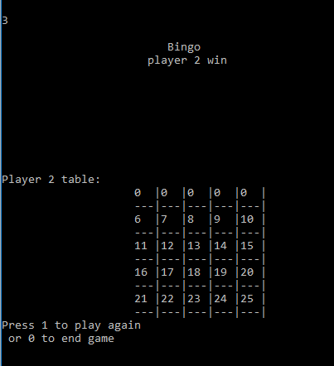
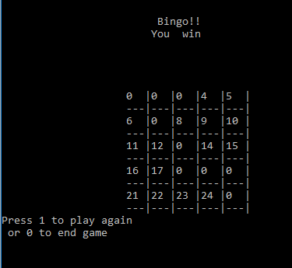
Game rules:

Slide 10
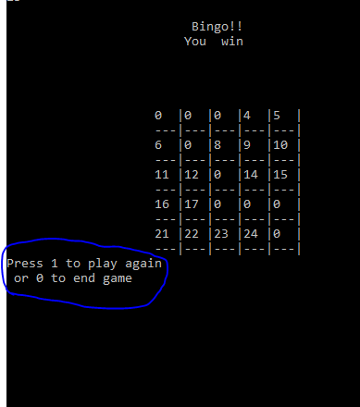
Game rules:
After finishing game you choose to play again or exit.
Press 1 for play again
Press 0 for exit.

Slide 11

limitation:
This game cannot be played by one or more than two players.
It’s not a high level game.
It’s doesn’t contain level.

Slide 12

Development:
In this game we can play single or double mode. But we can make it playable for more than 2 player.
We can develop it’s wining process.
We can add levels.

Slide 13


