Slide 1
IP2PGO APP
USER GUIDE FOR FIAT TRADES
17 JANUARY 2019

Slide 2
Sections
Creating a Sell Offer
When your Sell Offer is taken
Creating a Buy Offer
When your Buy Offer is taken
Taking another user’s Sell Offer
Taking another user’s Buy Offer

Slide 3
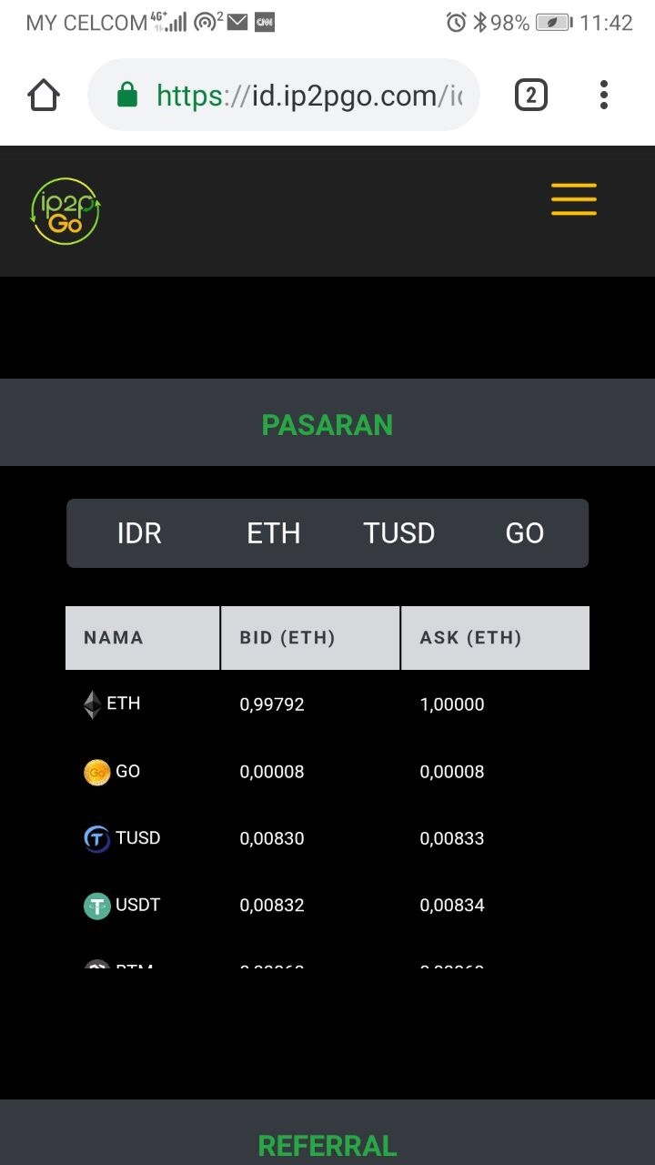
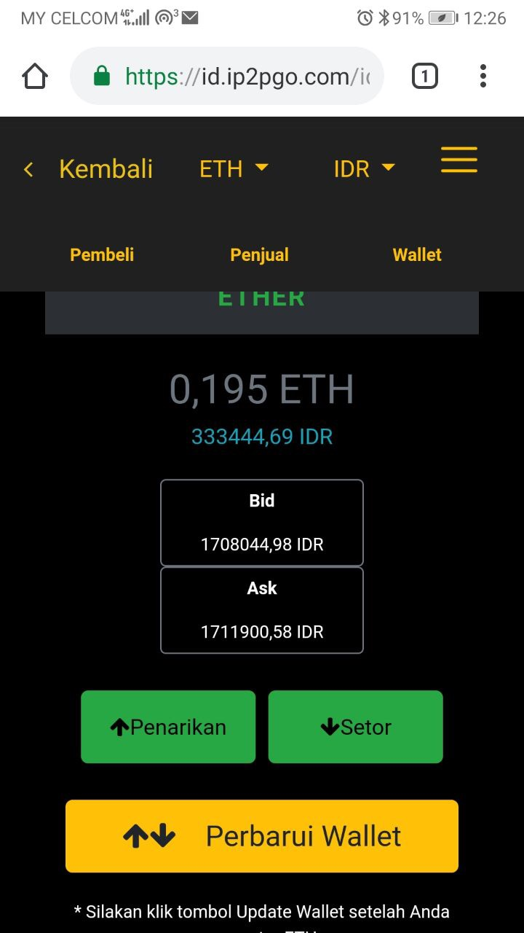
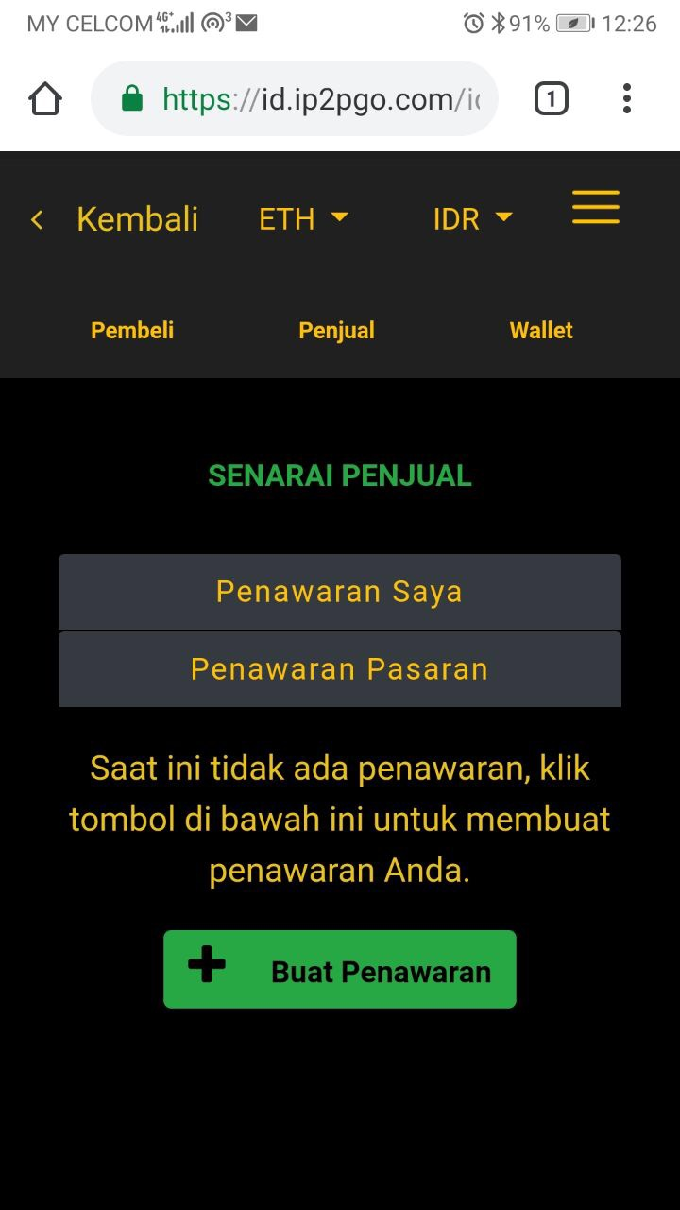
A. Creating a Sell Offer
(1) (2) (3)
1. Select the token that you want to sell from the main page. In this example, we want to sell ETH, so click on ETH under the Name column.
2. You will be able to see the pairing on top of the page is ETH and IDR. This can be changed according to your pairing that you want. In this example, we want to sell ETH for IDR. Click on the Sellers button.
3. You will be able to see the list of sellers of ETH for IDR. Click on the Create Offer button.

Slide 4
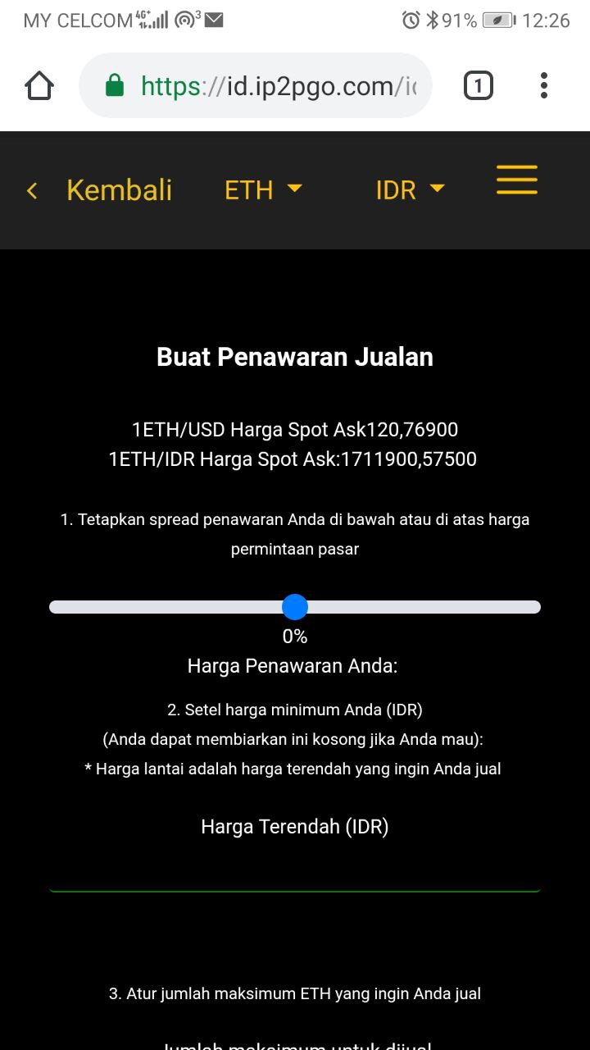
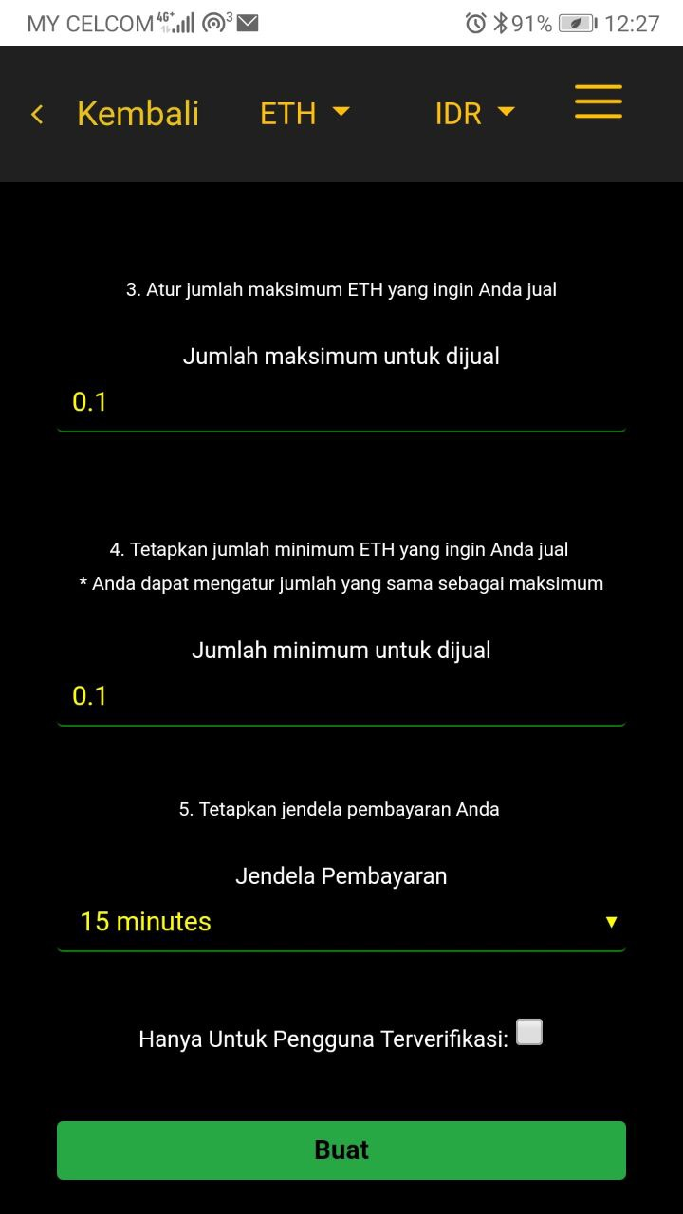
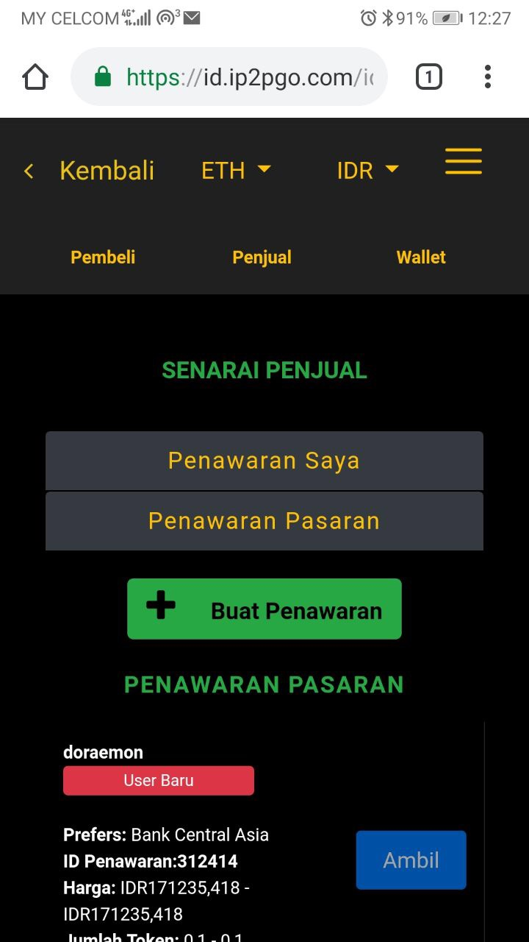
A. Creating a Sell Offer (con’t)
(4) (5) (6)
4. Use the slider to select between -5% to 5% against the spot sale price that you want to sell. After you have selected the %, your offer price in absolute terms for 1 ETH will be shown. You also have the option to set the minimum price that you wish to sell in the Floor Price field.
3. Key in the maximum and minimum amount of ETH that you wish to sell in this one offer. Select the time period you want to conclude this trade in the payment window before clicking on the Create button.
4. Your Sell Offer has been created and you can see it displayed under the Sellers tab. Each offer will have and ID, which in this case your Sell Offer ID is 312414.

Slide 5
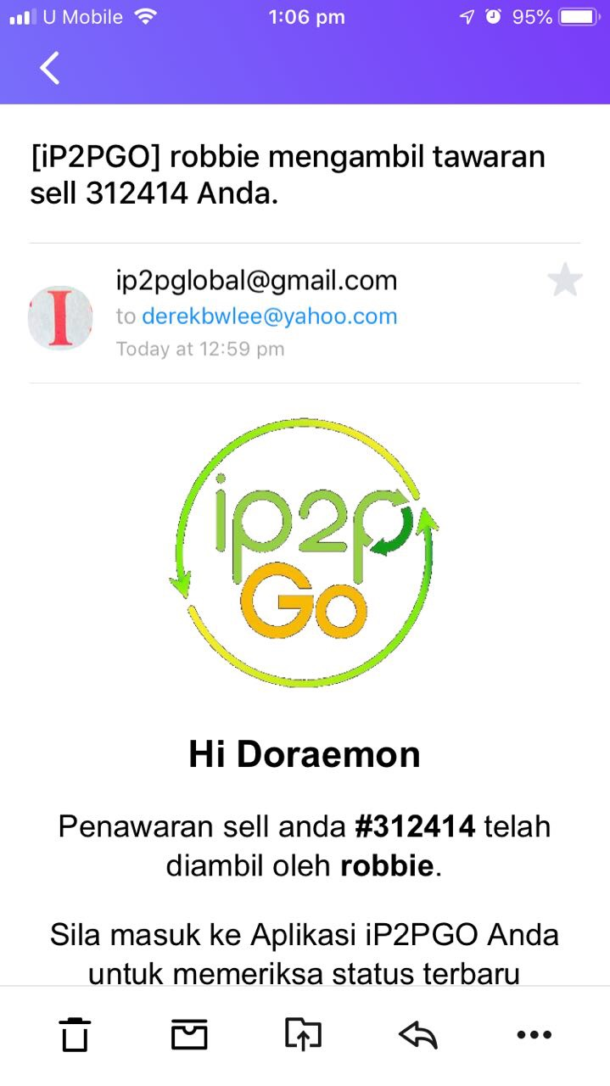
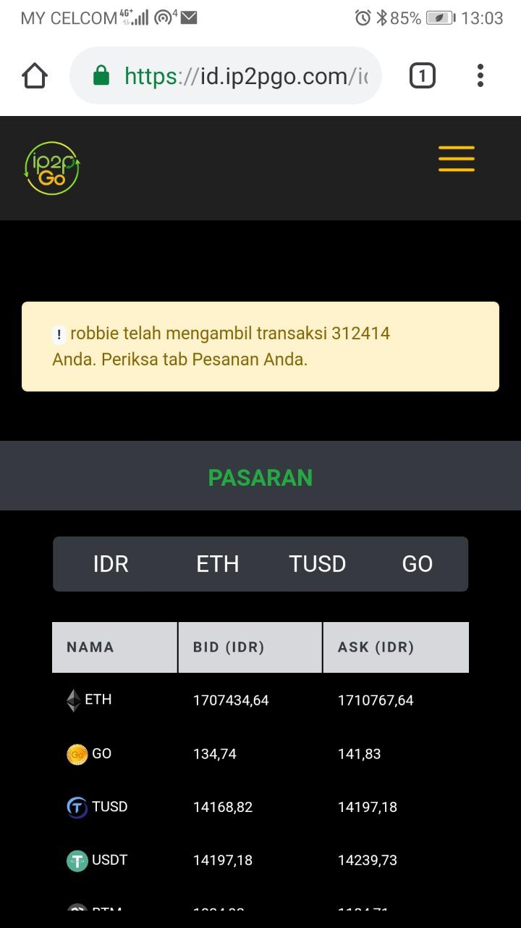
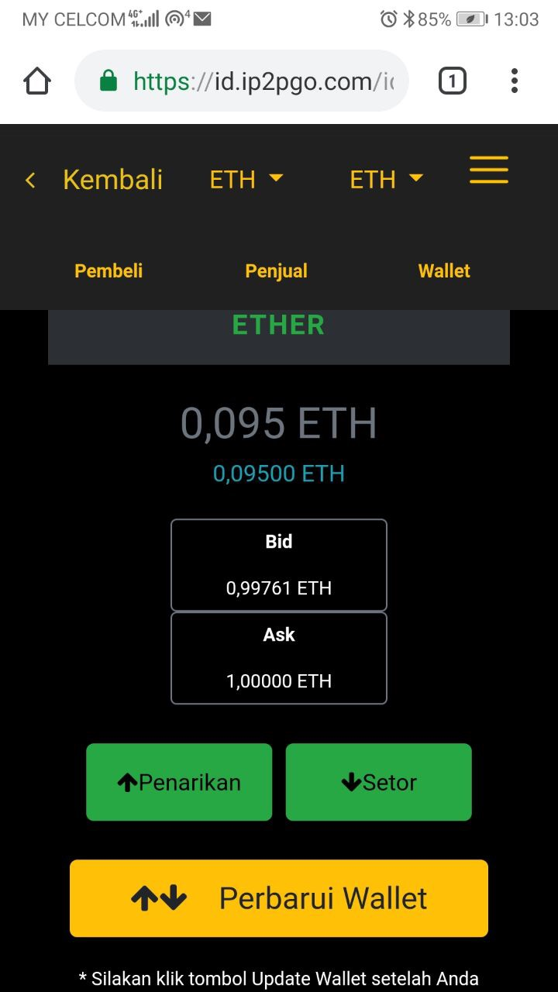
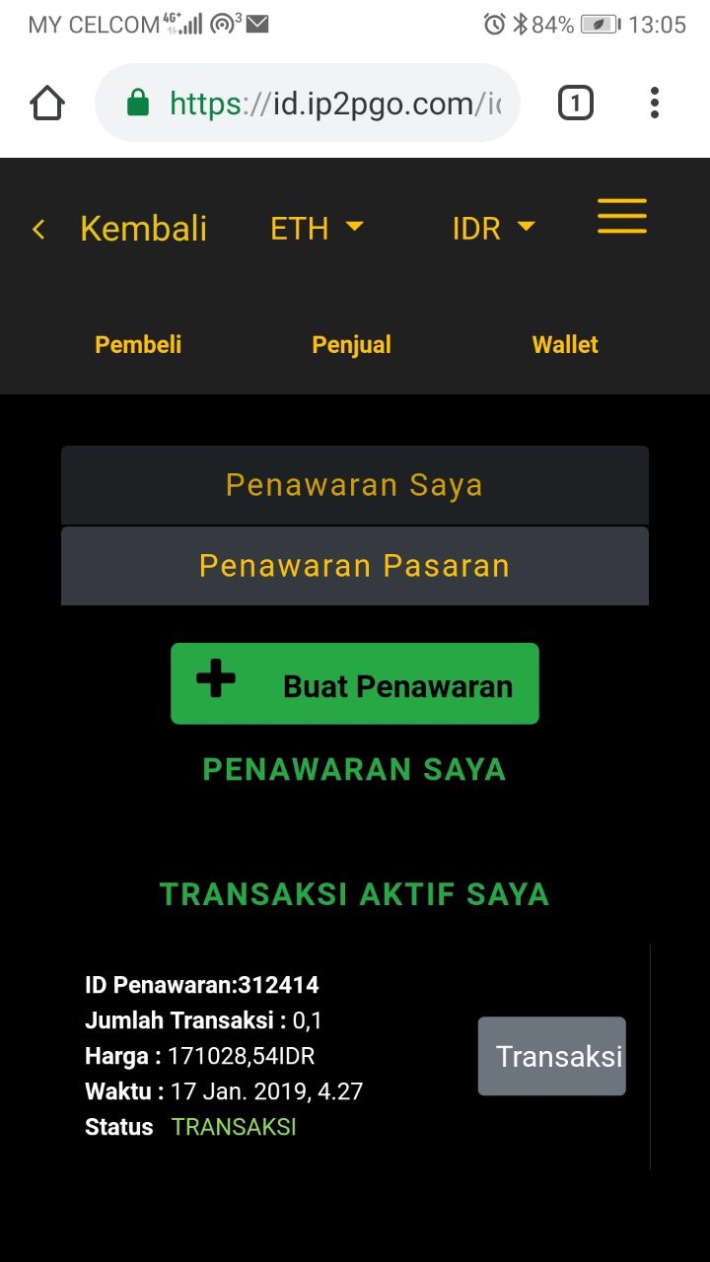
B. When your a Sell Offer is taken
(1) (2) (3) (4)
1. You will receive an email notifying you that your Sell Offer has been taken by a counterparty.
2. If you are in the App, you will also a message notifying that your Sell Offer has been taken.
3. Click on the ETH tab under the Name column and click on the Sellers button.
4. Click on My Trades button and you will see under My Active Trade section the trade that was taken by the counterparty. Click on the transaction.

Slide 6
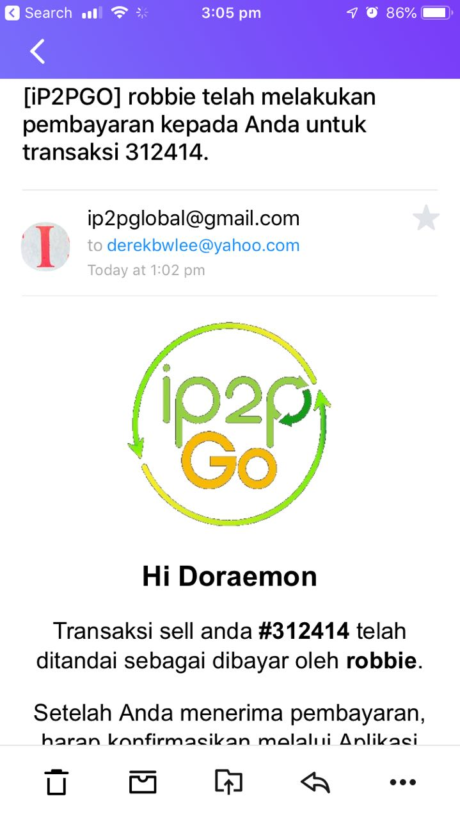
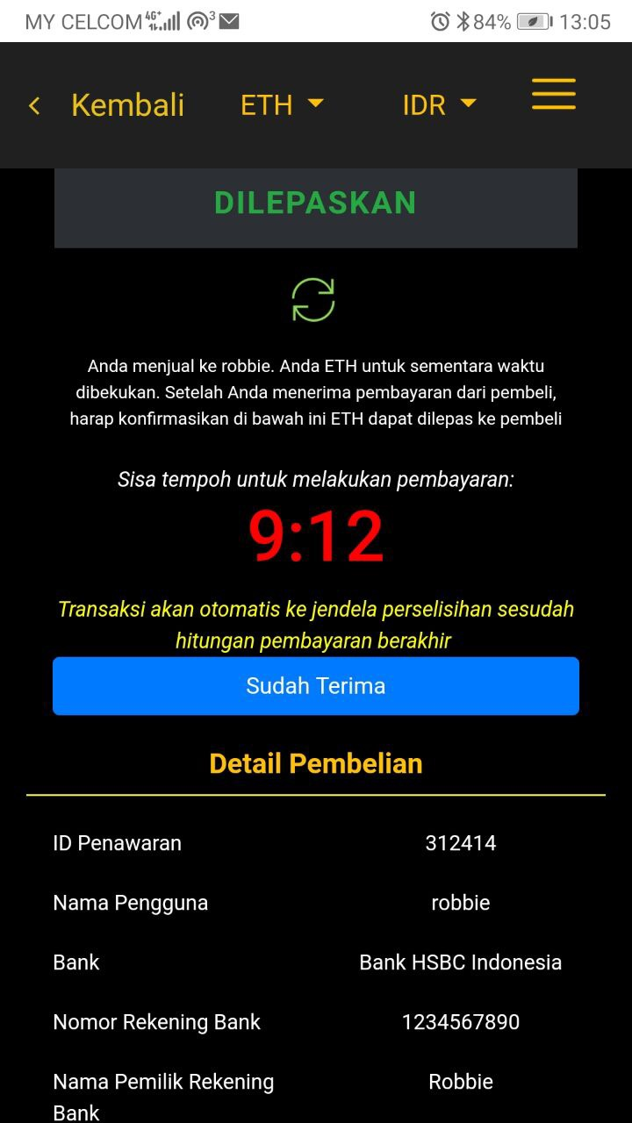
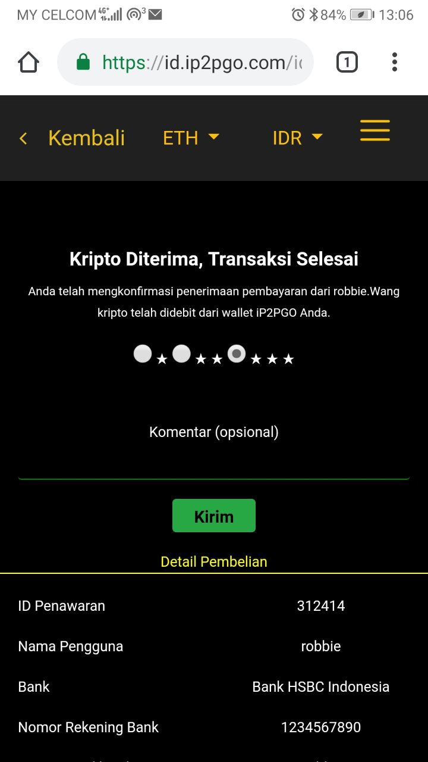
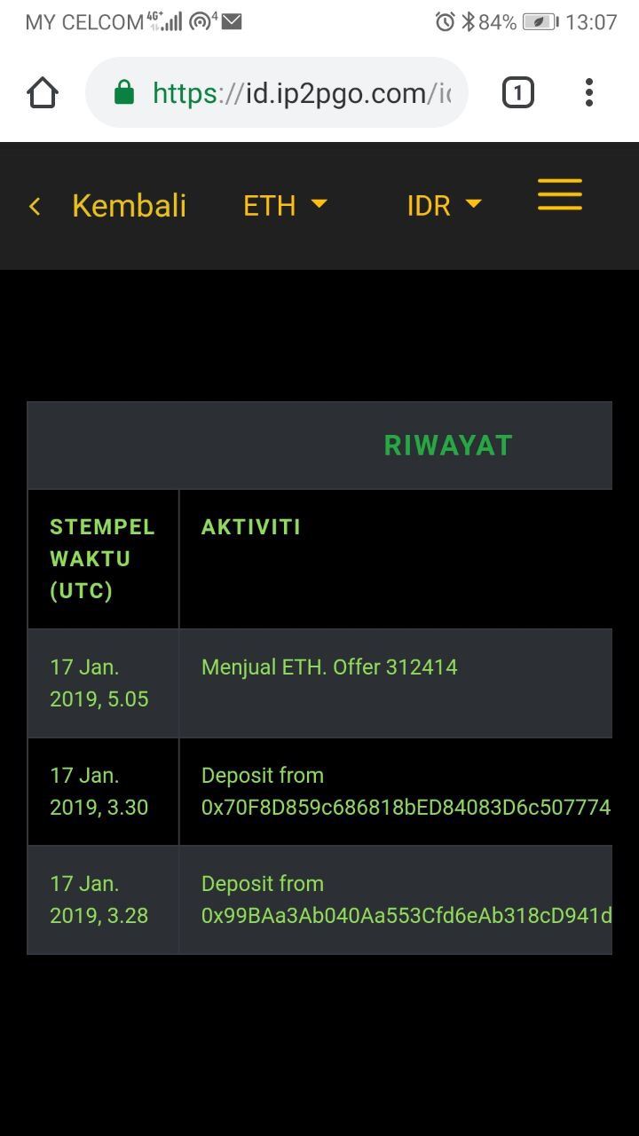
B. When your a Sell Offer is taken (con’t)
(5) (6) (7) (8)
5. If payment to you has been marked as paid by the counterparty, you will see receive an email notifying you that the counterparty has made payment to your bank account.
6. Check if the money has been received in your bank account successfully. If yes, you can proceed to click the blue I Have Received Payment button to complete the trade.
7. Your trade has been completed and you can provide rating and feedback on your counterparty that had transacted with you.
8. Your trade will also show in your history page under the main menu.

Slide 7
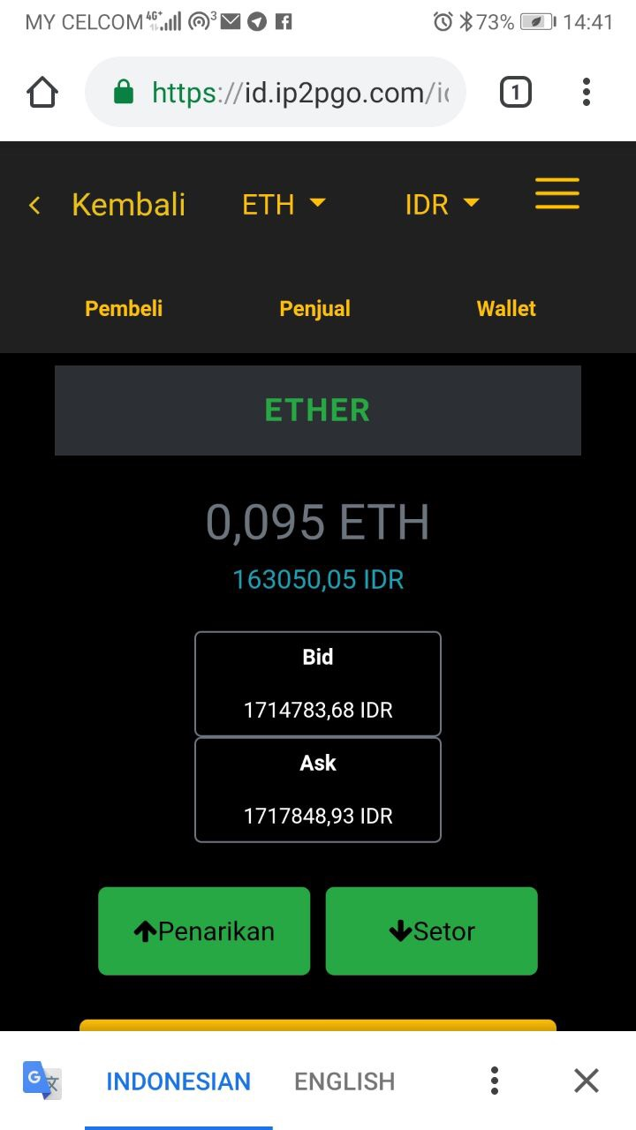
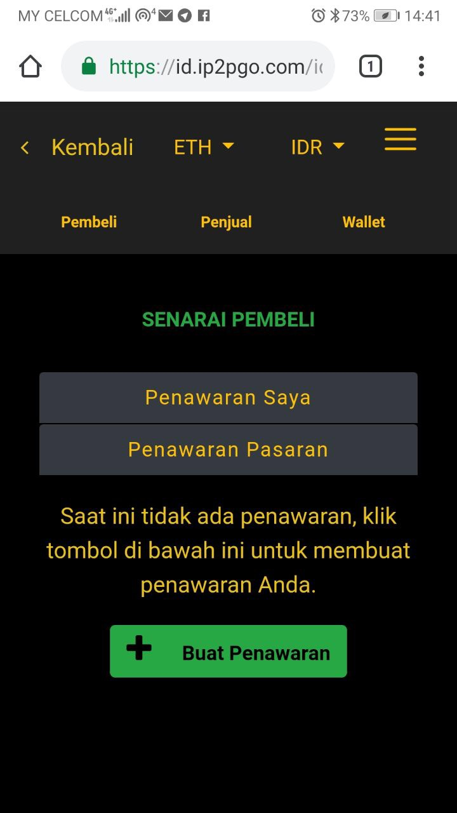
C. Creating a Buy Offer
(1) (2) (3)
1. Select the token that you want to sell from the main page. In this example, we want to buy ETH, so click on ETH under Name column.
2. You will be able to see the pairing on top of the page is ETH and IDR. This can be changed according to your pairing that you want. In this example, we want to buy ETH for IDR. Click on the Buyers button.
3. You will be able to see the list of buyers of ETH for IDR. Click on the Create Offer button.

Slide 8
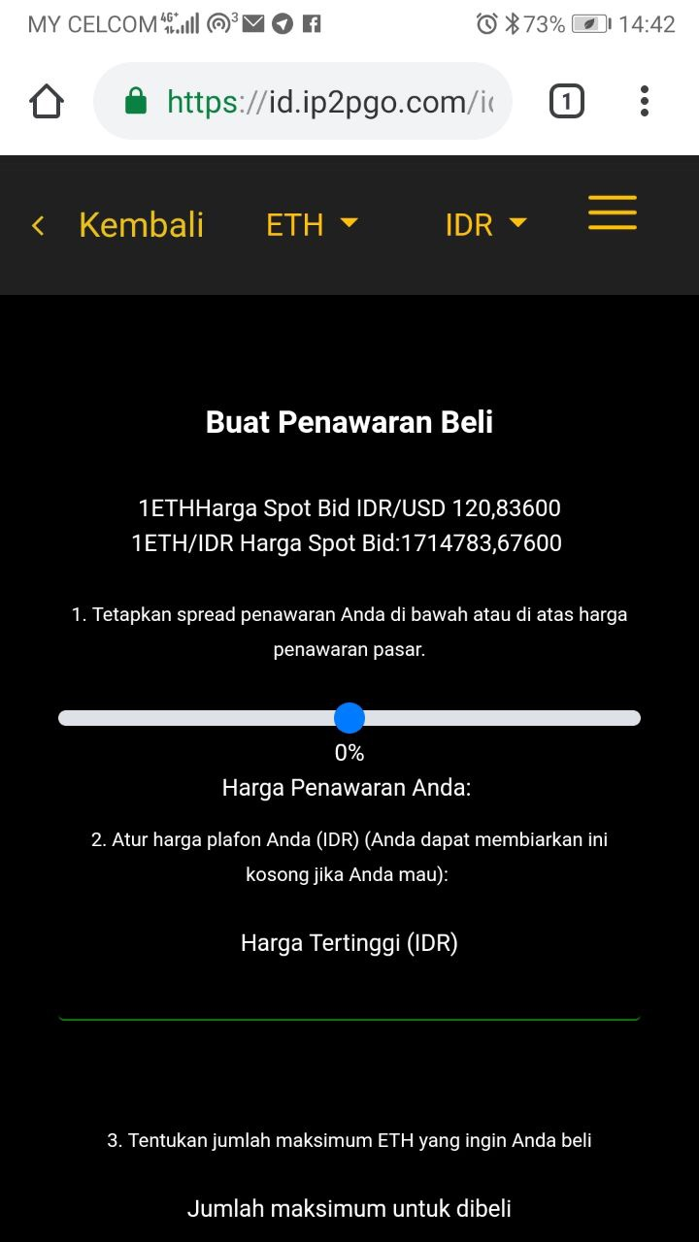
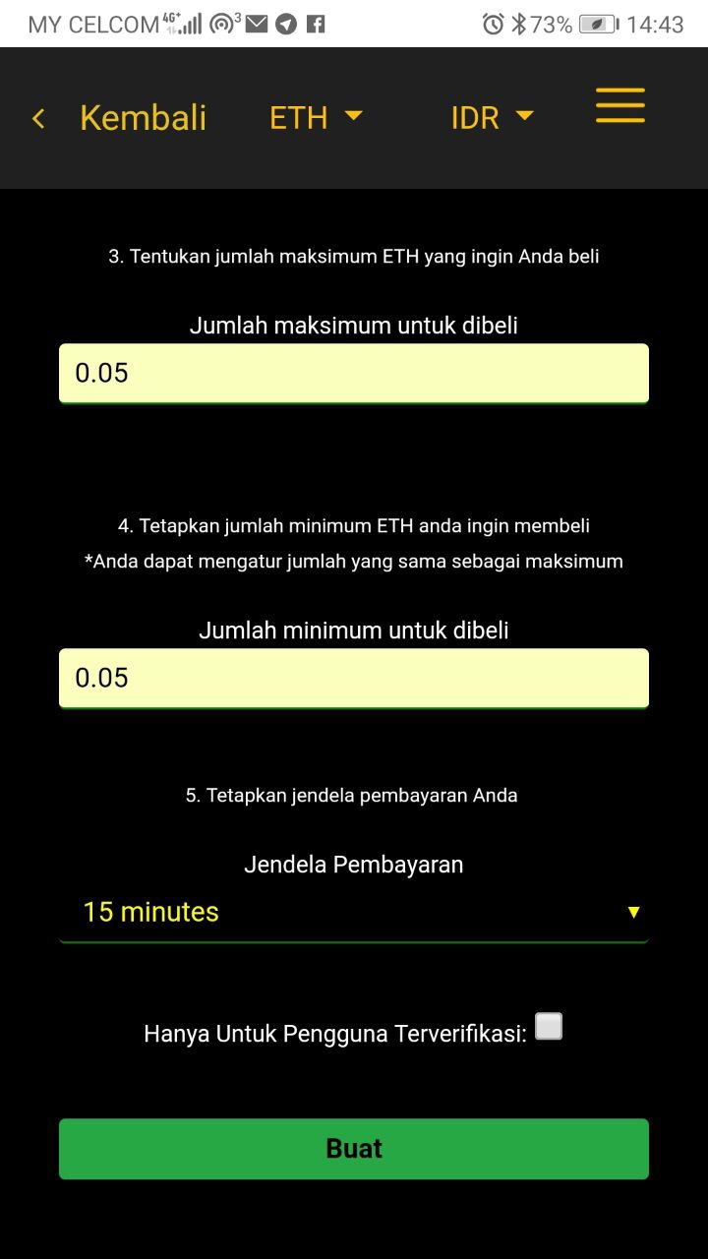
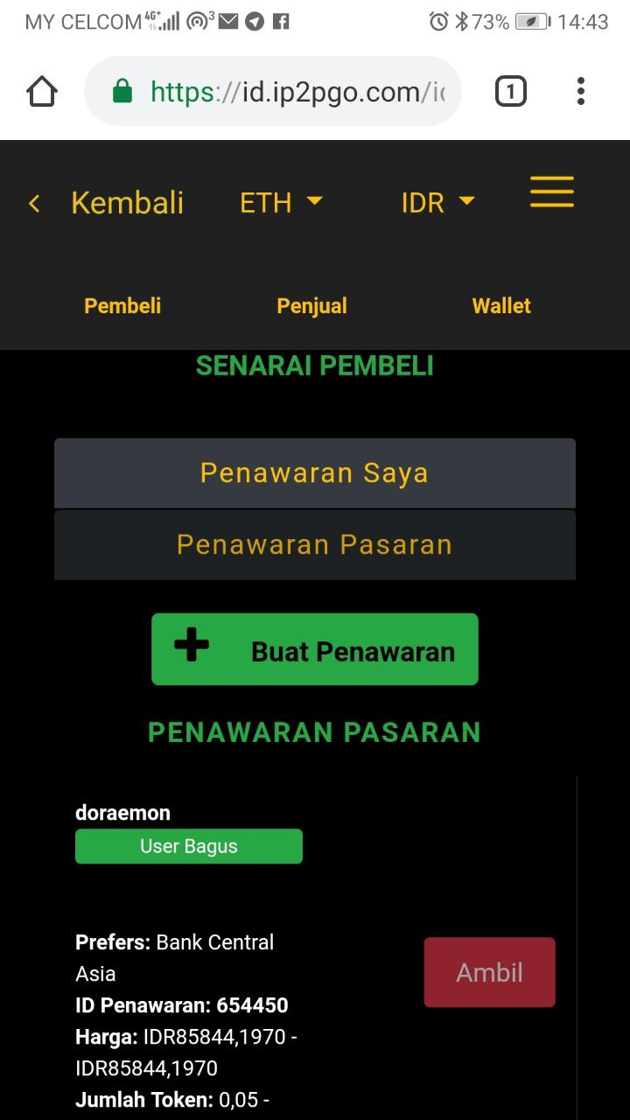
C. Creating a Buy Offer (con’t)
(4) (5) (6)
4. Use the slider to select between -5% to 5% against the spot sale price that you want to buy. After you have selected the %, your offer price in absolute terms for 1 ETH will be shown. You also have the option to set the maximum price that you wish to buy in the Ceiling Price field.
3. Key in the maximum and minimum amount of ETH that you wish to buy in this one offer. Select the time period you want to conclude this trade in the payment window before clicking on the Create button.
4. Your Buy Offer has been created and you can see it displayed under the Buyers tab. Each offer will have and ID, which in this case your Buy Offer ID is 654450.

Slide 9
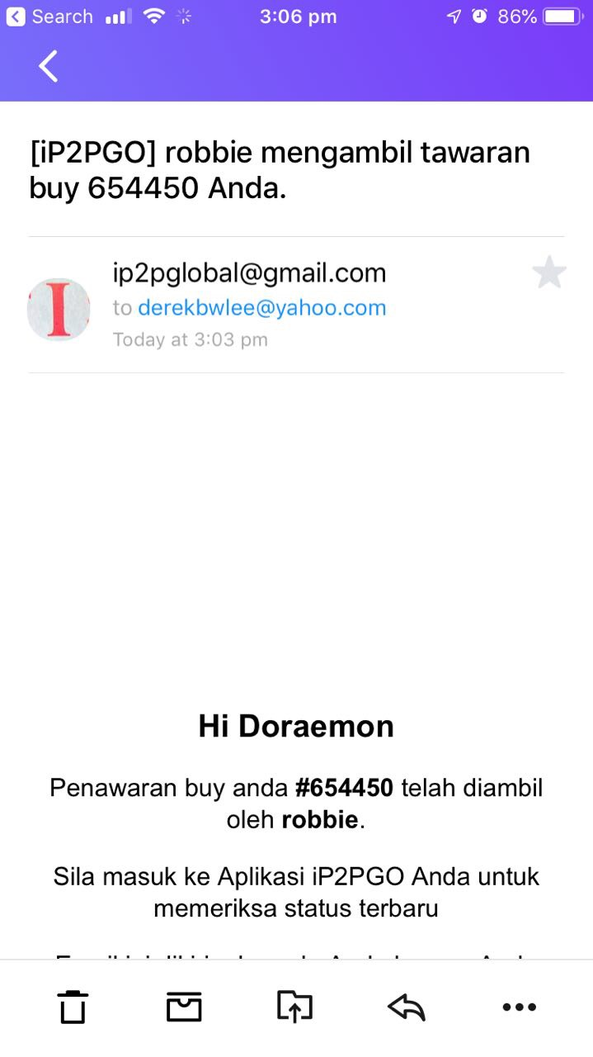
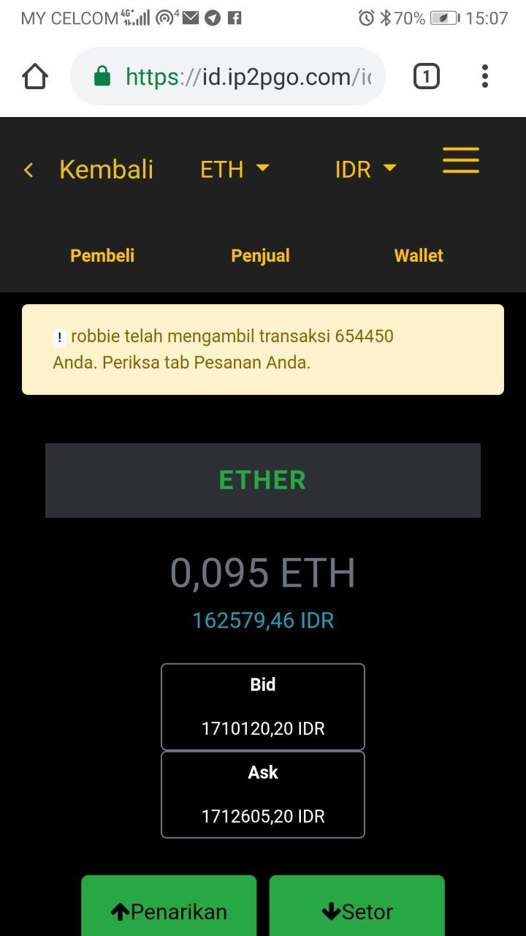
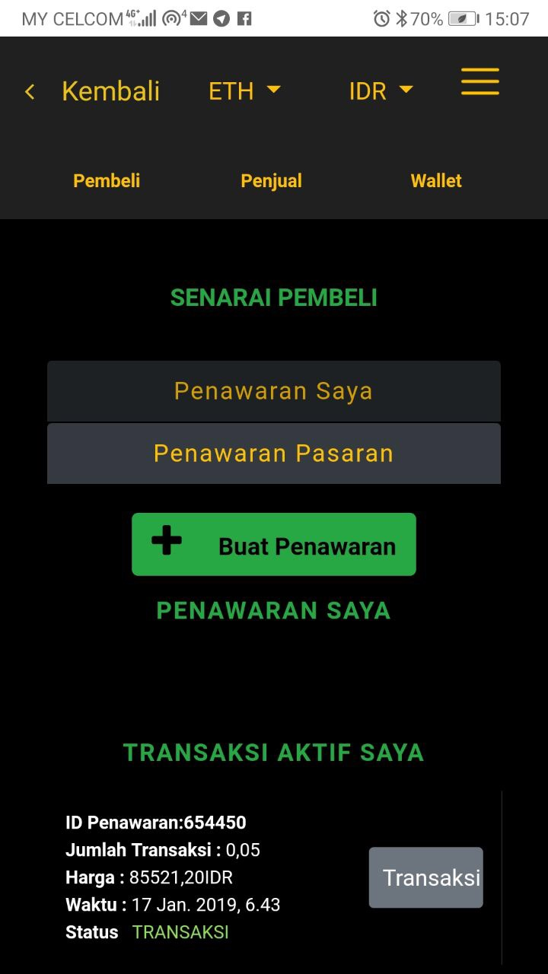
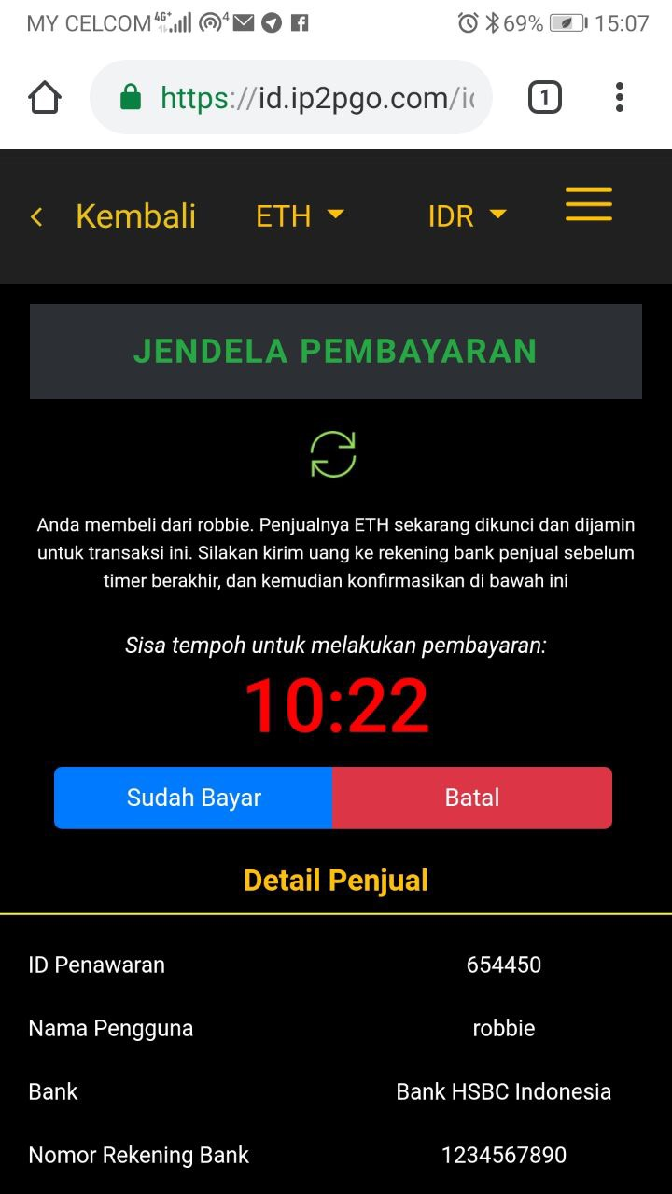
D. When your a Buy Offer is taken
(1) (2) (3) (4)
1. You will receive an email notifying you that your Buy Offer has been taken by a counterparty.
2. If you are in the App, you will also a message notifying that your Buy Offer has been taken. Click on the ETH tab and Buyers button.
3. Click on My Trades button and you will see under My Active Trade section the trade that was taken by the counterparty. Click on the transaction.
4. The counterparty bank details will be shown. Make the bank transfer to the counterparty according to the details shown. Once you have made the bank transfer, click on the I Have Paid button.

Slide 10
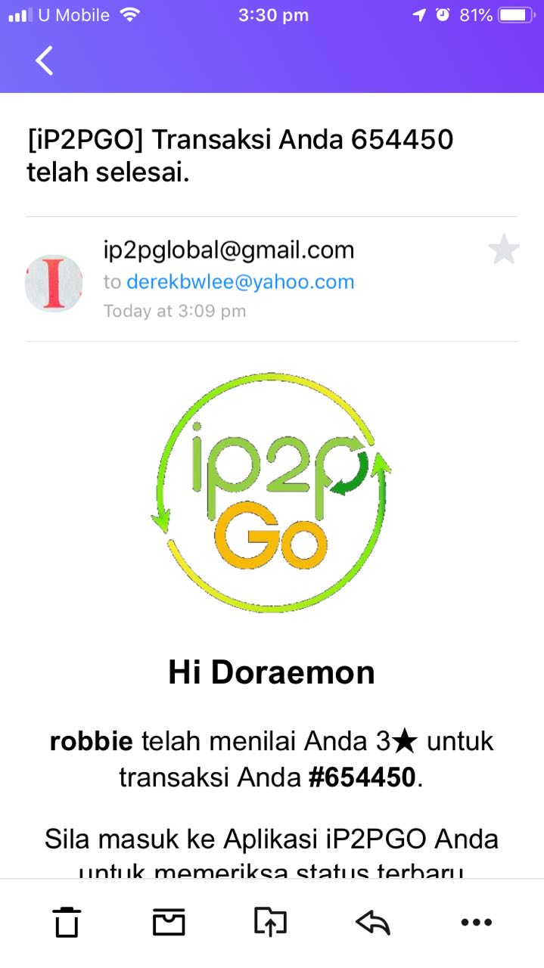
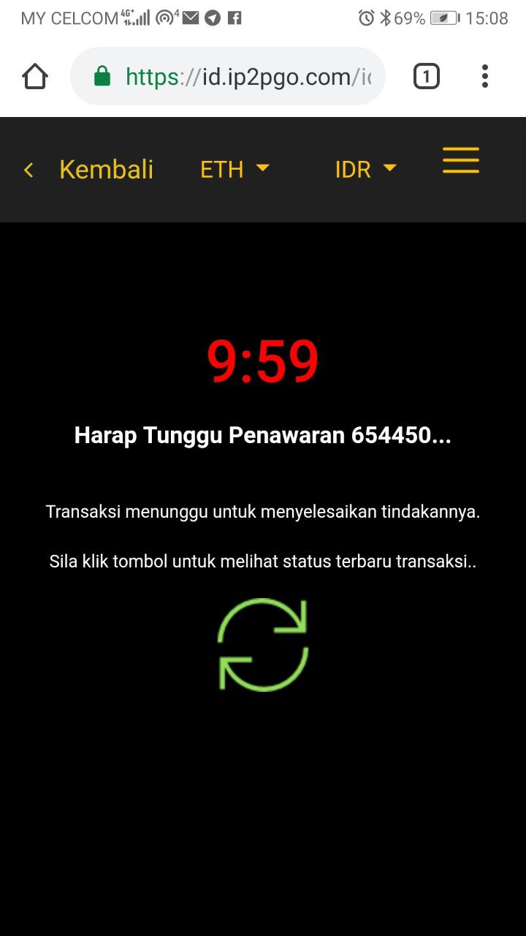
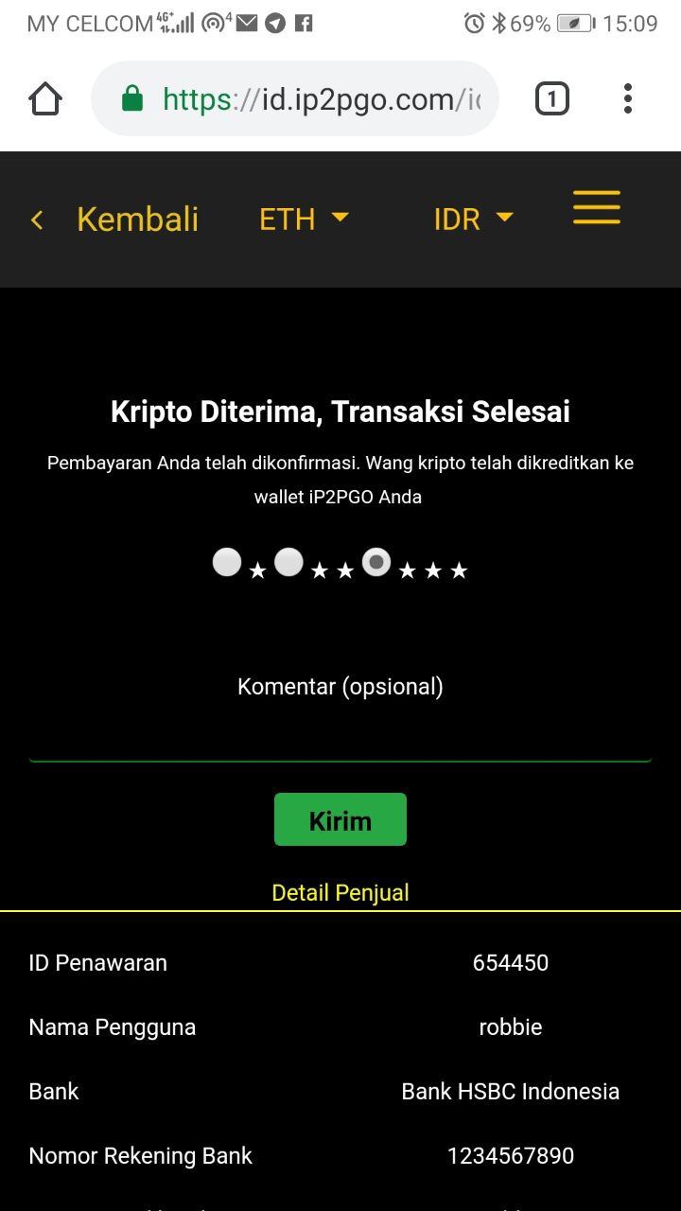
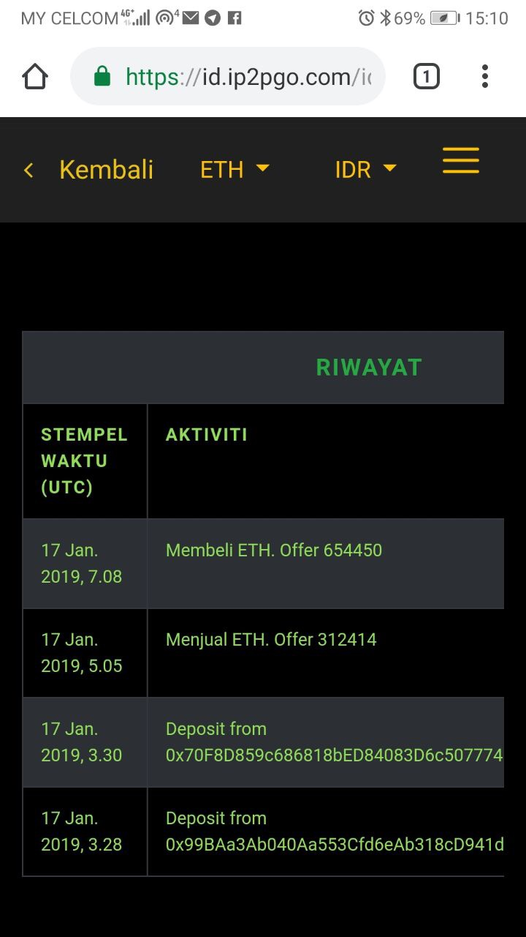
D. When your a Buy Offer is taken (con’t)
(5) (6) (7) (8)
5. You will receive an email when the counterparty has confirmed he has received your payment.
6. Click the refresh button on your trade.
7. Your trade has been completed and you can provide rating and feedback on your counterparty that had transacted with you.
8. Your trade will also show in your history page under the main menu.

Slide 11
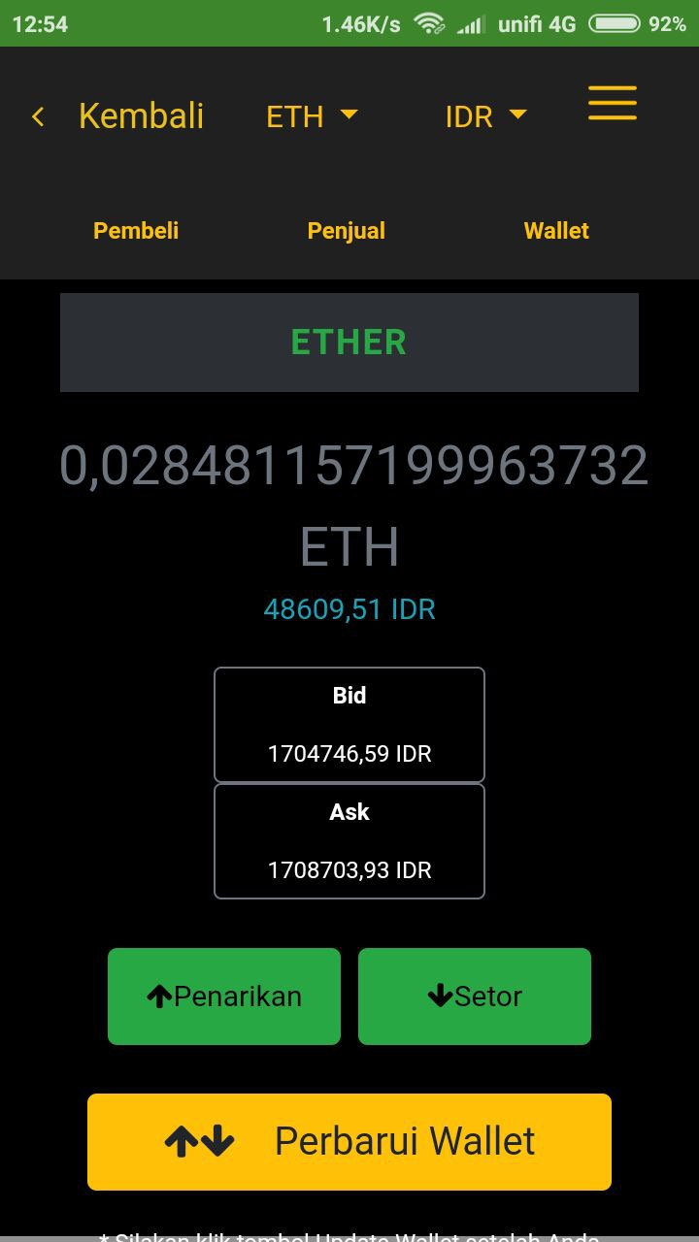
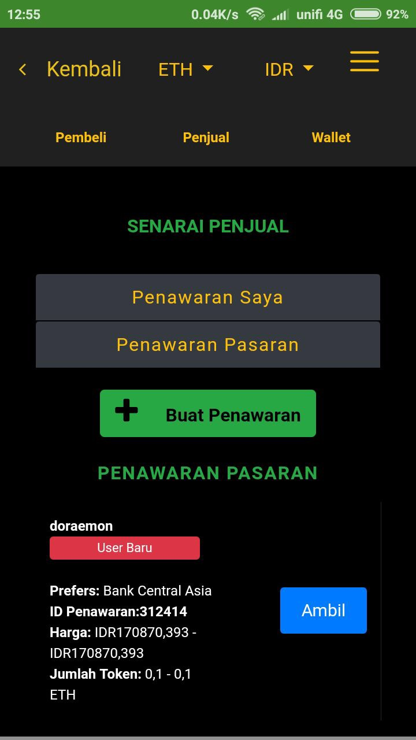
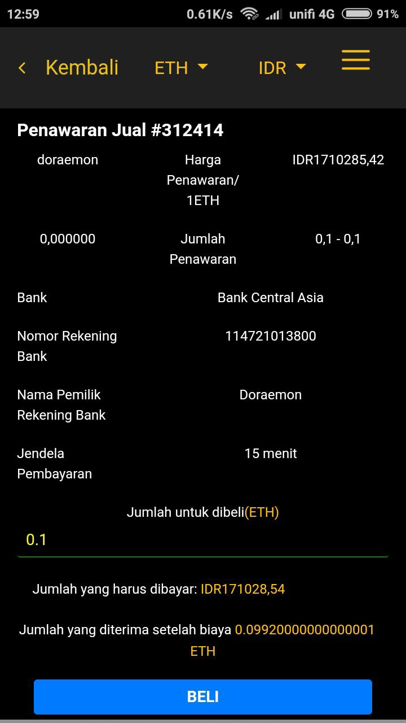
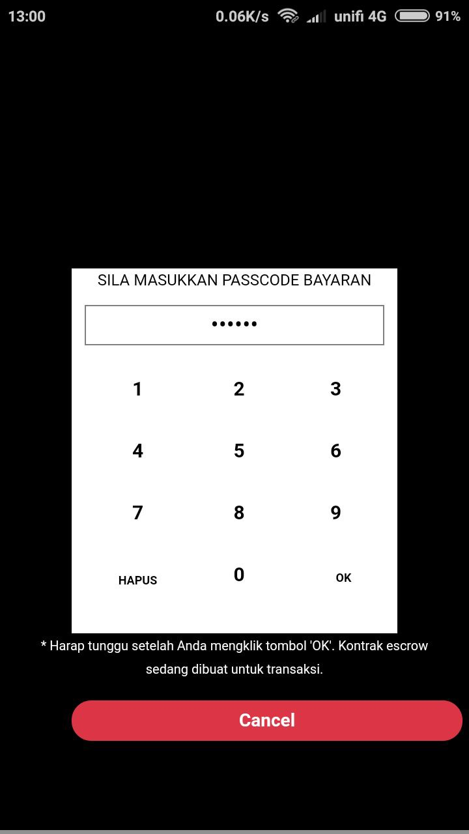
E. Taking another user’s Sell Offer
(1) (2) (3) (4)
1. Click on the token that you want to buy. In this example, we want to buy ETH with IDR. Click on the Sellers tab in the ETH/IDR pairing selection to view the sellers listings.
2. Select the sellers offer that you want to take. In this example, we will take Offer ID 312414. Press on the Take button for Offer ID 312414.
3. You will see counterparty’s offer price and offer amount (in ETH), bank details and the time required to conclude the trade. Key the amount of ETH that you want to buy and the amount to pay as well as net ETH receivable after fees will be shown. Press the Buy button.
4. You will need to key in your 6 digits passcode to proceed.

Slide 12
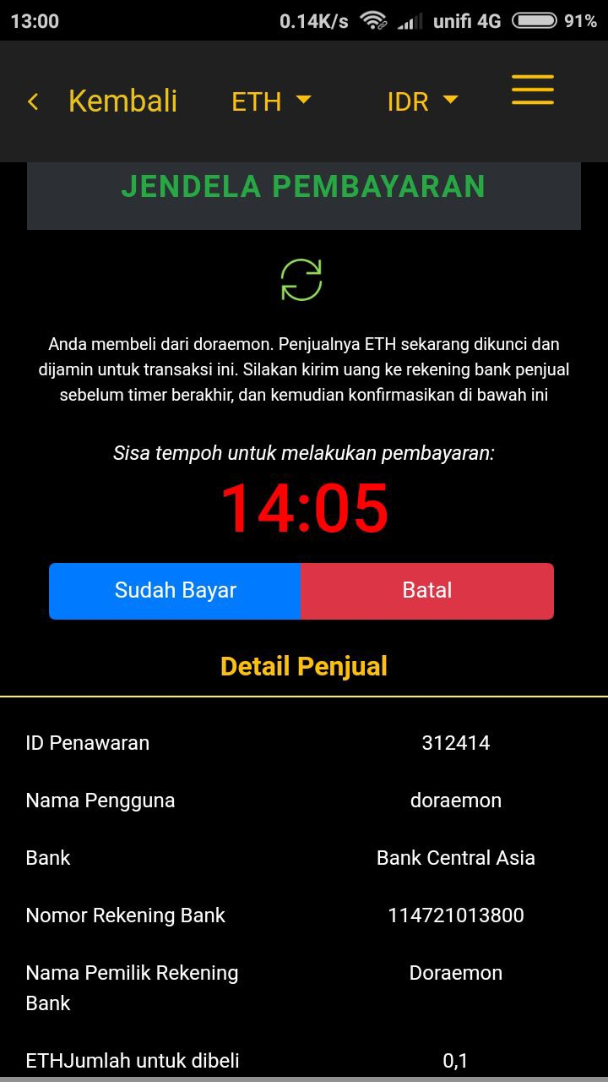
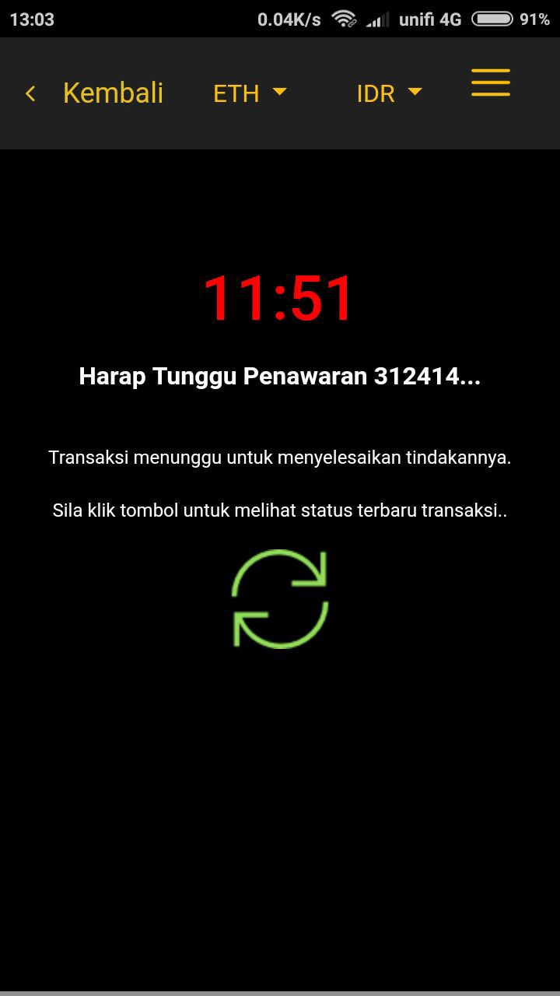
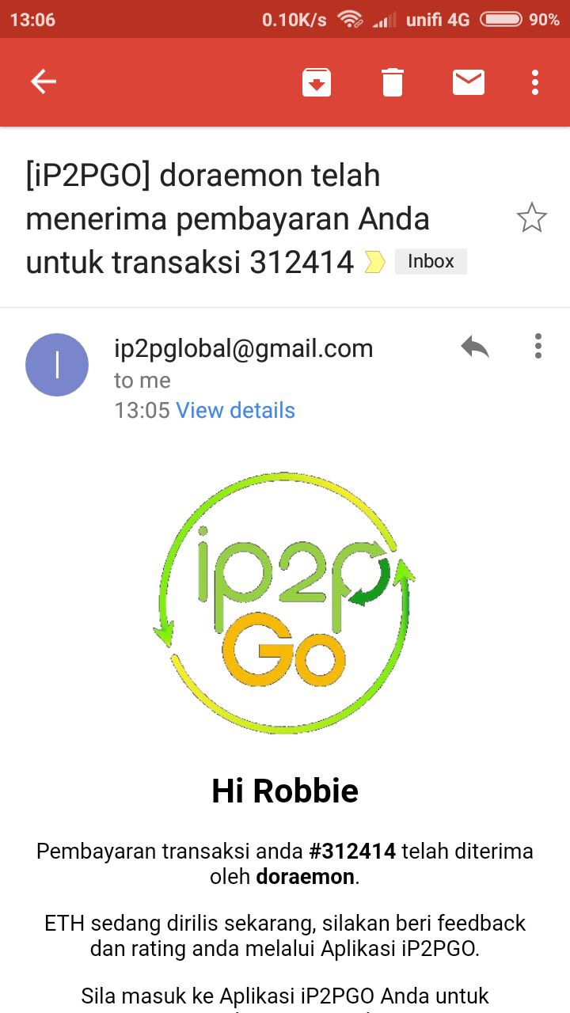
E. Taking another user’s Sell Offer (con’t)
(5) (6) (7)
5. You will see the timer left to pay as well as the bank details of the counterparty. After you made the instant online bank transfer to the counterparty, click on the blue I Have Paid button.
6. The trade is now pending confirmation from the counterparty that he has received the bank transfer that you have made.
7. When the counterparty confirms he has received the bank transfer, you will receive an email notifying you that your payment has been received by the counterparty.

Slide 13
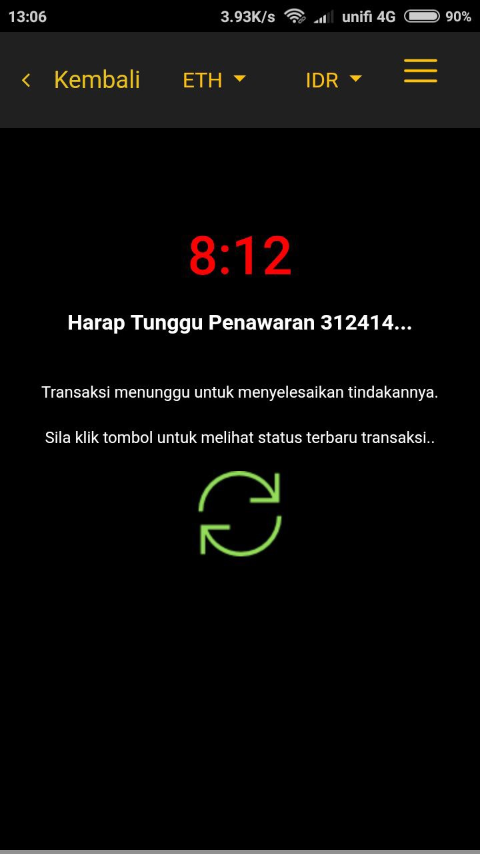
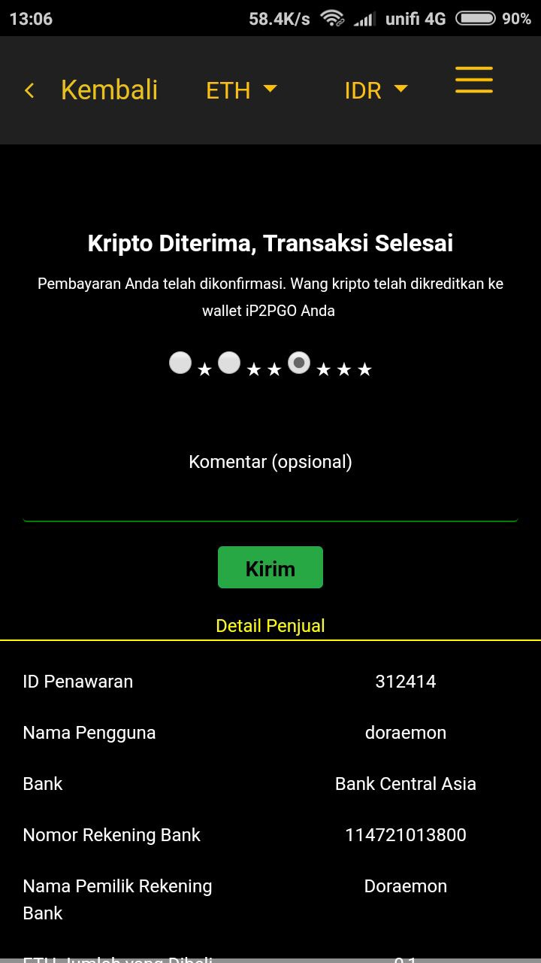
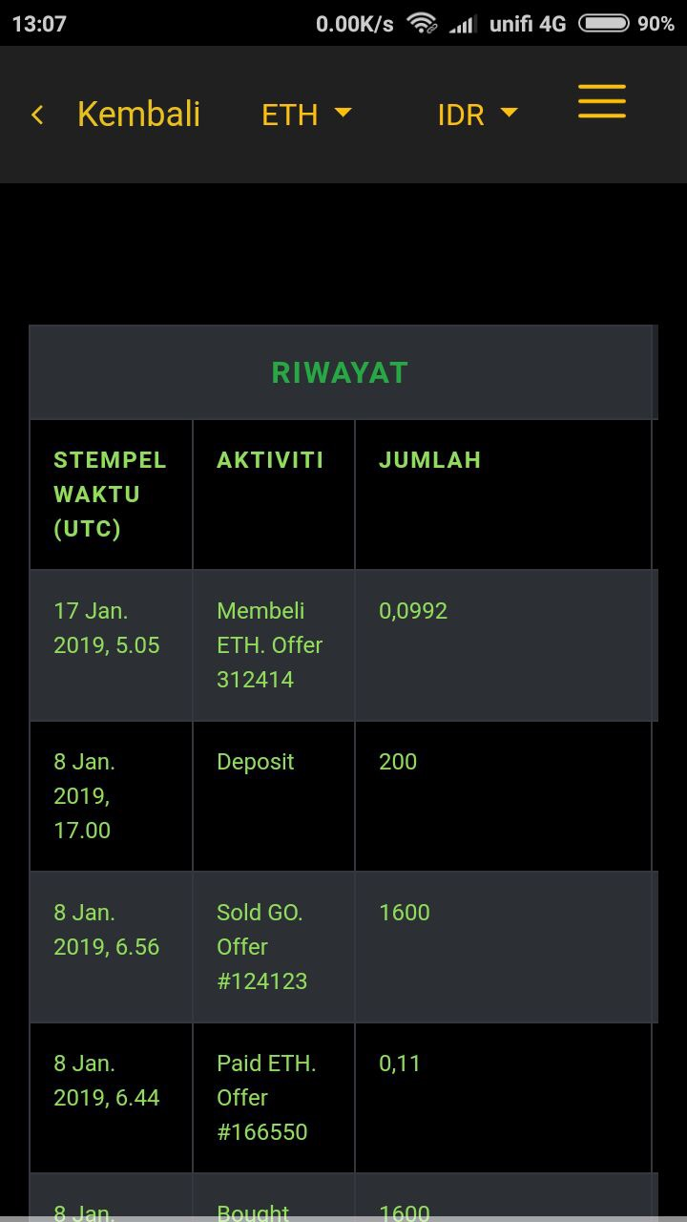
E. Taking another user’s Sell Offer (con’t)
(8) (9) (10)
8. Click the refresh button for your trade in the app.
9. You can provide rating and feedback on your counterparty that had transacted with you.
10. You trade will be recorded in your history page under main menu located on the top right of your screen.

Slide 14
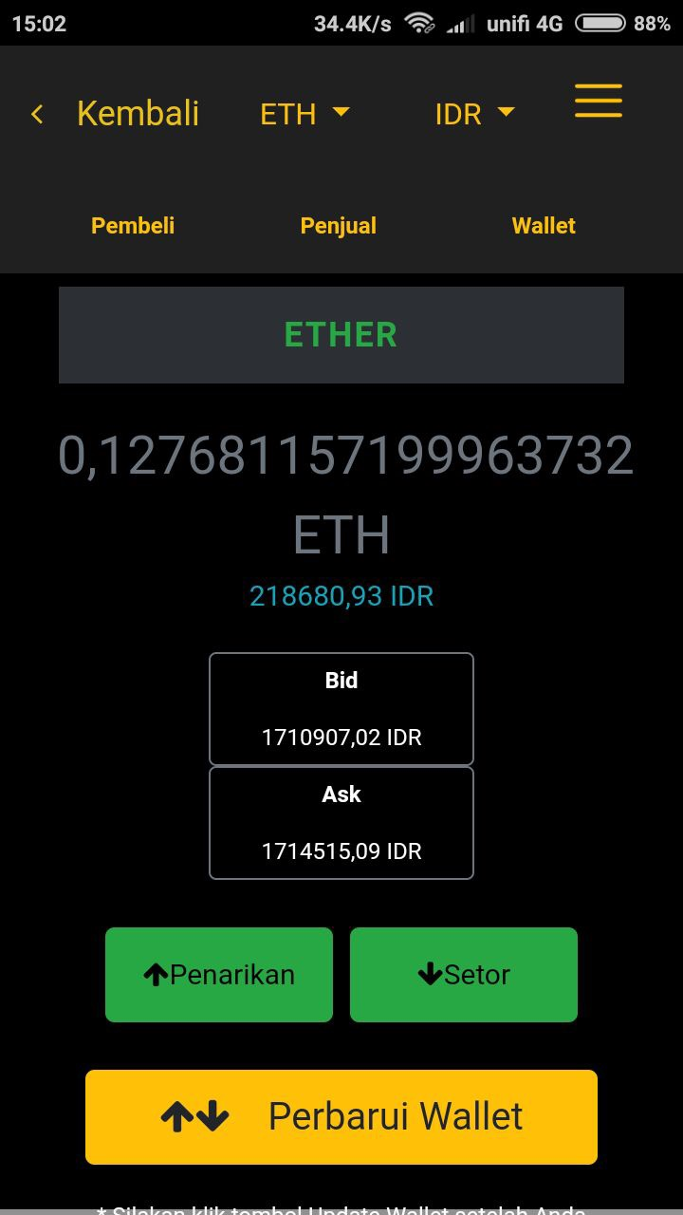
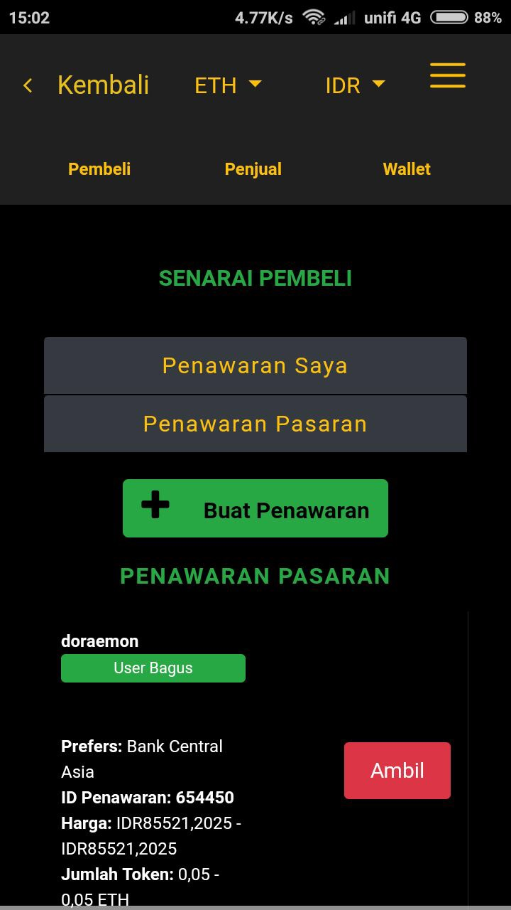
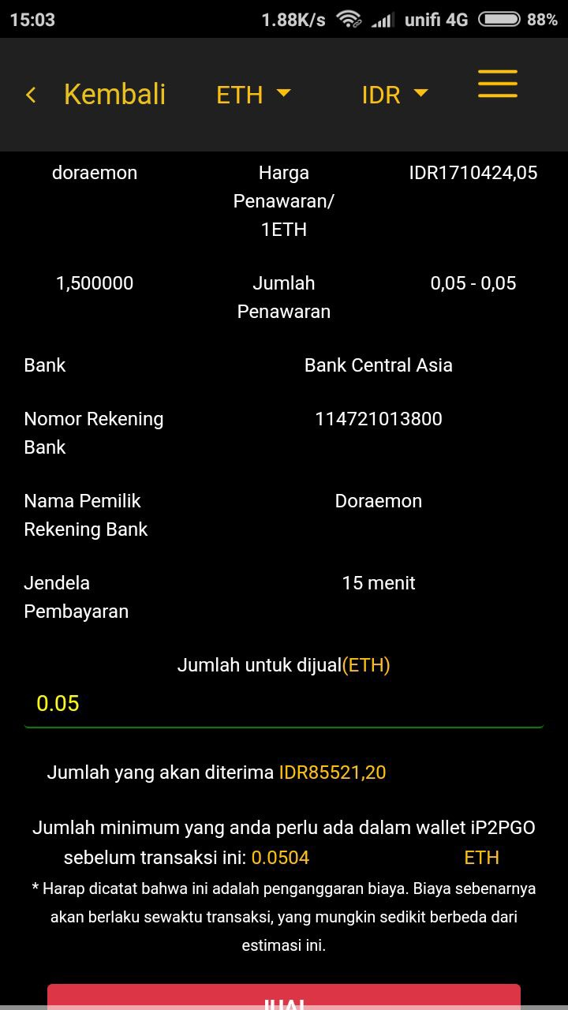
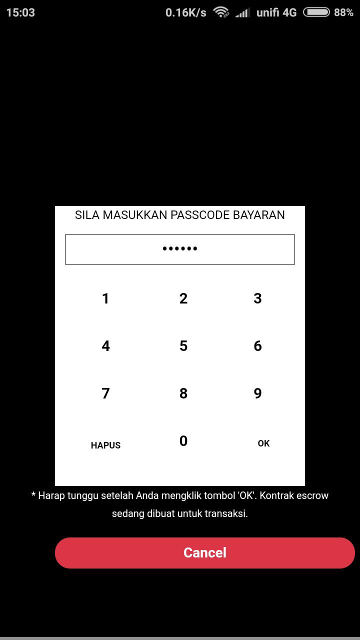
F. Taking another user’s Buy Offer
(1) (2) (3) (4)
1. Click on the token that you want to sell. In this example, we want to buy sell for IDR. Click on the Buyers tab in the ETH/IDR pairing selection to view the buyers listings.
2. Select the buyers offer that you want to take. In this example, we will take Offer ID 654450. Press on the Take button for Offer ID 654450.
3. You will see counterparty’s offer price and offer amount (in ETH), bank details and the time required to conclude the trade. Key the amount of ETH that you want to sell and the amount receivable as well as net ETH payable after fees will be shown. Press the Sell button.
4. You will need to key in your 6 digits passcode to proceed.

Slide 15
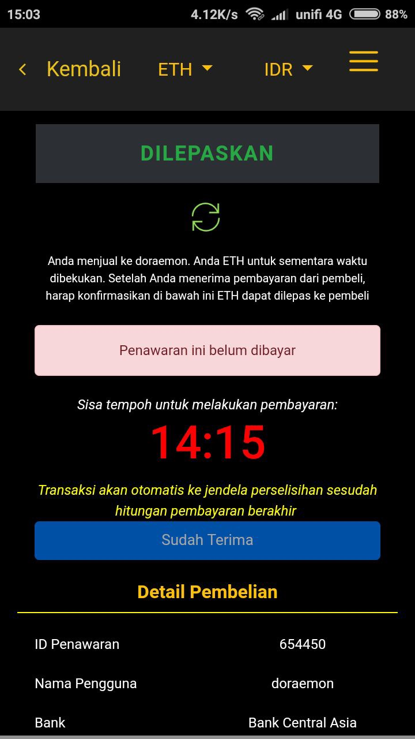
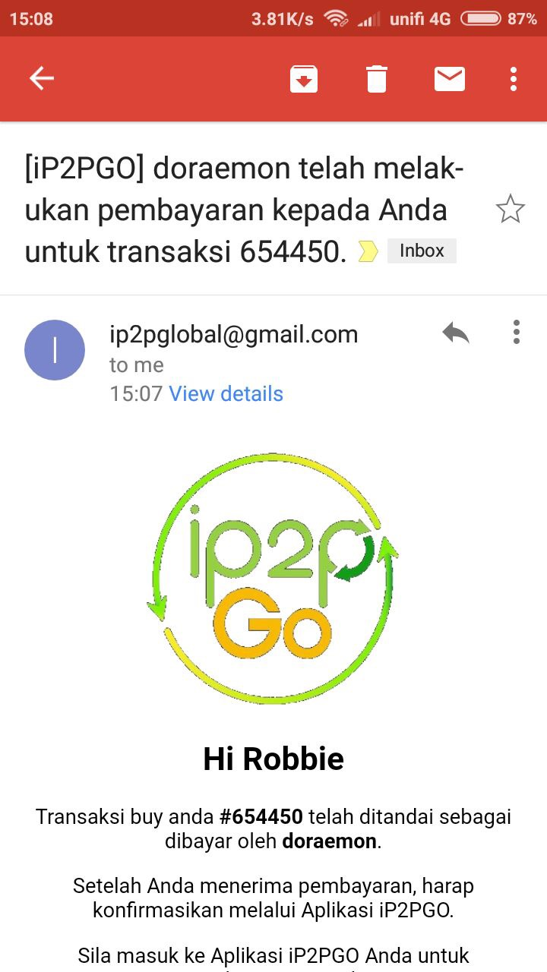
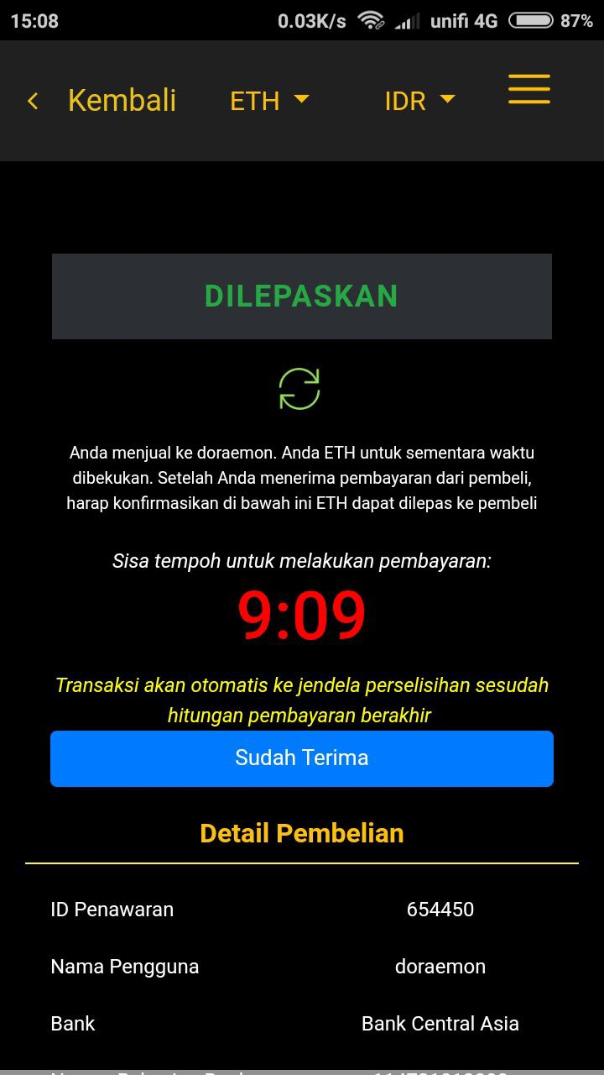
F. Taking another user’s Buy Offer (con’t)
(5) (6) (7)
5. You will see the timer left to receive money as well as the bank details of the counterparty. The trade is now pending confirmation from the counterparty that he has made the bank transfer to your bank account.
6. When the counterparty confirms he has made the bank transfer, you will receive an email notifying you that the counterparty has made the bank transfer.
7. Check your bank account that you have received the money. Once you have confirmed that you have received the money, you can press the I Have Received button for your trade in the app to conclude the trade.

Slide 16
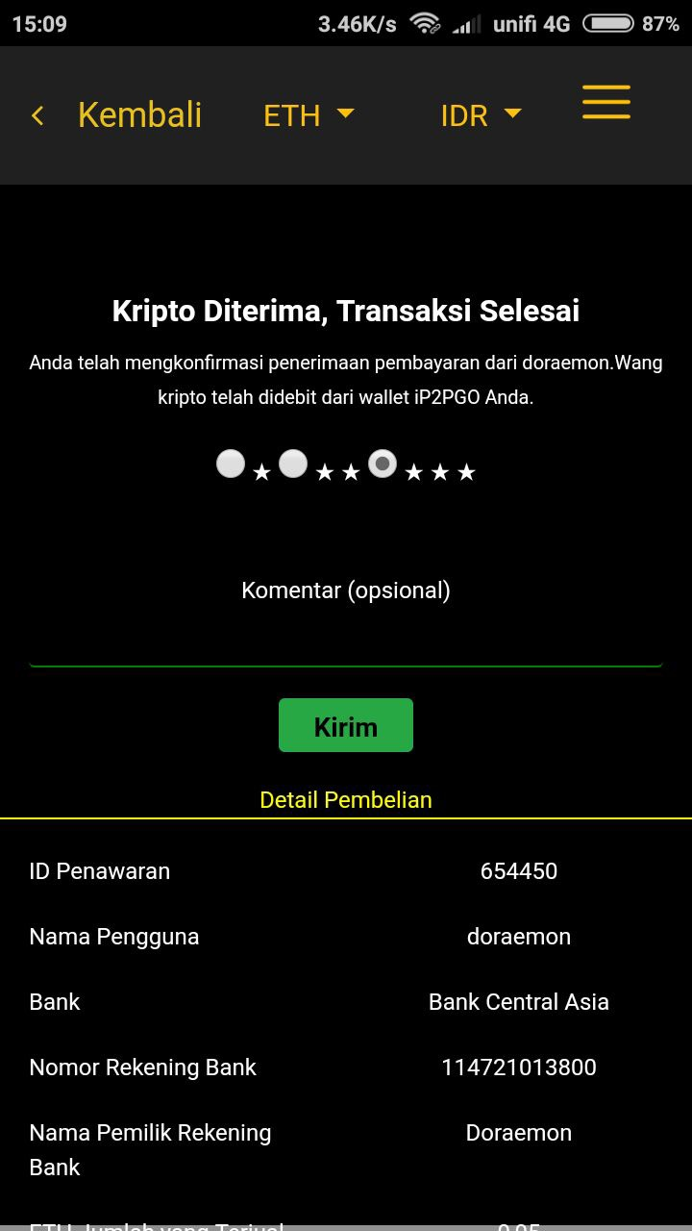
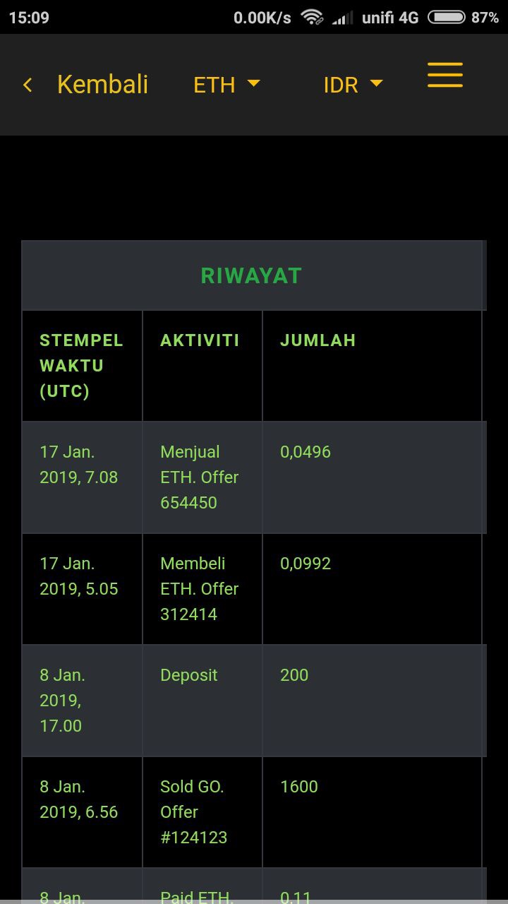
F. Taking another user’s Buy Offer (con’t)
(8) (9)
8. You can provide rating and feedback on your counterparty that had transacted with you.
9. You trade will be recorded in your history page under main menu located on the top right of your screen.

