Slide 1
IP2PGO APP
USER GUIDE FOR OTC TRADES
18 JANUARY 2019

Slide 2
Sections
Creating a Sell Offer
When your Sell Offer is taken
Creating a Buy Offer
When your Buy Offer is taken
Taking another user’s Sell Offer
Taking another user’s Buy Offer

Slide 3
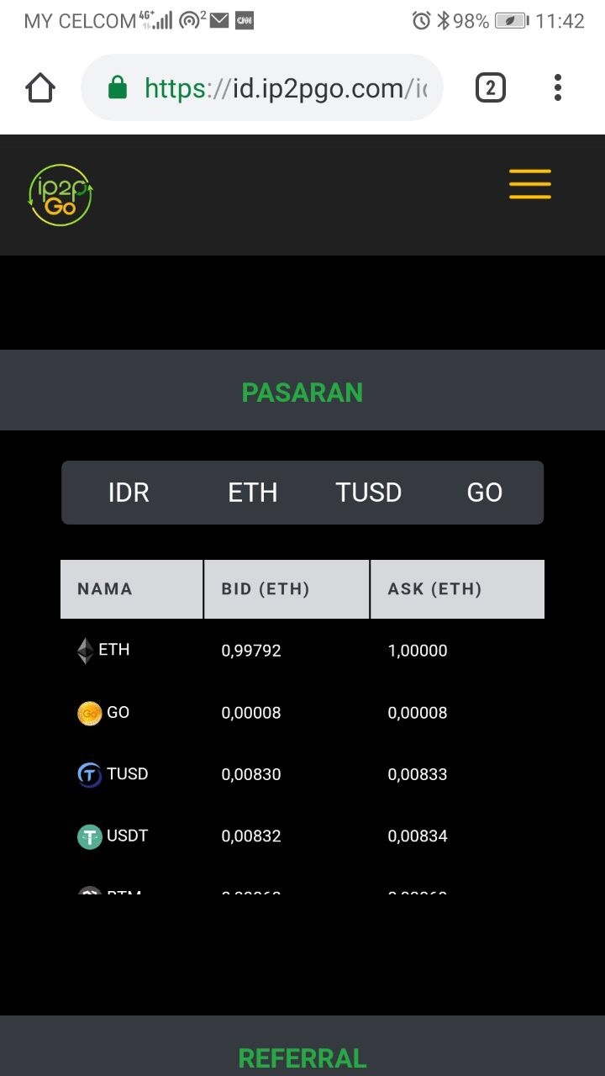
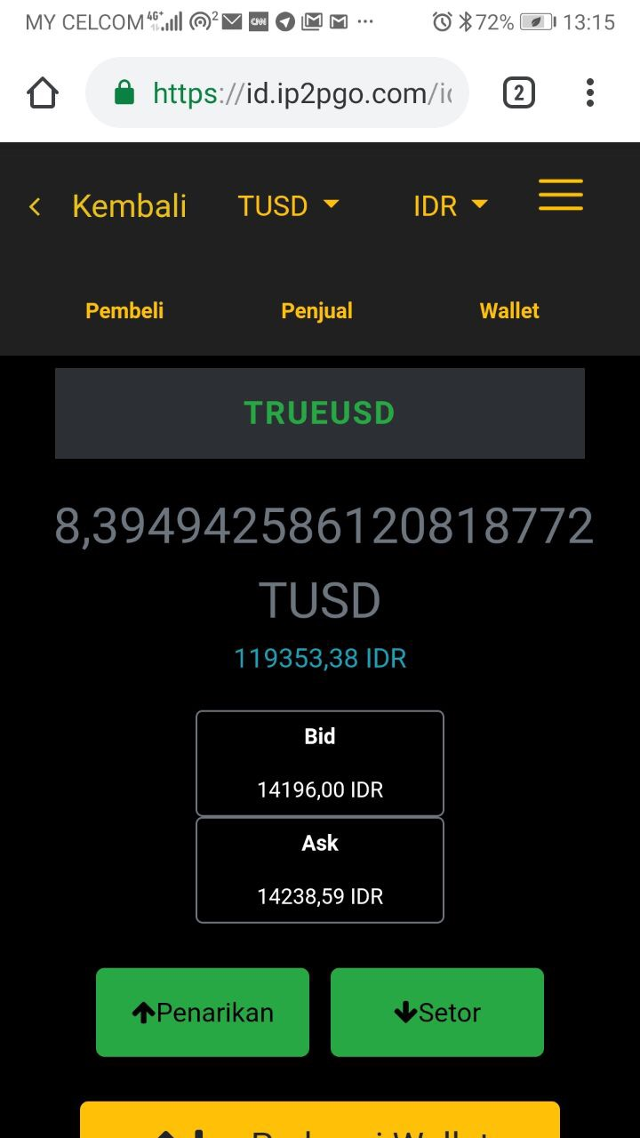
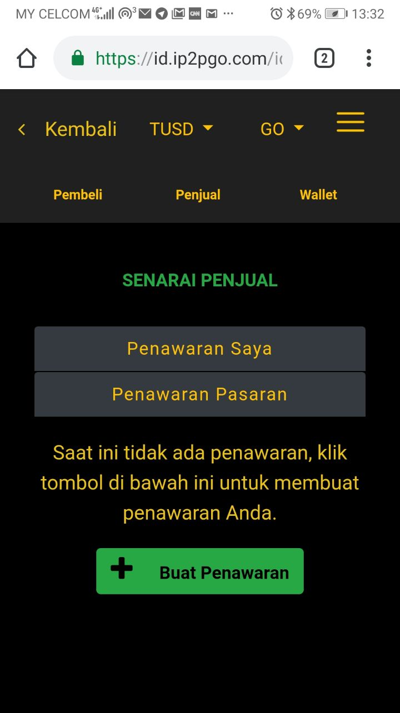
A. Creating a Sell Offer
(1) (2) (3)
1. Select the token that you want to sell from the main page. In this example, we want to sell TUSD, so click on TUSD under the Name column.
2. You will be able to see the pairing on top of the page is TUSD and IDR. This can be changed according to your pairing that you want. In this example, we want to sell TUSD for GO tokens. Click on the Sellers button.
3. You will be able to see the list of sellers of TUSD for GO tokens. Click on the Create Offer button.

Slide 4
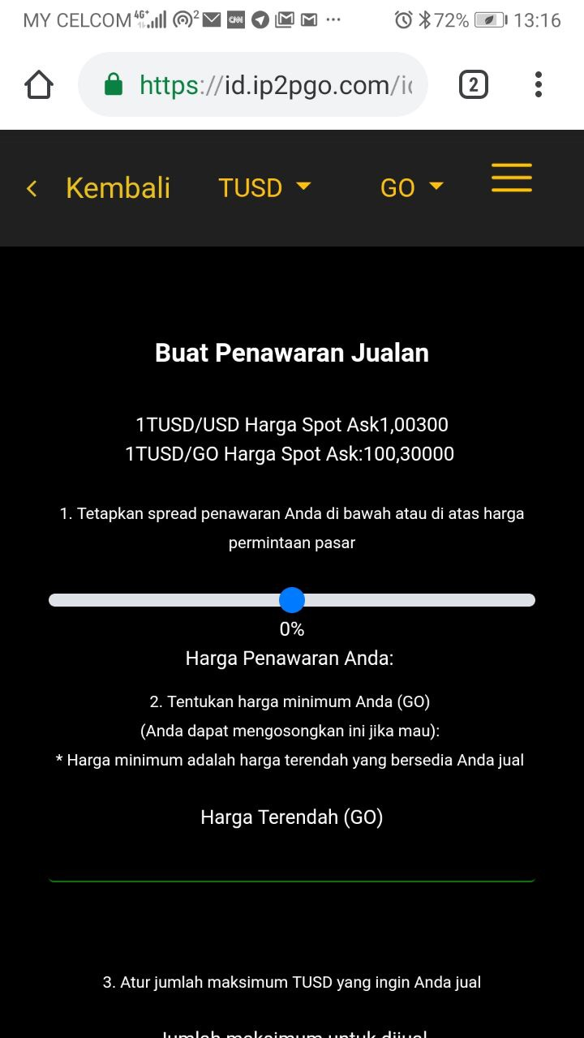
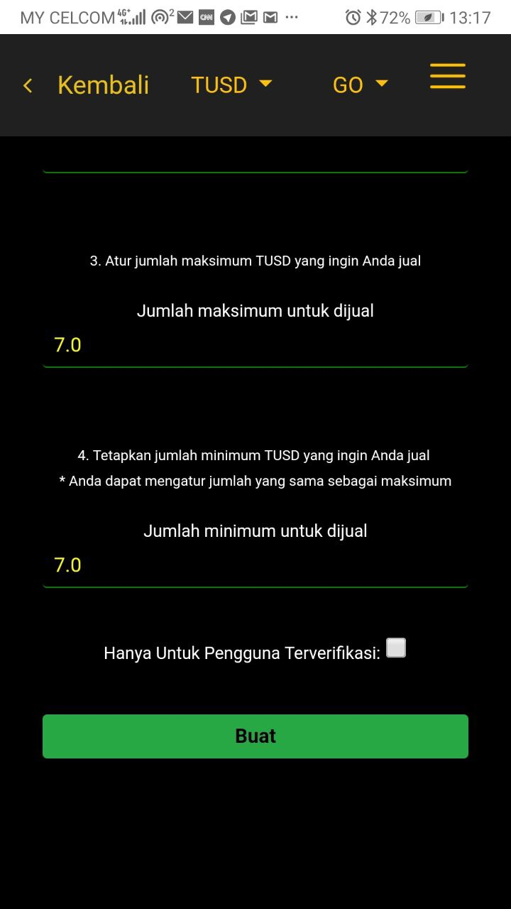
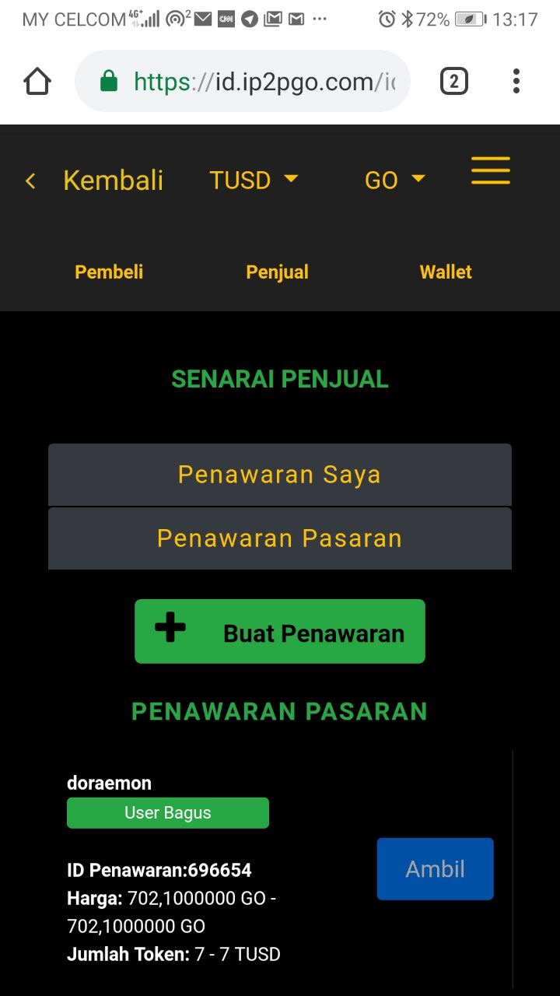
A. Creating a Sell Offer (con’t)
(4) (5) (6)
4. Use the slider to select between -5% to 5% against the spot sale price that you want to sell. After you have selected the %, your offer price in absolute terms for 1 TUSD will be shown. You also have the option to set the minimum price that you wish to sell in the Floor Price field.
5. Key in the maximum and minimum amount of TUSD that you wish to sell in this one offer. before clicking on the Create button.
6. Your Sell Offer has been created and you can see it displayed under the Sellers tab of the TUSD/GO pairing. Each offer will have and ID, which in this case your Sell Offer ID is 696654.

Slide 5
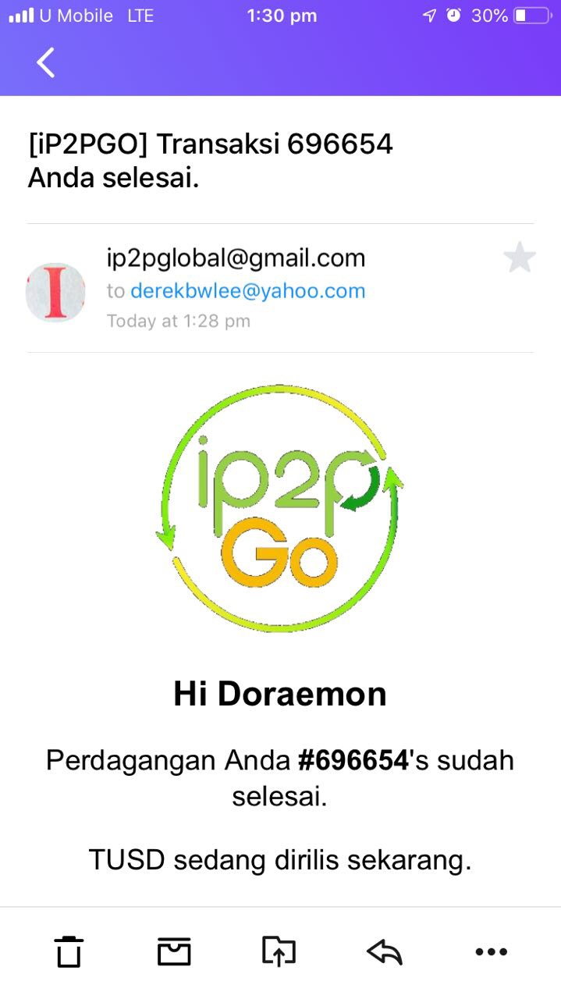
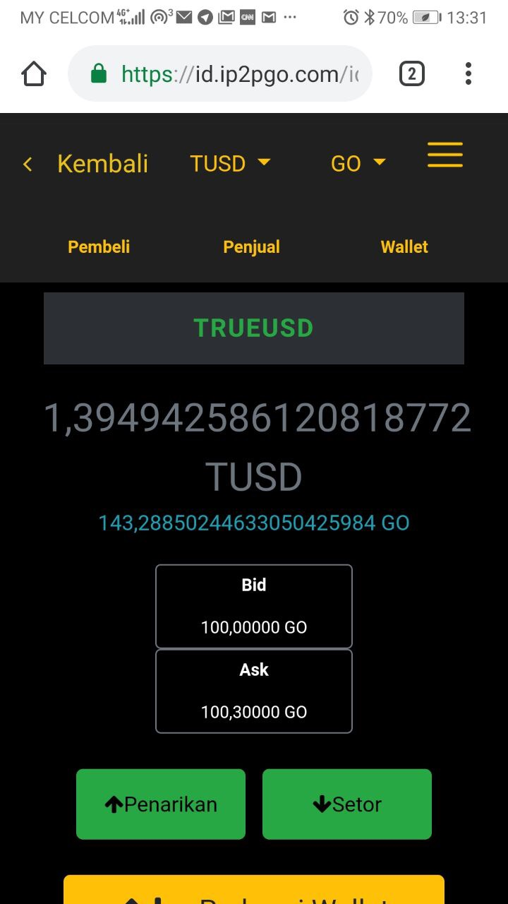
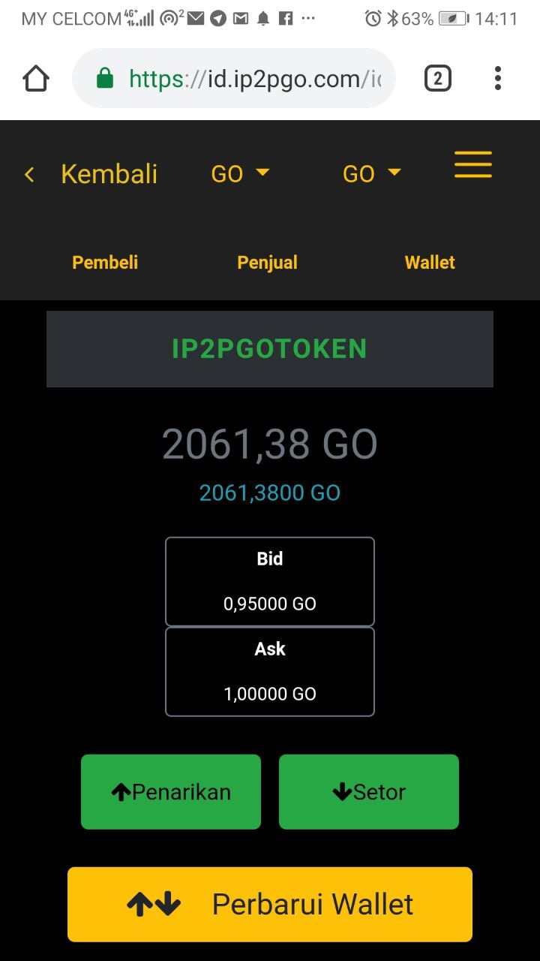
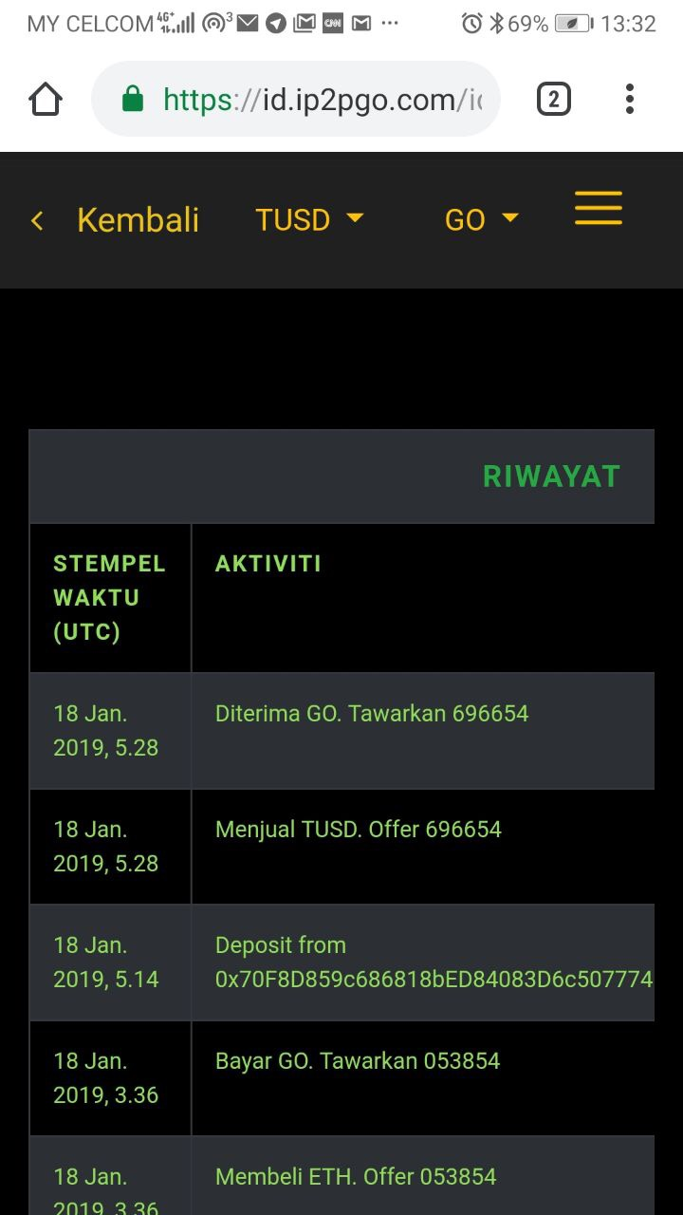
B. When your a Sell Offer is taken
(1) (2) (3) (4)
1. You will receive an email notifying you that your Sell Offer has been taken by a counterparty and is completed.
2. If you are in the App, you will also a message notifying that your Sell Offer has been taken and completed. You will see your TUSD wallet balance has reduced by the amount of TUSD sold from your Sell Offer.
3. You can select GO tokens in the 1st option at the top to check that the GO tokens that you bought has been reflected in your GO wallet balance.
4. Your trade will also show in your history page under the main menu.

Slide 6
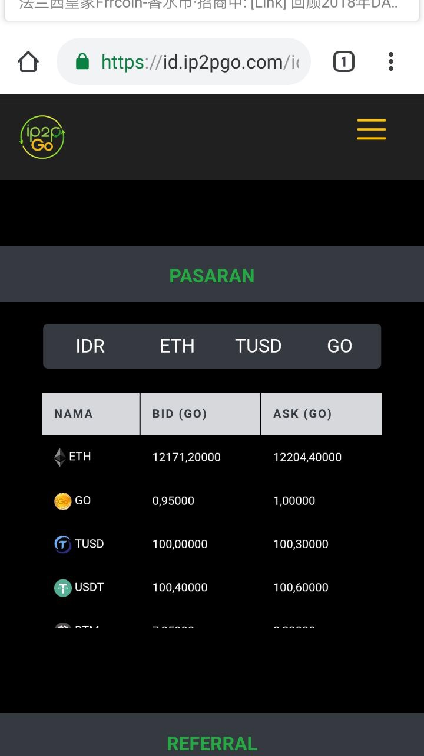
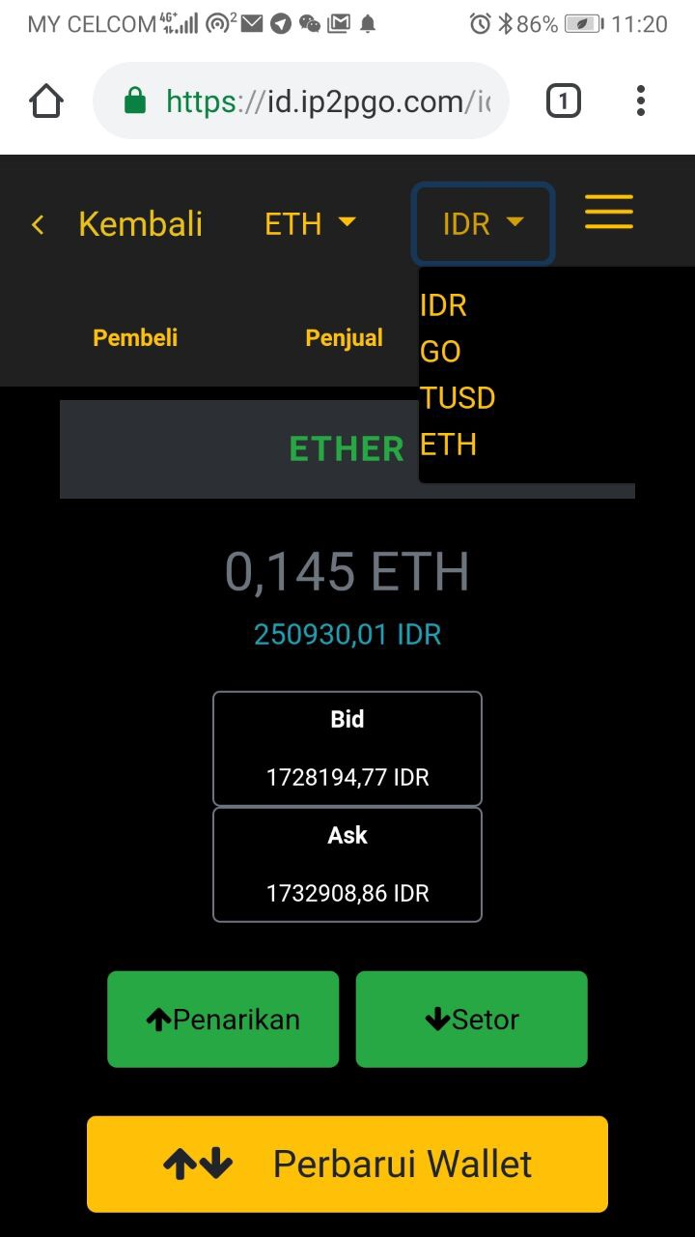
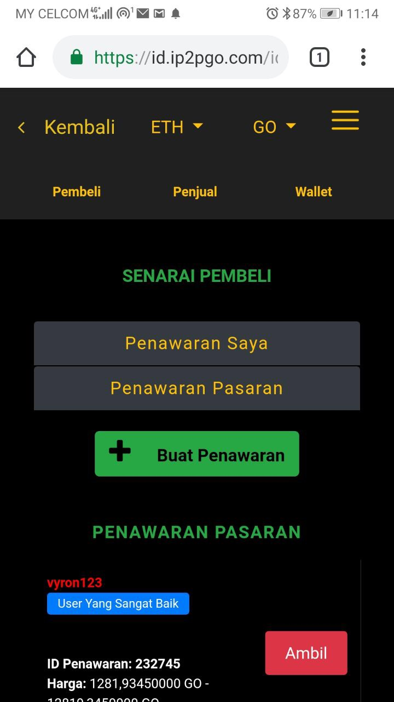
C. Creating a Buy Offer
(1) (2) (3)
1. Select the token that you want to buy from the main page. In this example, we want to buy ETH, so click on ETH under Name column.
2. You will be able to see the pairing on top of the page is ETH and IDR. This can be changed according to your pairing that you want. In this example, we want to buy ETH with GO tokens. Select GO tokens in the 2nd dropdown option.
3. Click on the Buyers button. You will be able to see the list of buyers of ETH for GO tokens. Click on the Create Offer button.

Slide 7
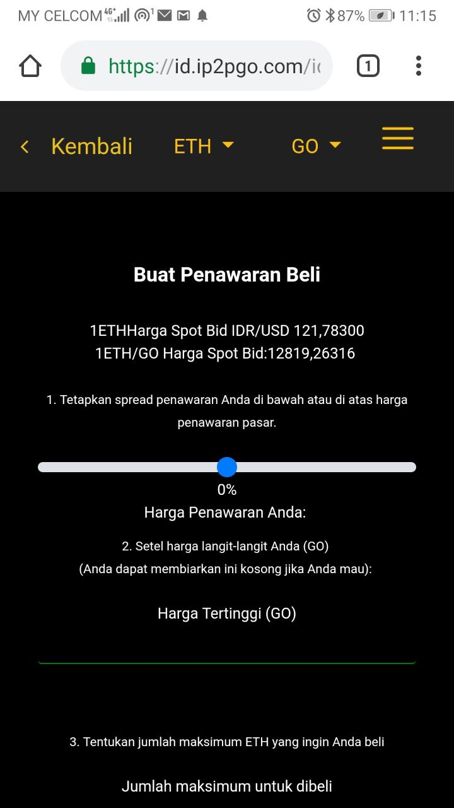
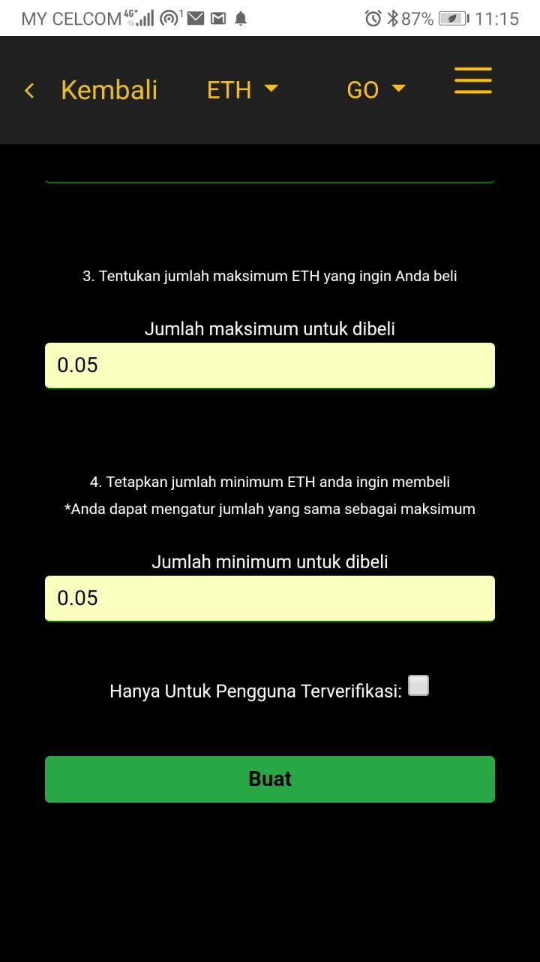
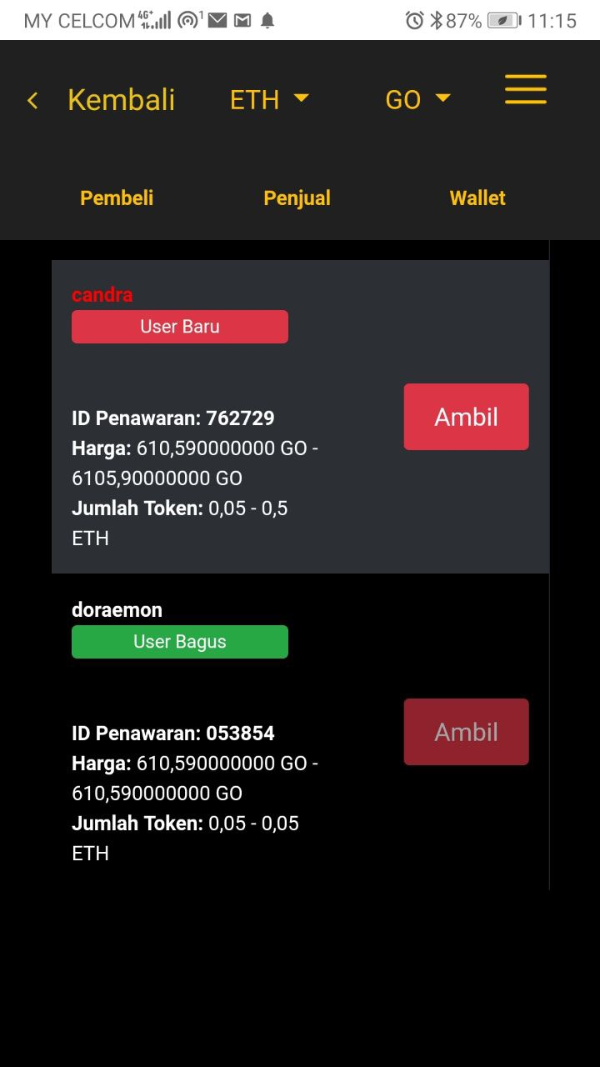
C. Creating a Buy Offer (con’t)
(4) (5) (6)
4. Use the slider to select between -5% to 5% against the spot sale price that you want to buy. After you have selected the %, your offer price in absolute terms for 1 ETH will be shown. You also have the option to set the maximum price that you wish to buy in the Ceiling Price field.
5. Key in the maximum and minimum amount of ETH that you wish to buy in this one offer before clicking on the Create button.
6. Your Buy Offer has been created and you can see it displayed under the Buyers tab under the ETH/GO pairing. Each offer will have and ID, which in this case your Buy Offer ID is 053854.

Slide 8
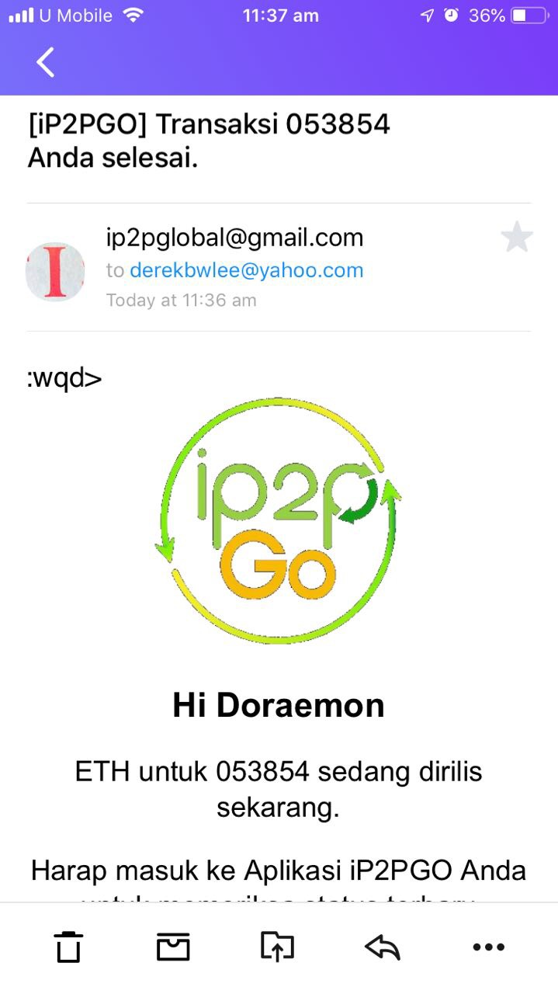
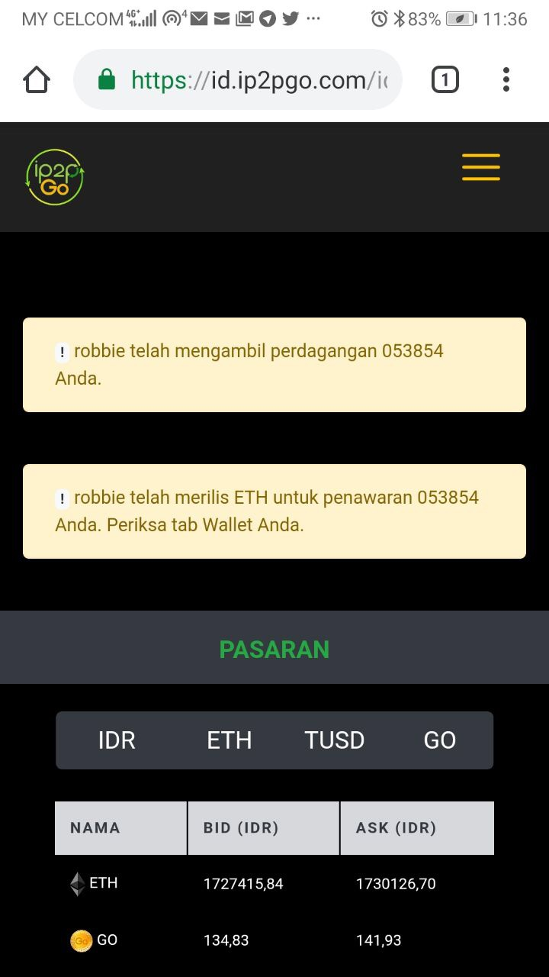
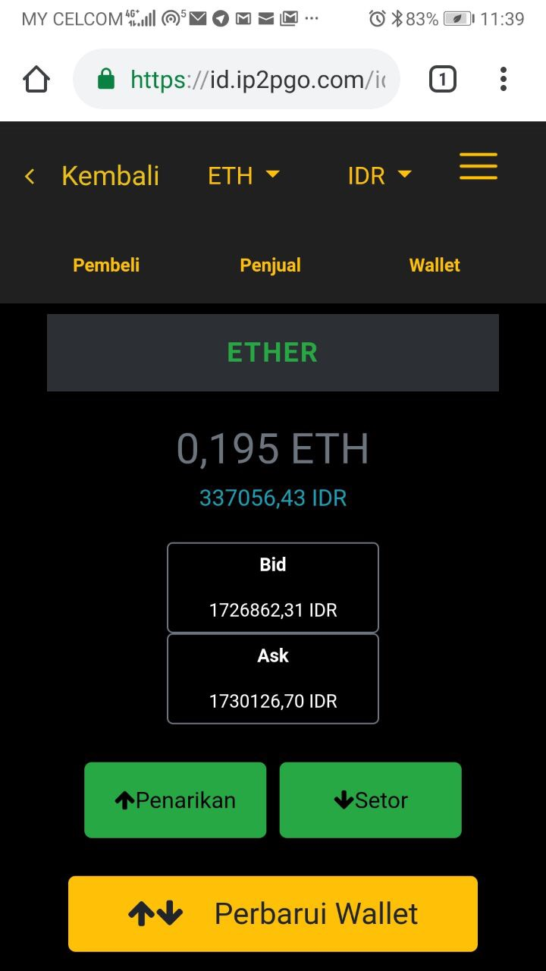
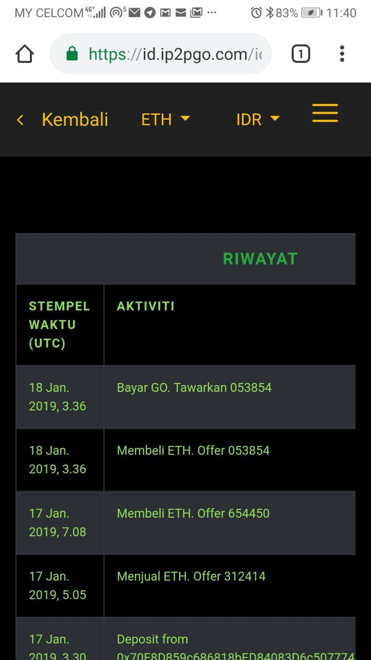
D. When your a Buy Offer is taken
(1) (2) (3) (4)
1. You will receive an email notifying you that your Buy Offer has been taken by a counterparty and is completed.
2. If you are in the App, you will also a message notifying that your Buy Offer has been taken and completed. Click on the ETH tab.
3. You will see your ETH wallet balance has increased by the amount of ETH bought from your Buy Offer.
4. Your trade will also show in your history page under the main menu.

Slide 9
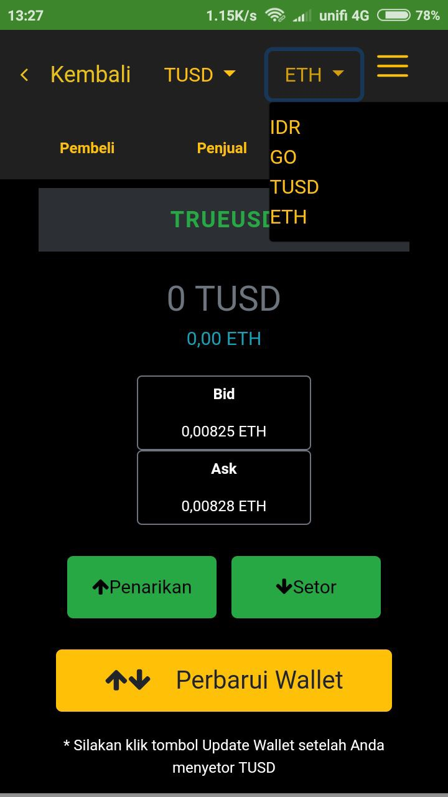
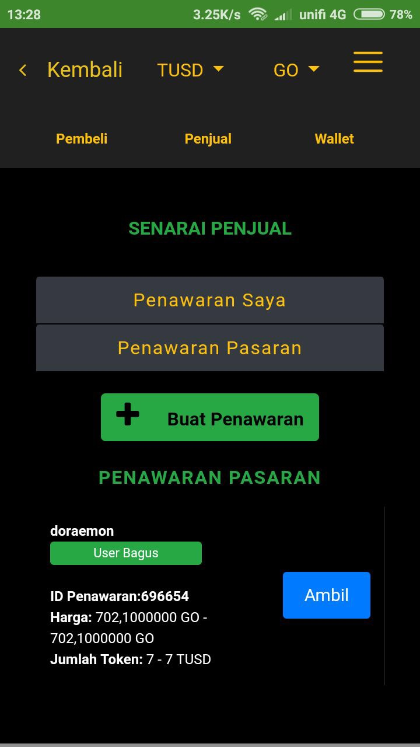
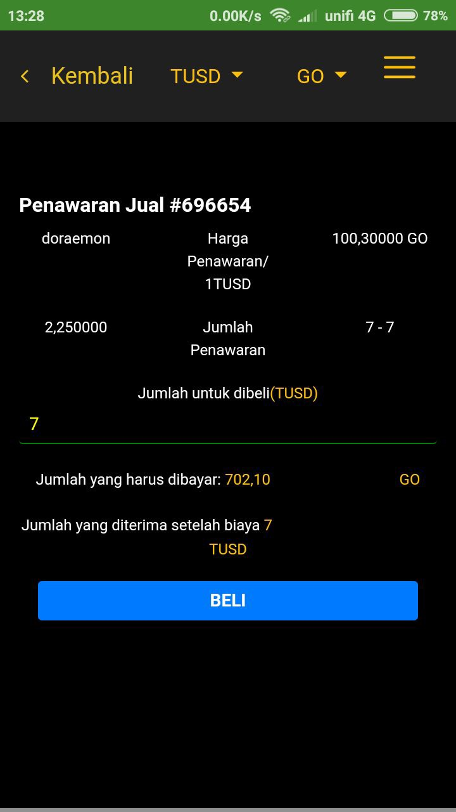
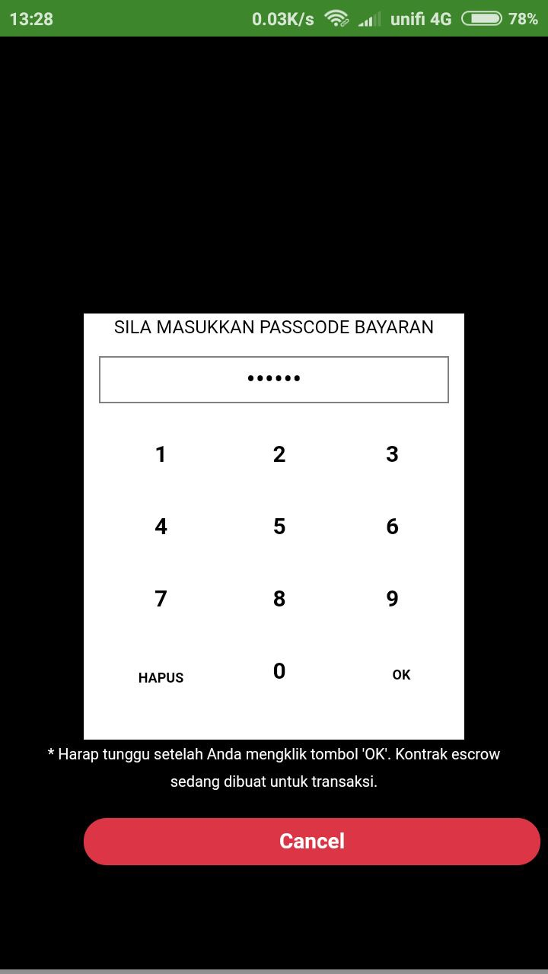
E. Taking another user’s Sell Offer
(1) (2) (3) (4)
1. Click on the token that you want to buy. In this example, we want to buy TUSD for GO tokens. Select GO tokens from the 2nd option. Click on the Sellers tab in the TUSD/GO pairing selection to view the sellers listings.
2. Select the sellers offer that you want to take. In this example, we will take Offer ID 696654. Press on the Take button for Offer ID 696654.
3. Key the amount of TUSD that you want to buy. The total token receivable as well as GO tokens required to be paid will be shown. Press the Buy button.
4. You will need to key in your 6 digits passcode to proceed.

Slide 10
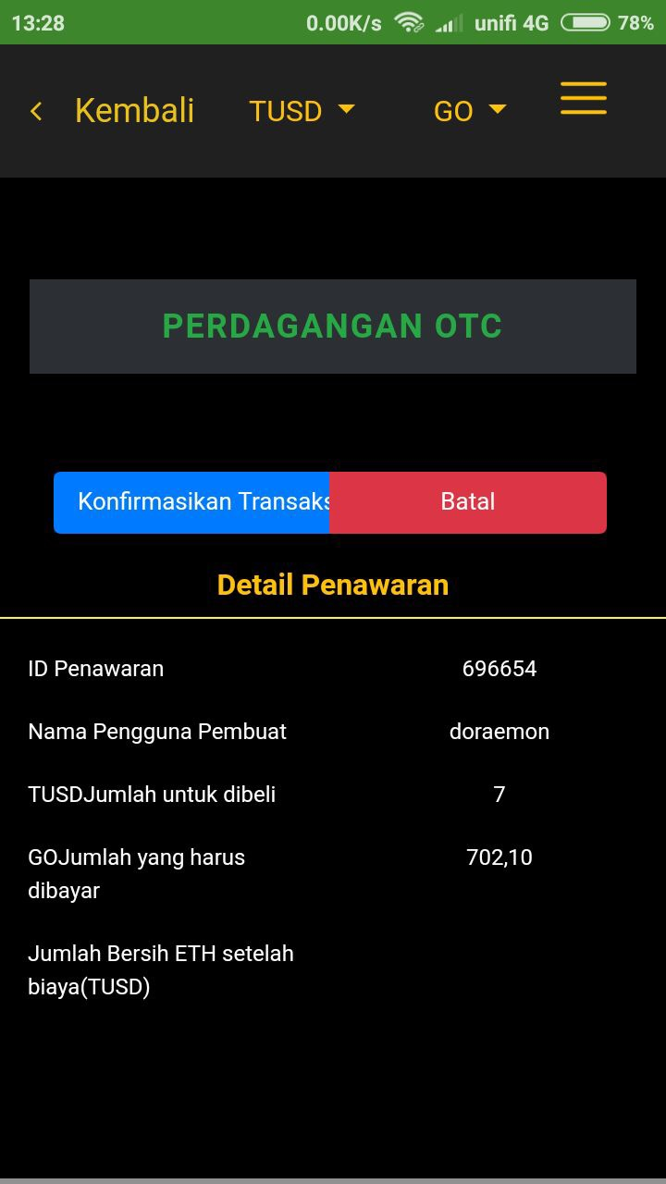
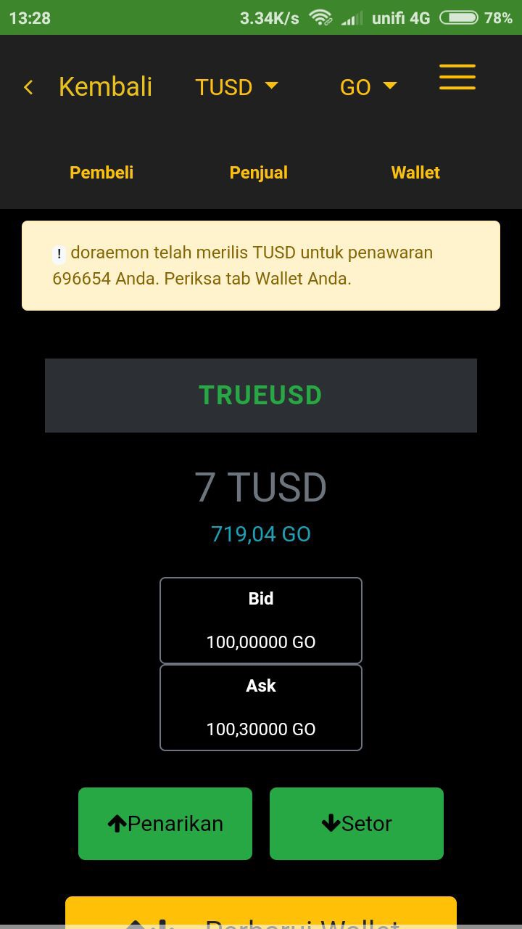
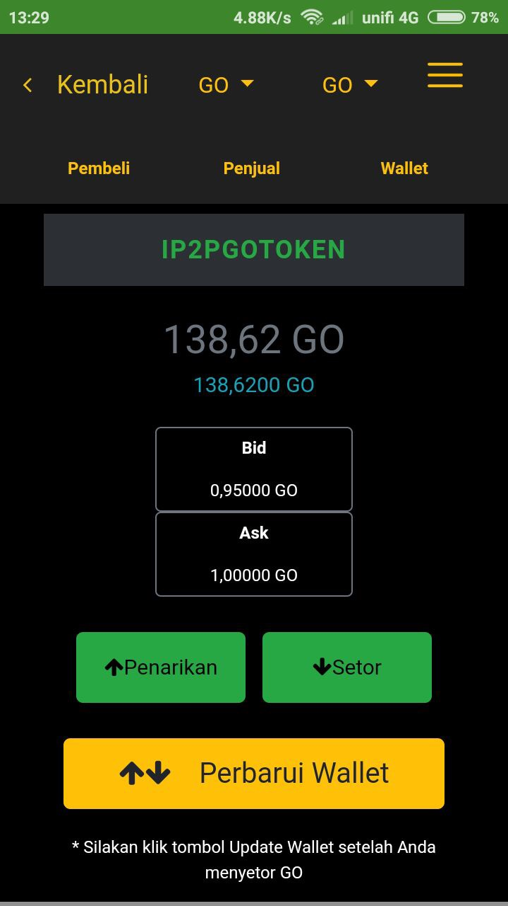
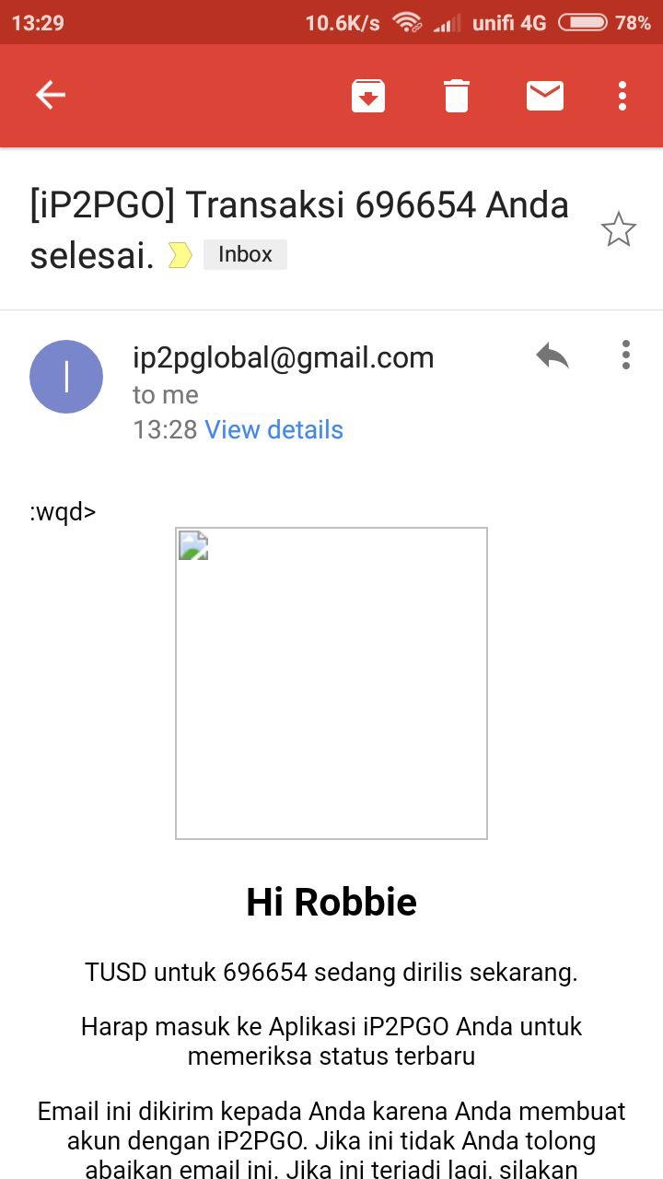
E. Taking another user’s Sell Offer (con’t)
(5) (6) (7) (8)
5. Click the Confirm Transaction button.
6. You will receive a notification in the app that the transaction is completed and your TUSD wallet balance will be shown.
7. You can select GO tokens in the 1st option at the top to check that the GO tokens that you sold has been reflected in your GO wallet balance.
8. You will also receive an email to inform you that the transaction has been completed.

Slide 11
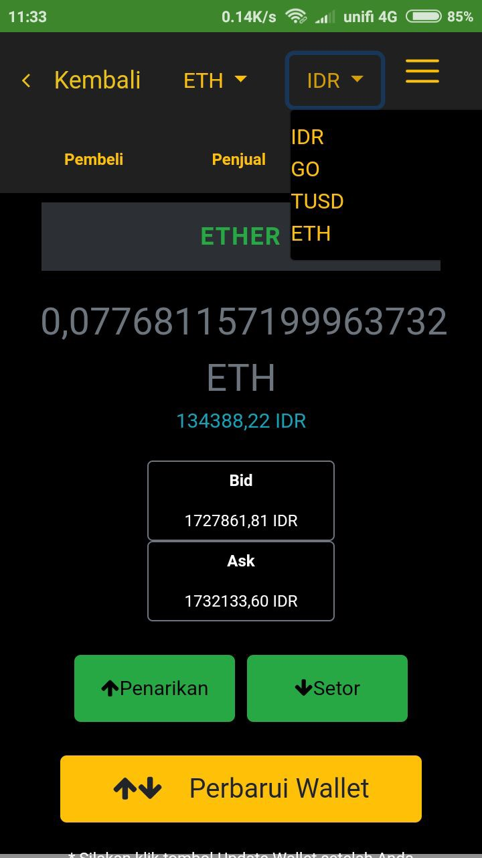
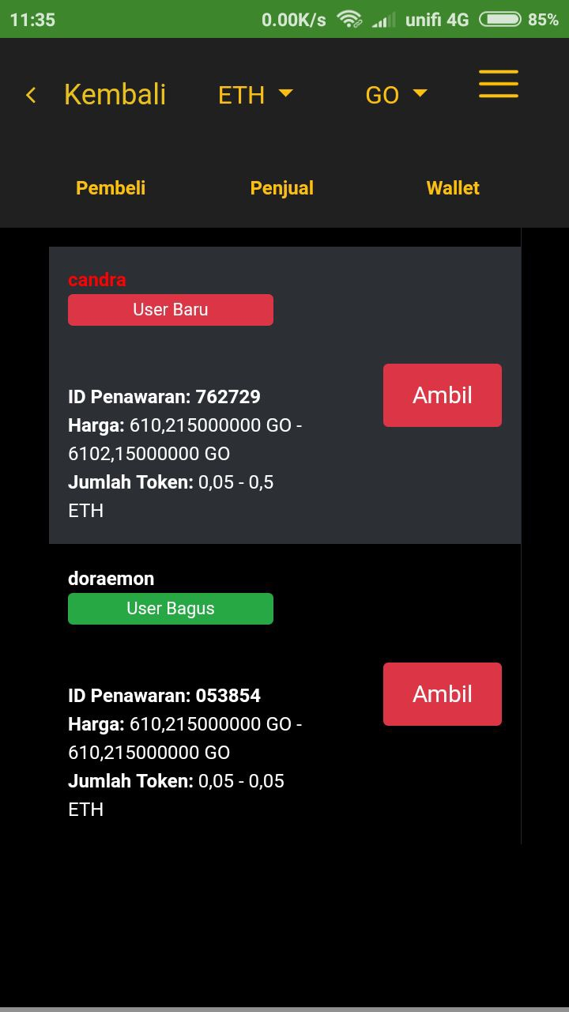
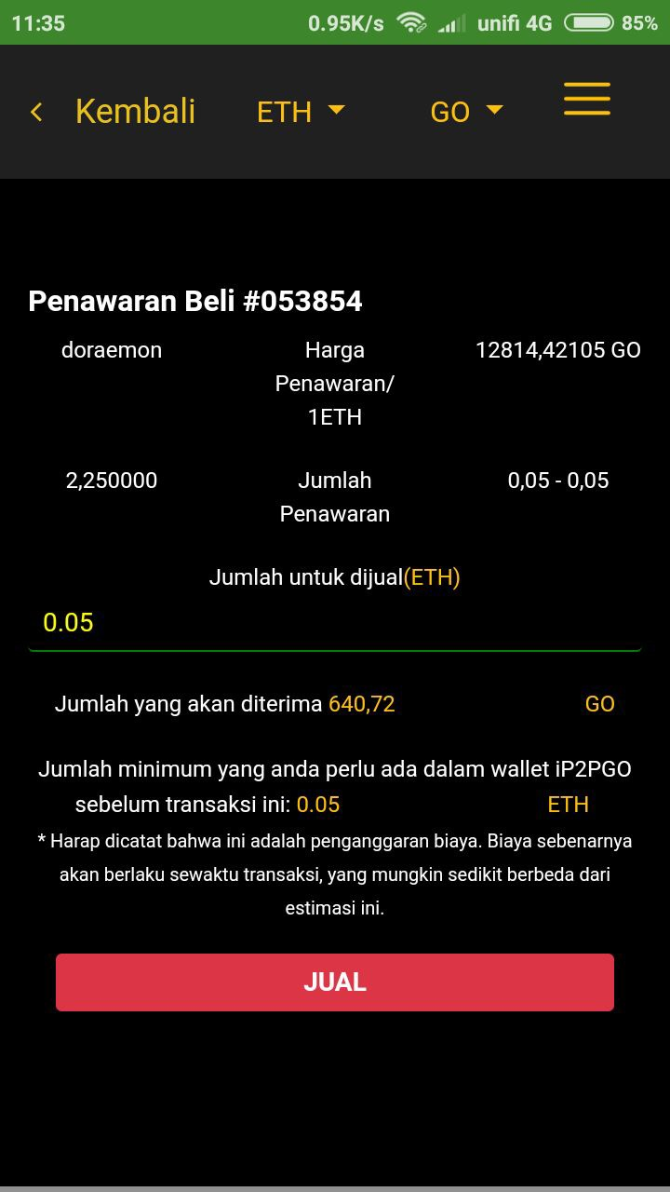
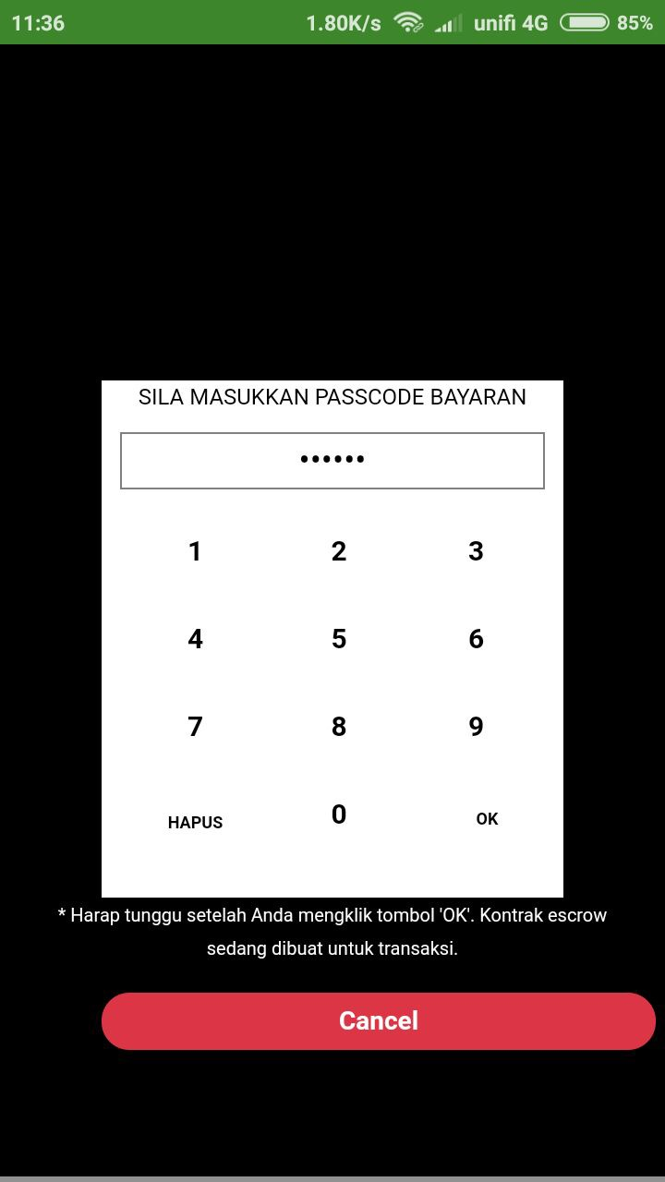
F. Taking another user’s Buy Offer
(1) (2) (3) (4)
1. Click on the token that you want to sell. In this example, we want to sell ETH for GO tokens. Select GO tokens from the 2nd option. Click on the Buyers tab in the ETH/GO pairing selection to view the buyers listings.
2. Select the buyers offer that you want to take. In this example, we will take Offer ID 053854. Press on the Take button for Offer ID 053854.
3. Key the amount of ETH that you want to sell. The total token receivable as well as minimum ETH wallet balance required to transact will be shown. Press the Sell button.
4. You will need to key in your 6 digits passcode to proceed.

Slide 12
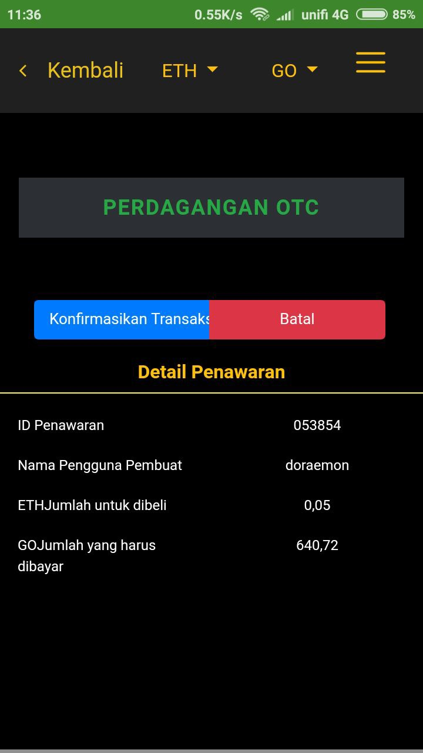
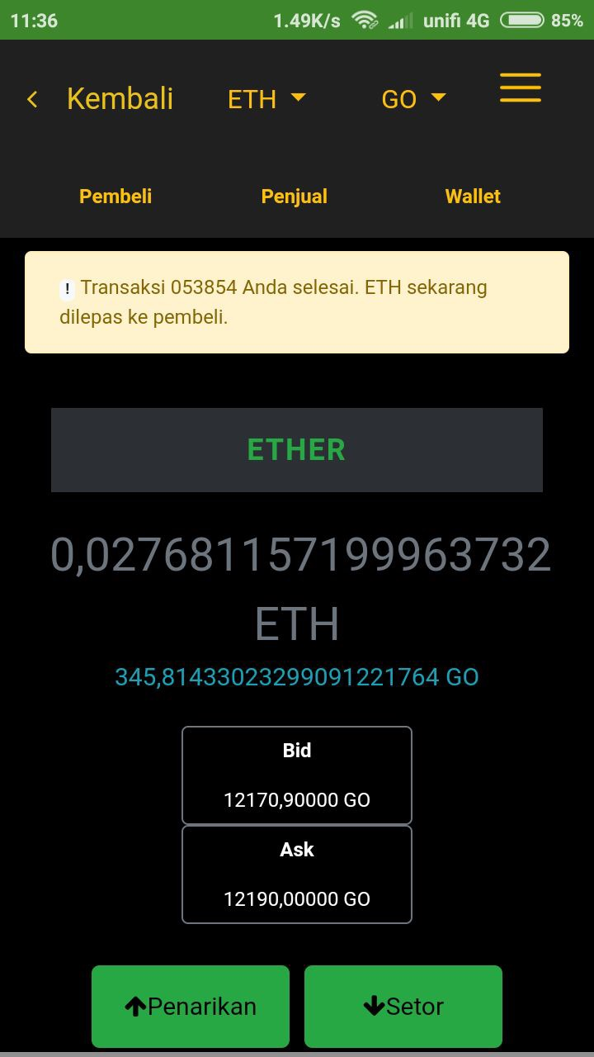
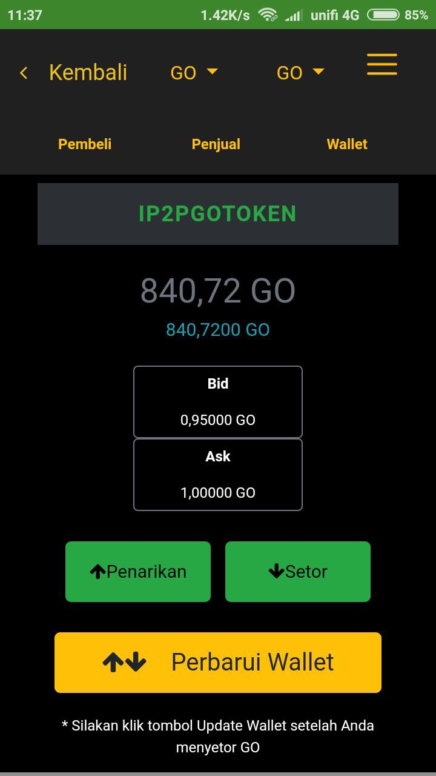
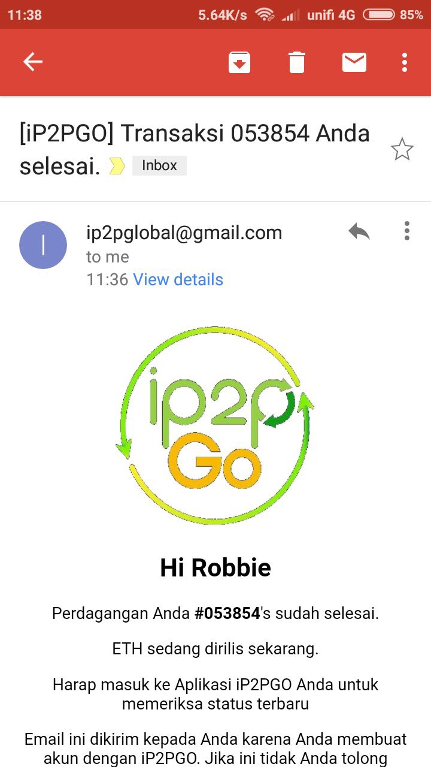
F. Taking another user’s Buy Offer (con’t)
(5) (6) (7) (8)
5. Click the Confirm Transaction button.
6. You will receive a notification in the app that the transaction is completed and your ETH wallet balance will be shown.
7. You can select GO tokens in the 1st option at the top to check that the GO tokens that you bought has been reflected in your GO wallet balance.
8. You will also receive an email to inform you that the transaction has been completed.

