Slide 1



CSCD-info@umich.edu
School of Nursing
Center for Complexity and
Self-management of
Chronic Disease (CSCD)
University of Michigan
School of Nursing
Center for Complexity and Self-management of Chronic Disease (CSCD)
University of Michigan
School of Nursing
Center for Complexity and Self-management of Chronic Disease (CSCD)
University of Michigan

Slide 2
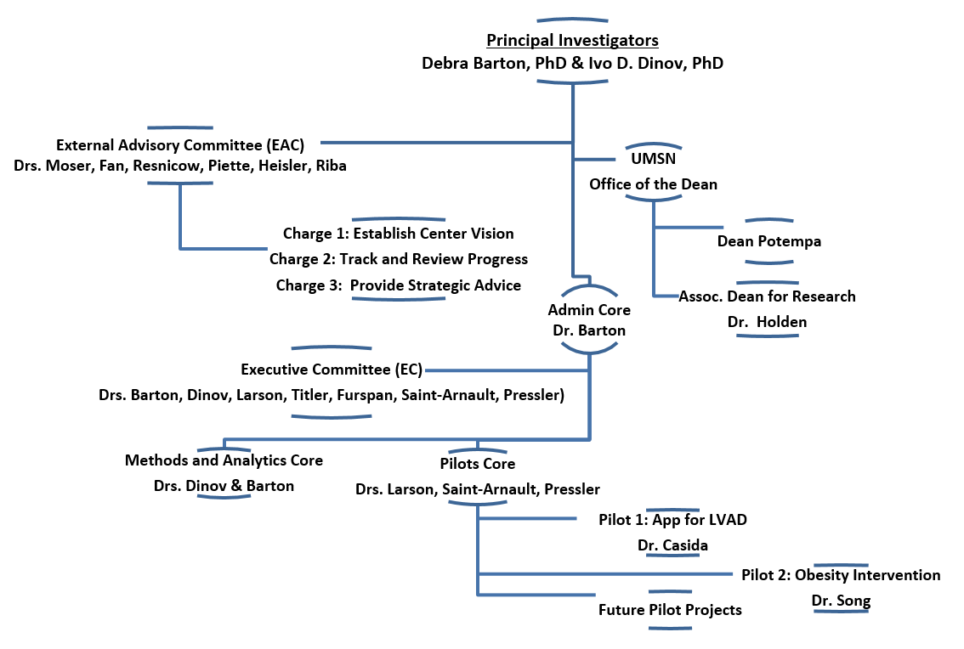

Slide 3
