Slide 1
SOCR Web Site
Learn
Webapps
Tools
About
EBook, Activities, Data,
News, Courses, Docs,
Projects, GuideMe
Translate, Navigators, History,
About, References, Docs, Team,
Acknowledgments, Funding
Data Oriented
Tool Type
GuideMe
User-Provided
SOCR-Simulated
Derived
Online
DBs/JSON
Analyses
Distributions
Experiments
Games
Modeler
EDA/Charts
Applications
Navigators
What are you Looking for?
Prob & Stats Learning
Available Data
Data Simulation
Data Analysis
Data Modeling
Virtual Experiments
Simulations
About SOCR
What Stats test to use?
Data Preprocessing
Modeling
Analyses
EDA/Charts
Others
Export/Save
Results
Save Webapp States
as unique URLs
Social Nets
Discussion
Activities
EBook

Slide 2
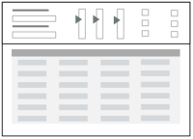
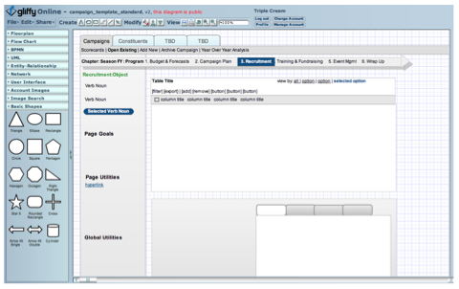
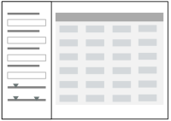
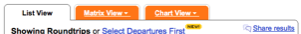
SOCR Webapp GUI
(Data Centric!)
Data Formatting,
Selection, Preprocessing
Data Oriented Webapp UI
Data
PreProc
Apps
Results
EDA
PostProc
List View
Matrix View
Chart View
Notes:
See UI Design Patterns: http://designingwebinterfaces.com/designing-web-interfaces-12-screen-patterns

Slide 3

SOCR.Info@umich.edu

