Slide 1
REGISTER
ADMIN MENU
LOGIN
TEACHER MENU
MANAGE TEACHER
SCHOOL RFID ATTENDANCE SYSTEM INTERFACE
MANAGE STUDENT
REGISTER STUDENT
DELETE STUDENT
UPDATE STUDENT

Slide 2
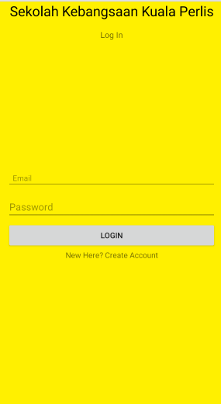
LOGIN INTERFACE

Slide 3
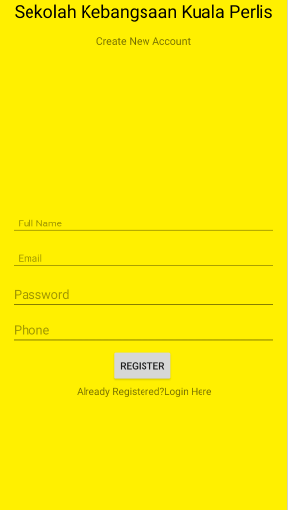
REGISTER INTERFACE

Slide 4
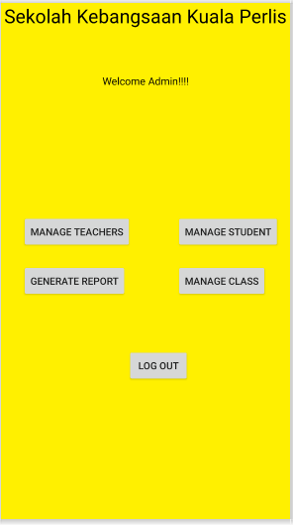
ADMIN MENU INTERFACE

Slide 5
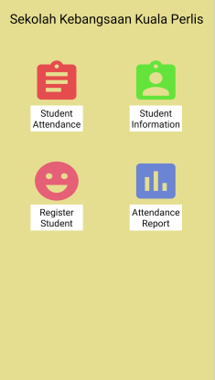
TEACHER MENU INTERFACE

Slide 6
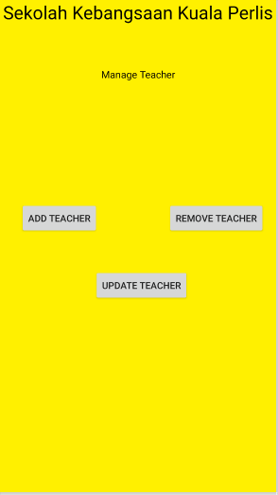
MANAGE TEACHER INTERFACE

Slide 7
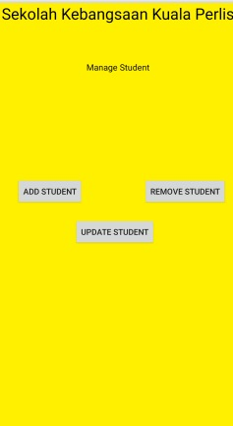
MANAGE STUDENT INTERFACE

Slide 8
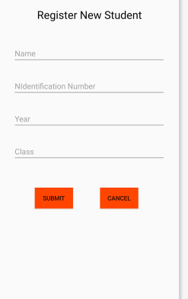
REGISTER STUDENT INTERFACE

Slide 9
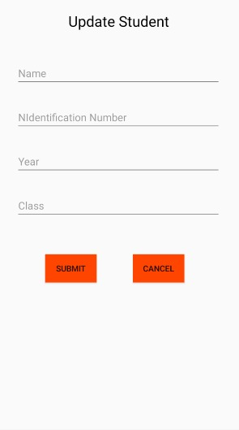
UPDATE STUDENT INTERFACE

Slide 10
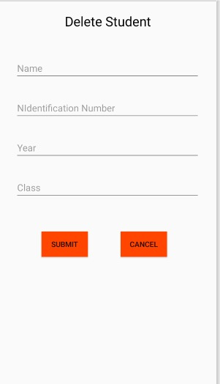
DELETE STUDENT INTERFACE

