Slide 1

DFT6014
INTEGRATED PROJECT
PROPOSAL PRESENTATION
GROUP NUMBER: 2
SUPERVISOR : ENCIK SABRI BIN SAEP
NAME OF GROUP MEMBER:
ZIHNY FARHAN HAQEEM BIN ZAINI (18DDT18F1040)
MUHAMMAD FARIS BIN ADNAN (18DDT18F1109)
AHMAD ANNOOR BIN ABDUL NASIR (18DDT18F1165)

Slide 2

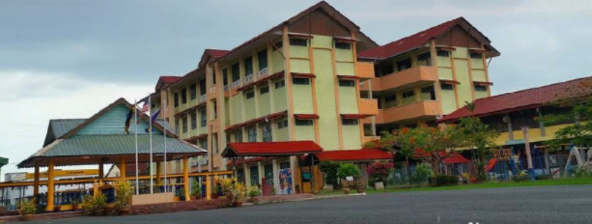
PROJECT TITLE:
SCHOOL ATTENDANCE SYSTEM USING RFID
COMPANY / CLIENT:
SEKOLAH KEBANGSAAN KUALA PERLIS

Slide 3
1. INTRODUCTION
School Attendance System Using RFID is a digital attendance system which uses Radio Frequency Identification (RFID) in order to record the presence of students in class. RFID is chosen because this application is widely used in all over the world and by applying this system, it may shorten the time compared to the current method which records the student attendance manually. Instead of using the manual method where students need to write their name manually, they can just touch their RFID Cards on card reader in order to record their attendance in class.
Hence a system is needed which will solve the issue of manual attendance.So, we as a group came up with a idea to created and conduct a system called “School Attendance System Using RFID”.This project attempts to record student’s attendance through RFID. School Attendance System Using RFID is an application developed to record daily student’s attendance in the targeted school that is Sekolah Kebangsaan Kuala Perlis.
Sekolah Kebangsaan Kuala Perlis or its short name SK Kuala Perlis, is a primary school located at Jalan Kuala Perlis.

Slide 4
2.PROBLEM STATEMENT:
The major problem that faced by this School is they are still record student’s attendance by manually system.The existing system largely consists of physical register where the teacher have to manually inputs the attendance record of all students one by one.Teacher always have to call the name of every students one by one to verify their attendance to be tick it right on the attendance book record.This will take some time for the teacher to start teaching
The traditional way for taking attendance has drawback, which is the data of the attendance list cannot be reuse and tracking and tracing student's attendance is harder.Besides, the paper may be torn, misplaced or lost for recording in database system manually.With the RFID-based system, all data will be secured and stored in database safely.
The teachers of Sekolah Kebangsaan Kuala Perlis have to come to class every morning to get the total attendance of their class everyday.The class teachers also need to call the teacher that incharge for the first subject to get attendance if they do not want to come to class in the morning. It make the teacher to waste their time to come to class or call first time subject teachers.

Slide 5
3.OBJECTIVE OF THE PROJECT:
To record Student attendance
To view and generate student attendance report
Manage or assign teachers and students information

Slide 6
4.SCOPE PRJECT:
USER SCOPE
Admin
The managing director of the company is the admin of the system. In this system, the admin of the company is able to update user of the system and view all update record and slots in Attendance System are done.
Teachers
Teachers can update students attendance records, remove students attendance records, view students record lists and can print attendance record lists.
Students
Students need to touch their RFID card at the scanner that which has been prepared in front of the hall and view their name verify at the lcd screen.

Slide 7
2.FUNCTION SCOPE
System to make it easier for teachers to record and view daily student attendance for more systematically rather than the traditional way.
3.SYSTEM SCOPE
This system can record the attendance of students and record the arrival of each students with students need to scan the RFID card on the scanner only. The name of the students will be displayed on the screen and also included in the system.
There are three types of users in this system. Each of the user will have its own functionality. Admin be able to add or remove staff who are using the system, able to update data of the user, and able to view all update record and slots in Attendance System.
Second is Teachers, teachers can update the information about the students and view all attendance of the students.
Third is students, students need to scan RFID for record the attendance to the teachers.

