Slide 1

DFT6014
INTEGRATED PROJECT
DEMO 2 PRESENTATION
GROUP NUMBER: 2
SUPERVISOR : ENCIK SABRI BIN SAEP
NAME OF GROUP MEMBER:
ZIHNY FARHAN HAQEEM BIN ZAINI (18DDT18F1040)
MUHAMMAD FARIS BIN ADNAN (18DDT18F1109)
AHMAD ANNOOR BIN ABDUL NASIR (18DDT18F1165)

Slide 2

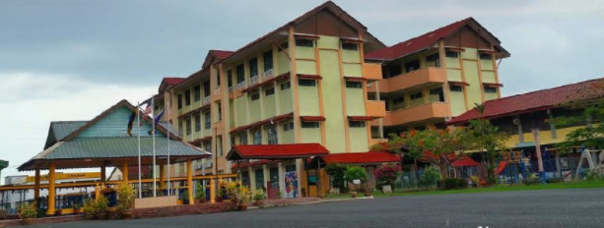
PROJECT TITLE:
SCHOOL ATTENDANCE SYSTEM USING RFID
COMPANY / CLIENT:
SEKOLAH KEBANGSAAN KUALA PERLIS

Slide 3
1. INTRODUCTION
School Attendance System Using RFID is a digital attendance system which uses Radio Frequency Identification (RFID) in order to record the presence of students in class. RFID is chosen because this application is widely used in all over the world and by applying this system, it may shorten the time compared to the current method which records the student attendance manually. Instead of using the manual method where students need to write their name manually, they can just touch their RFID Cards on card reader in order to record their attendance in class.
Hence a system is needed which will solve the issue of manual attendance.So, we as a group came up with a idea to created and conduct a system called “School Attendance System Using RFID”.This project attempts to record student’s attendance through RFID. School Attendance System Using RFID is an application developed to record daily student’s attendance in the targeted school that is Sekolah Kebangsaan Kuala Perlis.
Sekolah Kebangsaan Kuala Perlis or its short name SK Kuala Perlis, is a primary school located at Jalan Kuala Perlis.

Slide 4
3.OBJECTIVE OF THE PROJECT:
To record Student attendance
To view and generate student attendance report
Manage or assign teachers and students information

Slide 5
4.SCOPE PRJECT:
USER SCOPE
Admin
The managing director of the company is the admin of the system. In this system, the admin of the company is able to update user of the system and view all update record and slots in Attendance System are done.
Teachers
Teachers can update students attendance records, remove students attendance records, view students record lists and can print attendance record lists.
Students
Students need to touch their RFID card at the scanner that which has been prepared in front of the hall and view their name verify at the lcd screen.

