Slide 1
REGISTER
ADMIN MENU
LOGIN
TEACHER MENU
MANAGE TEACHER
SCHOOL RFID ATTENDANCE SYSTEM INTERFACE
MANAGE STUDENT
REGISTER TEACHER
DELETE STUDENT
UPDATE TEACHER
DELETE TEACHER
REGISTER STUDENT
UPDATE STUDENT

Slide 2
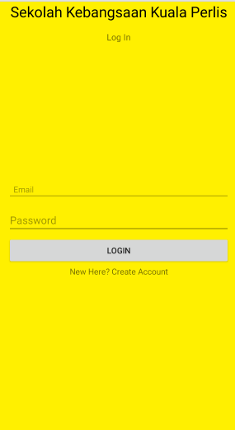
LOGIN INTERFACE
Login as Admin
Login as Teacher
CLICK HERE
CLICK HERE

Slide 3
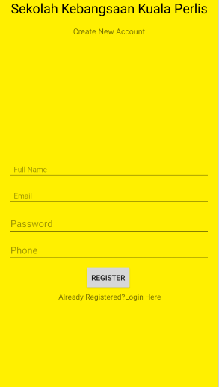
REGISTER INTERFACE

Slide 4
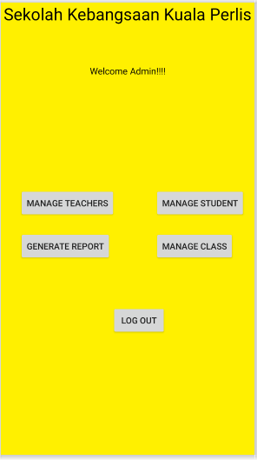
ADMIN MENU INTERFACE

Slide 5
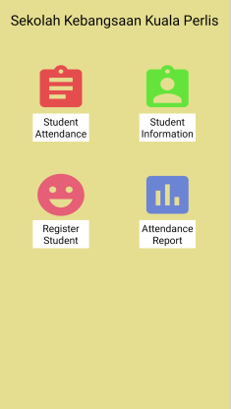
TEACHER MENU INTERFACE

Slide 6
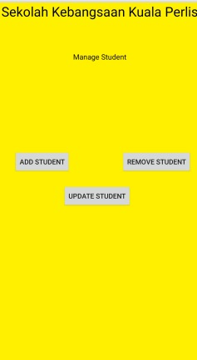
MANAGE STUDENT INTERFACE

Slide 7
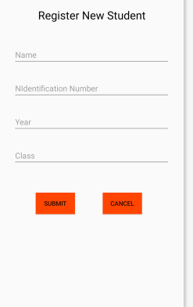
REGISTER STUDENT INTERFACE

Slide 8
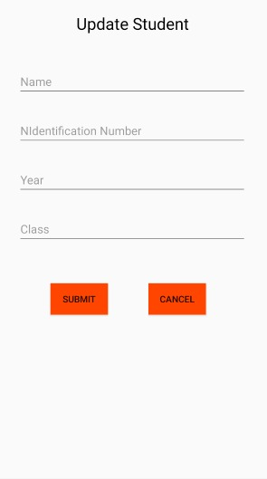
UPDATE STUDENT INTERFACE

Slide 9
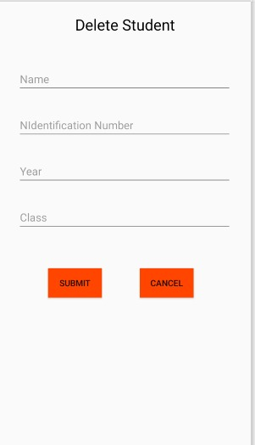
DELETE STUDENT INTERFACE

Slide 10
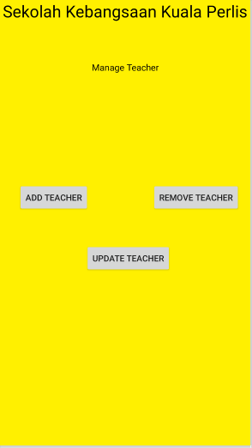
MANAGE TEACHER INTERFACE

Slide 11
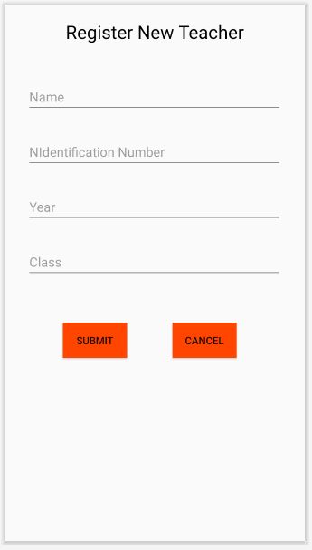
REGISTER TEACHER INTERFACE

Slide 12
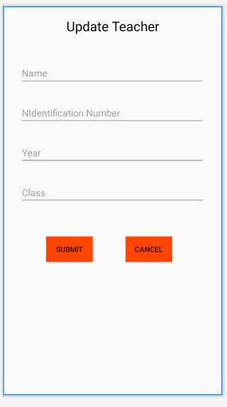
UPDATE TEACHER INTERFACE

Slide 13
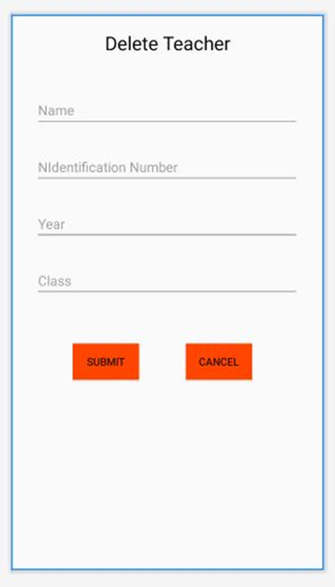
DELETE STUDENT INTERFACE

