Slide 1
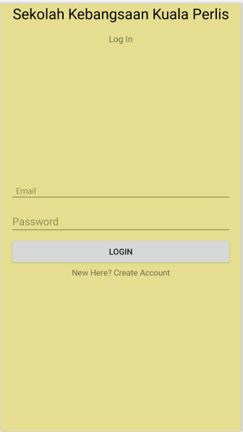
LOGIN INTERFACE
Login as Admin
Login as Teacher
CLICK HERE
CLICK HERE

Slide 2
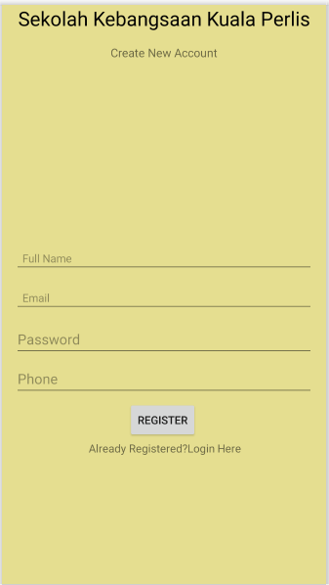
REGISTER INTERFACE

Slide 3
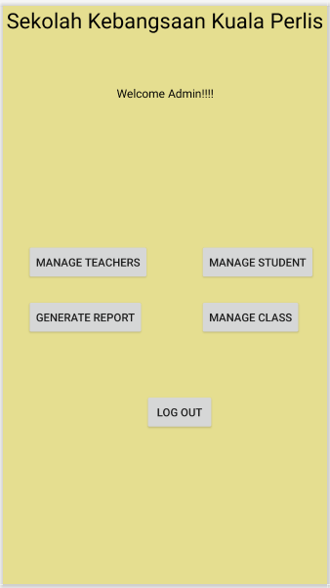
ADMIN MENU INTERFACE

Slide 4
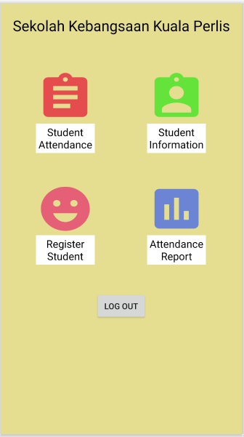
TEACHER MENU INTERFACE

Slide 5
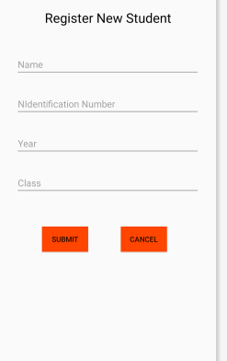
REGISTER STUDENT INTERFACE

Slide 6
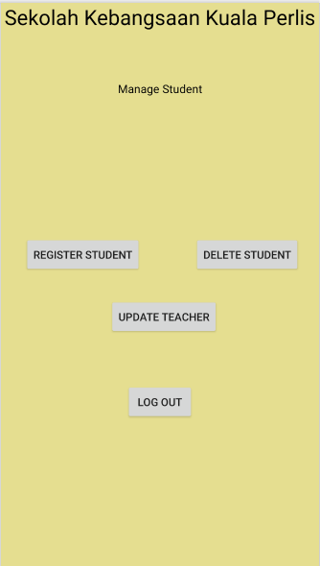
MANAGE STUDENT INTERFACE

Slide 7
REGISTER STUDENT INTERFACE

Slide 8
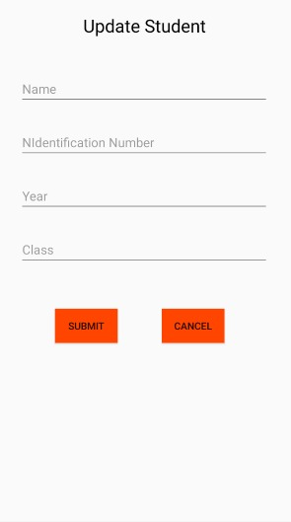
UPDATE STUDENT INTERFACE

Slide 9
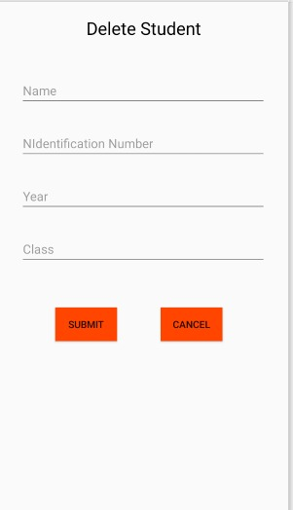
DELETE STUDENT INTERFACE

Slide 10
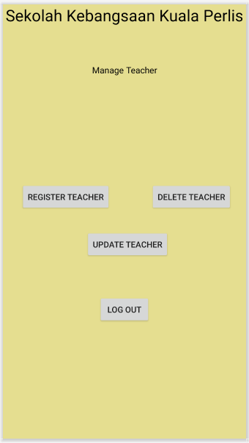
MANAGE TEACHER INTERFACE

Slide 11
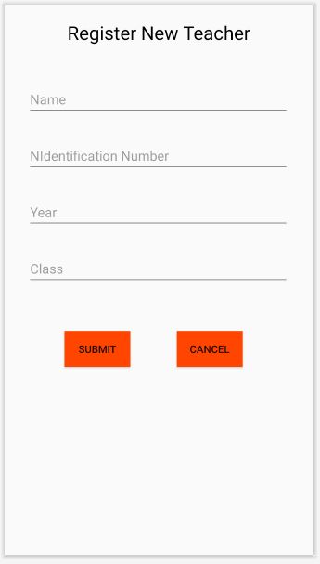
REGISTER TEACHER INTERFACE

Slide 12
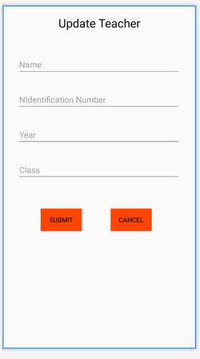
UPDATE TEACHER INTERFACE

Slide 13
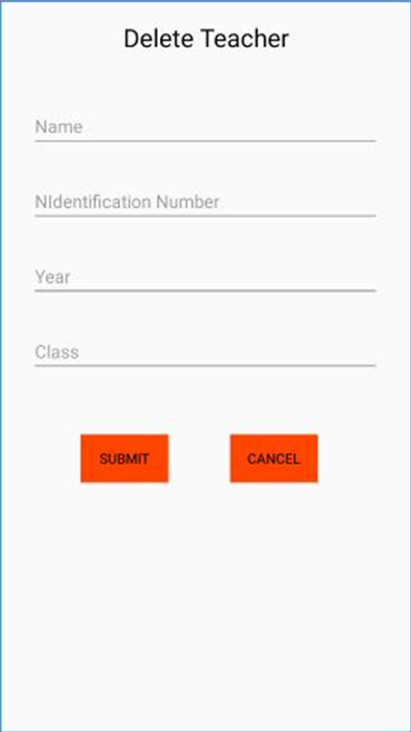
DELETE TEACHER INTERFACE

